Slide 1
Page Replacement

Slide 2
Section 3.4 Caching and Paging Algorithms

Slide 3
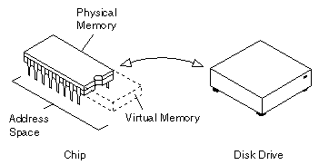
Virtual Memory
Caches, page files
Exist on disk to enlarge RAM
A cache of information stored for faster access
Virtual memory exists to extend main memory

Slide 4
What are these algorithms?
Optimize virtual memory or cache management
Examples are random replacement, least frequently used, and most-recently used
Each algorithm is better for some applications; there is no default

Slide 5
Design Goals
To achieve the lowest page fault rate (situations where a page must be brought in from disk)
Each algorithm is evaluated differently based on the application
Swap the page that will be least used in the future*

Slide 6
Pages in Virtual Memory
The virtual memory has it’s own address space
Divided into pages, which hold virtual addresses
When a page is needed, it’s copied to main memory and allocated address spaces – paging
Hence the name - pagefile

Slide 7
Page Faults
Occurs when a program requests data that is not currently in RAM. The O/S must then fetch the data from a page file and load it into RAM.
Not actually an error, necessary for many programs to run

Slide 8
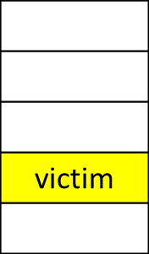
Page Replacement
What happens if there is no free frame to allocate?
Find some frame in memory which “isn’t that used”* and swap it out
RAM V.M.

Slide 9
Least Recently Used (LRU)
Pages that were heavily used in the last few instructions
will probably be heavily used in the next few
Throw out the page that has been unused for
the longest time
Maintain a linked list of all pages in memory, with the
most recently used page at the front - not cheap

Slide 10
Conclusion
The perfect algorithm; easy to describe, impossible to implement
Page faults are inevitable and sometimes necessary
Algorithms can be designed many ways to account for individual platforms

Slide 11
Section 3.5
Design Issues for Paging Systems
by Steven Palmer

Slide 12
Issues to be Covered
Local Vs Global Allocation
Load Control
Page Size
Separate Instruction & Data Spaces
Shared Pages & Libraries
Mapped Files
Cleaning Policy
Virtual Memory Interface

Slide 13
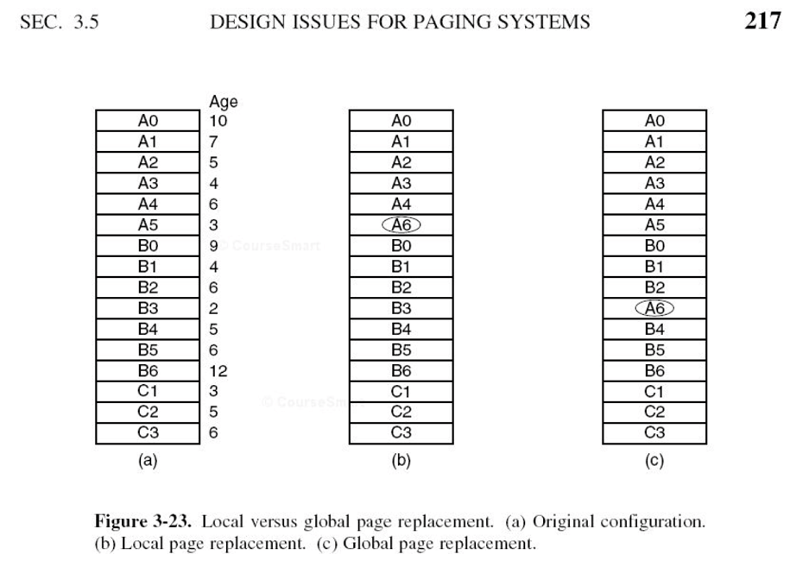
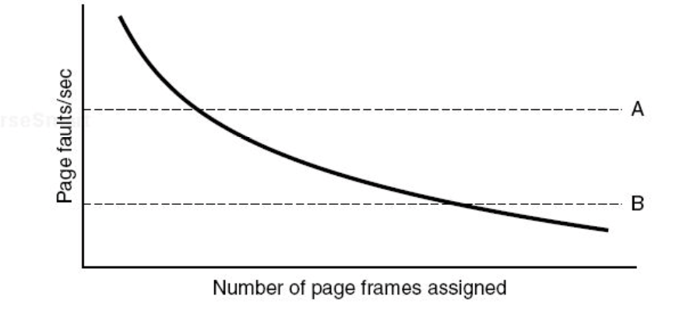
Local Vs Global Allocation
Global is better overall
Page Fault Frequency algorithm

Slide 14
Load Control
Beware of Thrashing
PFF as warning sign
Swapping processes in & out of memory

Slide 15
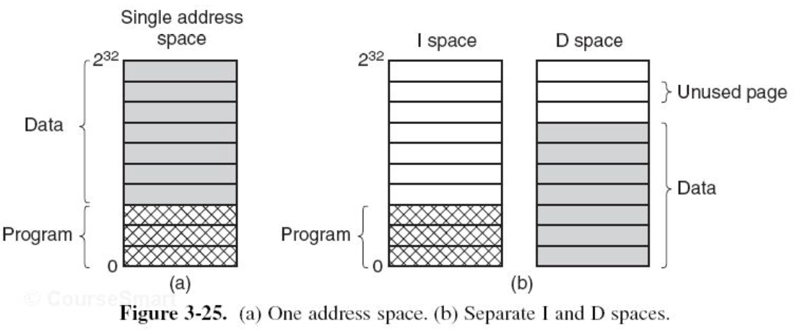
Page Size &
Separate Instruction & Data Spaces
se/2 + p/2 =0 yields
p = sqrt(2se)
Increasing available space

Slide 16
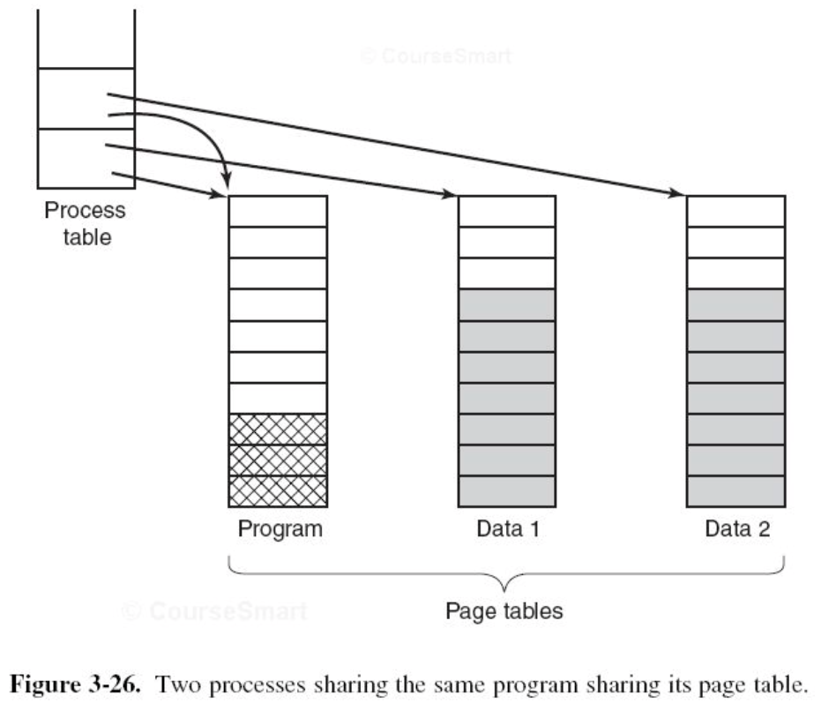
Shared Pages, Libraries, & Mapped Files
Sharing :
Is Conducive to multiprogramming
Is scalable
reduces repetition
easy to update
Has problems
multiprogramming
libraries
Enables communication

Slide 17
Cleaning Policy & VM Interface
The Paging Daemon is your friend
inspects
cleans
Virtual Memory Interface
Enabling sharing
Allows high-performance messaging b/t processes or across networks
Distributed shared memory

Slide 18
Issues Covered
Local Vs Global Allocation
Load Control
Page Size
Separate Instruction & Data Spaces
Shared Pages & Libraries
Mapped Files
Cleaning Policy
Virtual Memory Interface

Slide 19
Conclusion
Memory management
Design matters
Sharing is caring

Slide 20
Questions?
Questions on anything covered?

Slide 21
Section 3.6Implementation Issues for paging Systems

Slide 22
Issues to be Discussed
- OS Involvement
- Page Fault Handling
- Instruction
- Locking Pages in Memory
- Backing Store
- Separation of Policy and Mechanism

Slide 23
OS Involvement
- Process Creation Time
- Create page table
- Allocation of space in swap area
- Process Execution Time
- MMU must be reset and TLB flushed
- New page table must be made current
- Page Fault Time
- Read hardware registers
- Perform page replacement
- Process Termination Time
- Release page table, pages and disk space
Notes:
MMU = Memory management unit
TLB = Translation lookaside buffer

Slide 24
Page Fault Handling
Sequence to Page Fault Handling
1 - Hardware traps to kernel
2 - Assembly code routine started
3 - OS discovers page fault and its address
4 - OS checks address
5 - Page scheduled for transfer
6 - OS looks up address for needed page
7 - Page tables updated
8 - Faulting instruction and program counter reset
9 - Faulting process scheduled
10 - Routine returns to user space to continue execution

Slide 25
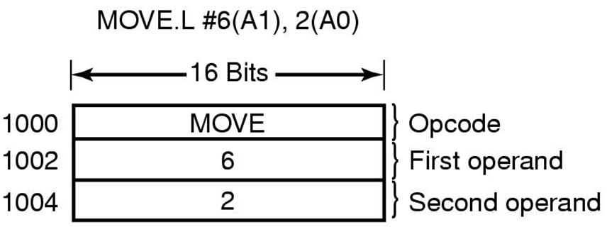
Instruction Backup
- When page fault is resolved, instructions must be restarted.
- Easier said than done
- Some CPUs provide
solution
Figure 3-28 an instruction causing a page fault.

Slide 26
Locking Pages in Memory
- Some pages in memory should not be
removed.
- “Pinning” a page to memory
- Another solution is Kernel Buffers

Slide 27
Backing Store
- Fixed Swapping Partition
- Program size is not fixed
- Not always logistically possible
- Dynamic Swapping Partition
- Additional table per process

Slide 28
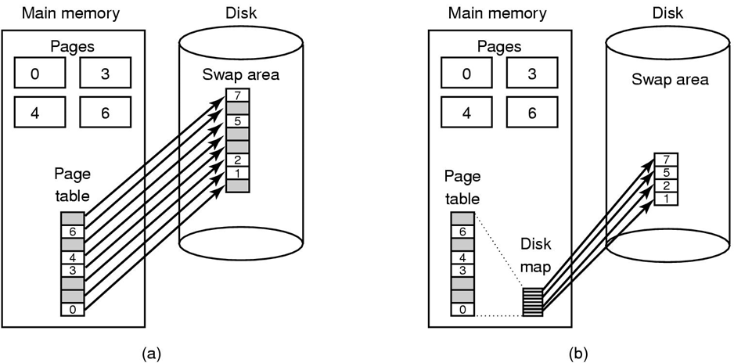
Backing Store
Figure 3-29 (a) Paging to a static swap area. (b) Backing up pages dynamically.

Slide 29
Separation of Policy and Mechanism
- Memory manager run user-level.
- No access to R and M bits
- Advantages: Modular Code and Flexibility
- Disadvantages: Multiple User-Kernel boundary
crossings, extra overhead.

Slide 30
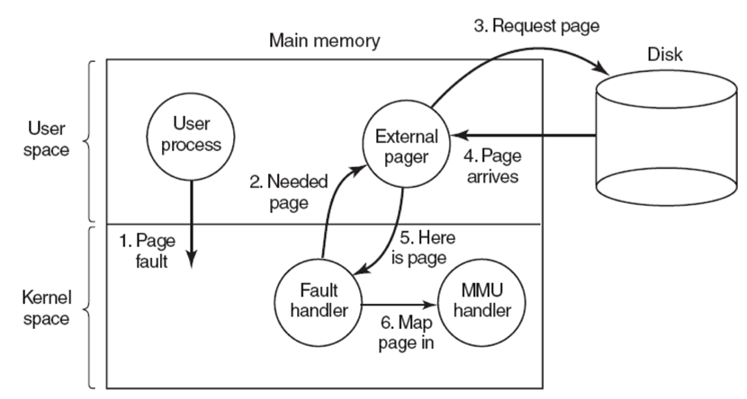
Separation of Policy and Mechanism
Figure 3-30 Page fault handling with an external pager.

Slide 31
Conclusion

Slide 32
Questions?

