Slide 1
Management and Optimization
Example File Systems

Slide 2
Topics to Cover
Management and Optimization
1. Disk Space Management
2. File System Backups
3. File System Consistency
4. File System Performance
5. Defragmenting Disks
Example File Systems
1. CD-ROM File Systems
2. The MS-DOS File System
3. The UNIX V7 File System

Slide 3
Disk Space Management
Provides data that system administrators need to track disk space availability for designated systems.
Why is this important?
Two strategies for storing an n byte file.

Slide 4
Block Size
Once it has been decided to store files in fixed-size blocks, the question arises
of how big the block should be.
If you have a small block size…
If you have a large block size...

Slide 5
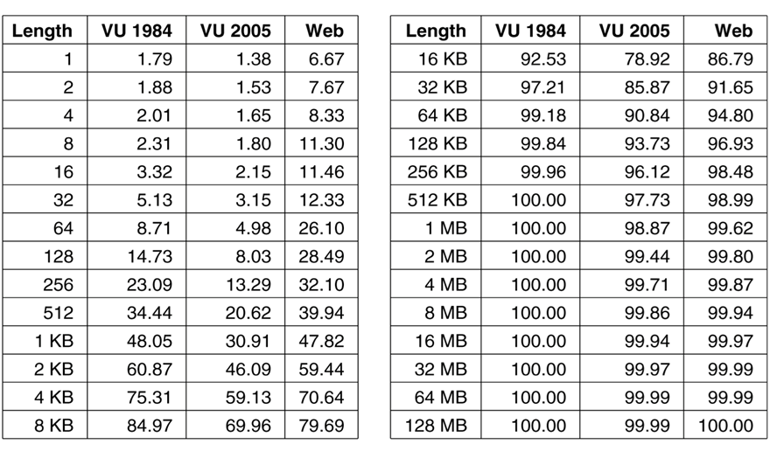
File Size Distribution

Slide 6
How do we calculate block size?
There is a formula for that!
Example: Consider a disk with 1000000 bytes/track, a rotation time of 8.33 msec, and an average seek time of 5 msec.
What is the data rate for a block size of 2KB?

Slide 7
Keeping Track of Free Blocks
Choose a block size, then keep track of available blocks. There are two methods that are used.
1. Linked List
2. Bitmap

Slide 8
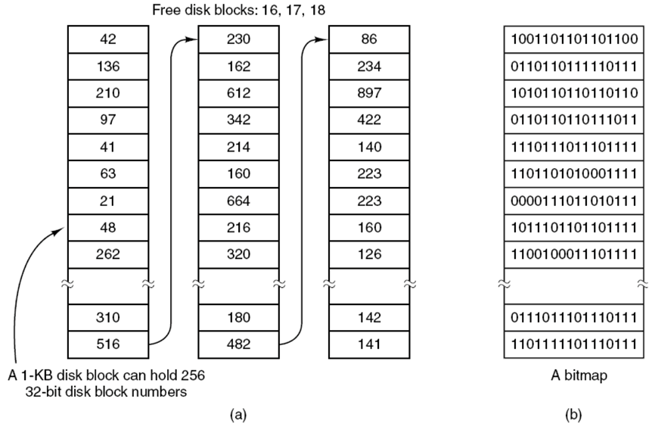
Keeping Track of Free Blocks

Slide 9
Disk Quotas
This stops people from taking too much disk space.
How is this done?

Slide 10
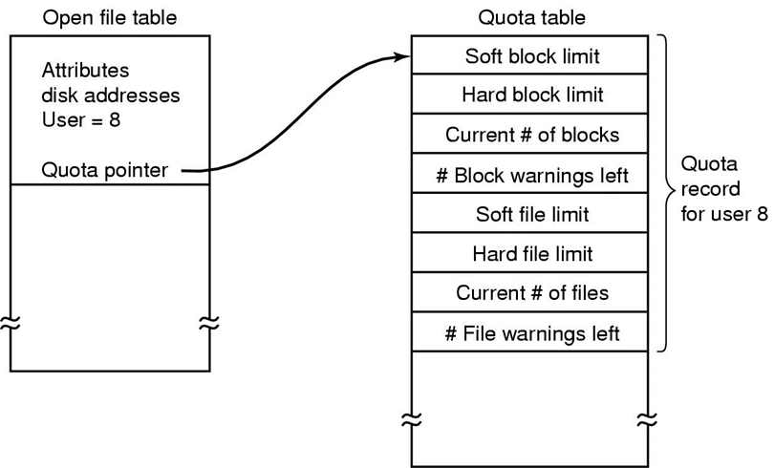
Disk Quotas

Slide 11
File System Backups
The destruction of a computer is worse than the destruction of a file system. True or False?
What happens when a computer’s file system is lost?
Do not wait until after your something happens to your computer, make backups now!

Slide 12
File System Backups
There are two main reasons we would want to make backups.
1. Recover from disaster
2. Recover from stupidity

Slide 13
File System Consistency
A file system can be in an inconsistent state if it crashes before all of the modified blocks have been written out.
Windows - scandisk
UNIX - fsck
What happens when a file in Windows is deleted?

Slide 14
File System Consistency
File System Check(fsck)
Can check file system consistency for blocks and files
How does it do this?

Slide 15
File System Consistency
Checking for block consistency
The program builds two tables
First table keeps tracks of block in files
Second table keeps track of blocks present in the free list

Slide 16
File System Consistency
Consistent File Systems:
Used Blocks: 01010101
Free Blocks: 10101010
File System with Missing Blocks
Used Blocks: 01000101
Free Blocks: 10101010

Slide 17
File System Consistency
File System with Duplicate Data Block
Used Blocks: 01020101
Free Blocks: 10101010
File System with Duplicate Free Block
Used Blocks: 01000101
Free Blocks: 10121010

Slide 18
File System Consistency
Missing Blocks - Not a major problem, but can reduce disk space.
Duplicate Free Blocks - Also not a huge problem, but we need to rebuild the free list to correct them.

Slide 19
File System Consistency
Duplicate Data Block - The worst situation for a file consistency check. If one block is present in two files this can lead and almost always will end up in a garbaged file.
Note: Duplicate blocks cannot occur
in a free space bitmap

Slide 20
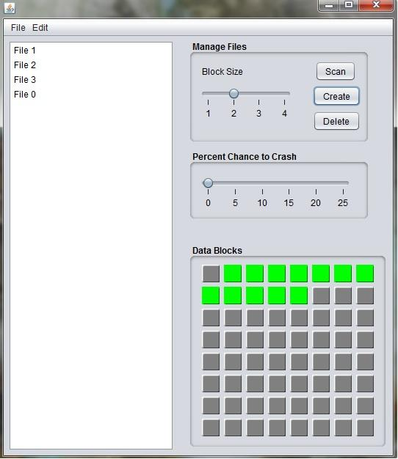
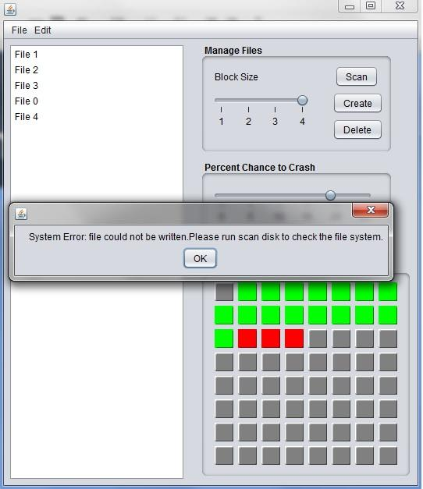
Program Implementation

Slide 21
Program Implementation
The program implemented simulates a storage device with 64 blocks of data storage.
Files may be created and deleted, and the status of the drive is updated to show free and used blocks.

Slide 22
Program Implementation
The program allows for files of different sizes to be created from 1 to 4 blocks.
There is also a percent chance for the system to crash when writing a file.

Slide 23
File System Consistency
Checking for File Consistency
We also need to check for the consistency of directories and files beyond blocks as well.

Slide 24
File System Consistency
Uses a table that counts the number of files present in all directories starting from the root.
It then compares it the the number of hard links every file has.

Slide 25
File System Consistency
Consistent File System
File count and hard link counts match
Inconsistent File System
The hard link count could be higher than the file count, while not serious
it waste space on the disk.

Slide 26
File System Consistency
Inconsistent File System
If the link count is lower that the file count we could have a situation where one file’s block could be assigned to new files needing to be written.

Slide 27
File System Performance
There are three optimizations a computer can use.
1. Caching
2. Block Road Ahead
3. Reducing Disk Arm Motion

Slide 28
Cache
Block Cache/Buffer Cache
The hard drive will keep copies of frequently used disk sectors in RAM to avoid having to access the disk frequently.

Slide 29
Cache
Block Cache/Buffer Cache
Blocks not in cache are copied over to the RAM
Uses hashing to quickly look up blocks in the cache

Slide 30
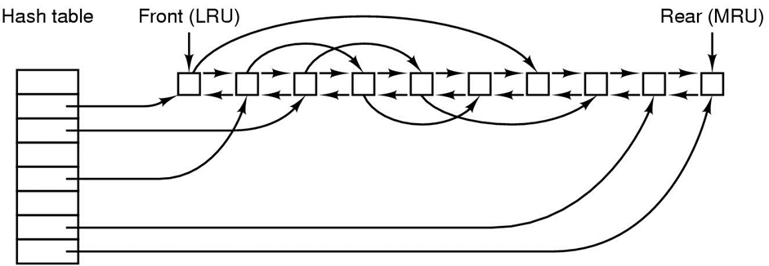
Cache

Slide 31
Cache
Block Cache/Buffer Cache
Much like paging in chapter 3, we can use the FIFO or LRU algorithm to store and move blocks into memory.
But are these desirable?

Slide 32
Cache
Block Cache/Buffer Cache
While they do increase speed we must worry about the system crashing and blocks in cache not being written back to the disk.
If they are critical blocks we may be
in trouble.

Slide 33
Cache
Write-through caches
In order to combat the possibility of crashing before blocks are written back to the disk we might write them back as soon as they are modified.
However, they require more disk I/O

Slide 34
Block Road Ahead
Trying to get blocks into the cache before they are needed to increase hit rate.
The system might check to see if it can move the next block ahead into cache

Slide 35
Block Road Ahead
This technique is preferred for blocks if they are being read sequentially.
However if files are being randomly accessed we will not get any kind of speed up.

Slide 36
Reducing Disk Arm Motion
Reduce the amount of disk arm motion by putting blocks that are likely to be accessed in sequence close to each other, preferably in the same cylinder.

Slide 37
Reducing Disk Arm Motion
With bitmaps it is easy to allocate space for a file, we can choose a block closest to the last file written.
For free lists it is much harder.

Slide 38
Reducing Disk Arm Motion
We can use free block clusters to store blocks in consecutive groups on the disk.
We can reduce the seek time by doing this.

Slide 39
Reducing Disk Arm Motion
One way we can do this is to put the blocks in the middle of the disk rather than the start.
Another way is to divide the disk into cylindrical groups.

Slide 40
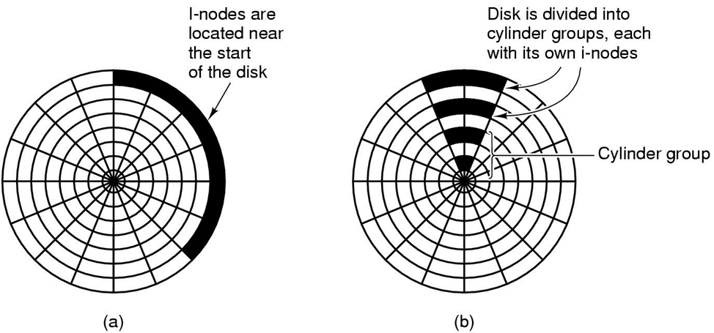
Reducing Disk Arm Motion

Slide 41
Defragmenting Disks
After continuous use of a disk it can become fragmented and storage can become sparse.
With files being created and deleted over and over again holes may spread
over the disk decreasing storage
reducing performance.

Slide 42
Defragmenting Disks
Performance can be restored by moving files around to make them contiguous.
However some files such and paging
files and hibernation files cannot be moved

Slide 43
4.5 Example File Systems
CD-ROM File Systems
1. In 1988 - The standard for CD-ROM file systems
2. To make every CD-ROM readable on
every computer. Some limitations
Rock Ridge Extensions represents
UNIX file systems on a CD-ROM.
Joliet Extensions were designed
for Windows file systems

Slide 44
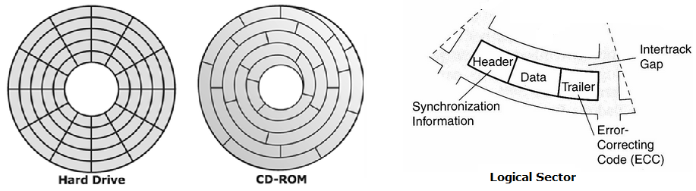
The ISO 9660 File System
- CD-ROM vs. Hard Drive
3. Unlike magnetic disks, CD-ROMs have
a single continuous spiral containing
the bits in a linear sequence

Slide 45
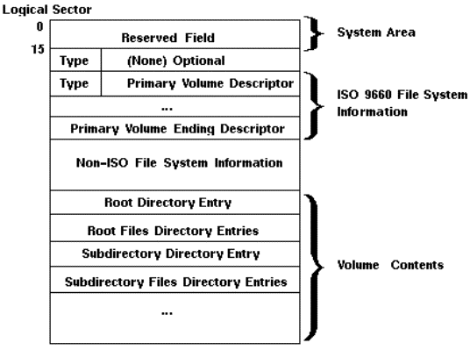
The ISO 9660 File System
- Logical Sector

Slide 46
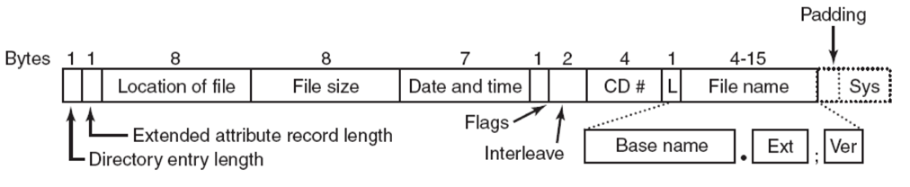
The ISO 9660 File System
- The format of an ISO 9660 directory entry

Slide 47
The ISO 9660 File System
- Three levels of ISO 9660
1. Level 1:
File names : 8 + 3 characters
Directory names : 8 characters
2. Level 2
Files and directories names : of up to 31 characters.
3. Level 3
It uses the same name limits as level 2.
Files are allowed to be non-contiguous

Slide 48
The MS-DOS File System
The MS-Dos File System of the first IBM PC came with.
It was the main file system for windows 98 and windows ME.
Still supported through Windows 2000, XP, and Vista
No longer standard on new PCs except for floppy disks.
However, become widely used for many embedded systems.

Slide 49
The MS-DOS File System
To read a file, MS-DOS program first make an open call to get a handle for it.
System call specify path, either absolute or relative to current working directory
Path looked up component by component until final directory is located and read into memory
Then search for the file to be open

Slide 50

The MS-DOS File System
Fixed size 32 byte directory entry
Format of MS-DOS Directory Entry
  File name
  Attributes
  Creation Date and time
  Starting block
  Exact file size

Slide 51
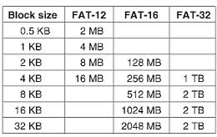
The MS-DOS File System
FAT(File Allocation Table),
is an extension of MS-DOS
File system contains
  FAT-12
  FAT-16
  FAT-32

Slide 52
The UNIX V7 File System
Developed in 1979, was the last version of research UNIX.
PDP-11 was the primary platform for UNIX V7.
In the form of a tree starting at the root directory, with the addition of links, forming a directed acyclic graph.

Slide 53
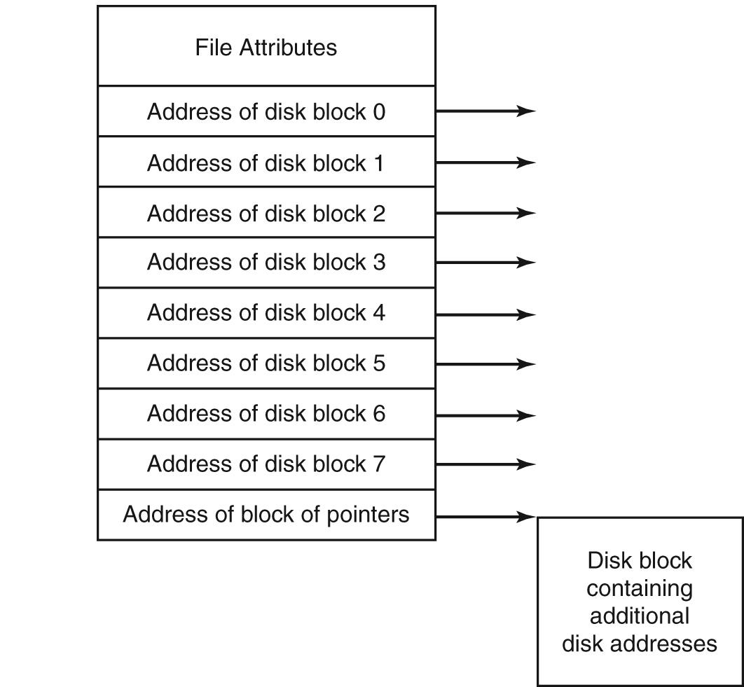
The UNIX V7 File System
UNIX uses the i-node (index-node) scheme.
I-nodes lists the attributes and disk addresses of the file’s blocks.
UNIX i-nodes attributes includes: File Size, Creation, Last Access, Last modification, Owner, Group, Protection Information, and a count of the number of directory entries that point to an i-node.
When links are added to an i-node, the count in i-node is incremented and when links are removed then the count is decremented.
If it gets to 0, then the i-node is reclaimed and the disk blocks are put back in the free list.

Slide 54
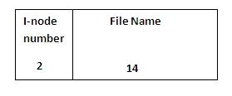
The UNIX V7 File System
UNIX directory entry contains one entry for each file in that directory.
Directory entry contains only two fields:
  File name (14 bytes).
  The number of the i-node for that file (2 bytes).
  This limit the number of files per file system to 64K.
File names are up to 14 characters and can contain any ASCII characters except / - (forward slash because that is the separator between components in a path) and NUL (because that is used to pad out names shorter than 14 characters).

Slide 55
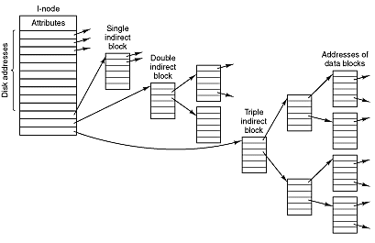
The UNIX V7 File System
How UNIX V7 file system keeps track of large files:
Single indirect block
Double indirect block
Triple indirect block

Slide 56
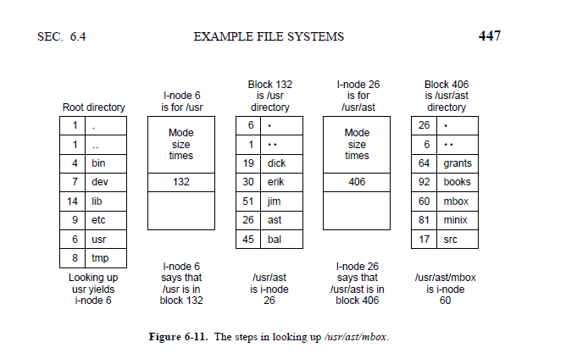
The UNIX V7 File System
Opening a file example with pathname: /usr/ast/mbox

Slide 57
Video Clip
http://www.youtube.com/watch?v=ygzwu4r1p7I

Slide 58
Questions?

