Slide 1
Disks

Slide 2
Disks
Circular-shaped storage medium
Two main types: Magnetic and Optical
Random access to memory
The hardware must be controlled by driver software called the “controller” in order to be used

Slide 3
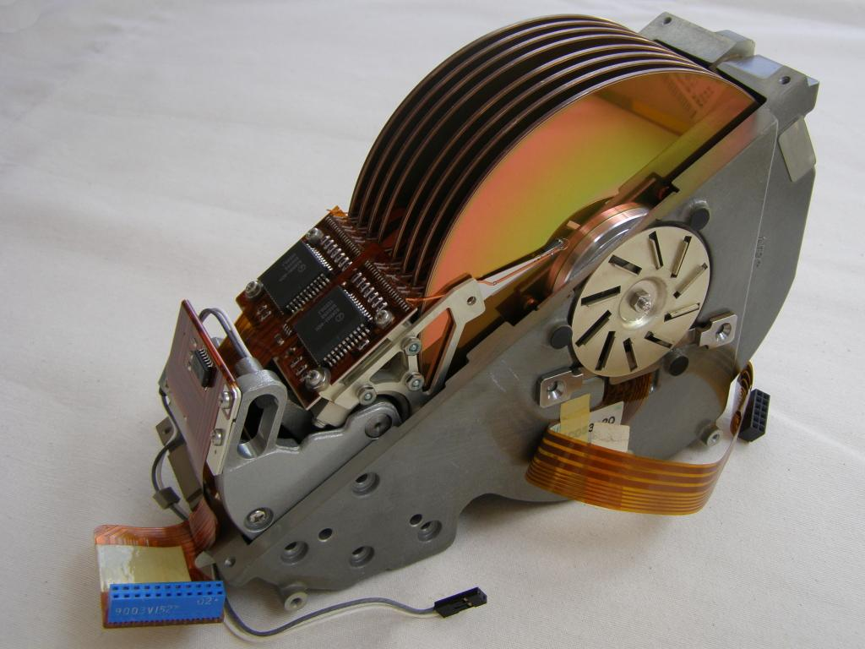
Hard Disks, RAID, and Error Handling

Slide 4
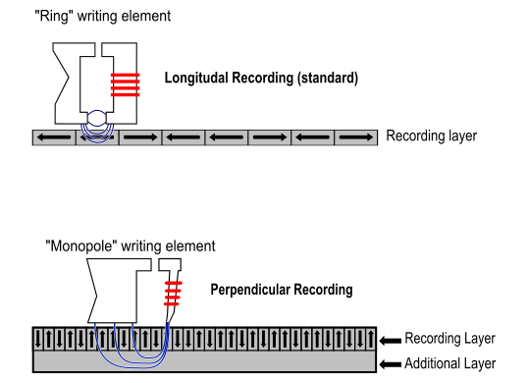
Magnetic Disks
Used to store non-volatile memory.
Reads & writes are equally fast
Main types are hard disks & floppy disks
Controller driver controls the hardware to varying degrees

Slide 5
Hard Disks
Usually contain dedicated microcontroller hardware to provide the driver controller a higher-level abstraction. Since the CPU doesn't have to control the particularities of the drive, the CPU is free to do other things and let the drive's I/O run asynchronously.
(eg overlapped seeks)

Slide 6
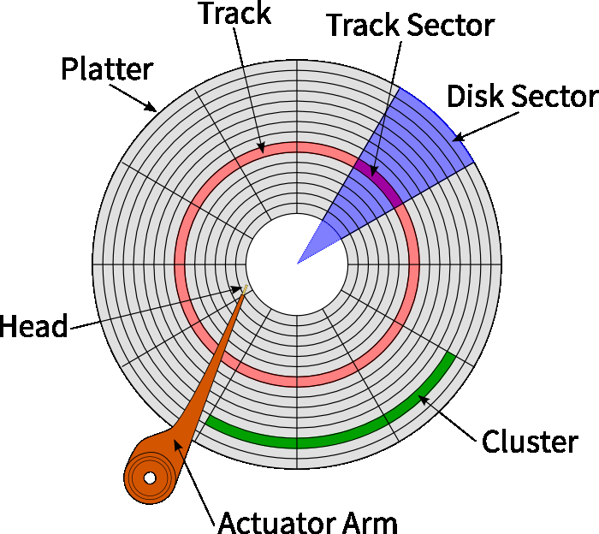
Disk Structure

Slide 7
RAID
“Redundant Array of Independent Disks”
Contrasted with “SLED” (Single Large Expensive Disk)
Parallelism with I/O is a good idea
RAID controller hardware is used, which allows the RAID to interact with the operating system without any special software

Slide 8
RAID concepts
Striping distributes data over multiple drives in round-robin fashion
“Parity” drives hold error correcting codes (ECC) that can correct data if one of the drives fail.

Slide 9
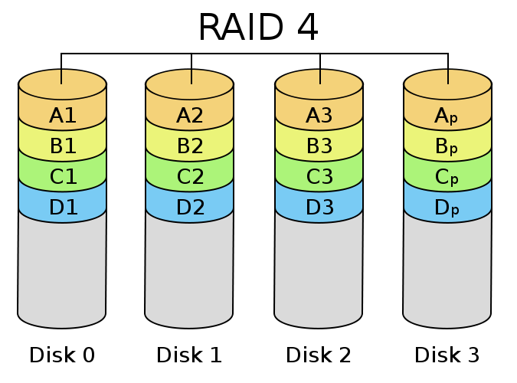
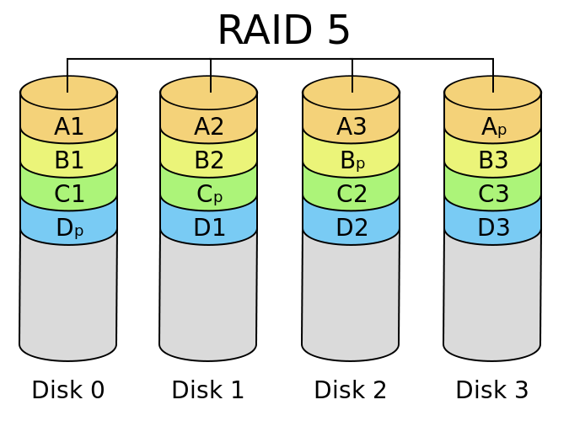
Different RAID configurations

Slide 10
Error Handling
Disks may have defects when they are manufactured, so there must be a way to still use these disks correctly with the defects. There are multiple strategies of dealing with the defects.

Slide 11
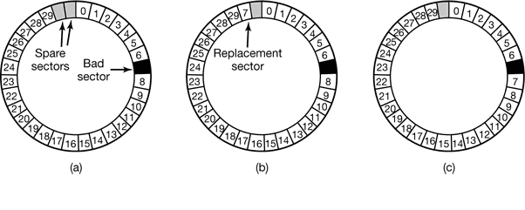
Ways of handling disk defects
A replacement sector must be used, which can be done either by putting the bad sector in, or shifting every sector after the bad sector down one. This must be handled by either the operating system or the controller.

Slide 12
Optical Discs
Optical rather than magnetic
Higher densities than magnetic disks
Have gone through rapid evolution

Slide 13
First Generation & Compact Discs
Optical discs were invented by Dutch electronics company Philips for the purpose of holding movies
Philips teamed up with Sony to create the Compact Disc (CD) in 1980
Specifications were published in the “Red Book” in order to create a standard format for CDs
120 mm across
1.2 mm thick
15 mm hole in the center
First successful mass market digital storage medium

Slide 14
Technical Details
How they're made
A high-power infrared laser burns tiny holes into a glass disc, which is used to create a mold of molten polycarbonate resin.
Pits – depressions in the polycarbonate substrate
Lands – unburned areas of the disc
To play a disc, a low-power laser shines on the disc, detecting the pits and lands. A transition from a pit to a land or vice-versa is considered a 1 for computation purposes, whereas no change is considered a 0.

Slide 15
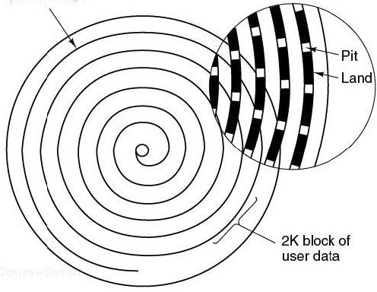
Technical Details (cont)
Pits and lands are organized into a single spiral that circles the disc 22,188 times. If one was unwound, the spiral would be 5.6 kilometers long.

Slide 16
CD-ROM
In 1984, Philips and Sony published standards for CD-ROMs (Compact Disc – Read-Only Memory), which were used to store computer data.

Slide 17
CD-ROM (cont)
A standard audio CD has room for 74 minutes of music, or 681,984,000 bytes.
In 1986, Philips added graphics and the ability to interleave audio, video, and data in the same sector.
High Sierra – File system devised to make it possible to use the same CD-ROM on different computers. It later evolves into IS 9660. There are three levels.
Level 1 – restricts file name length to 8 chars and requires contiguous files. Can be read by just about any computer.
Level 2 – allows names of up to 32 characters.
Level 3 – allows noncontiguous files

Slide 18
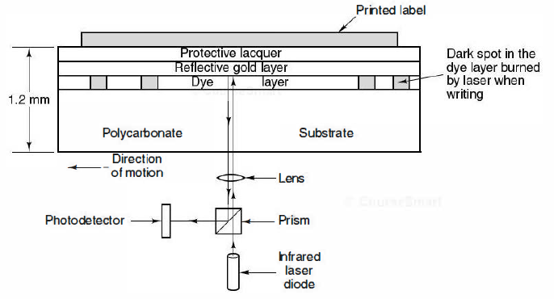
CD-Recordable
To write to a CD-R, a high powered laser is fired at the gold layer. When the beam hits a spot of dye, it changes the molecular structure of the dye and creates a dark spot. The dark spot is treated as a shift between a land and a pit would on a CD-ROM.

Slide 19
CD-Rewritable
Same size as CD-R, but uses a different type of dye that allows the disc to be rewritten multiple times.
A CD-RW drive has lasers with three different settings.
High power laser melts the alloy into a low reflectivity state to represent a pit.
Medium power laser melts and reforms the alloy into a reflective state, representing a land.
Low power laser used for reading the disc that does not change the alloy.

Slide 20
DVD
Same general design as CDS, but:
Uses smaller pits
Has a tighter spiral
Uses a thinner, red laser
Seven times as much space as a CD (4.7 GB)

Slide 21
Disk Formatting & Stable Storage

Slide 22
Topics
Steps of formatting a disk for first time use
Stable storage and operations used to keep disk in check

Slide 23
Formatting
Before use, each disk platter must receive a low-level format
Disk capacity gets reduced by this format
After low-level format, disk gets partitioned
Partitions allow for multiple operating systems to coexist
Final step for preparing a disk is a high-level format of each partition

Slide 24
Low-level Formatting
Format consists of series of concentric tracks
Each contains some number of sectors with short gaps in between
Format of a sector shown below

Slide 25
Video Link
http://www.youtube.com/watch?v=apPd4zummUc​

Slide 26
Stable Storage
Goal is to keep disk consistent at all costs
3 operations
Stable writes
Stable reads
Crash recovery

Slide 27
Stable Writes
Consists of writing the first block on drive 1, then reading back to verify correctness
If not correct, then write and reread are done again up to n times until they work
After n consecutive failures, the block is remapped onto a spare and repeats until success
After write to drive 1 succeeds, the block on drive 2 is written and reread repeatedly

Slide 28
Stable Reads
First reads the block from drive 1
If yields an incorrect ECC, read is tried again up to n times
If all tries give bad ECCs, corresponding block from drive 2 is read
Stable read always succeeds when stable write succeeds

Slide 29
Crash Recovery
After a crash, recovery program scans both disks comparing corresponding blocks
If both blocks are good and the same, nothing is done
If one has an ECC error, the bad block is written over with the corresponding good block
If a pair of blocks are both good but different, then the block from drive 1 is written into drive 2

Slide 30
Image sources
Hard Disk
http://upload.wikimedia.org/wikipedia/commons/2/20/NEC_D5662_Hard_disk.jpg
Raid 4
http://upload.wikimedia.org/wikipedia/commons/thumb/a/ad/RAID_4.svg/675px-RAID_4.svg.png
Raid 5
http://upload.wikimedia.org/wikipedia/commons/thumb/6/64/RAID_5.svg/675px-RAID_5.svg.png
Disk Structure
http://lnx.cx/docs/vdg/output/images/disk-structure.png
Other images are from the textbook.

