Slide 1
Digital Modulation, Telephone, Cable Television

Slide 2
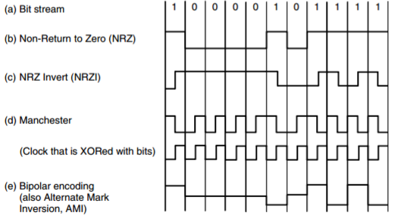
Digital Modulation
Wires and wireless channels carry analog signals such as continuously varying voltage, light intensity, or sound intensity.
To send digital information, we must devise analog signals to represent bits.
Process of converting between bits and signals that represent them
Fig 1. Digital Modulation
Notes:
Akash Bhardwaj

Slide 3
Transmissions
Schemes that regulate the amplitude, phase, or frequency of a carrier signal to convey bits result in Passband Transmission
The signal occupies a band of frequencies around the frequency of the carrier signal
Common for wireless and optical channels for which the signals must reside in a given frequency band.
Schemes that directly convert bits into a signal result in Baseband Transmission
The signal occupies frequencies from zero up to a maximum that depends on the signaling rate
Common for wires.
Notes:
Akash Bhardwaj

Slide 4
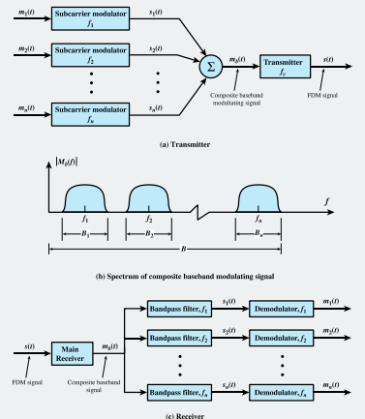
Frequency Division Multiplexing
Analog multiplexing technique to combine analog signals
Each carrier has their own frequency
Guard bands separate channels
Bandpass filters are used on received signal
Signals cannot overlap
Notes:
Matthew Bakkestuen

Slide 5
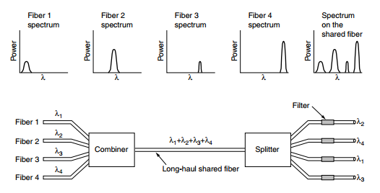
Wavelength Division Multiplexing
Analog multiplexing technique to combine optical signals
Laser beams are used at different frequencies
Multiplexer combines source channels for transmission over a single fiber channel
Demux separates single fiber channel into multiple channels
Notes:
Matthew Bakkestuen

Slide 6
Time Division Multiplexing
Multiplexing is used to combine inputs from multiple low data rate lines into a high data rate line
Data rate of the link is n times faster and the unit duration is n times shorter
A complete cycle of data units from each input is collected into a frame. Each frame has n slots. Each slot duration is 1/n shorter. Each slot is dedicated to each sending input.
Notes:
Matthew Bakkestuen

Slide 7
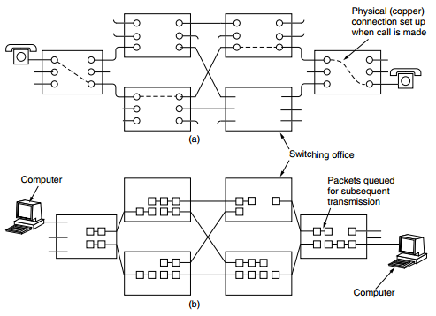
Circuit Switching
Designed for voice transmission
Dedicated path between two stations
One dedicated channel on each link
Each link divided into n channels
Circuit Switching has three phases
Establish -> Transfer -> Disconnect
Advantages
Guaranteed data transfer
Disadvantages
Takes time to setup

Slide 8
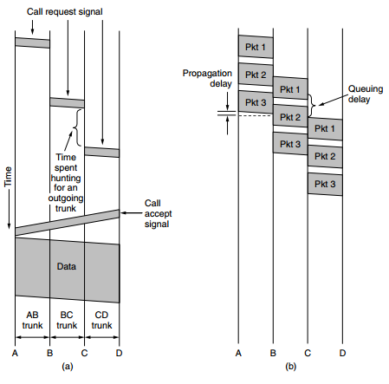
Packet Switching
Designed for data transmission
Packets contain control information and user data
Packets are received, stored and passed to next node
Resources are allocated on demand
No setup phase
Packets can take any route

Slide 9
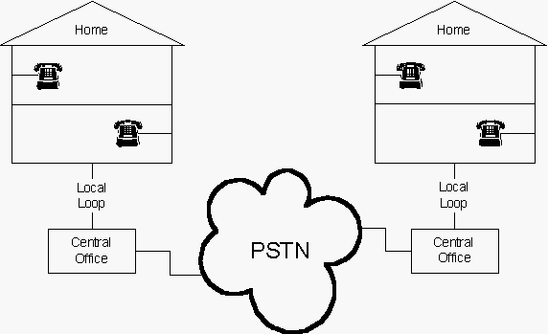
PSTN (Public Switched Telephone Network)
Network designers must rely on the existing telecommunication facilities, especially the PSTN
Designed many years ago, with a completely different goal in mind: transmitting the human voice
Their suitability for use in computer-computer communication is often marginal at best, very slow
The telephone system is tightly intertwined with (wide area) computer networks
Notes:
Jachin Flancher

Slide 10
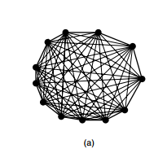
Structure of the Telephone System
The initial market was for the sale of telephones, which came in pairs. It was up to the customer to string a single wire between them.
If a telephone owner wanted to talk to n other telephone owner's, separate wires had to be strung to all n houses.
Within a year, the cities were covered with wires passing over houses and trees in a wild jumble. It became immediately obvious that the model of connecting every telephone to every other telephone was not going to work.
Notes:
Jachin Flancher

Slide 11
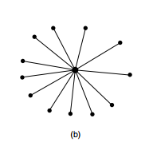
Structure of the Telephone System
Bell saw this problem early on and formed the Bell Telephone Company, which opened its first switching office in 1878.
The company ran a wire to each customer’s house or office. To make a call, the customer would crank the phone to make a ringing sound in the telephone company office to attract the attention of an operator, who would then manually connect the caller to the callee by using a short jumper cable to connect the caller to the callee.
Notes:
Jachin Flancher

Slide 12
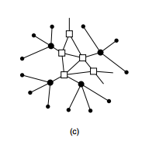
Structure of the Telephone System
Bell System switching offices were springing up everywhere and people wanted to make long-distance calls between cities
Bell System began to connect the switching offices. The original problem soon returned: to connect every switching office to every other switching office by means of a wire between them quickly became unmanageable
Second-level switching offices were invented. After a while, multiple second-level offices were needed. Eventually, the hierarchy grew to five levels.
Notes:
Ashish Bhattarai

Slide 13
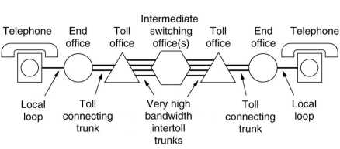
Telephone System
While there have been improvements in all three areas since then, the basic Bell System model has remained essentially intact for over 100 years.
The telephone system consists of three major components:
1. Local loops (analog twisted pairs going to houses and businesses).
2. Trunks (digital fiber optic links connecting the switching offices).
3. Switching offices (where calls are moved from one trunk to another)
Notes:
Ashish Bhattarai

Slide 14
First Generation (1G) Mobile Phones
Second Generation (2G) Mobile Phones
•Established in the late 70’s and 80’s.
•Mobile phones in 1st G was used for public service with a speed of 2.4kps.
are analog system.
•AMPS was first launched in the United States.
•The main idea of 1st G of cellular networks is that geographical area is divided into cells. Basically every 10-25Km. Each served by a base station.
1G can only be used for voice service
•Established in the early 1990’s.
•The second generation introduced GSM which stands as Global System for Mobile Communications. Can be used in many countries supporting GSM.
•Radio signals that 2G networks use are digital.
•Data speed was up to 64Kps.
•2G systems provide encryption to secure and have more data transmitted.
•Availability of digital data services, such as SMS and email.

Slide 15
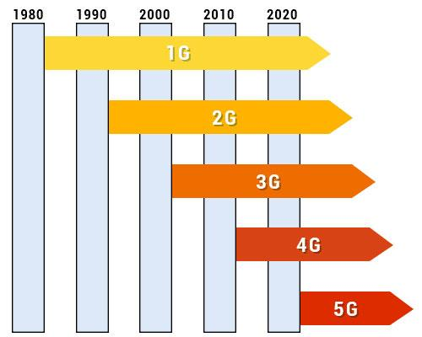
Third Generation (3G) Mobile Phones
•3G technology was Established in 2000’s.
•Data speed 144Kps-2Mbps.
•Typically called Smart Phones.
•The third generation of mobile phones made it possible for users to use video applications and audio.
•Public service usage – Higher capacity and broadband data.
•Many benefits of 3G are High Speed web, advanced security and faster communications.

Slide 16
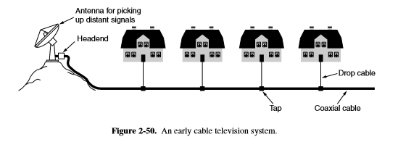
Cable Television
Many people nowadays get their telephone and Internet service over cable
Conceived in the late 1940s as a way to provide better reception to people living in rural or mountainous areas.
Initially consisted of a big antenna on top of a hill to pluck the television signal out of the air, an amplifier, called the headend, to strengthen it, and a coaxial cable to deliver it to people’s houses
Notes:
Jachin Flancher

Slide 17
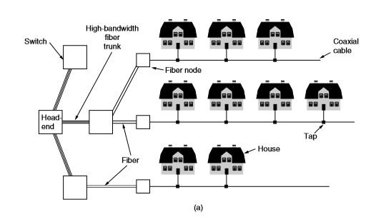
Cable Television
Over the course of the years the cable system grew and the cables between the various cities were replaced by high-bandwidth fiber
A system with fiber for the long-haul runs and coaxial cable to the houses is called an HFC (Hybrid Fiber Coax) system
Many cable operators decided to get into the Internet access business
All the one-way amplifiers in the system had to be replaced by two-way amplifiers to support upstream as well as downstream transmissions.
Notes:
Jachin Flancher

