Slide 1
Sliding Window Protocol | Go-Back-N
ITCS 3166

Slide 2
Definition
Definition
Goals
Sliding window is a technique for controlling transmitted data packets between two network devices where reliable and sequential delivery of data packets is required.
Go-Back-N is a specific instance of the automatic repeat request (ARQ) protocol of Layer 2 in which the sending process continues to send a number of frames specified by a window size even without receiving an acknowledgement (ACK) packet from the receiver.
Maximize throughput using sliding window protocol
Error recovery, retransmitting damaged or lost frames
Flow control, limiting the number of acknowledged frames by receptor

Slide 3
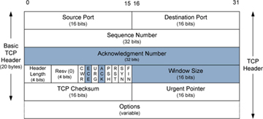
Determining Window Size
Window Size = 16 Bits
At the beginning of a transmission, the sender's window contains n-1 frames (i.e. a window size of 7 would equal frames 0-6) which is contained in the TCP header
The number of data octets, beginning with the ACK field, which the sender of the segment is willing to accept
Notes:
Question: Does the sender and receiver have to have the same Window size?
Answer: No

Slide 4
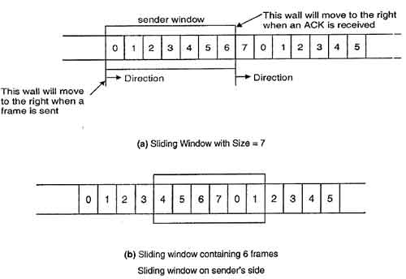
Sender Window
After the window size is determined, all frames in the window are sent sequentially
When an ACK is received, the frame in the window shifts one frame to the right
After the shift, the newest (rightmost) frame is sent
Notes:
Kevin Meyer

Slide 5
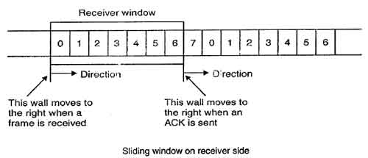
Receiver Window
When a frame is successfully transmitted by the sender, it is accepted by the receiver and the left window wall is moved
The receiver then sends an ACK back to the sender along with the number of the next expected frame
When the ACK is sent, the receiver window is shifted over to the right
Notes:
Question: Which window sends the ACK?
Answer: Reciever

Slide 6
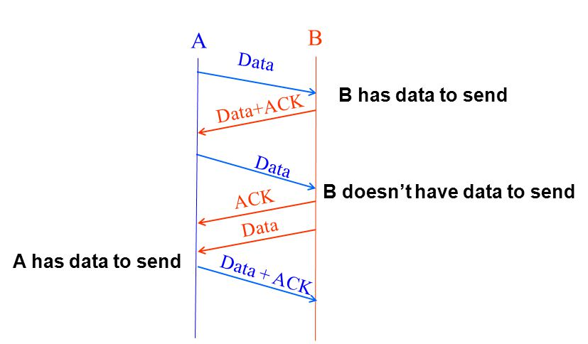
Piggybacking
The receiver waits and does not send the control frame (ACK) back to the sender immediately.
The receiver waits until its network layer passes in the next data packet. The delayed ACK is then attached to this outgoing data frame (piggybacking)
The major advantage of piggybacking is better use of available channel bandwidth

Slide 7
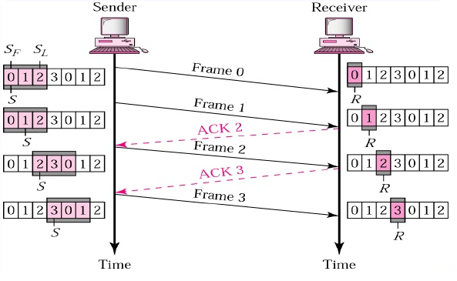
Flow Control
One of the functions of this layer is to prevent congestion which is called flow control.
The way this is achieved is by limiting the number of frames sent at one time using a window size that is shared by both the sender and receiver.
After the receiver receives a frame it sends back an ACK requesting the next frame.
Notes:
Question: Does every frame require an ACK?

Slide 8
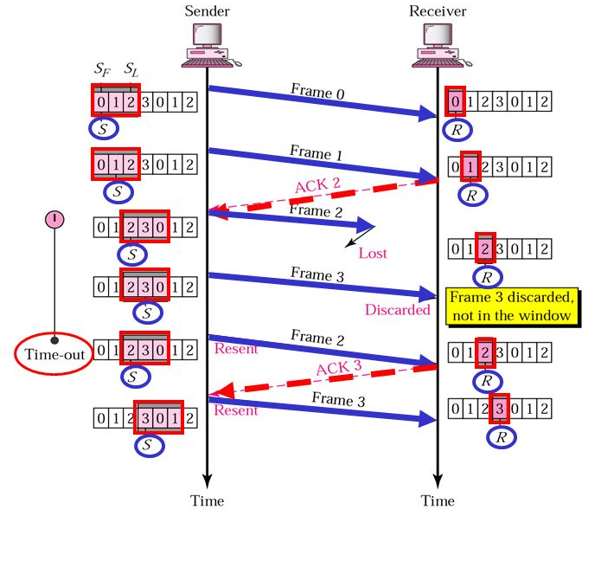
Missing Frame
A frame goes missing by being lost during transmission to the receiver
When the receiver is given a frame out of sequence, it sends back a response containing the number of the next frame it was expecting
Even if additional frames are sent that
The sender shifts its window so that the expected frame is first and then sends the whole window back to the receiver again

Slide 9
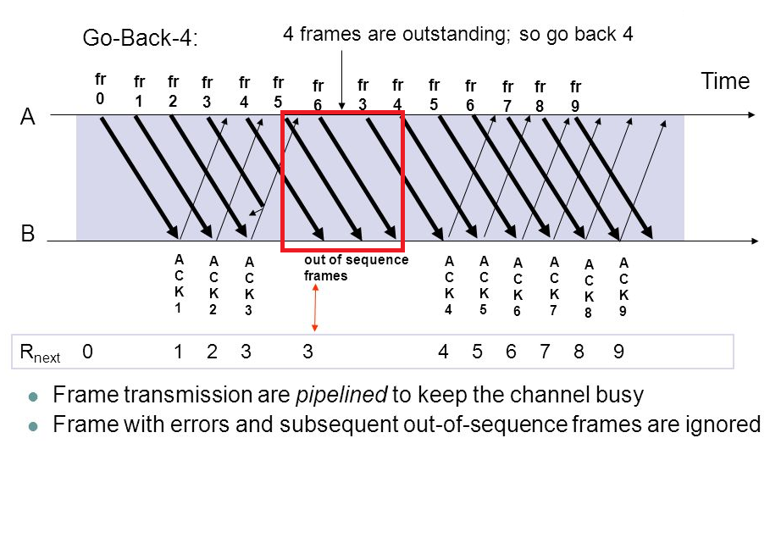
Time-out of Frame
When the ACK gets lots when transmitted back to the receiver.
The Sender is waiting on an ACK but when it does not receive one within a specified amount of time, it resends the frames again to the receiver.
Notes:
Question: What it is called when the sender doesn’t receive an ACK in a specified amount of time?
Answer: Time-out

Slide 10
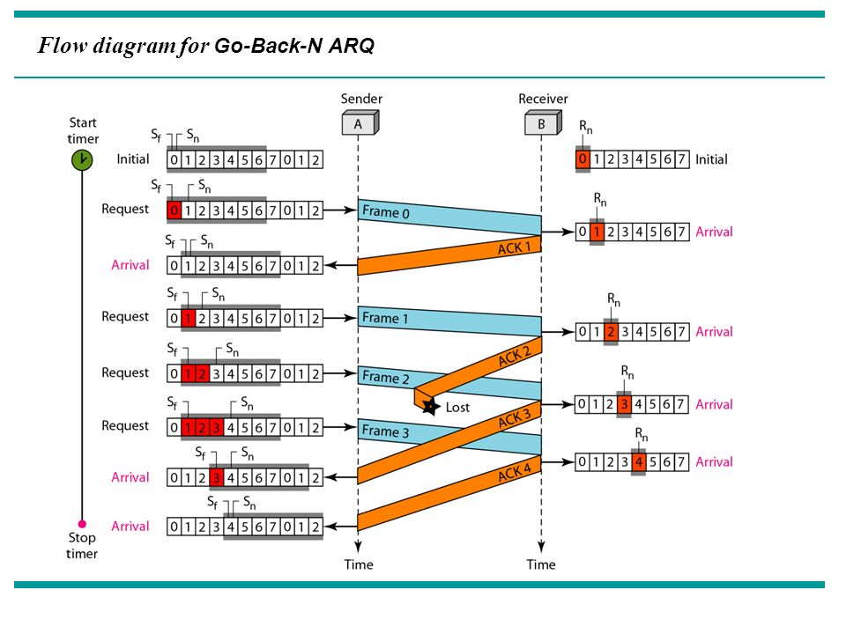
Go-Back-N | In Action
N = window size
Rn = request number
Sn = sequence number
Sb = sequence base
Sm = sequence max
Sender:
Sb = 0
Sm = N − 1
Repeat the following steps forever:
1. If you receive a request number where Rn > Sb
Sm = (Sm - Sb) + Rn
Sb = Rn
2. If no packet is in transmission,
Transmit a packet where Sb <= Sn <= Sm.
Packets are transmitted in order.
Receiver:
Rn = 0
Do the following forever:
If the packet received = Rn and the packet is error free
Accept the packet and send it to a higher layer
Rn = Rn + 1
Else
Refuse packet
Send a Request for Rn

Slide 11
Video | Go-Back-N
Notes:
Question: In the video, when a packet is “killed”, what does this represent?
Answer: A lost packet.

Slide 12
JAVA Animation
Show Demonstration -
Notes:
Question: What is a sliding protocol?
Answer: A technique for controlling transmitted data packets between two network computers where reliable and sequential delivery of data packets is required.

Slide 13
Conclusion
Real-World Uses
In summary, Go-Back-N is beneficial because:
The size of the sender window can be altered
The sender can send many frames at a time
A timer can be set for a group of frames
One ACK can acknowledge multiple frames
More efficient
Wait time is minimal
Layer 2
Mobile Radios
802.11/802.16
LLC/HDLC
Notes:
Question:
Answer:

Slide 14
Sources
http://deeprajbhujel.blogspot.com/2014/05/sliding-window-protocol.html
https://en.wikipedia.org/wiki/Go-Back-N_ARQ
https://www.youtube.com/watch?v=raZYelgmyb0
https://www.youtube.com/watch?v=9BuaeEjIeQI

