Slide 1
Bluetooth, RFID, Data Link Layer Switching
Ch4.6 - 4.8

Slide 2
1.
BLUETOOTH
You know what this is.

Slide 3
Brief History of Bluetooh
1994 L. M. Ericsson company
1998 SIG (Special Interest Group)
Project named Bluetooth after a Viking King

Slide 4
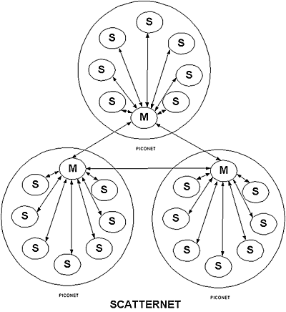
Bluetooth Architecture
Basic unit: Piconet
Master node, 7+ slave nodes, Bridge slave
Interconnection = Scatternet
Designs purpose is to keep cost low
Communication is exclusive

Slide 5
Bluetooth Applications
Profiles to specify particular applications to be supported and provides different protocols for each one.
Large complexity
Example Profiles:
Intercom
Headset
Human interface device
Dial-up networking

Slide 6
The Bluetooth Protocol Stack
Does NOT follow the OSI model, the TCP/IP model, 802 model, or any other model.

Slide 7
Bluetooth Radio Layer
The radio layer moves the bits from master to slave, or vice versa. It is a low-power system with a range of 10 meters
The band is divided into 79 channels of 1 MHz each. To coexist with other networks using the ISM band, frequency hopping spread spectrum is used.
It turned out that early versions of Bluetooth and 802.11 interfered enough to ruin each other’s transmissions. The solution is for Bluetooth to adapt its hop sequence to exclude channels on which there are other RF signals. This process reduces the harmful interference. It is called adaptive frequency hopping.

Slide 8
Bluetooth Link Layers
The link control layer is the closest thing Bluetooth has to a MAC sublayer. It turns the raw bit stream into frames and defines some key for- mats.
The link manager protocol sets up logical channels, called links, to carry frames between the master and a slave device that have discovered each other.
A pairing procedure is followed to make sure that the two devices are allowed to communicate before the link is used.
The SCO (Synchronous Connection Oriented) link is used for real-time data, such as telephone connections.
The other kind is the ACL (Asynchronous ConnectionLess) link. This type of link is used for packet-switched data that is available at irregular intervals.

Slide 9
The Bluetooth Frame Structure
Bluetooth defines several frame formats. It begins with an access code that usually identifies the master so that slaves within radio range of two masters can tell which traffic is for them. Next comes a 54-bit header containing typical MAC sub layer fields.
The Address field identifies which of the eight active devices the frame is intended for. The Type field identifies the frame type (ACL, SCO, poll, or null), the type of error correction used in the data field, and how many slots long the frame is.
The Flow bit is asserted by a slave when its buffer is full and cannot receive any more data. This bit enables a primitive form of flow control. The Acknowledgement bit is used to piggyback an ACK onto a frame. The Sequence bit is used to number the frames to detect retransmissions

Slide 10
2.
RFID
You’ve probably heard of it. It’s everywhere.

Slide 11
RFID
Definition
EPC Gen 2 Architecture
EPC Gen 2 Physical Layer
EPC Gen 2 Tag Identification Layer

Slide 12
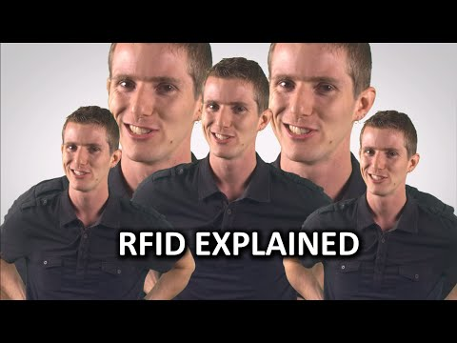
Project Video
Here is a quick overview.
Place your screenshot here

Slide 13
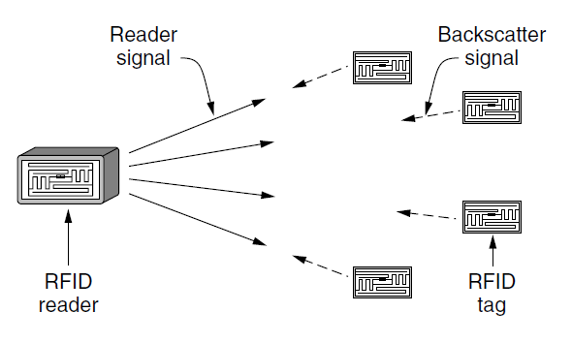
EPC 2 Gen Architecture

Slide 14
EPC 2 Gen Physical Layer

Slide 15
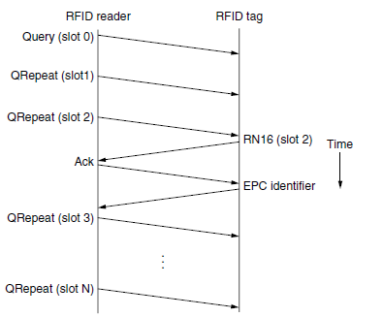
EPC Gen 2 Tag Identification Layer
Tags pick any slot to reply in this case (slot 2)
Tags do not send their ID when they first reply
Instead sends short 16-bit rand num in RN16message
If no collision Reader receive this message and send Ack message
Then tag has acquired the slot and sends its EPC ID
Once IDs are known, the reader can act on them
IDs can read and write to tags
Tags respond only with data—no headers

Slide 16
Tag Identification Message Formats
Physical layers: set properties such as transfer rate
Tag Selection layers: chooses which tags to connect and allows multiple connections.
Q: Defines how many slots the tag will respond in.
CRC: Error detection

Slide 17
3.
Data Link Layer Switching
This might be new to you.

Slide 18
Data Link Layer Switching
Use of Bridges
Learning Bridges
Spanning Tree Bridges

Slide 19
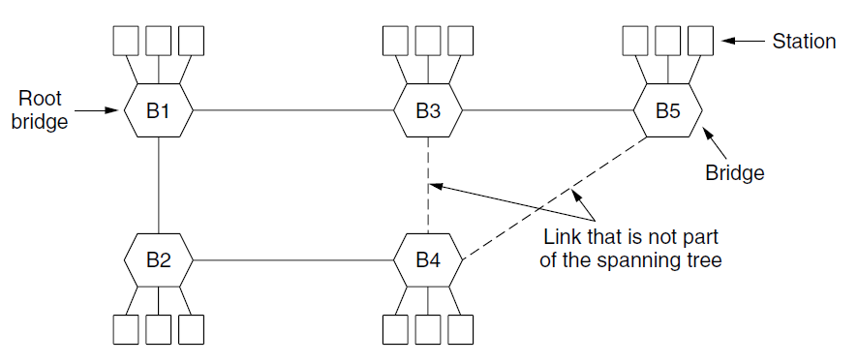
Spanning Tree

Slide 20
Data Link Layer Switching
Repeaters, Hubs, Bridges, Switches, Routers and Gateways
Virtual LANs

Slide 21
Thanks guys!
Any questions?

