Slide 1
Bluetooth,
RFID,
Data Link Layer Switching

Slide 2
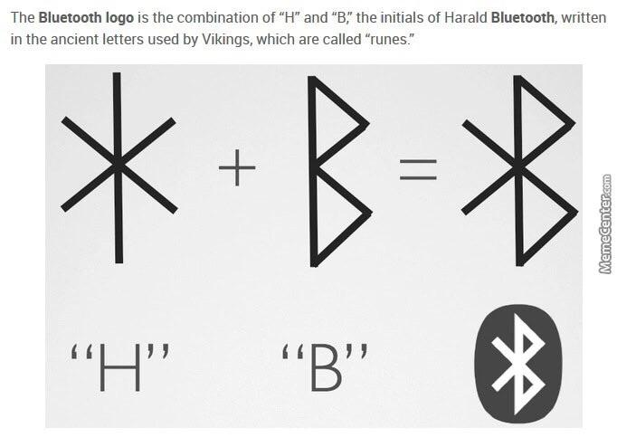
Background
1994: L.M. Ericsson company
Interest in connecting their mobile phones to other devices without cables
1998: Special Interest Group (SIG)- IBM, Intel, Nokia, and Toshiba
To develop a wireless standard for interconnecting computing and communication devices using short range, low-power, inexpensive wireless radios.
Project: Bluetooth
Harald Blaatand “Bluetooth” II
Bluetooth 1.0 released in 1999
Notes:
Harald Blaatand - famous for uniting Scandinavia just as we intended to unite the PC and cellular industries. Had a death tooth that looks blue.
1999- Bluetooth 1.0: Allow devices to find and connect with each other and securely transfer data called pairing.
2004- Bluetooth 2.0: High rates were added
2009- Bluetooth 3.0: Can be used for device pairing in combination with 802.11 for high-throughput data transfer
2009- Bluetooth 4.0: Specified low-power operation

Slide 3
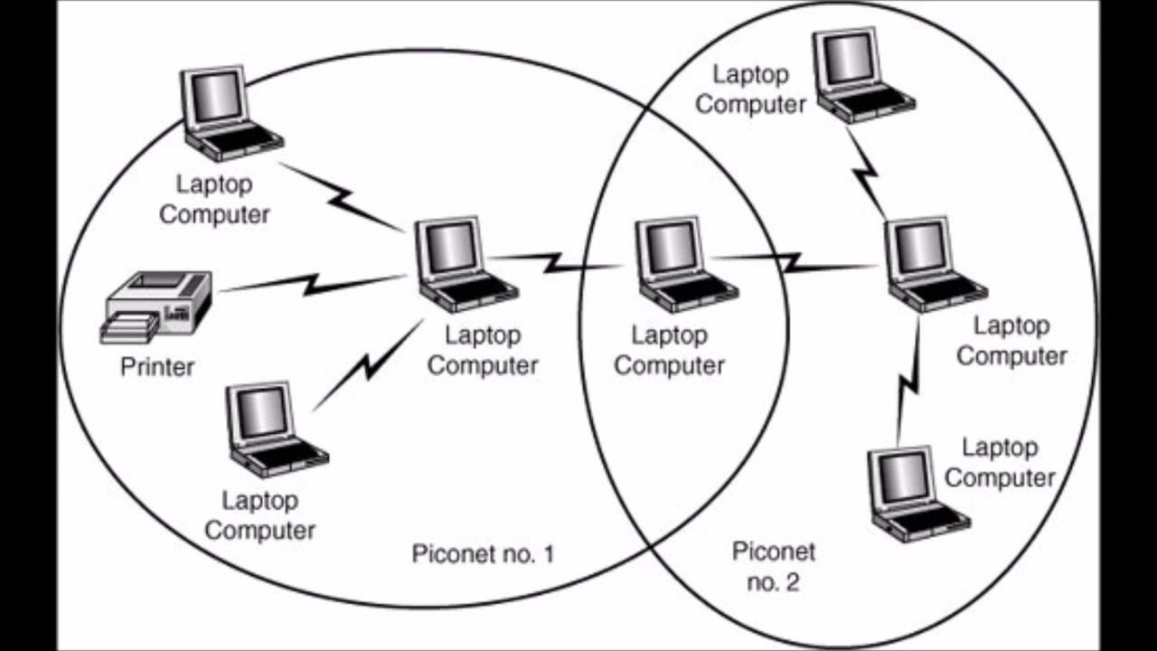
Architecture
Piconet
Basic unit of a Bluetooth system.
1 master node - controls the clock and determines which devices gets to communicate during which time slot
Up to 7 active slave nodes
Up to 255 parked nodes
An interconnected collection of piconets is called a scatternet.
Notes:
Parked nodes - devices that the master has switched to a low-power state to reduce battery drain. In parked state, device cannot do anything except respond to an activation or beacon signal from the master.
Multiple piconets can exist in the same room and can even be connected via a bridge node.

Slide 4
Applications
Bluetooth specifies particular profiles to handle different protocols
25 different applications/profiles
6 for audio and video
Connecting keyboards and mice to computers
Allow mobile phones and other computers to receive images from a camera or send pictures to a printer
Enable networking
Notes:
Most network protocols just provide channels between communicating entities and let application designers figure out what they want to use them for. Bluetooth differs.

Slide 5
What is the basic unit of a Bluetooth System?
Piconet

Slide 6
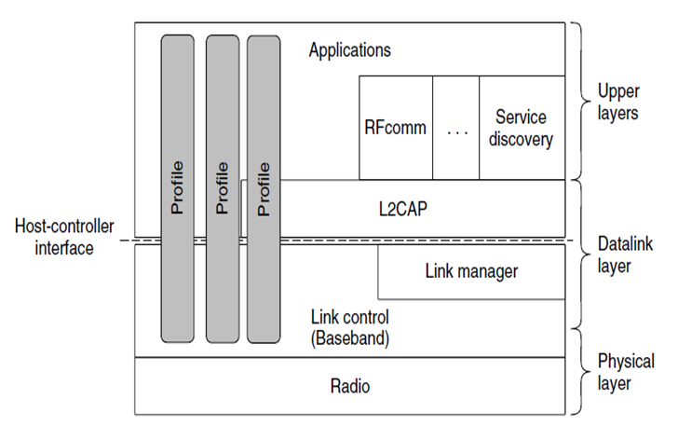
Bluetooth Protocol Stack
Structure does not follow the OSI model, TCP/IP, 802, or any other model.
Bottom layer: Physical Layer
Middle Layer: Datalink layer
Top Layer: Upper Layers

Slide 7
Bluetooth Protocol Layers
Physical Layer
Deals with radio transmission and modulation
Datalink Layer
Deals with how the master controls time slots and how these slots are grouped into frames
Upper Layer
Where the applications are located

Slide 8
Which Bluetooth Protocol layer deals with radio transmission?
Physical

Slide 9
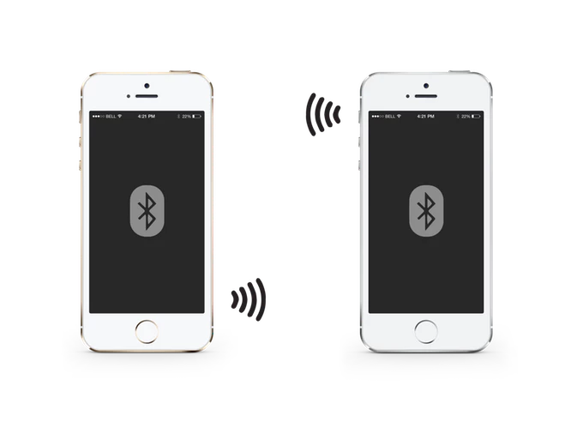
Bluetooth Radio Layer
moves the bits from master to slave
It is a low-power system with a range of 10 meters operating in the same 2.4-GHz ISM (Industrial, Scientific and Medical ) band as 802.11.
frequency hopping spread spectrum is used so networks can coexist within the ISM band
All nodes in a piconet hop frequencies simultaneously
Earlier version of bluetooth and 802.11 interfered with each other’s transmissions
Solution: Adaptive frequency hopping - Bluetooth adapts its hop sequence to exclude channels on which there are other RF signals.

Slide 10
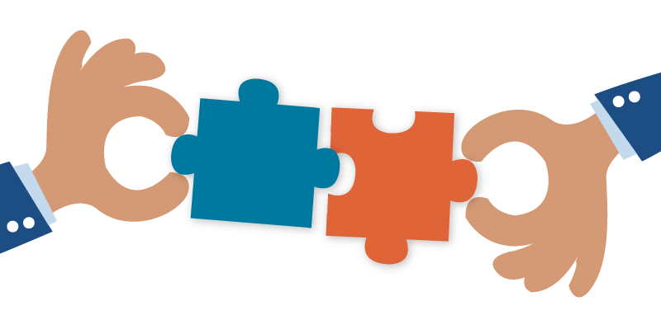
Bluetooth Link Layers
It turns the raw bit stream into frames with key formats. Contains a master and a slave in each piconet
The link manager protocol sets up logical channels, called links, to carry frames between the master and a slave device that have discovered each other
Pairing allows devices to communicate with each other before links are set up
Old pairing method - both devices configured using the same 4 digit PIN but was unsecure because 0000 or 1234
New pairing method- secure simple pairing method enables users to confirm that both devices are displaying the same passkey
After pairing , link manager sets up links - 2 main links:
SCO(Synchronous Connection Oriented) link - used for real- time data, such as telephone connections
ACL(Asynchronous ConnectionLess) link -used for packet-switched data that is available at irregular intervals

Slide 11
Video
https://www.youtube.com/watch?v=TXmOpc5_PO8&ab_channel=Scienceeverywhere%21
Stop at 1:35

Slide 12
Bluetooth Frame Structure
Frame can be sent at basic rate or enhanced rate
Both share a header
Address field- identifies which active device the frame is for
Type field- identifies the frame type (ACL, SCO, poll, or null), the type of error correction used in the data field, and how many slots long the frame is
Flow bit - is asserted by a slave when its buffer is full and cannot receive any more data
Acknowledgement bit- used to piggyback an acknowledgement onto a frame
Sequence bit - used to number the frames to detect retransmissions
Checksum- 8-bit header

Slide 13
What are the two main kind of links to carry user data?
SCO (Synchronous Connection Oriented)
ACL (Asynchronous ConnectionLess)

Slide 14
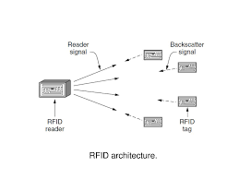
RFID (Radio Frequency IDentification)
Used in smart cards, animal implants, passports, library books, etc.
A notable example is the EPC (Electronic Product Code) basically this is a replacement for barcodes and carry larger amount of information and is readable up to 10 m.
EPC Gen 2 Architecture
RFID tags are small, inexpensive devices that have a unique 96 bit epc identifier.
Tiny dot in the middle of the RFID is the integrated circuit.
EPC Gen 2 Physical Layer
How bits are sent between the RFID reader and tags.
Backscatter - low energy way for the tag to create a weak signal of its own that shows up on the reader
EPC Gen 2 Tag ID layer
Notes:
-low end wireless devices that people may not recognize as forming a computer network
-figure: has two key components, tags & readers.
-

Slide 15
Tag Identification Message
Has three fields and three flags
According to the picture, which represents the physical parameters and the tag selection?
At first tags were for identification purpose, over time they resemble small computers.

Slide 16
Data Link Layer Switching
-Uses of bridges
-Learning bridges
-Spanning tree bridges
-Repeaters, hubs, bridges, switches, routers, and gateways
-Virtual LANs

Slide 17
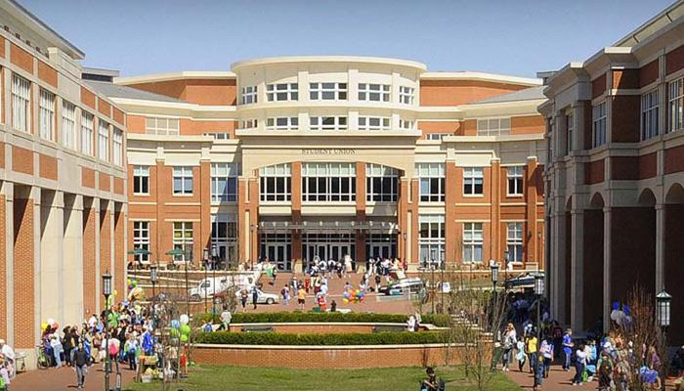
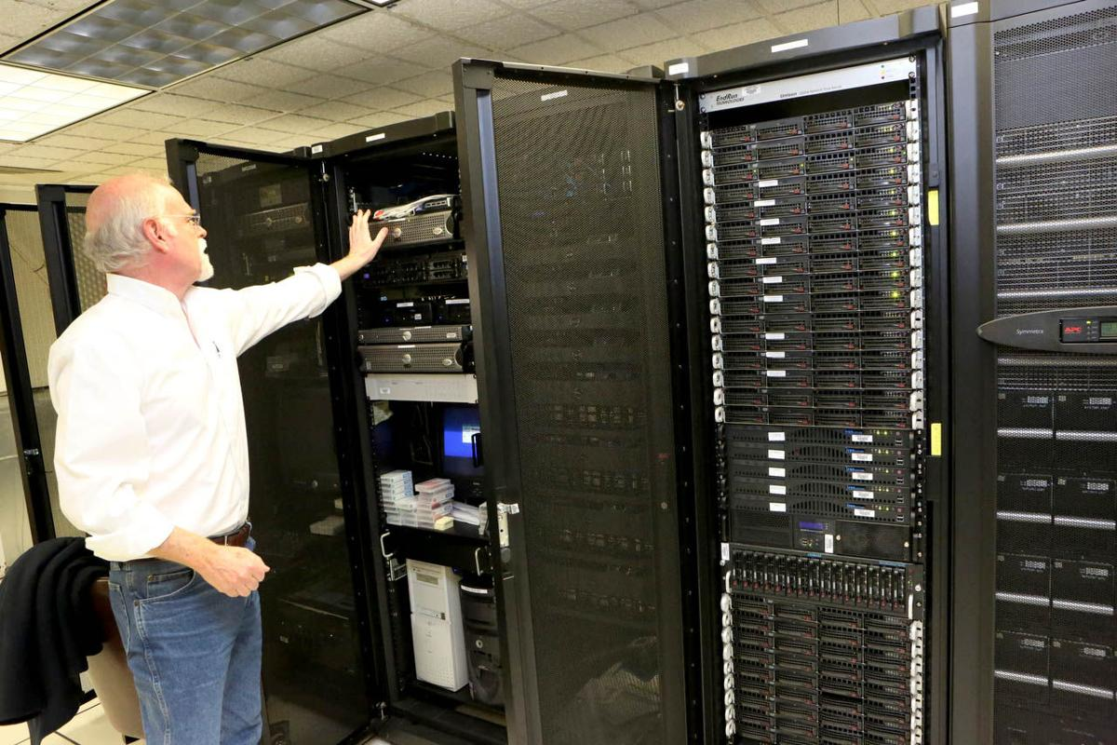
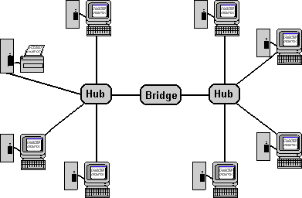
Uses of Bridges

Slide 18
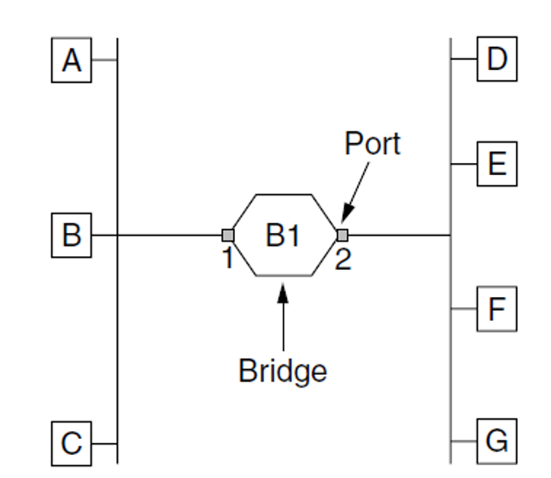
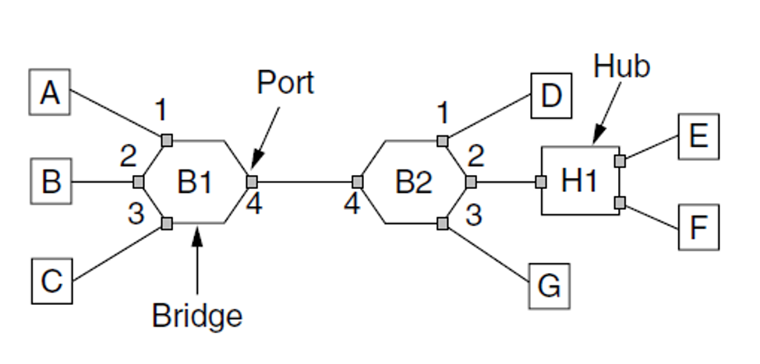
Learning Bridges
Hubs are connected by bridges
Different kinds of cables are allowed
Each bridge accepts every frame transmitted

Slide 19
Learning Bridges(cont.)
Backward Learning Algorithm
-Every frame is seen on the ports
Routing Procedure
If destination port == Source port, discard frame.
If destination port != Source port, send frame to destination port.
If destination port not known, use flooding to send frame to all except source.

Slide 20
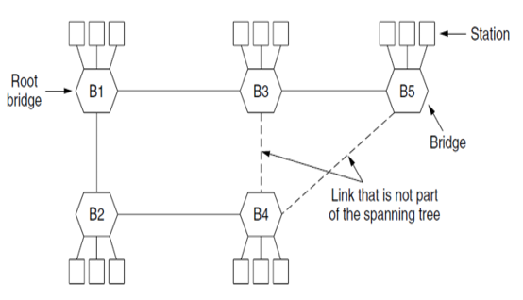
Spanning Tree Bridges

Slide 21
What is a type of bridge?
LAN bridge
Spanning Tree bridge
Loop bridge
Fake bridge

Slide 22
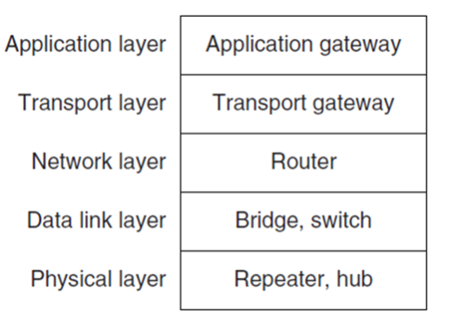
Repeaters, Hubs, Bridges, Switches, Routers, and Gateways

Slide 23
Virtual LANs
-standardized by the IEEE 802 committee and is now widely deployed in many organizations

Slide 24
ANY Questions?

