Slide 1
CONGESTION CONTROL, QUALITY OF SERVICE, & INTERNETWORKING
5.3-5.5

Slide 2
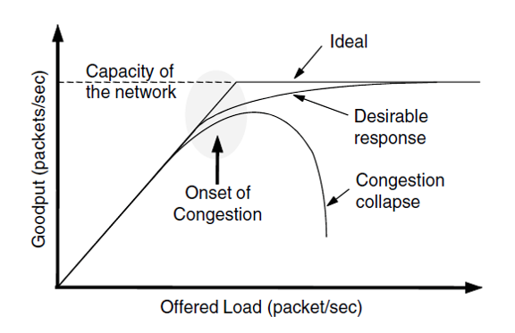
CONGESTION CONTROL
Congestion in network layer = too many packets in the network
leads to packet delay or loss
performance degradation
Goodput is the rate at which useful packets are delivered by network.
Offered load approach carrying capacity
Bursts of traffic fill up buffers packet loss
Consumes capacity
Drop in number of delivered packets
Retransmit packets that are greatly delayed.
Same packet sent to network wastes capacity.
Congestion collapse – performance plummets when load increases beyond network’s capacity

Slide 3
Eliminate congestion?
Key control can’t avoid
congestion = load > resources
2 possible solutions: increase resources, decrease load
Routing algorithms
Part of network software layer responsible for deciding which output line an incoming packet should be transmitted on – determines best path for data
Four types for congestion control –
Admission control, traffic aware routing, traffic throttling, and load shedding
Preventative method more preplanning required (time consuming) to reactive discard packets that are not deliverable, load shedding

Slide 4
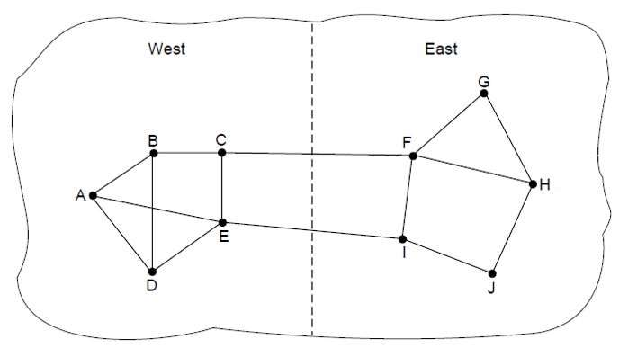
CONGESTION CONTROL
Traffic Aware Routing
Attempts to predict which routes will become congested first and shift traffic away from areas heavily used
Considers load to calculate route distance and changes shortest path weight
Paths with the least weight favors paths that are lightly loaded
Issue – including loads, queueing delay and changing weights -> routing oscillations -> erratic routing
Solution – Multipath routing (use multiple paths to avoid congestion) or Shift traffic routing scheme (slowly shifts traffic away from congestion). Doesn’t consider load only bandwidth and propagation delay
Internet routing protocols not typical to adjust routes based on load alternatively adjustments occur outside of the Internet routing protocol by slowing changing the inputs, called traffic engineering

Slide 5
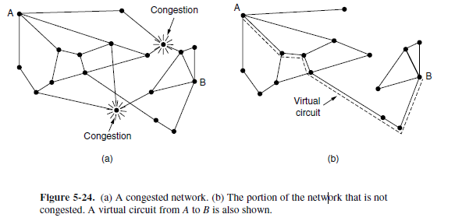
ADMISSION CONTROL
Idea is to not set up a new virtual circuit unless the network can carry the added traffic
Traffic can often come in bursts, how do we know how much to plan for?
Browsing internet vs. watching HD Movie
Leaky (or token) bucket descriptor binds average rate and instantaneous burst in one parameter
Internet usage statistics give context for planning network
Admission control + traffic aware routing can create connections around hotspots

Slide 6
LOAD SHEDDING
Load shedding is final resort
when previous methods don't work, router starts throwing away packets
Packets dropped depend application accessing network
"Wine" - Send old packets but drop new ones
"Milk" - Send new packets but drop old ones
Random Early Detection
Algorithm deciding to preemptively start dropping packets
Picks small fraction of packets at random to drop

Slide 7
TRAFFIC THROTTLING
Catching congestion before it happens is key
Most effect way is to measure buffering of queued packets inside the router
Choke Packets are sent directly to source host
When host receives choke packet, it is required to reduce traffic sent for a certain amount of time
Explicit Congestion Notification
Routers may tag packets as congested as they transmit between hosts, and the sender then throttles transmission
Hop-by-Hop Backpressure
Has choke packet take effect at every hop
Provides immediate relief at current hop but puts greater demand on previous hop
If/when congestion reaches originating hop, slow down finally occurs

Slide 8
QUALITY OF SERVICE
WHAT IS IT?
IN ITS ESSENCE, IT IS THE ABILITY TO ENSURE
THE QUALITY OF THE END USER’S EXPERIENCE
-SPEED
-TRANSMISSION
-BANDAWIDTH
-PERFORMANCE
-ETC...
Notes:
QoS was defined by ITU (International Telecommunication Union) in 1994

Slide 9
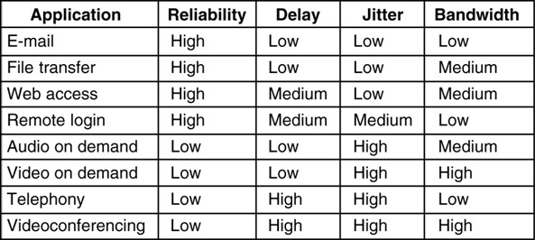
QUALITY OF SERVICE
HOW DO WE ACHIEVE THIS??
WHAT APPLICATIONS NEED FROM THE NETWORK
HOW TO REGULATE TRAFFIC THAT ENTERS THE NETWORK
HOW TO RESERVE RESOURCES AT ROUTERS TO GUARANTEE PERFORMANCE
WHETHER THE NETWORK CAN SAFELY ACCEPT MORE TRAFFIC
REQUIREMENTS

Slide 10
QUALITY OF SERVICE
TRAFFIC SHAPING
TRAFFIC IN DATA NETWORKS IN BURSTY
GOAL IS TO REGULATE THE AVERAGE RATE OF DATA ENTERING A NETWORK
SLA - AGREEMENT BETWEEN USER AND PROVIDER DEALING WITH THE PATTERN OF TRAFFIC THAT WILL COME FROM USER’S NETWORK

Slide 11
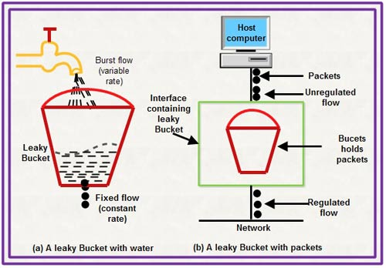
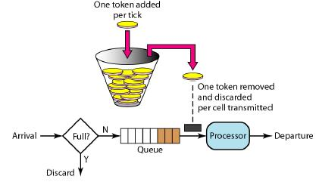
QUALITY OF SERVICE
LEAKY BUCKET ALGORITHM
TOKEN BUCKET ALGORITHM
-OUTPUT IS CONSTANT RATE, R, WHEN THERE IS ANY WATER IN BUCKET AND ZERO WHEN BUCKET IS EMPTY
-ANY ADDITIONAL WATER IS SPILLAGE
-RUNNING AT A RATE, R, WITH A CAPACITY OF B
-NO MORE THAN A FIXED NUMBER OF WATER, B, CAN ACCUMULATE IN BUCKET
-IF BUCKET IS EMPTY, WE MUST WAIT UNTIL MORE TOKENS ARRIVE BEFORE SENDING ANOTHER PACKET
Notes:
Leaky Bucket technique was proposed by Jonathan S. Turner

Slide 12
QUALITY OF SERVICE
FIFO (FIRST-IN-FIRST-OUT
PACKETS ARE PUT IN A QUEUE UNTIL THEY CAN BE SENT
SENT IN THE ORDER THEY ARE RECEIVED
SIMPLE TO IMPLEMENT,BUT NOT A GOOD CHOICE WHEN MULTIPLE FLOWS ARE INVOLVED
IF FIRST FLOW IS AGGRESSIVE WITH LARGE BURSTS IT WILL LODGE THE QUEUE
FAIR QUEUEING
ROUTERS HAVE SEPARATE QUEUES, ONE FOR EACH FLOW FOR A GIVEN OUTPUT LINE
WHEN LINES BECOME IDLE, QUEUES ARE SCANNED ROUND ROBIN
TAKES THE FIRST PACKET ON THE NEXT QUEUE
GIVES MORE BANDWIDTH TO HOSTS WITH LARGER PACKETS RATHER THAN THOSE THAT USE SMALL PACKETS
PACKET SCHEDULING
RESOURCE RESERVATION
BANDWITH
BUFFER SPACE
CPU CYCLES

Slide 13
INTERNETWORKING
Connecting two or more networks – Internetwork aka The Internet
Different networks will have different protocols at data link, physical, and network layer
Source packets may have to traverse multiple networks
Build a common layer between networks at the boundaries of networks
TCP/IP – Cerf and Kahn
2004 Turing Award
Foundation of Internet

Slide 14
INTERNETWORKING
Router to handle multiple protocols – Multiprotocol Router
IPv4 (32 bit address) or IPv6 (128 bit address)
Tunneling – Package an IPv6 packet in an IPv4 Packet
Overlay – Connect isolated hosts using other networks ie. VPN

Slide 15
INTERNETWORKING
Two Level Routing
Interior Gateway Protocol – routing in network
Exterior Gateway Protocol – routing across networks
Autonomous System – network is operated independently of other networks
Packet Fragmentation
Packet Size limited in different protocols – Path Maximum Transmission Unit
Path MTU Discovery – IP packet sent with header will not allow fragmentation
Large packet returns error and receiver will drop packet
Router will reply with maximum size and process continues through route

