Slide 1
Congestion Control, Internet Transport Protocols: UDP

Slide 2
Congestion Control
If the transport entities on many machines send too many packets into the network too quickly, the network will become congested, with performance degraded as the packets are delayed and lost.
Controlling congestion to avoid this problem is the combined responsibility of the network and transport layers.

Slide 3
Congestion Control (cont.)
Congestion occurs at routers, so it is detected at the network later.
However, congestion is ultimately caused by traffic sent into the network by the transport layer.
The only effective way to control congestion is for the transport protocols to send packets into the network more slowly.

Slide 4
Desirable Bandwidth Allocation
We must specify the state in which a good congestion control algorithm will operate the network.
Goal: avoid congestion AND to find a good allocation of bandwidth to the transport entities that are using the network.
A good allocation will deliver good performance because:
It uses all the available bandwidth but avoids congestion
Will be fair across competing transport entities
Will quickly track changes in traffic demands

Slide 5
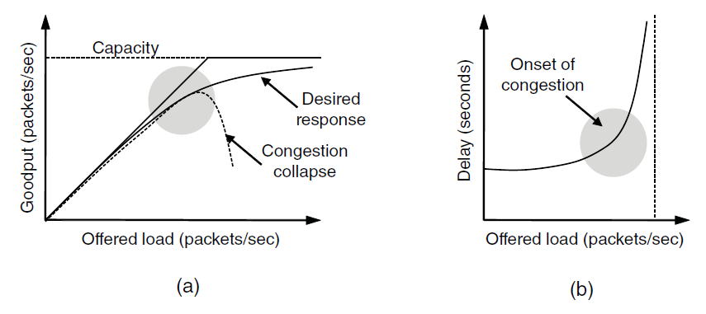
Efficiency and Power
An efficient allocation of bandwidth across transport entities will use all of the network capacity that is available.
A) Goodput: rate of useful packets arriving at the receiver
B) Delay as a function of offered load

Slide 6
Power
For both goodput and delay, performance begins to degrade at the onset of congestion.
We’ll get the best performance from the network if we allocate bandwidth up until the delay starts to climb rapidly. This point will be below the capacity.
To identify it:
Power= load/delay
Power will initially rise with offered load, as delay remains small and roughly constant, but will reach a maximum and fall as delay grows rapidly.

Slide 7
Max-Min Fairness
If the network gives a sender some amount of bandwidth to use, the sender should just use that much bandwidth.
But it is often the case that networks do not have a strict bandwidth reservation for each connection.
It is simple enough if N flows use a single link, in which case they can all have 1/N of the bandwidth.
But what happens if the flows have different, but overlapping network paths?
We will adopt a form of fairness that is often desired for network usage: Max-Min Fairness
An allocation is max-min fair if the bandwidth given to one flow cannot be increased without decreasing the bandwidth given to another flow with an allocation that is no larger.
That’s saying, increasing the bandwidth of a flow will only make the situation worse for flows that are less well off.

Slide 8
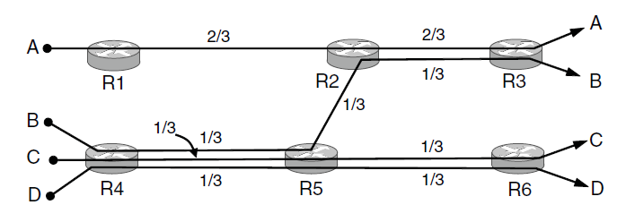
Max-Min bandwidth allocation for 4 flows: A, B, C, and D

Slide 9
Convergence
The congestion control algorithm needs to converge quickly to a fair and efficient allocation of bandwidth.
Connections are always coming and going in a network, and the bandwidth needed by a given connect will vary over time too.
Because of the variation of demand, the ideal operating point for the network varies over time.
A good congestion control algorithm should rapidly converge to the ideal operating point, and it should track that point as it changes over time.

Slide 10
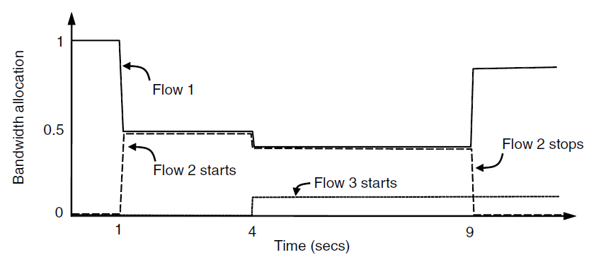
Bandwidth allocation that changes over time and converges quickly
At all times, the total allocated bandwidth is approximately 100%, so that the network is fully used, and the competing flows get equal treatment…But do not have to use more bandwidth than they need.

Slide 11
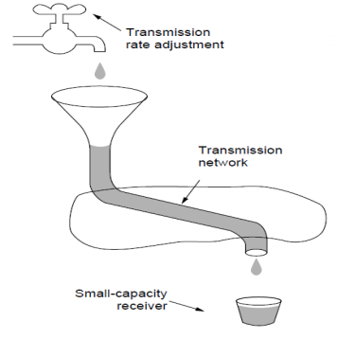
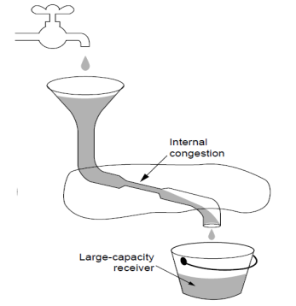
Regulating the Sending Rate
How do we regulate the sending rates to obtain a desirable bandwidth allocation? The sending rate may be limited by two factors:
Flow Control (insufficient buffering at the receiver)
Congestion (insufficient capacity in the network)

Slide 12
Regulating the Sending Rate (cont.)
The way that a transport protocol should regulate the sending rate depends on the form of the feedback returned by the network.
Different network layers may return different kinds of feedback. Feedback may be:
Explicit or implicit
Precise or imprecise
Example of explicit, precise design is when routers tell the sources the rate at which they may send.
Example of explicit, imprecise design is when the routers set bits on packets that experience congestion to warn the senders to slow down, but they do not tell them how much to slow down.
And in other designs, there is no explicit signal.
Figure 6-23 on page 537 shows signals of some congestion control protocols.

Slide 13
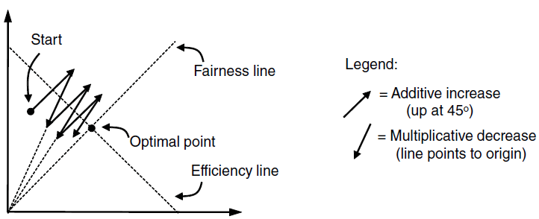
AIMD
Additive Increase Multiplicative Decrease (AIMD) is the appropriate control law (the way in which the rates are increased or decreased) to arrive at the efficient and fair operating point.

Slide 14
Wireless Issues
The main issue with wireless networks is that packet loss is often used as a congestion signal, including by TCP. Wireless networks lose packets all the time due to transmission errors.
With the AIMD control law, high throughput requires very small levels of packet loss.
To function well, the only packet losses that the congestion control algorithm should observe are losses due to insufficient bandwidth, not losses due to transmission errors.
One solution to this problem is to mask the wireless losses by using retransmissions over the wireless link.

Slide 15
Masking Issues
The masking strategy is sufficient to let most transport protocols run well across most wireless links, but it is not always a fitting solution.
Some wireless links have long round-trip times. (satellites) For these, other techniques must be used to mask loss.
Variable capacity (the capacity of a wireless link changes over time, sometimes abruptly, as nodes move and the signal-to-noise ratio varies with the changing channel conditions.)
This is unlike wired links whose capacity is fixed.

Slide 16
Internet Transport Protocols
UDP
Connectionless Protocol.
Complementary of the Connection-Oriented Protocol of TCP
Does almost nothing other than sending packets between applications

Slide 17
Introduction to UDP
User Datagram Protocol
Provides a way for applications to send encapsulated IP datagrams without establishing a connection
Transaction oriented
Delivery is not guaranteed
Described in RFC 768

Slide 18
UDP Transmission
Transmits in segments consisting of an 8 byte header and a payload
Endpoints within the source and destination machines are identified by 2 ports
Upon arrival the payload is handed off to the process attached to the Destination Port
The port fields allow the transport layer to know what to do with incoming packets

Slide 19
The UDP Header

Slide 20
The UDP Header
The Source Port is needed when a reply must be sent to the source
The UDP Length field consists of the 8 byte header and the data
Minimum length= 8 bytes
Maximum length = 65,515 bytes
UDP Checksum (Optional) is for reliability

Slide 21
The UDP Header
How Checksum works
Checksum field set to 0
Data field is padded with an extra 0 byte if the length is an odd number
The Algorithm is to add all the 16-bit words in ones complement and take the ones complement of the sum
Result should be 0

Slide 22
IPv4 Pseudoheader

Slide 23
Pseudoheader IPv4/IPv6
Contains the 32 bit IPv4 address of the source and destination machines, UPD Protocol number and byte count for the UDP segment (with header).
Inclusion in UDP Checksum calculation helps detect misdelivered packets.
Inclusion is also a violation of protocol hierarchy- IP addresses belong in the IP Layer, not UDP.

Slide 24
What UDP Does NOT Do
Flow and congestion control
Retransmission after receiving a bad segment

Slide 25
What UDP Does Do
Provides an interface for the IP Protocol with demultiplexing multiple processes using the ports
Optional error detection

Slide 26
Remote Procedure Call
Sending a message to a remote host to get a response back.
The basis for many networking applications.
RPCs should look as much like local procedures as possible
Client- machine making the call
Server- machine accepting the called procedure

Slide 27
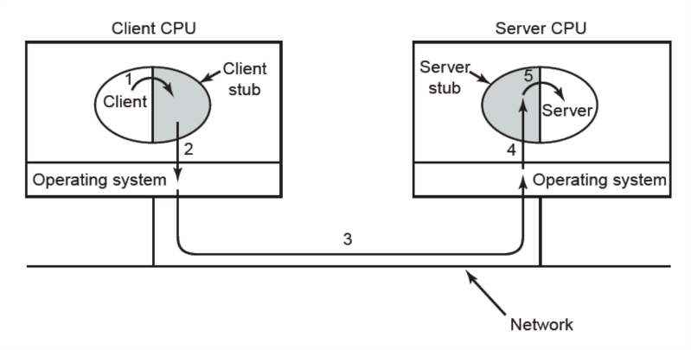
Remote Procedure Call

Slide 28
Steps in an RPC
Step 1- Client calls Client Stub (Small library procedure on Client)
Step 2- Client Stub packs parameters into a message and makes a system call to send the message. Packing the parameters is called Marshaling
Step 3- OS sends message from Client Machine to Server Machine
Step 4- OS passes the incoming packet to the Server Stub
Step 5- Server Stub calls the server procedure with the unmarshaled parameters
Step 6- Reply. This traces the same path in the reverse direction

Slide 29
RPC- Names to Know
Birrell and Nelson (1984)
Suggested the idea to allow programs to call procedures located on remote hosts
Machine 1 calls Machine 2
Calling process suspends on M1 Execution of procedure takes place on M2
Message passing is transparent to application programmer

Slide 30
RPC Problems
Cannot pass pointer parameters because Client and Server are in different address spaces
Possible in some languages to write a procedures that are essentially impossible for the Client Stub to marshal the parameters because it cannot determine how large they are
Not always possible to deduce the types of parameters, even from the code
Global Variables may not be shared across machines

Slide 31
Real-time Transport Protocols
Described in RFC 3550
In widespread use for multimedia applications- Streaming Radio/Video, VOIP etc.
Initially each application was having its own real time protocol, but they were all similar, but became apparent that a generic protocol that could handle multiple applications would be beneficial

Slide 32
RTP (Real-time Transport Protocol
Has 2 parts
First part is the protocol for transporting audio and video data in packets
Second part is the processing that takes place- usually at the receiver to play the audio and video at the correct time.

Slide 33
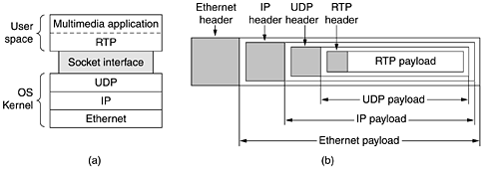
Real-time Transport
a- The position of RTP in the protocol stack
B- Packet nesting

Slide 34
Real-time Transport Protocol
The basic function is to multiplex several real time data streams onto a single stream of UDP packets which can then be sent to single (unicasting) or multiple (multicasting) destinations
The UDP packets receive no special consideration except in the case of QOS features being enabled
Each packet send is assigned a number 1 higher than the one before to determine if any are missing
If a packet is not received then that data is skipped or approximated. There is not usually retransmission, nore is there an acknowledgement

Slide 35
Real-time Transport Protocol
RTP paylods may contain multiple samples, each encoded multiple ways.
RTP only provides the header field specifying the encoding only
RTP supports time stamping
Time stamping reduces effects of network delay and also allows multiple streams to be synchronized with each other

Slide 36
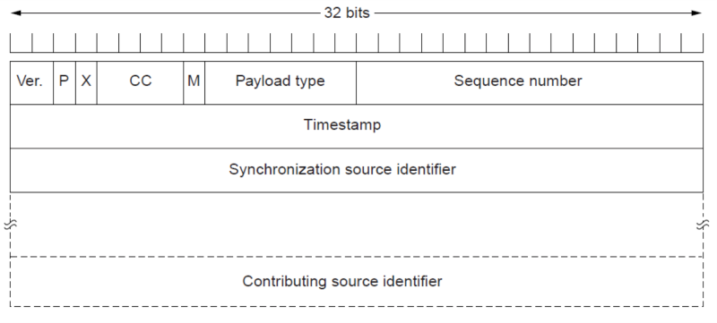
RTP Header

Slide 37
RTP Header
Consists of three 32-bit words and possibly som extensions
The first word contains the Version field
The P bit indicates the packet has been padded to a multiple of 4 bytes. The final padding byte indicates how many bytes were added
The X bit indicates an extension header is present. The only thing defined is that the first word of the extension gives the length
The CC field tells how many contributing sources are present from 0 to 15
The M bit is application specific marker bit. It is used to mark the start of something the application understand
The Payload type tells which encoding algorithm has been used

Slide 38
Continued
The Sequence number is the counter incremented on each RTP packet sent. Used to detect lost packets
The Timestamp is produced by the source to indicate when the first sample was made. Only the differences between timestamps is significant.
Synchronization source identifier identifies which stream the packet belongs to. This is the method used in multiplexing and demultiplexing multiple data streams into a single stream of UDP packets.
Contributing source identifiers are used when mixers are present in the studio (if at all)

Slide 39
Real-Time Transport Control Protocol
A control protocol that does not transport any media
Provides feedback on delay, delay variation, jitter, bandwidth and congestion to the transmission sources. This allows the encoding to constantly be adjusted to compensate if there is a problem in the network, and adjust encoding if conditions improve.
RTCP Feedback reports are designed to only consume a preset amount of bandwidth determined by the number of participants to prevent congestion
Handles interstream synchronization
Provides a way for naming various sources to be displayed on the receivers screen

Slide 40
RTCP- Buffering and Jitter Control
Jitter is caused by packets reaching the receiver at slightly different relatives times. Effects video and audio
Buffering is the process of delaying playback a set amount of time so all the necessary packets for that period to arrive and be synchronized. This is a continuous process
If a packet is delayed too long the media will either skip it or stop playing until the packet arrives. Usually in live applications such as VOIP calls, the packet is skipped.
Streaming applications can use a larger buffer, but Live media applications typically use a smaller buffer because responsiveness is a priority

Slide 41
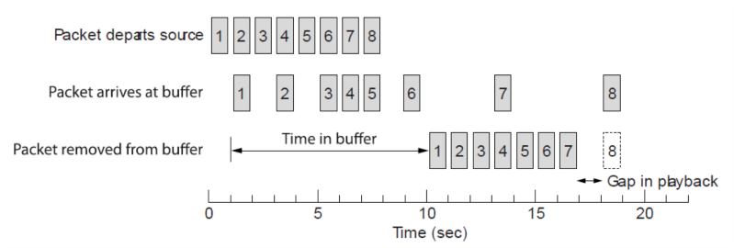
Buffering Visualized

Slide 42
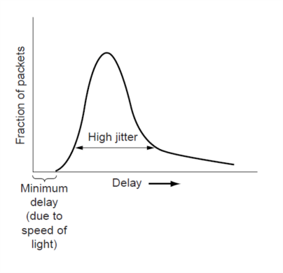
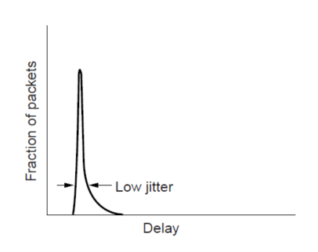
Jitter Visualized
a. High Jitter b. Low Jitter

