Slide 1
Streaming Audio & Video, Content Delivery

Slide 2
What Is Audio?
Digital audio is a digital representation of an audio wave that can be used to recreate it
Audio waves can be converted to digital form using an ADC (analog-to-digital-converter)
Sound wave are continuous one-dimensional acoustic waves. Naturally these waves are analog in nature.

Slide 3
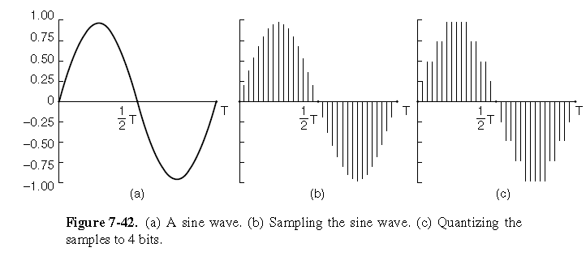
Digitizing
Digitizing Audio
Analog sound waves must be sampled at a rate of at least twice the frequency of the wave. The Result is a digitized representation of the sound wave.

Slide 4
What Is Streaming Audio?
A method of delivering an audio signal to your computer over the Internet. The data is constantly being delivered to the user as its being provided by the provider.
With streaming audio, you are able to listen to the music of your choice as it arrives to your computer without downloading the full file.
Multiple methods of audio streaming . (Connecting to a server to view stored files, or live broadcasts)
The more traditional or “normal method” would be to download a “.wav”, “.au”, “mp3” or other type of file completely before being able to listen to it

Slide 5
Examples of Streaming Audio
The most popular example of streaming audio is live broadcast such as Internet Radio
Internet Radio stations (Pandora, TuneIn, SiriusXM, iTunes Radio)

Slide 6
Streaming Audio Process
As the data arrives, it’s buffered for a few seconds and then playback begins. As the audio is playing, more data is constantly arriving (streaming), and as long as you are receiving a constant stream of data, you will hear an uninterrupted amount of sound.
Why is buffering essential???

Slide 7
Streaming Audio Buffering
Reliable protocols, such as the Transmission Control Protocol (TCP), guarantee correct delivery of each bit in the media stream. However, they accomplish this with a system of timeouts and retries, which makes them more complex to implement. It also means that when there is data loss on the network, the media stream stalls while the protocol handlers detect the loss and retransmit the missing data

Slide 8
The Leaky Bucket Buffer Model
Three parameters define the bucket:
The capacity (B)
The rate at which water flows out of the bucket (R)
The initial fullness of the bucket (F)
In this metaphor, the bucket is the buffer:
If water enters the bucket at exactly the same rate as R the F value doesn’t change. If the input rate exceeds R, the water accumulates causing possible overflow.
Similar to an audio stream that would pause and buffer before continuing to play.

Slide 9
Streaming Audio Requirements
There is a wide array of media formats which allow streaming audio. A user must have a software or device that has a compatible media player and receiver in order to stream audio. Much of this is done through smartphone apps and other platforms.
Today there are additionally a few different ways to access streaming media. Some is streamed live while others are streamed from storage media such as file servers. For live feed streaming, the internet connection must be able to keep up with the requirements of the streaming audio.

Slide 10
Streaming Multimedia: UDP or TCP?
UDP
server sends at rate appropriate for client (oblivious to network congestion !)
often send rate = encoding rate = constant rate
then, fill rate = constant rate - packet loss
short playout delay (2-5 seconds) to compensate for network delay jitter
error recover: time permitting
.TCP
send at maximum possible rate under TCP
fill rate fluctuates due to TCP congestion control
larger playout delay: smooth TCP delivery rate
HTTP/TCP passes more easily through firewalls

Slide 11
Digital Video
For color video, many systems use 8 bits for each of the red, green and blue (RGB) primary color components. This representation is possible because any color can be constructed from a linear superposition of red, green, and blue with the appropriate intensities
The digital representation of video is a sequence of frames, each consisting of a rectangular grid of picture elements, or pixels.
The human eye has the property that when an image appears on the retina, the image is retained for some number of milliseconds before decaying. If a sequence of images is drawn at 50 images/sec, the eye does not notice that it is looking at discrete images. All video systems exploit this principle to produce moving pictures

Slide 12
How Video Streaming Works
https://youtu.be/AeJzoqtuf-o

Slide 13
Digital Video Compression
Many formats are used for video that is sent over the Internet, some proprietary
and some standard. The most popular encoding is MPEG in its various
Forms.
Video Compression is absolutely necessary in order to send video over the internet. Uncompressed video of standard quality would far exceed the internet capabilities of most all internet services.
In practice, most video codecs also use audio compression techniques in parallel to compress the separate, but combined data streams as one package. In theory video is simply comprised of a series of still images + sound.

Slide 14
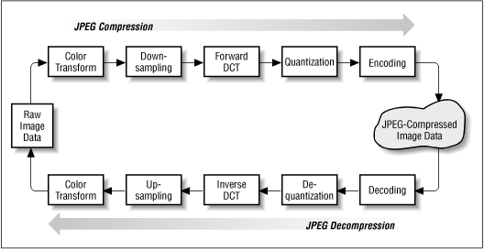
The JPEG Standard
JPEG (Joint Photographic Experts Group) – was developed by photographic experts. (extension jpg)
The JPEG standard – is a standard for compressing continuous-tone still pictures.
JPEG are compressed using a very complex algorithm that allows up to a 20:1 compression ratio
The algorithm is performed in reverse order to decompress the image.

Slide 15
The MPEG Standard
MPEG (Motion Picture Experts Group) - is a working group of experts that was formed by ISO and IEC to set standards for audio and video compression and transmission.
There is actually more than one MPEG standard:
MPEG-1
MPEG-2
MPEG-4

Slide 16
Streaming Stored Media
The most common example of streaming media that is already stored in files is watching videos over the Internet. Consumers would consider this being a form of VoD (Video on Demand).
Examples of streaming stored media:
Apple iTunes
Amazon Instant Video
Blockbuster on Demand
Netflix
Hulu

Slide 17
Streaming Live Media
Today, people and companies of all sizes stream live audio and video.
Live streaming is used for online presence by major television stations called IPTV (IP Television).
Internet Radio - is an audio service transmitted via the Internet.
Podcast - viewers can connect to a server’s archives, pull up any program, and download it for listening

Slide 18
Streaming Live Media
Today, people and companies of all sizes stream live audio and video.
Live streaming is used for online presence by major television stations called IPTV (IP Television).
Internet Radio - is an audio service transmitted via the Internet.
Podcast - viewers can connect to a server’s archives, pull up any program, and download it for listening

Slide 19
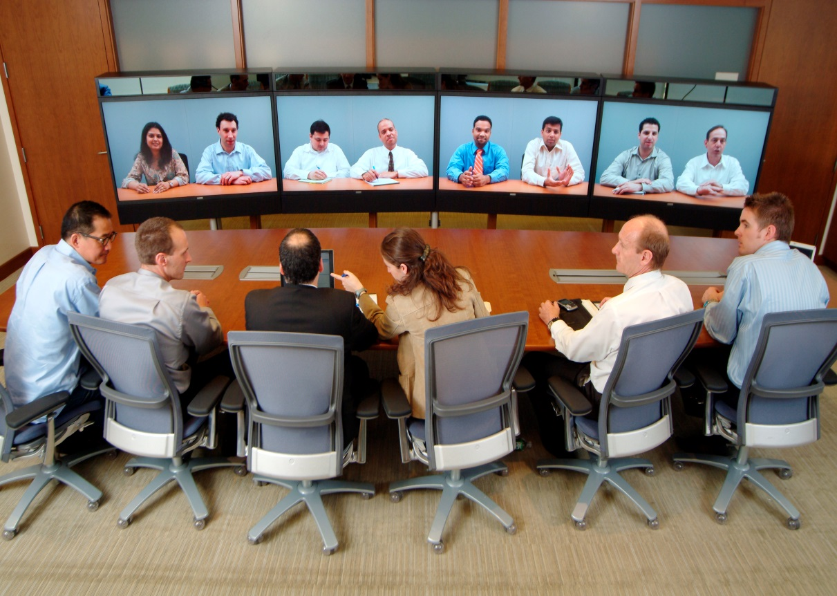
Video Conferencing
Real-Time Conferencing - refers to a service that allows conferencing events to be shared with remote locations.
Examples of Real-Time Conferencing:
Voice-over-IP
Internet Telephony

Slide 20
Content Delivery
The Internet used to be all about communication, like the telephone network. Since the
Web grew up, however, the Internet has become more about content than communication.
The switch to content has been so pronounced that the majority of Internet
bandwidth is now used to deliver stored videos.
Content Distribution Networks or CDN’s consist of a distributed collection of machines spread across the Internet that serve content to clients
Peer to Peer networks or P2P are made up of a collection of computers that pool their resources to serve content to each other without separate servers or a central point of control

Slide 21
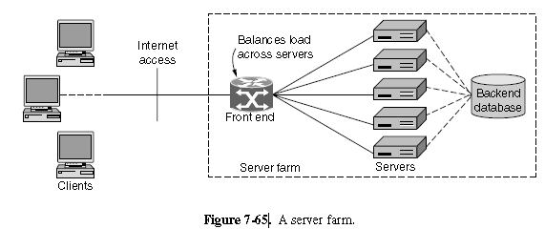
Server Farms
No matter how much bandwidth one machine has, it can only serve so many Web requests before the load is too great. The solution in this case is to use more
than one computer to make a Web server. This leads to the server farm model of

Slide 22
Server Farms
Server farms are clusters of computers that act as a single server so that many more web requests can be served than with a single machine
The problem with the server farm model is that it must appear to be a single logical Web site to client computers
One solution is to use DNS to distribute client requests
When a DNS request is made for the Web URL, the DNS server returns a rotating list of the IP addresses of the servers
Each client tries one IP address typically the first on the list and the result is that different clients contact different servers to contact the same website

Slide 23
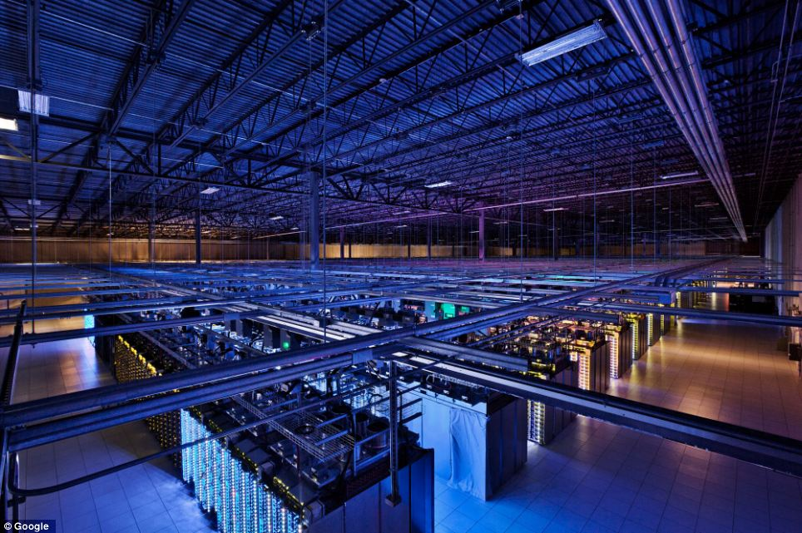

Slide 24
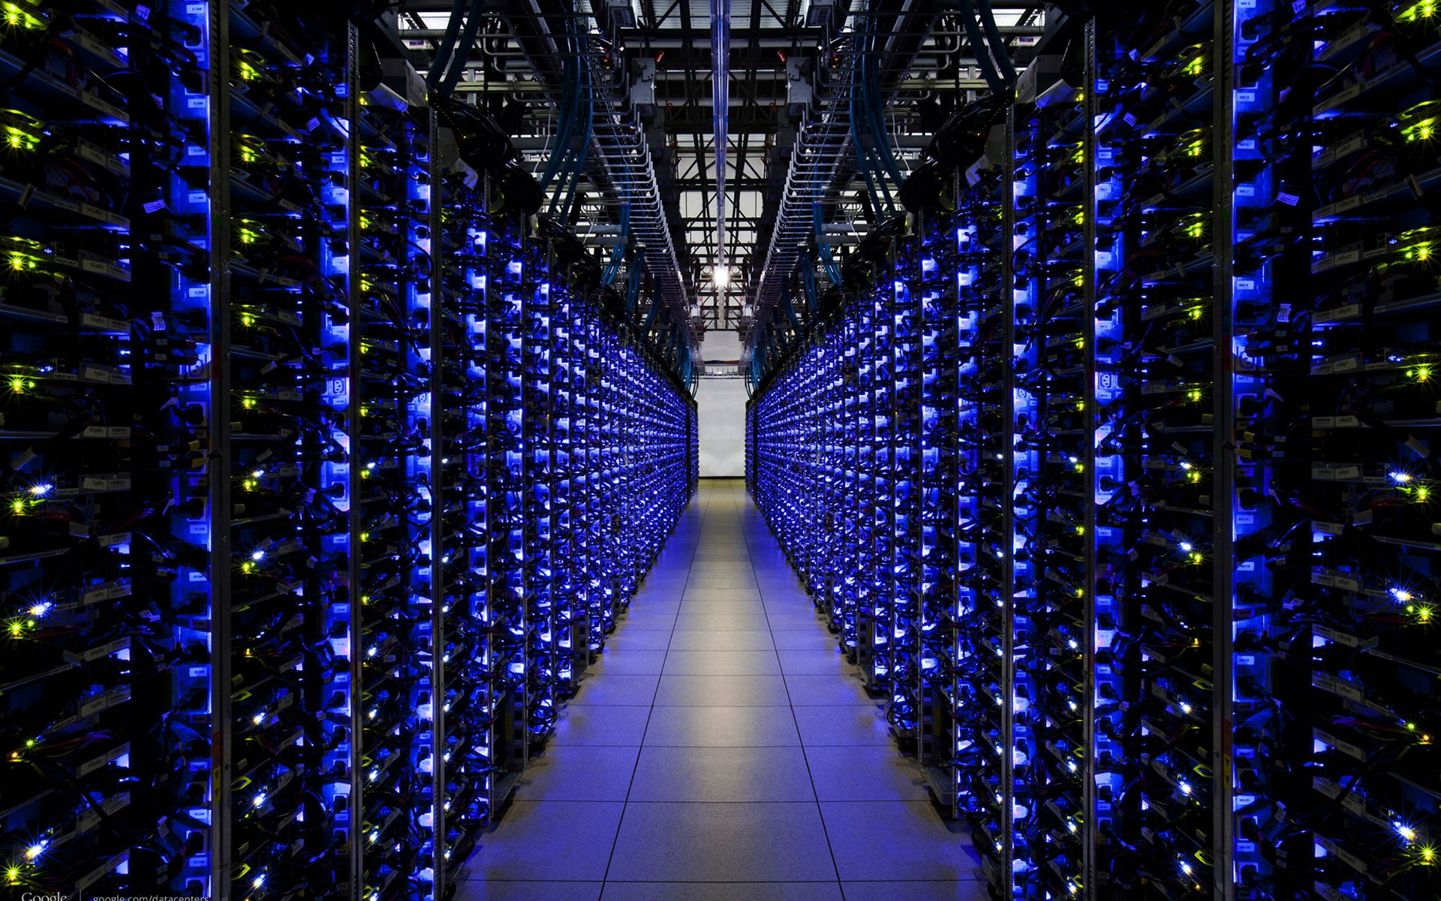
Amazon Server Farm

Slide 25
Caching
Caching improves performance by shortening the response time and reducing the network load
The best a browser can do is to cache all of the web pages that the user has previously visited
One method of making caching more effective is by sharing the cache among many users
A page which has been fetched for one user can be returned to another user when that user makes the same request
Without browser caching users would need to fetch the page from the server

Slide 26
Web Proxy
A web proxy is used to share a cache among users and since it is shared across users it has a substantially larger cache than a browser
When a proxy is used it is common for an organization (a company or an ISP) to operate one Web proxy for all of its users
The use of a Web proxy speeds up web requests for its users and reduces bandwidth speeds

Slide 27
Web Proxy
To use the proxy each browser is configured to make page requests to the proxy instead of to the pages real server
If the proxy has the page it is immediately returned and it fetches the page from the server if it does not
When the page is fetched from the server it is added to the cache for future use and returned to the client that requested it
Clients perform their own caching so the proxy is only consulted after the browser has tried to satisfy the request from its own cache

Slide 28
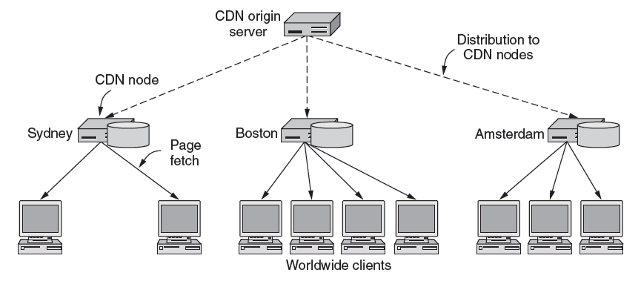
Content Distribution Networks (CDN)
Although server farms and Web proxies are sufficient for the construction of large websites and performance improvement they are inadequate for the most popular websites
For those websites Content Distribution Networks are needed to place a copy of the page in a set of nodes at different locations and direct the client to use a nearby node as the server

Slide 29
Content Distribution Networks
Most companies do not build their CDN but instead use the services of a CDN provider to make their site perform faster
The entry pages of a website are hosted by a content owner and the content is hosted by the CDN
Another advantage of using a CDN is that episodes of rapid future demand known as flash crowds can cause websites to crash and having a CDN gives a site extra emergency capacity

Slide 30
P2P (Peer to Peer) Networks
Peer to Peer file sharing networks consist of many computers pooling their resources to form a content distribution system
The computers are called peers because each one can alternately act as a both a client and server to a peer
Most of the computers on peer to peer networks are just ordinary home computers and there is no central point of control

Slide 31
P2P (Peer to Peer) Networks vs. Server

Slide 32
P2P (Peer to Peer) Networks
Peer to Peer networks have an enormous capacity to distribute content
A P2P network made up of N average users each with a broadband connectivity at 1 Mbps will have an aggregate upload and download capacity of N x Mbps
Each user can upload and download at the same time because they each have a 1 Mbps link in each direction

Slide 33
BitTorrent
Every content provider creates a content description called a torrent which is a file that contains:
The name of a tracker which is a server that leads peers to the content of the torrent
A list of equal sized pieces or chunks that make up the content
To download torrent content a peer contacts the tracker for the torrent which contains a list of all the other peers that are actively downloading and uploading content
This set of peers is called a swarm and they contact the tracker regularly to report that they are still active and also when they leave the swarm

Slide 34
BitTorrent
When a swarm is first formed some peers known as seeders must have all of the chunks that make up the content
While a peer participates in a swarm it simultaneously downloads chunks that it is missing from other peers and uploads chunks that it has to other peers who need them
Peers can leave the swarm and return at any time

Slide 35
Distributed Hash Tables or Structured Peer to Peer Networks
The traditional form of BitTorrent uses peer to peer transfers and a centralized tracker for each swarm
Distributed Hash Tables were created to solve the problem of creating distributed indexes that performed well
This means each node keeps only a small amount information about other nodes
Each node can look up entries in the index quickly and at the same time
The tracker is hard to decentralize in a P2P system because it would take too much effort to keep the indexes of all peers up to date
The use of the term hash table refers to the fact that the basic functionality of an index is to map a key to a value which is like a hash table

Slide 36
Distributed Hash Tables
In the DHT solution known as Chord the overall index is a listing of all of the swarms that a computer may join to download content
The key used to look up the index is the torrent description of the content
The key uniquely identifies a swarm from which content can be downloaded as the hashes of all the content chunks
The value stored in the index for each key is the list of peers (computers) that make up the swarm

Slide 37
Thank You.

