Slide 1
Streaming Audio and Video Content Delivery

Slide 2
7.4 Streaming Audio and Video
Web applications and the mobile Web are not the only exciting developments in the use of networks. For many people, audio and video are the holy grail of networking. When the word ‘‘multimedia’’ is mentioned, The former see immense technical challenges in providing voice over IP and video-on-demand to every computer. The latter see equally immense profits in it.
While the idea of sending audio and video over the Internet has been around since the 1970s, it is only since roughly 2000 that real-time audio and real-time video traffic has grown.

Slide 3
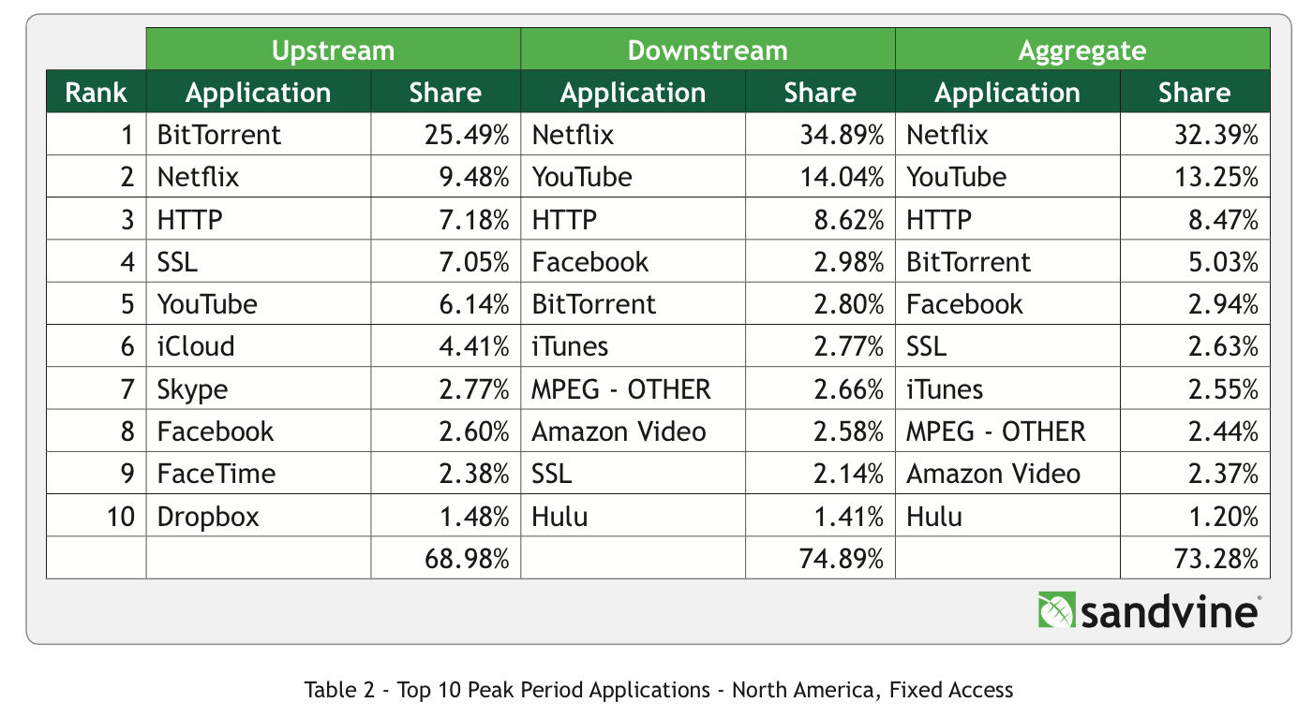

Slide 4
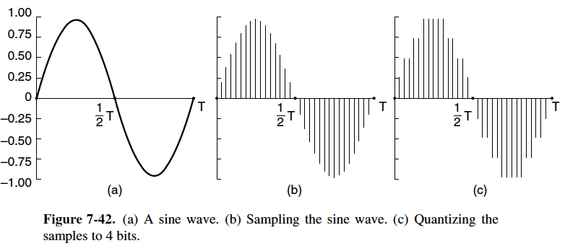
7.4.1 Digital Audio
Audio waves can be converted to digital form by an ADC (Analog-to-Digital Converter).
An ADC takes an electrical voltage as input and generates a binary number as output.

Slide 5
7.4.1 Digital Audio
The reverse process takes digital values and produces an analog electrical voltage.
It is done by a DAC (Digital-to-Analog Converter).
A loudspeaker can then convert the analog voltage to acoustic waves so that people can hear sounds.

Slide 6
7.4.1 Digital Audio con’t
Digital samples are never exact, The samples of Fig. 7-42(c) allow only nine values, from −1.00 to +1.00 in steps of 0.25.
An 8-bit sample would allow 256 distinct values.
A 16-bit sample would allow 65,536 distinct values.
The error introduced by the finite number of bits per sample is called the quantization noise.
If it is too large, the ear detects it.

Slide 7
Quantization noise Example
https://youtu.be/_cRFBBnUFug?t=37

Slide 8
Question?
WHAT IS THE NUMBER ONE DOWNSTREAM APPLICATION USED ON THE INTERNET?

Slide 9
7.4.2 Digital Video
The simplest digital representation of video is a sequence of frames, each consisting of a rectangular grid of picture elements, or pixels.
Each pixel can be a single bit, to represent either black or white.
The next step up is to use 8 bits per pixel to represent 256 gray levels.
This scheme gives high-quality ‘‘black-and-white’’ video.

Slide 10
7.4.2 Digital Video
For color video, many systems use 8 bits for each of the red, green and blue (RGB) primary color components.
This representation is possible because any color can be constructed from a linear superposition of red, green, and blue with the appropriate intensities.
With 24 bits per pixel, there are about 16 million colors, which is more than the human eye can distinguish.

Slide 11
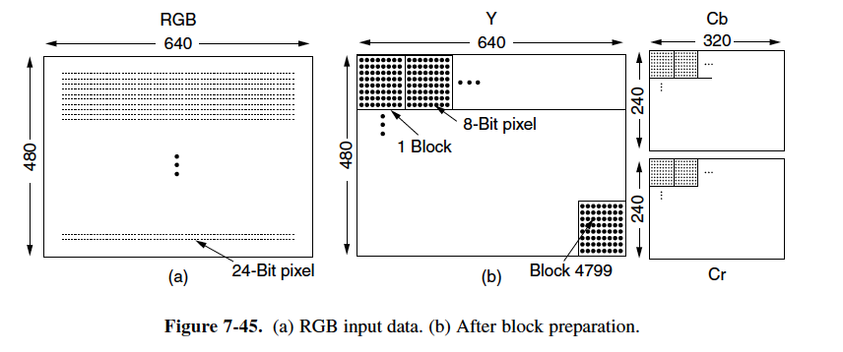
7.4.2 Digital Video

Slide 12
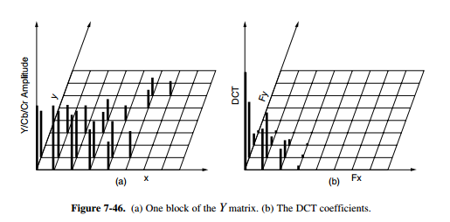
7.4.3 Streaming Stored Media

Slide 13
7.4.3 Streaming Stored Media con’t
The most common example is watching videos over the internet
Other forms of Video on Demand use a provider network that is separate from the Internet to deliver the movies (i.e. the cable network).
To get around long download times sites link to a metafile, a very short file just naming the movie. Example: rtsp://joes-movie-server/movie-0025.mp4

Slide 14
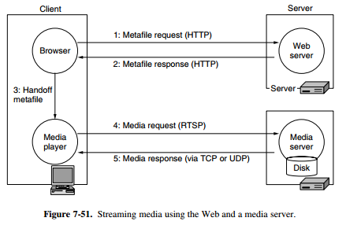
7.4.3 Streaming Stored Media con’t
The browser gets the page as usual in steps 1 & 2 (which is now a one-line file.
It starts the media player and hands it the one-line file in step 3.
The media player reads the metafile and sees the URL of where to get the movie. It contacts the server and asks for the movie in step 4.
The movie is streamed back to the media player in step 5.

Slide 15
7.4.4 Streaming LIve Media
Live streaming is used for an online presence by major television stations (IPTV) and for broadcasting radio radio stations (Internet Radio).
Both IPTV and Internet radio reach audiences worldwide for events ranging from fashion shows to World Cup soccer
Live streaming over IP is used as a technology by cable providers to build their own broadcast systems.

Slide 16
7.5 Content Delivery
The internet used to be all about communication. Now it has become more about content than communication.
FACT: It is believed YouTube accounts for up to 10% of Internet traffic.
Researches have developed two architectures for bandwidth distribution:
CDN (Content Distribution Network) - a provider sets up a distributed collection of machines at locations inside the Internet and uses them to serve content to clients
P2P (Peer-to-Peer) - a collection of computers pool their resources to serve content to each other, without separately provisioned servers or any central point of control.

Slide 17
7.5.1 Content and Internet Traffic
There are a small number of websites with massive traffic and a vast number of web sites with smaller traffic.
Packet Trains - the idea being that express trains with a large number of packets would suddenly travel down a link.
Long packet flow are described as elephants and short traffic flows as mice--the idea being that there are only a few elephants and many mice, but the elephants matter because they are so big.
Zipf’s Law - noted that the frequency of a word’s usage in a large body of text is inversely proportional to its rank. Example: the 40th most common word is used twice as much as the 80th most common word

Slide 18
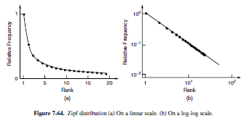
7.5.1 Content and Internet Traffic

Slide 19
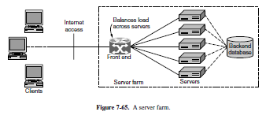
7.5.2 Server Farms and Web Proxies
A machine can only serve so many Web requests before the load is too great, the solution to this problem is a server farm i.e. use more than one computer to make a web server
Load balancing is used to balance the workload across the servers

Slide 20
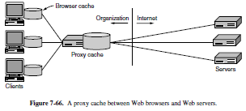
7.5.2 Server Farms and Web Proxies
Caching improves performance by shortening the response time and reducing the network load; a way to cache more effective is to share the cache among multiple users
A web proxy is used to share a cache among users. A proxy is an agent that acts on behalf of someone else. In this case, a web proxy fetches web requests on behalf of users

Slide 21
7.5.3 Content Delivery Networks
Server farms and web proxies help to build large sites and improve web performance, but they are not sufficient for truly popular websites
CDNs (Content Delivery Networks) - instead of having clients look for a copy of the requested page in a nearby cahec, it is the provider who places a copy of the page in a set of nodes at different location and directs the client to use a nearby node as the server; CDNs use a tree structure that yields three benefits:
The content distribution can be scaled up to as many clients as needed by using more nodes in the CDN, and more levels in the tree when the distribution among CDN Nodes becomes the bottleneck
Each client gets good performance by fetching pages from a nearby server instead of a distant server
The total load is placed on the network is also kept to a minimum.
Flash crowds - surges in demand i.e. when Apple releases an update
How to combat?: CDNs can quickly scale up a site’s serving capacity

Slide 22
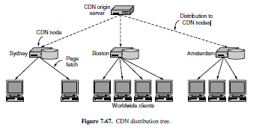
7.5.3 Content Delivery Networks

Slide 23
7.5.4 Peer-to-Peer Networks
Not everyone can afford to set up a 1000-node CDN at locations around the world.
The introduction of P2P networks burst onto the scene in 1999 and their first widespread application was for mass crime: 50 million Napster users were exchanging coprighted songs without the copryright owners’ permission
Basic idea of P2P file-sharing networks is that many computers come together and pool their resources to form a content distribution system
BitTorrent - protocol developed in 2001 to let a set of peers share files quickly and easily
DHTs (Distributed Hash Tables) or Structured P2P networks - solution to issues with P2P; basic funcionality of an index is to map a key to a value; a hash is used to help create a node identifier

Slide 24
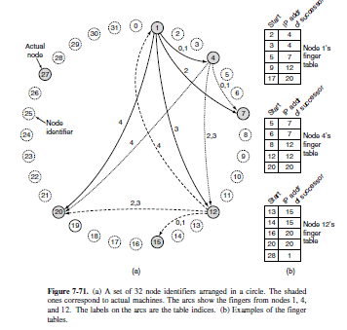
7.5.4 Peer-to-Peer Networks

Slide 25
Video Time!
What is CDN and How Does it Work?
https://www.youtube.com/watch?v=nle1q0qSYmA

Slide 26
7.4.2 Digital Video

Slide 27
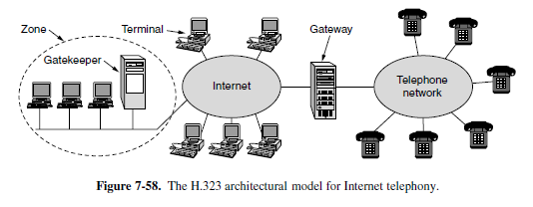
7.4.5 Real-Time Conferencing

Slide 28
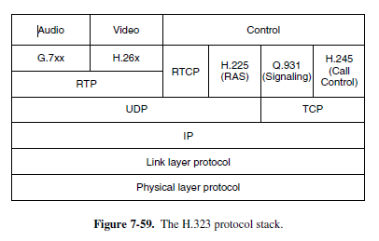
7.4.5 Real-Time Conferencing

Slide 29
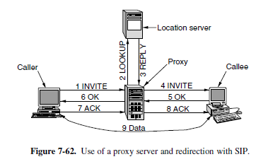
7.4.5 Real-Time Conferencing

Slide 30
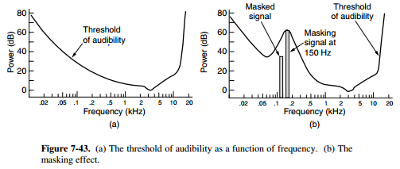
7.4.1 Digital Audio

