Slide 1
Streaming Audio and Video, Content Delivery
Group 8:
Paras Rayamajhi, Ria Mahajan, Paul Jones, Priyanksinh Kapletiya, Ranim Almudairees

Slide 2
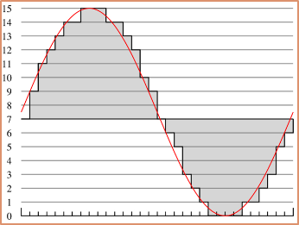
Digital Audio
Digital audio is sound reproduction using pulse-code modulation and digital signals.
It is a one-dimensional acoustic (pressure) wave.
The frequency range of the human ear runs from 20Hz to 20,000 Hz
Audio waves can be converted to digital form by an ADC (Analog to Digital Converter)
Digital audio is useful in the recording, manipulation, mass-production, and distribution of sound.
The error introduced by the finite number of bits per sample is called the quantization noise.
Some popular formats are :
MP3 (MPEG audio layer 3)
AAC (Advanced Audio Coding)
MP4 (MPEG-4)

Slide 3
Digital Video
Image frames comprise the video (A moving pictures).
Digital video is recorded digitally, as ones and Zeros.
Since it is stored in a digital format, digital video can be recognized and edited by a computer, which is also a digital device.
Frame rate = presentation of successive frames
Minimal image change between frames
Frequency of frames is measured in frames per second [fps].
Sequencing of still images creates the illusion of movement
Using 8 bits allows us to use shades of gray for the pixels.

Slide 4
Question?
The error introduced by the finite number of bits per sample is called______ ?
Quantization noise
Sampling rate
Signal Noise
Distortion

Slide 5
Streaming
A method of delivering an audio signal to your computer over the Internet. The data is constantly being delivered to the user as its being provided by the provider.
Rather than loading videos entirely before they are loaded, we use metafiles, things that point to where we can access the video from.
Video players have jobs to do – mainly dealing with errors, decompressing, and eliminating jitter.
For error handling, we attach parity packets to the end of our information, which duplicates the data.

Slide 6
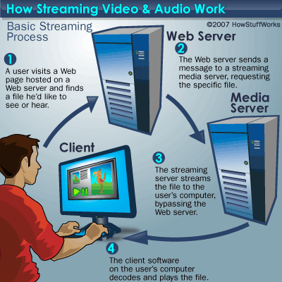
Streaming Stored media
Examples: 1-Pre-recorded songs 2-Famous lectures 3-Video on demand 4-RealPlayer 5-Netshow 6-interactivity includes pause, ff , rewind 7-Delays of 1 to 10 seconds or so 8-Not so sensitive to jitter 9-Apple Itunes 10-Amazon instant video

Slide 7
Question?
What is an example of Streaming Stored media?

Slide 8
Streaming Live Media
Today, people and companies stream all sizes of live audio and video.
Live streaming is used for online presence by major television stations called IPTV (IP Television).
Internet Radio - is an audio service transmitted via the Internet.
Podcast - viewers can connect to a server’s archives, pull up any program, and download it for listening

Slide 9
Approaches
Record programs to disk- Let viewers connect to server and access a program
Like streaming media
Broadcast live over the Internet
Just TV but can you can rewind or pause
Multicast
one-to-many delivery service
Server sends each media packet once using IP multicast to a group address. The network then delivers a copy of the packet to each member of the group.

Slide 10
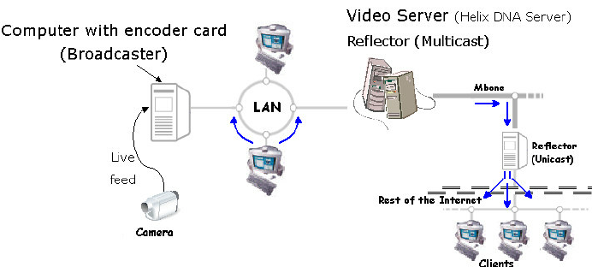
Live video streaming diagram

Slide 11
How Video Streaming Works

Slide 12
Question?
What is the disadvantage of live streaming over TCP ?
Notes:
the server must send a separate copy of the media for each client.

Slide 13
Real Time Conferencing
VoIP services are provided by:
Regular phone lines
Or through computers connected through the internet
Can be more constrained.
Requires far less latency than other services.
UDP is favored over TCP, since TCP uses a round trip
Smaller packet size will be faster than larger packet sizes.
Packets that take too long, lead to “jitter.”
Differentiated Services required.
Sufficient Bandwidth will be necessary due to the smaller packet sizes.
Requires 150ms to prevent delays.
Notes:
Jones begins

Slide 14
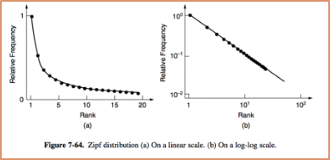
Content and Internet Traffic
The Internet used to be all about communication, like the telephone network
Since the web grew the Internet has become more about content than communication.
The switch to content has been so major that the majority of Internet bandwidth is now used to deliver stored videos.

Slide 15
Server Farms
Server farms are clusters of computers that act as a single server so that many more web requests can be served than with a single machine
Problem:
Set of computers must look like a single logical website to clients.
Solution
Use DNS to distribute client requests
When a DNS request is made for the Web URL, the DNS server returns a rotating list of the IP addresses of the servers
Notes:
Jones ends

Slide 16
Question
What are server farms and why are they necessary?

Slide 17
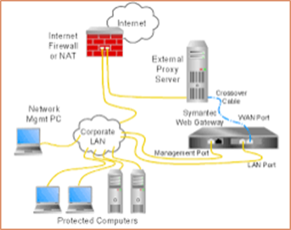
Web Proxy
A web proxy is used to share a cache among users and since it is shared across users it has a substantially larger cache than a browser
Problem:
Loading web sites from various servers takes time.
Solution:
Cache responses and reuse them to answer future requests.

Slide 18
Web Proxy
What is the Effect?
Caching improves performance by shortening the response time and reducing the network load.
Limitations: Shared caching is beneficial until the number of users reaches the size of a small company (100 people).
Too many unpopular requests and one time visits cannot be cached due to lack of storage space.

Slide 19
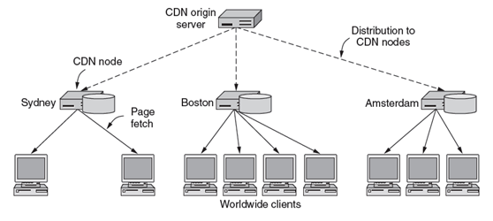
Content Delivery Networks
System of distributed servers that deliver web content based on the location of the user. CDN’s use a structure that has three levels
an origin server, a node, and worldwide clients.
To support a CDN, we can use either a web proxy, mirroring, or DNS redirection.

Slide 20
Content Distribution Networks
Most companies do not build their CDN but instead use the services of a CDN provider to make their site perform faster
The entry pages of a website are hosted by a content owner and the content is hosted by the CDN
Advantage of using a CDN
episodes of rapid future demand (“flash crowds”) can cause websites to crash
having a CDN gives a site extra emergency capacity

Slide 21
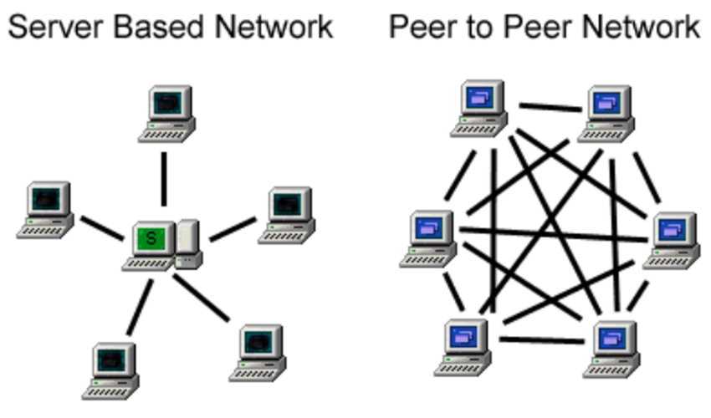
P2P (Peer to Peer) Networks
Consist of many computers pooling their resources to form a content distribution system
The computers are called peers because each one can alternately act as a both a client and server to a peer
Most of the computers on peer to peer networks are just ordinary home computers and there is no central point of control

Slide 22
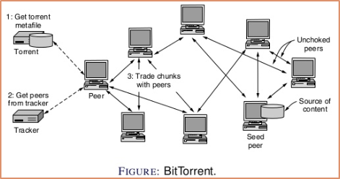
Peer-To-Peer Networks
Peer-to-Peer networks are self-scaling, meaning their usable upload capacity grows in tandem with download demands from their users.
Commonly used because CDN’s have large amounts of personal information about many people, which can then be used to provide a better service.
More efficient with popularity.

Slide 23
Question?
What consist of many computers pooling their resources to form a content distribution system
Peer to Peer Networks
CDN’s
Web Proxy
Server Farms

Slide 24
The End
Any questions while we load our code?

