Slide 1
Authentication
Protocols

Slide 2
Authentication
Authentication is the technique by which a process verifies that its communication partner is who it is supposed to be and not an imposter.
Verifying the identity of a remote process in the face of a malicious, active intruder is difficult and requires complex protocols.

Slide 3
Types of Protocols
Challenge-Response: One party sends a random number to the other, who then transforms it in a special way and returns the result.
Diffie-Helman key exchange: Allows strangers to establish a shared secret key.
Needham-Schroeder: refers to one of the two communication protocols intended for use over an insecure network, both proposed by Roger Needham and Michael Schroeder
- Symmetric Key: establishes a session key between two parties on a network, typically to protect further communication.
- Public Key: intended to provide mutual authentication between two partied communicating on a network, but its proposed form is insecure.

Slide 4
Email Security

Slide 5
E-mail Security
PGP is a widely used secure e-mail system that encrypts data by using a block cipher called IDEA (International Data Encryption Algorithm.)
Since PGP supports text compression, secrecy, and digital signatures, and also provides extensive key management facilities, but not e-mail facilities.

Slide 6
Understanding Private and Public Key Rings with E-mail Security
Key management is considered the “Achilles’ heel” of security systems.
There is private key ring which contains one or more personal private/public key pairs. Meaning by supporting multiple pairs, the messages that are currently in preparation or transit won’t be invalidated if one is compromised or thought to be compromised.

Slide 7
Understanding Private and Public Key Rings with E-mail Security
--continue
Public key ring contains public keys of the users correspondents.

Slide 8
Web Security

Slide 9
Web security can be roughly divided into three parts:
First, how are objects and resources named securely?
Second, how can secure, authenticated connections be established?
Third, what happens when a Web site sends a client a piece of executable code?

Slide 10
Threats
Secure Naming
SSL—the Secure Sockets Layer
Mobile Code Security

Slide 11
Threats
All of the following can be used to compromise your system:
Packet sniffers
IP weakness
Password attacks
Dos or DDos
Man-in-the-middle attacks
Application layer attacks
Trust exploitation
Port redirection
Virus
Trojan horse
Operator error
Worms

Slide 12
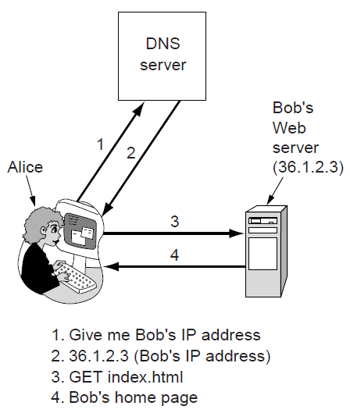
Secure Naming
Normal situation

Slide 13
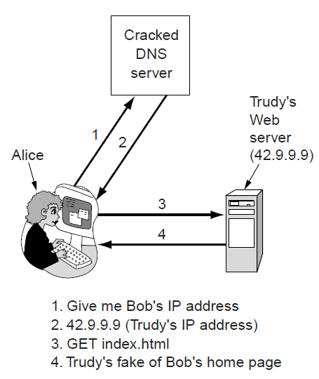
Secure Naming
An attack based on breaking into DNS
and modifying Bob’s record.

Slide 14
Secure Naming
Tricking a DNS server into installing a false IP address is called DNS spoofing.
A cache that holds an intentionally false IP address like this is called a poisoned cache.

Slide 15
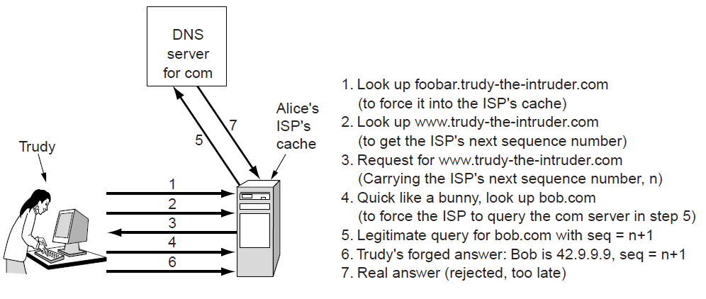
Secure Naming
How Trudy spoofs Alice’s ISP.

Slide 16
Secure DNS
in 1994 IETF set up a working group to make DNS fundamentally secure. This (ongoing) project is known as DNSsec (DNS security);
Its first output was presented in RFC 2535.
Unfortunately, DNSsec has not been fully deployed yet, so numerous DNS servers are still vulnerable to spoofing attacks.

Slide 17
Secure DNS
DNSsec is conceptually extremely simple. It is based on public-key cryptography.
Every DNS zone has a public/private key pair. All information sent by a DNS server is signed with the originating zone’s private key, so the receiver can verify its authenticity.
DNSsec offers three fundamental services:
1. Proof of where the data originated.
2. Public key distribution.
3. Transaction and request authentication.

Slide 18
Secure DNS
DNS records are grouped into sets called RRSets (Resource Record Sets), with all the records having the same name, class, and type being lumped together in a set.

Slide 19
Secure DNS
An example RRSet for bob.com. The KEY record is Bob’s public key. The SIG record is the top-level com server’s signed hash of the A and KEY records to verify their authenticity.

Slide 20
SSL – The Secure Socket Layer
Before long, some companies got the idea of using it for financial transactions.
These applications created a demand for secure connections.
In 1995, Netscape Communications Corp., the then-dominant browser vendor, responded by introducing a security package called SSL (Secure Sockets Layer) to meet this demand.
What is SSL?

Slide 21
SSL – The Secure Socket Layer
SSL builds a secure connection between two sockets, including:
1. Parameter negotiation between client and server.
2. Authentication of the server by the client.
3. Secret communication.
4. Data integrity protection.

Slide 22
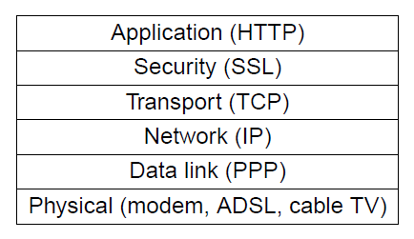
The positioning of SSL in the usual protocol stack
Layers (and protocols) for a home user browsing with SSL.

Slide 23
SSL – The Secure Socket Layer
SSL consists of two subprotocols:
one for establishing a secure connection
and one for using it.

Slide 24
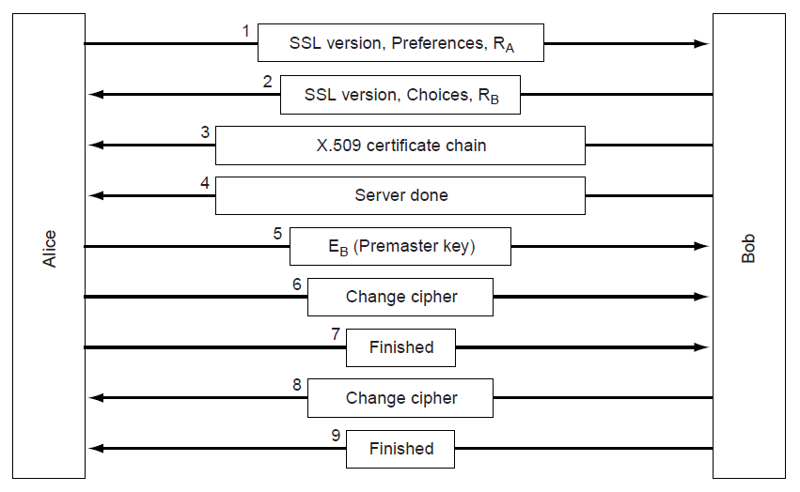
A simplified version of the SSL connection establishment subprotocol.

Slide 25
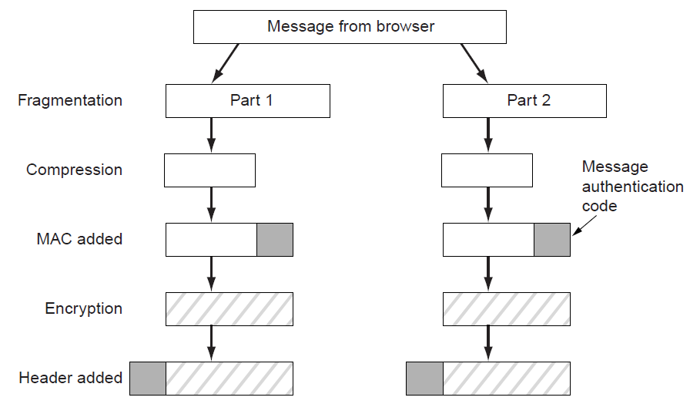
Data transmission using SSL

Slide 26
SSL – The Secure Socket Layer
A problem with SSL is that the principals may not have certificates, and even if they do, they do not always verify that the keys being used match them.
In 1996, Netscape Communications Corp. turned SSL over to IETF for standardization. The result was TLS (Transport Layer Security). It is described in RFC 5246.
TLS was built on SSL version 3. The changes made to SSL were relatively small, but just enough that SSL version 3 and TLS cannot interoperate.

Slide 27
Mobile Code Security
In the early days, when Web pages were just static HTML files, they did not contain executable code. Now they often contain small programs, including Java applets, ActiveX controls, and JavaScripts.
Downloading and executing such mobile code is obviously a massive security risk, so various methods have been devised to minimize it.

Slide 28
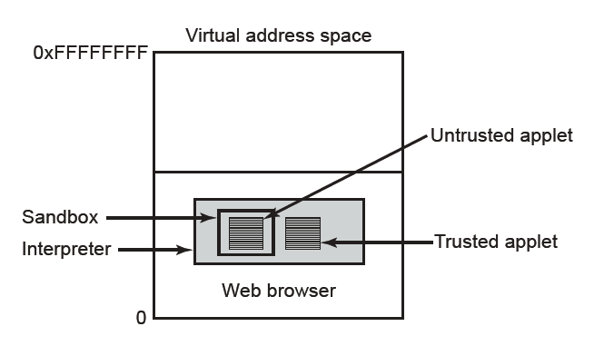
Mobile Code Security
Java applets are small Java programs compiled to a stack-oriented machine language called JVM (Java Virtual Machine).
Applets can be interpreted by a Web browser

Slide 29
Mobile Code Security
ActiveX controls are x86 binary programs that can be embedded in Web pages.
The method that Microsoft chose for making this decision is based on the idea of code signing. Each ActiveX control is accompanied by a digital signature—a hash of the code that is signed by its creator using public-key cryptography.
The Microsoft system for verifying ActiveX controls is called Authenticode.
JavaScript does not have any formal security model, but it does have a long history of leaky implementations. Each vendor handles security in a different way.
The fundamental problem is that letting foreign code run on your machine is asking for trouble.

Slide 30
Mobile Code Security
As well as extending Web pages with code, there is a booming marketplace in browser extensions, add-ons, and plug-ins. They are computer programs that extend the functionality of Web browsers.
Viruses are another form of mobile code. Only, unlike the examples above, viruses are not invited in at all.
The difference between a virus and ordinary mobile code is that viruses are written to reproduce themselves.

Slide 31
Social Issues

Slide 32
Privacy
Freedom of Speech
Copyright

Slide 33
Privacy
In the 1990s, some critics of a nontraditional religious group posted their views to a USENET newsgroup via an anonymous remailer. This server allowed users to create pseudonyms and send email to the server, which then remailed or re-posted them using the pseudonyms, so no one could tell where the messages really came from.
Many users who wish anonymity chain their requests through multiple anonymous remailers.

Slide 34
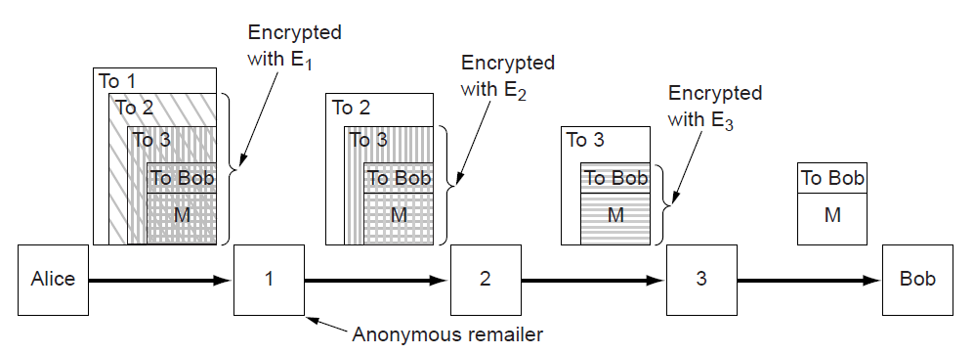
Privacy
Alice uses 3 remailers to send Bob a message

Slide 35
Freedom of Speech
Possible banned material:
1. Material inappropriate for children or teenagers.
2. Hate aimed at various ethnic, religious, sexual or other groups.
3. Information about democracy and democratic values.
4. Accounts of historical events contradicting the government’s version.
5. Manuals for picking locks, building weapons, encrypting messages, etc.

Slide 36
Copyright
Copyright is granting to the creators of IP (Intellectual Property), including writers, poets, artists, composers, musicians, photographers, cinematographers, choreographers, and others, the exclusive right to exploit their IP for some period of time, typically the life of the author plus 50 years or 75 years in the case of corporate ownership.

Slide 37
Thank You

