Slide 1
Decision Tree, Random Forest

Slide 2
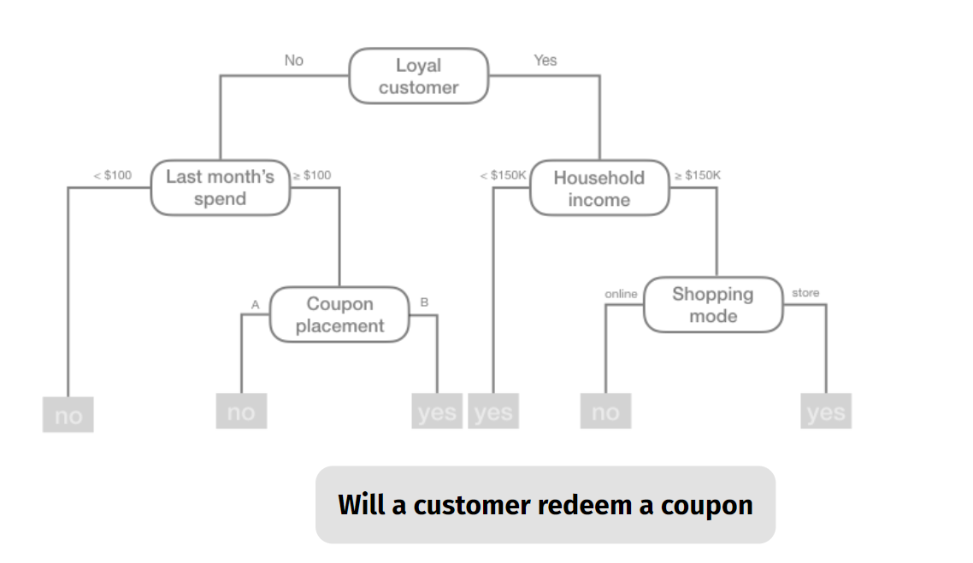
Example Decision Tree – Retail Data

Slide 3
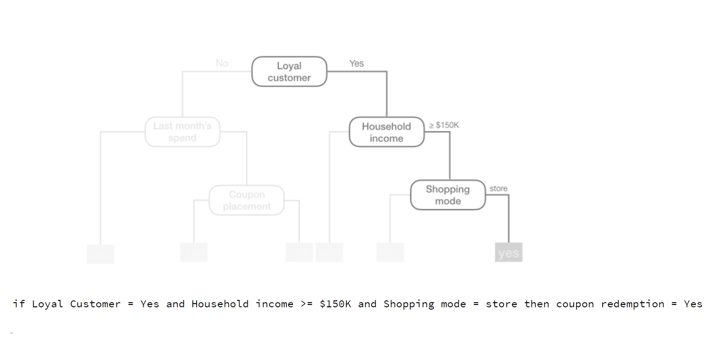
Decision Tree - Ruleset Model

Slide 4
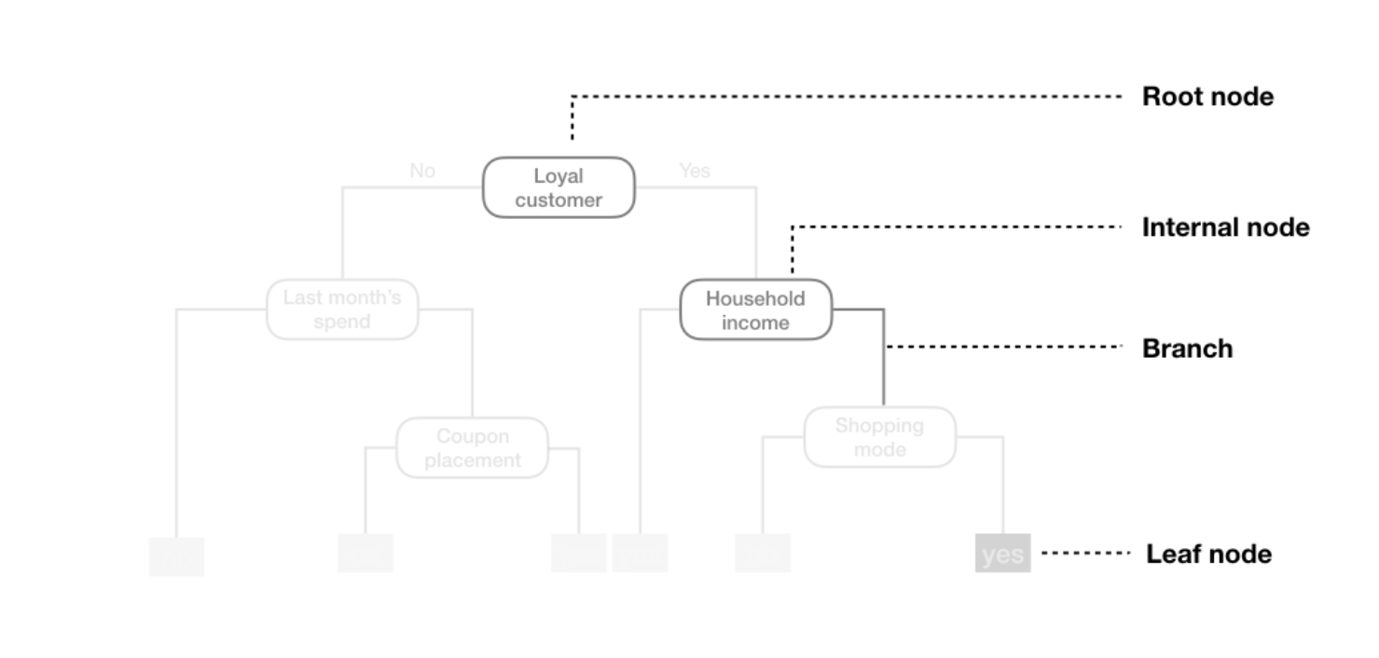
Terminology

Slide 5
Best Binary Partitioning

Slide 6
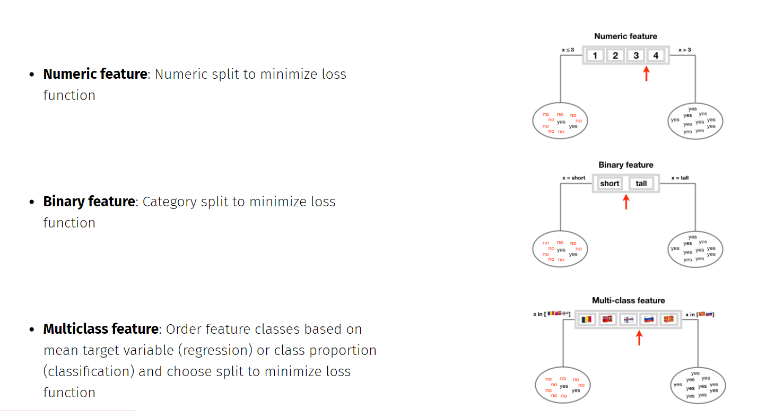
Best Binary Partitioning

Slide 7
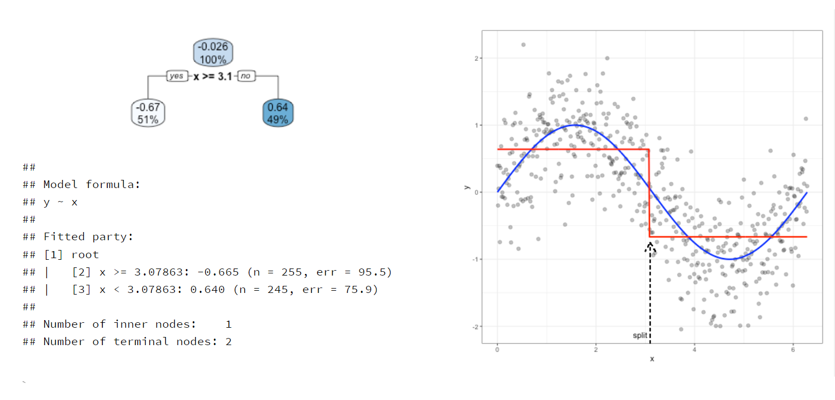
Tree Depth = 1 (Decision Stump)

Slide 8
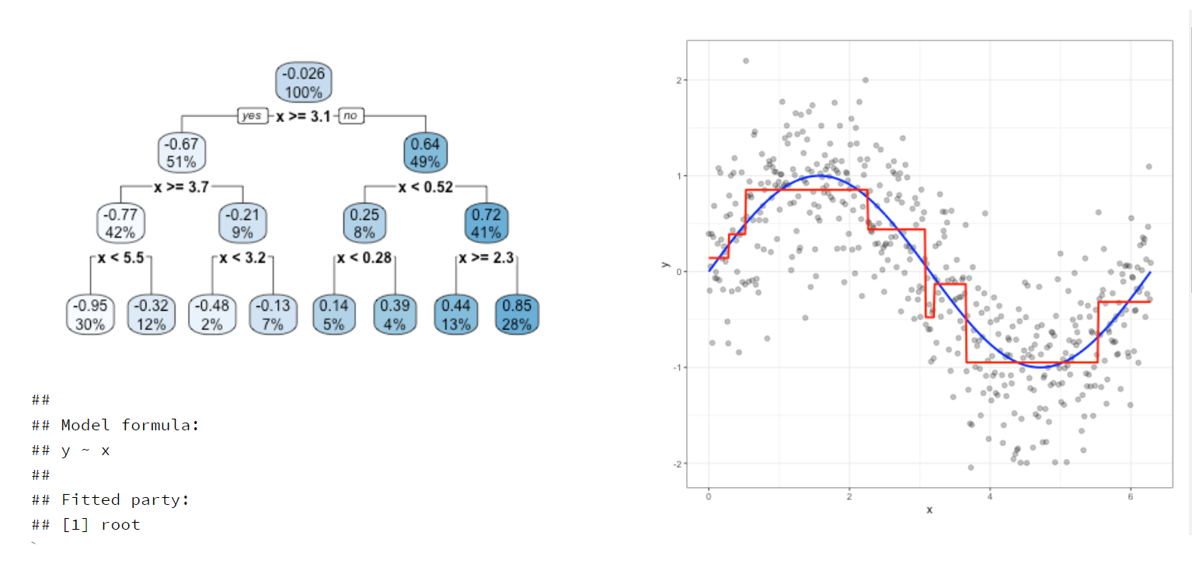
Tree Depth = 3

Slide 9
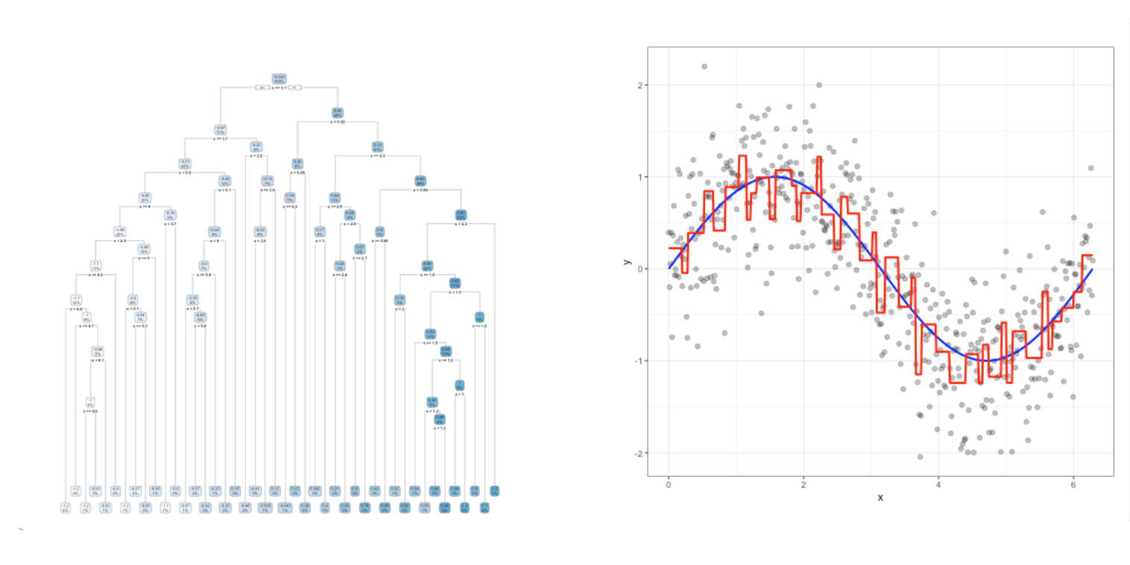
Tree Depth = 20 (Complex Tree)

Slide 10
Two Predictor Decision Boundaries

Slide 11
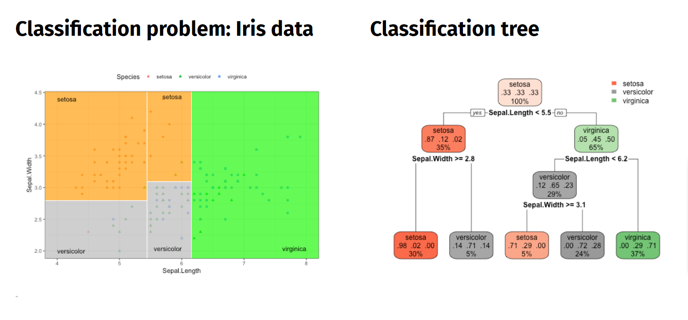
Two Predictor Decision Boundaries

Slide 12
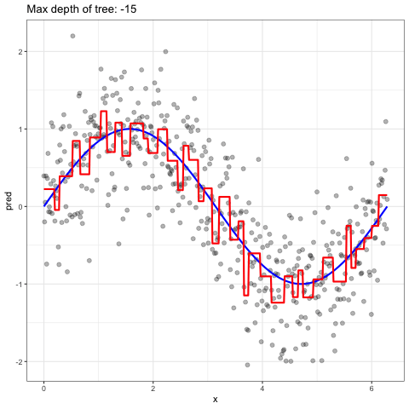
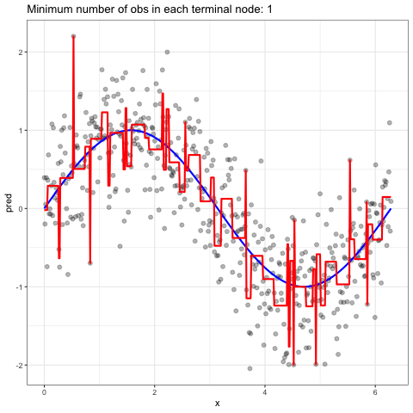
Minimize overfitting: Early stopping

Slide 13
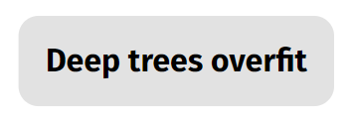
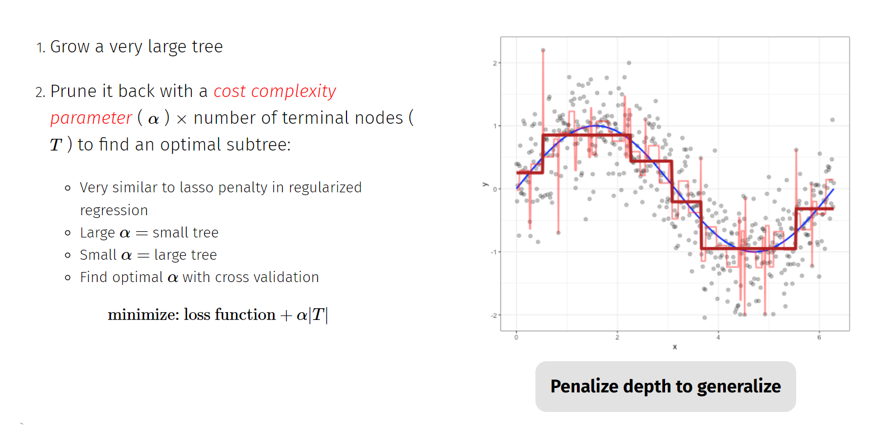
Minimize overfitting: Pruning

Slide 14
Decision Tree - Strengths & Weaknesses

Slide 15
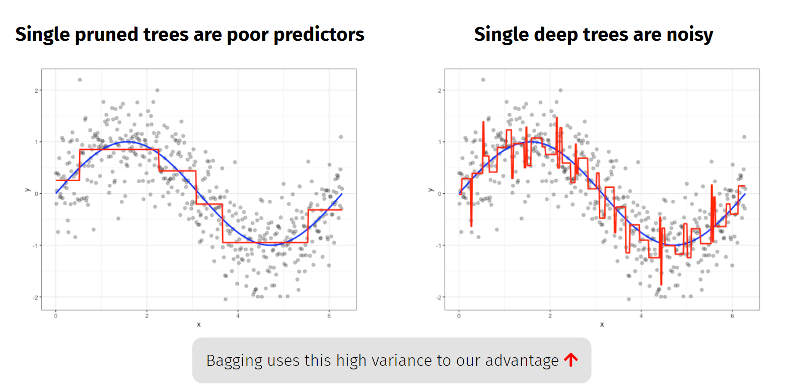
The Problem with Single Decision Trees

Slide 16
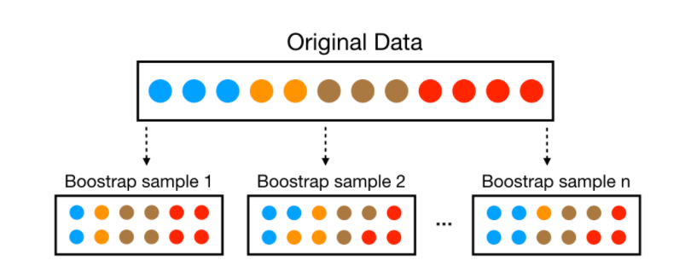
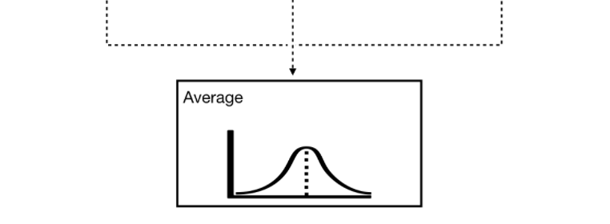
Bagging : Bootstrap Aggregating : wisdom of the crowd
1. Sample records with replacement (aka "bootstrap"
the training data)
Sampling is the process of selecting a subset of items from a vast collection of items.
Bootstrap = Sampling with replacement. It means a data point in a drawn sample can reappear in future drawn samples as well.
2. Fit an overgrown tree to each resampled data set
3. Average predictions

Slide 17
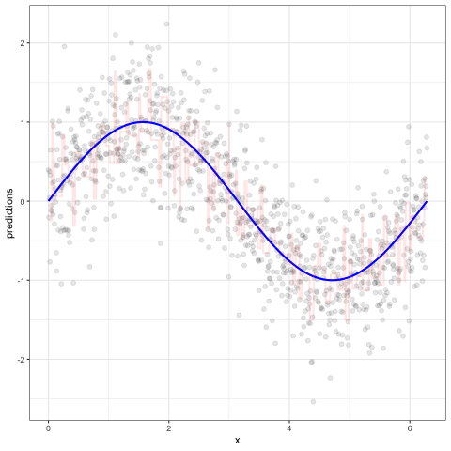
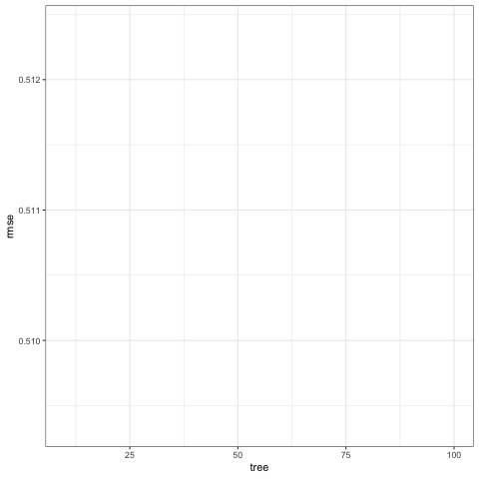
Bagging : Bootstrap Aggregating : wisdom of the crowd
As we add more trees...
our average prediction error reduces

Slide 18
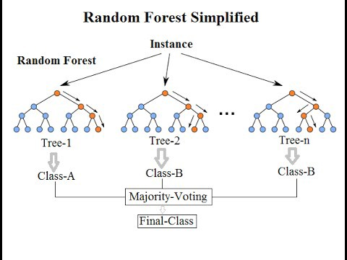
Random Forest
Random forest is identified as a collection of decision trees. Each tree estimates a classification, and this is called a “vote”. Ideally, we consider each vote from every tree and chose the most voted classification (Majority-Voting).
Random Forest follow the same bagging process as the decision trees but each time a split is to be performed, the search for the split variable is limited to a random subset of m of the p attributes (variables or features) aka Split-Attribute Randomization :
classification trees: m = √p
regression trees: m = p/3
m is commonly referred to as mtry
Random Forests produce many unique trees.

Slide 19
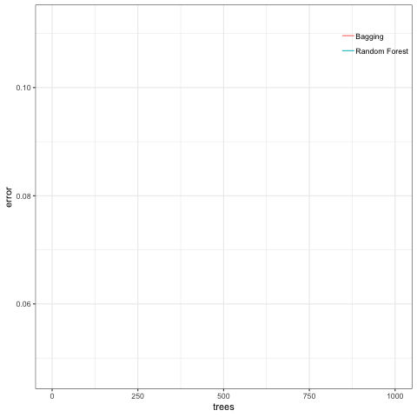
Bagging vs Random Forest
Bagging introduces randomness into the rows of the data.
Random forest introduces randomness into the rows and columns of the data
Combined, this provides a more diverse set of trees that almost always lowers our prediction error.
Split-Attribute Randomization : Prediction Error

Slide 20
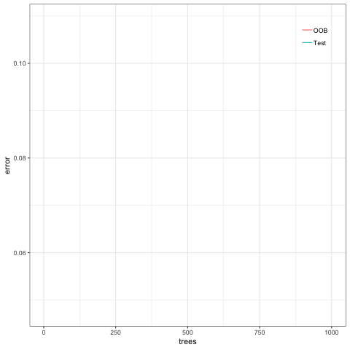
Random Forest : Out-of-Bag (OOB) Observations

Slide 21
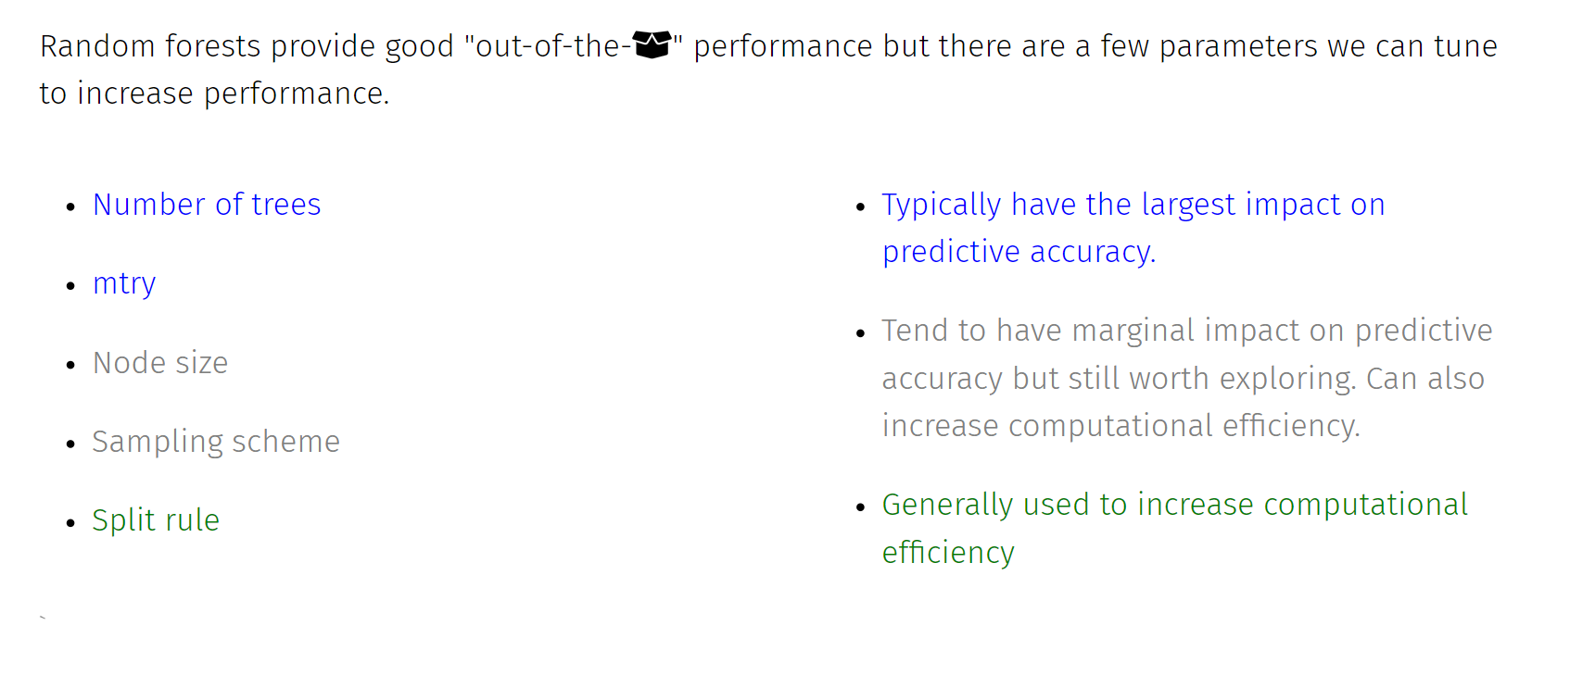
Random Forest : Tuning

Slide 22
Random Forest - Strengths & Weaknesses

