Slide 1
Association Rule Mining

Slide 2
Association Rule Mining is one of the ways to find patterns in data. It finds features(or dimensions) that occur together(or are correlated)

Slide 3
In simple terms
If…Then Condition

Slide 4
In simple terms
It is an If... Then Condition
For example, people who buy diapers are likely to buy baby powder. Or we can rephrase the statement by saying: If (people buy diaper), then (they buy baby powder). Note the if, then rule.

Slide 5
Rules do not extract an individual’s preference, rather find relationships between set of elements of every distinct transaction. This is what makes them different from collaborative filtering.

Slide 6
Association Rule Mining – Part 2

Slide 7
Rules vs Collaborative filtering
Rules do not tie back a users’ different transactions over time to identify relationships. List of items with unique transaction IDs (from all users) are studied as one group. This is helpful in placement of products on aisles.
On the other hand, collaborative filtering ties back all transactions corresponding to a user ID to identify similarity between users’ preferences. This is helpful in recommending items on e-commerce websites, recommending songs on spotify, etc.

Slide 8
Measures of Effectiveness of the Rule
Support
Confidence

Slide 9
Measures of Effectiveness of the Rule
Support:
Support means how much historical data supports your rule

Slide 10
Measures of Effectiveness of the Rule
Confidence:
Confidence means how confident are we that the rule holds

Slide 11
Examples of Association Rule Mining
People who visit webpage X are likely to visit webpage Y
People who have age-group [30,40] & income [>$100k] are likely to own home

Slide 12
Market Basket Analysis - 1

Slide 13
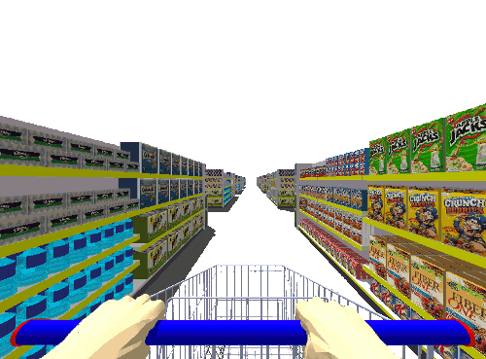
What is Market Basket Analysis?

Slide 14
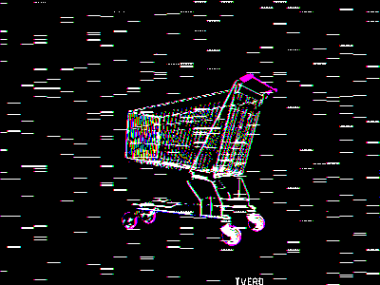
Machine Learning is now assisting the retail industry in a variety of ways. You might anticipate that machine learning (ML) has various applications in the retail industry, ranging from projecting sales performance to identifying purchasers. One of the best applications of machine learning in the retail industry is "Market Basket Analysis." We can determine which products are usually purchased jointly by clients by studying their previous purchasing activity. Market Basket Analysis is a popular example of frequent itemset mining. This technique discovers client buying behaviors by identifying links between the various goods that customers place in their "shopping baskets.".

Slide 15
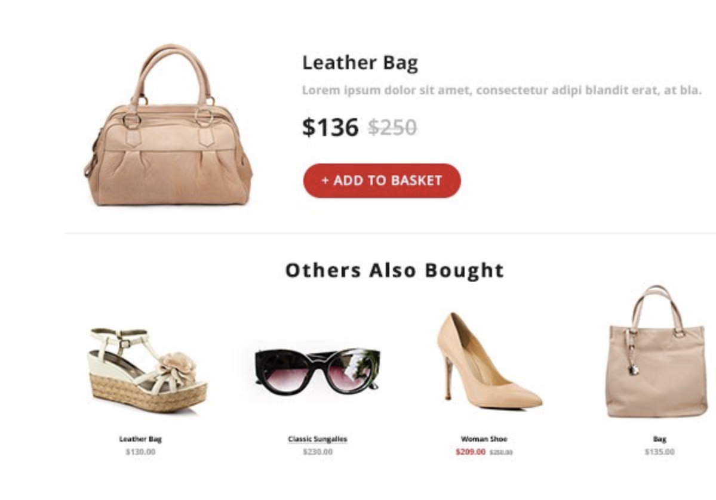
What is Association Rule Mining?
Association Rule Mining is generally utilized when you wish to detect frequent patterns in a transactional database or a relational database after identifying an association between various objects in a set (RDBMS).

Slide 16
Types of Algorithms used in Association Rule Mining
AIS
SETM Algorithm
Apriori Algorithm
FP Growth

Slide 17
AIS: The AIS algorithm creates various passes on the complete database or transactional data. It scans all transactions in each and every pass.
SETM Algorithm: This Algorithm is quite similar to the AIS algorithm. The SETM algorithm creates collective passes over the database.
FP growth algorithm: This algorithm is represented in the form a FP tree or Frequent Pattern. most frequent patterns can be using the FP tree, and this is the main use of the FP tree.
Apriori Algorithm: It is very famous, and it is also considered accurate than AIS and SETM algorithms. It is used in finding frequent item sets and used in identifying the association rules among those items.

Slide 18
References
https://medium.com/@vinujakhatode/market-basket-analysis-using-association-rule-mining-f9e479d966e9
https://www.analyticsvidhya.com/blog/2021/10/a-comprehensive-guide-on-market-basket-analysis/
https://ghumare64.medium.com/market-basket-analysis-using-association-rule-mining-2f87e4064ee7

Slide 19
Market Basket Analysis - 2

Slide 20
Advantages
Market basket Analysis(MBA) is helpful for marketing team of the organisation for taking the better decision on sales. This analysis is applied on the sales data of the customers and will help in below things
Understand customer interests and achieve better engagement.
Estimating the demand of particular products(High and low in demand)
Prioritise marketing strategies/plans.
To boost the sales in turn increasing the profits.

Slide 21
Customers perspective
MBA helps in identifying the related products, so that they can be grouped together.
When an organization arranges the products with relevant items as together then customer finds easy to shop.
Since the suggestions to the customers are helpful especially on online ordering then they are likely to come back again in future.
Customers are more satisfied when they find their interested products together.

Slide 22
Market basket analysis example
Consider we have a website for customers who want to buy the products online.
Raw market basket transactions
Transaction Id | Items bought
1 | a,b,c,d
2 | b,c,e
3 | a,b,c
4 | c,d,e
5 | a,b,e

Slide 23
Market basket analysis example
After MBA patterns identified are
{b,c} and {a,e}
Based on the results the customers who are interested to buy product b, if our website can suggest product c along with b then customer is more prone to buy b,c together(like phone and cable).
Also the customers find easy shopping in the website as they get what they want at single place.

Slide 24
References
https://www.analyticsvidhya.com/blog/2021/10/a-comprehensive-guide-on-market-basket-analysis/
https://towardsdatascience.com/a-gentle-introduction-on-market-basket-analysis-association-rules-fa4b986a40ce

Slide 25
Association rule mining
Finds patterns in data
Patterns found by this represent relationships between items.
Market Basket Analysis
When the above patterns is used with sales data
It helps in building the strategies

Slide 26
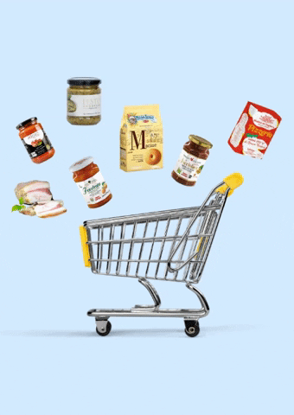
Businesses build sales strategies
Objective of any business is to become profitable
Attracting more customers and improving their sales.
Combining products to sell better
Combining fries with coke

Slide 27
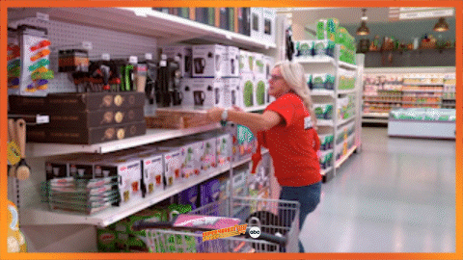
Build marketing strategies
Building strategies by knowledge of what items sell together and what not
Ex: ornaments do not sell as well others during Christmas may help manager offer a sale on the non-frequent ornaments.

Slide 28
Shelf-life planning
Enable store managers to plan their inventory as well as ensure that they don’t lose out by overstocking low-selling perishables.
Ex: if olives don’t sell very often, knowing who buy pizza dough tend to buy olives, the olives can be offered at a lower price in combination with the pizza dough.

Slide 29
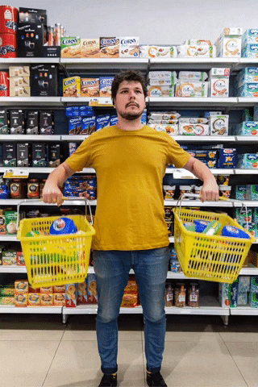
In-store organization
More selling products are moved closer together in the store.
Arranging 2 selling items to same aisle.

Slide 30
Steps involved in Association Rule Mining

Slide 31
Step 1: Find all frequent itemsets.
An itemset is a set of items that occurs in a shopping basket.
For example, [bread, butter, eggs] is an itemset from a supermarket database.:
support count:
The support count of an item is defined as the frequency of the item in the dataset.

Slide 32
Itemsets and their respective support counts.

Slide 33
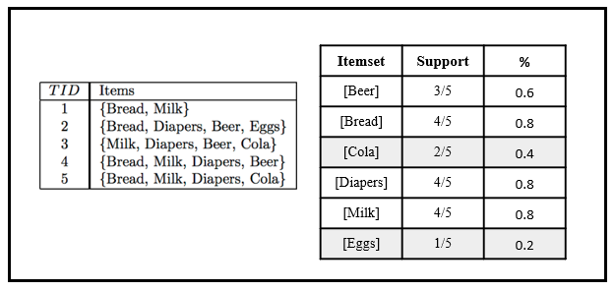
Support of an itemset is the frequency of the itemset with respect to the number of transactions.

Slide 34
Step 2: Generate strong association rules from the frequent itemsets.
Association rules are generated by building associations from frequent itemsets generated in step 1. This uses a measure called confidence to find strong associations. This has been covered in the example section.

Slide 35
Example of
Market Basket Analysis
(Association Rule Mining)

Slide 36
Introduction
Market Basket Analysis is one of the key techniques used by large retailers to uncover associations between items.
It works by looking for combinations of items that occur together frequently in transactions.
What relationships there are between items is the target of the analysis.
Knowing what your customers tend to buy together can help with marketing efforts and store/website layout.

Slide 37
Example:
Market basket analysis isn’t limited to shopping carts.
Other areas where the technique is used include:
Analysis of fraudulent insurance claims
Credit card purchases.
Market basket analysis can also be used to cross-sell products.
Example: Amazon famously uses an algorithm to suggest items that you might be interested in, based on your browsing history or what other people have purchased.

Slide 38
Mobile
Mobile Cover
Amazon uses past transactions of similar customers and thereby suggest best product to cross sell with current Product.

Slide 39
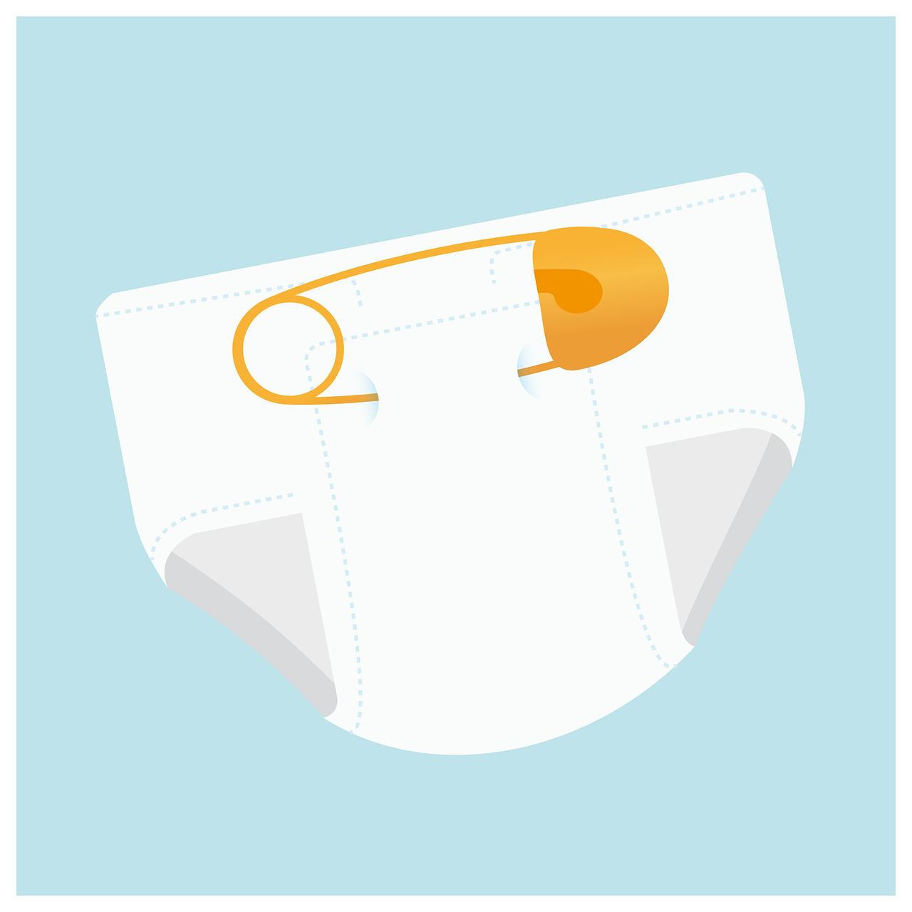
Three important terms:
Support
Confidence
Lift
We will take classic example of beer and diaper; it was found in study that whenever customer purchased beer they purchased diaper as well in same transaction.

Slide 40
In a Supermarket there are 5 transactions done:
Transaction ID: | Products Purchased
1 | Oil, Bread, Beer, Diaper
2 | Ice cream, Beer, Diaper
3 | Beer, Wafer
4 | Butter, Bread
5 | Beer, Diaper
Let Beer -> X and Diaper -> Y
Aim: To find how many time X was purchased with Y (X -> Y)
Support = Number of Transactions with Beer and Diaper /Total Number of Transactions.
= ⅗ = 60%
Confidence = No. of transactions with Beer and Diaper / No. of transactions with Beer.
=¾= 75 %
Lift = Confidence of buying both beer and diaper / Probability of buying beer
= 75%/80% =0.93

Slide 41
Applications:
Store layout:
Outlets will place products that co-occur together in the analysis
in close proximity on the store floor to improve the shopping
experience of the customer.
Cross-selling or Up-selling:
Outlets will market extra products to the customer based
on prior purchase behavior patterns or what is currently
in their cart.
3. Placement of items on a website or products in Catalogs.

Slide 42
Thank You

Slide 43
APRIORI ALGORITHM -1

Slide 44
INTRODUCTION
The Apriori algorithm is an influential algorithm for finding a general set of elements for learning association rules.
Apriori Algorithm uses bottom up approach.
It expands set of frequently occurring elements
It is designed to operate on a database which contains transactional data
Apriori algorithm was the first algorithm that was
individually.
proposed for frequent itemset mining

Slide 45
Key Concepts
Frequent Item sets : Set of products/items that frequently bought together.
Threshold :
Minimum Support : (s)
support(I) = Total number of transactions containing I / Total number of transactions
Minimum Confidence : (c)
Confidence(X->Y) =Number of transactions containing X and Y / Number of transactions containing X

Slide 46
Apriori Algorithm : Pseudo Code
L[1] = {frequent 1-itemsets};
for (k=2; L[k-1] != 0; k ++) do begin
// perform self-joining C[k] = getUnion(L[k-1])
// remove pruned supersets C[k] = pruning(C[k])
// get itemsets that satisfy minSup
L[k] = getAboveMinSup(C[k], minSup) end
Answer = L U K

Slide 47
THANK YOU

Slide 48
APRIORI ALGORITHM

Slide 49
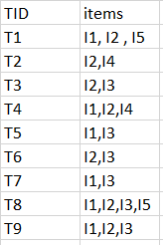
Example of Apriori Algorithm
minimum support count is 2
minimum confidence is 60%

Slide 50
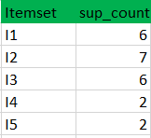
Step-1:
(I) Create a table containing support count of each item present in dataset – Called C1(candidate set)
(II) compare candidate set item’s support count with minimum support count(here min_support=2 if support_count of candidate set items is less than min_support then remove those items). This gives us itemset L1.

Slide 51
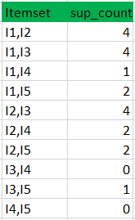
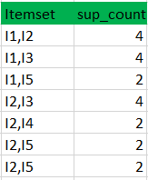
Step-2:
Generate candidate set C2 and compare candidate (C2) support count with minimum support count
Table 1 Table 2

Slide 52
Step-3:
Generate candidate set C3
Compare candidate (C3) support count with minimum support count

Slide 53
Step-4:
Generate candidate set C4 is that, they should have elements in common. So here, first 2 elements (items) should match.
Check all subsets of these itemsets are frequent or not (Here itemset formed by joining is {I1, I2, I3, I5} so its subset contains {I1, I3, I5}, which is not frequent). So no itemset in C4
We stop here because no frequent itemsets are found further

Slide 54
Advantages
This is the most simple and easy-to-understand algorithm among association rule learning algorithms.
It doesn't require labeled data as it is fully unsupervised; as a result, you can use it in many different situations because unlabeled data is often more accessible
Disadvantages
Requires many database scans.
Very slow.
The time needed to hold a large number of candidate-sets with many frequent itemsets.
If the dataset is small, the algorithm can find many false associations that happened simply by chance.

Slide 55
LIMITATIONS
Apriori Algorithm can be very slow when the size of database is huge.
For example If there are 10⁵ frequent 1-item sets then it will generate 10⁷ 2-item sets
Apriori algorithm will fail when the size of the database is very large as DB will not fit in memory. So each prune requires large number of disk reads.

Slide 56
Methods to Improve Apriori Efficiency
Partitioning : Any item set that is frequent in database must be frequent in one of its partitions.
Sampling: With the help of random sampling
Transaction Reduction : A transaction that doesn’t contain any frequent itemsets is useless for the scan.
By using new database mapping way to avoid scanning the DB repeatedly.

Slide 57
THANK YOU

