Slide 1
Example of
Market Basket Analysis
(Association Rule Mining)

Slide 2
Introduction
Market Basket Analysis is one of the key techniques used by large retailers to uncover associations between items.
It works by looking for combinations of items that occur together frequently in transactions.
What relationships there are between items is the target of the analysis.
Knowing what your customers tend to buy together can help with marketing efforts and store/website layout.

Slide 3
Example:
Market basket analysis isn’t limited to shopping carts.
Other areas where the technique is used include:
Analysis of fraudulent insurance claims
Credit card purchases.
Market basket analysis can also be used to cross-sell products.
Example: Amazon famously uses an algorithm to suggest items that you might be interested in, based on your browsing history or what other people have purchased.

Slide 4
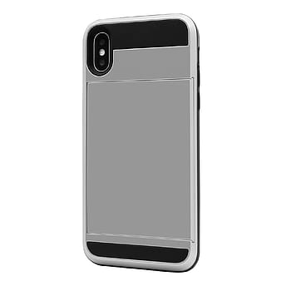
Mobile
Mobile Cover
Amazon uses past transactions of similar customers and thereby suggest best product to cross sell with current Product.

Slide 5
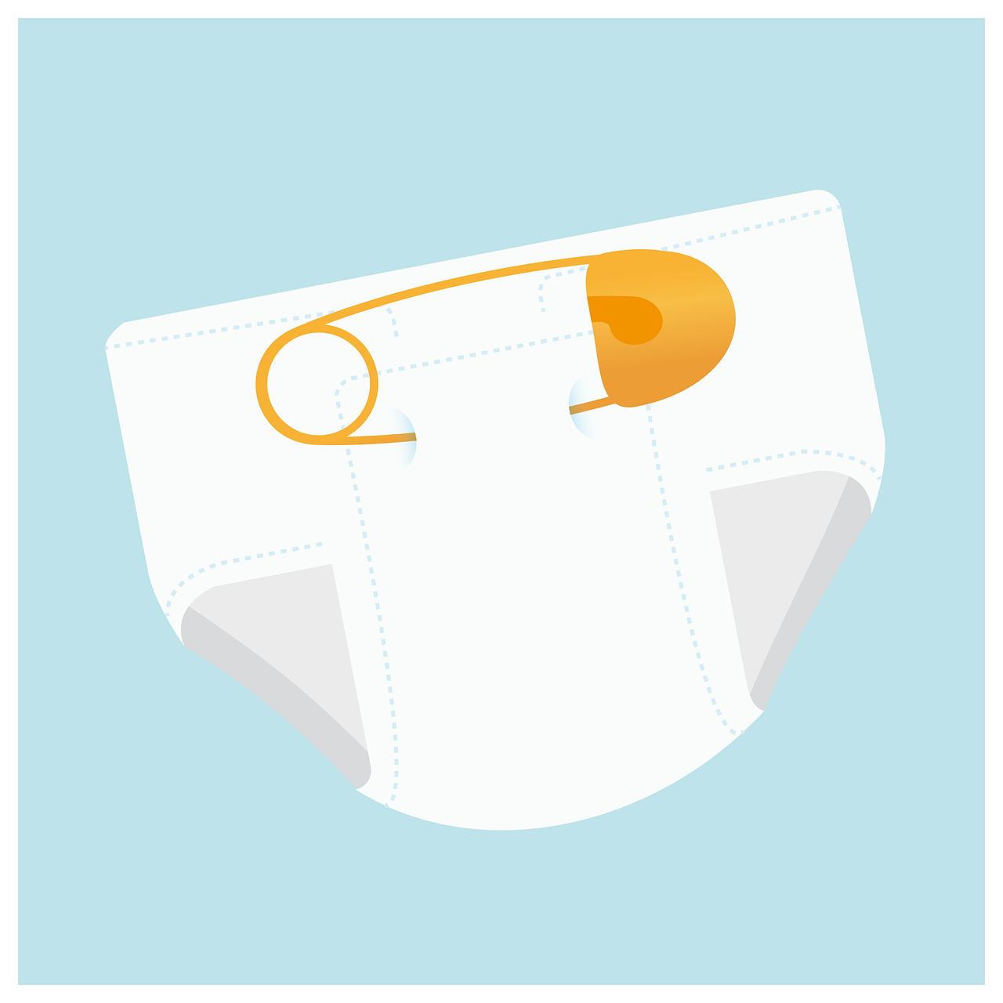
Three important terms:
Support
Confidence
Lift
We will take classic example of beer and diaper; it was found in study that whenever customer purchased beer they purchased diaper as well in same transaction.

Slide 6
In a Supermarket there are 5 transactions done:
Transaction ID: | Products Purchased
1 | Oil, Bread, Beer, Diaper
2 | Ice cream, Beer, Diaper
3 | Beer, Wafer
4 | Butter, Bread
5 | Beer, Diaper
Let Beer -> X and Diaper -> Y
Aim: To find how many time X was purchased with Y (X -> Y)
Support = Number of Transactions with Beer and Diaper /Total Number of Transactions.
= ⅗ = 60%
Confidence = No. of transactions with Beer and Diaper / No. of transactions with Beer.
=¾= 75 %
Lift = Confidence of buying both beer and diaper / Probability of buying beer
= 75%/80% =0.93

Slide 7
Applications:
Store layout:
Outlets will place products that co-occur together in the analysis
in close proximity on the store floor to improve the shopping
experience of the customer.
Cross-selling or Up-selling:
Outlets will market extra products to the customer based
on prior purchase behavior patterns or what is currently
in their cart.
3. Placement of items on a website or products in Catalogs.

Slide 8
Thank You

