Slide 1
Data Discretization
GROUP-8

Slide 2
What are the steps involved in Data Discretization.?
Steps involved in discretization are –
· Binning
· Histogram Analysis
· Entropy Based Discretization
· Interval Merging by chi square analysis
· Cluster Analysis
· Discretization by Intuitive Partitioning

Slide 3
Types of Data Discretization
Data discretization can be classified into two types: supervised discretization and unsupervised discretization. The term "supervised discretization" refers to a method that makes use of class data. Unsupervised discretization is a method that is based on how an operation is carried out.
Various methods/features for the discretization of data:
Histogram analysis
Binning
Cluster Analysis
Data discretization using decision tree analysis
Data discretization using correlation analysis
Notes:
This slide is good to go..

Slide 4
Types of data discretization
Histogram analysis:A histogram is a graph that depicts a continuous data set's underlying frequency distribution. The histogram is useful for data distribution inspection. Outliers, skewness representation, normal distribution representation.
Binning:Binning is a data smoothing technique for grouping a large number of continuous values into smaller ones. This technique can also be utilized for data discretization and the formation of idea hierarchy.
Cluster Analysis: Data discretization is a type of cluster analysis. To isolate a computational feature of x, a clustering algorithm divides the values of x numbers into clusters.
Notes:
This slide is good to go..

Slide 5
Cont.. of types of data discretization
Data discretization using decision tree analysis: A top-down slicing technique is employed in a decision tree analysis called data discretization. It is carried out under the supervision of a medical professional. In a numeric attribute discretization, you must first choose the attribute with the lowest entropy, and then you must run it using a recursive process. Using the same splitting criterion, the recursive procedure divides it into distinct discretized disjoint intervals from top to bottom.
Data discretization using correlation analysis: You can get the best surrounding interval by discretizing data using a linear regression technique, and then the large intervals are joined to produce a larger overlap, resulting in the final 20 overlapping intervals. It is a technique that is overseen.
Notes:
Add two more methods discussed…

Slide 6
Cont.. of types of data discretization
Generation Concept Hierarchy for Nominal Data :Concept hierarchy transforms the data into many layers. By adding partial or absolute ordering between the attributes, the definition hierarchy can be generated and this can be achieved at the level of the schema.
Entropy Based Discretization:An effective technique in handling continuous attributes for data mining, especially for classification problems.

Slide 7
Data discretization and concept hierarchy generation
The term hierarchy represents an organizational structure or mapping in which items are ranked according to their levels of importance. In other words, we can say that a hierarchy concept refers to a sequence of mappings with a set of more general concepts to complex concepts. It means mapping is done from low-level concepts to high-level concepts. For example, in computer science, there are different types of hierarchical systems. A document is placed in a folder in windows at a specific place in the tree structure is the best example of a computer hierarchical tree model. There are two types of hierarchy: top-down mapping and the second one is bottom-up mapping.

Slide 8
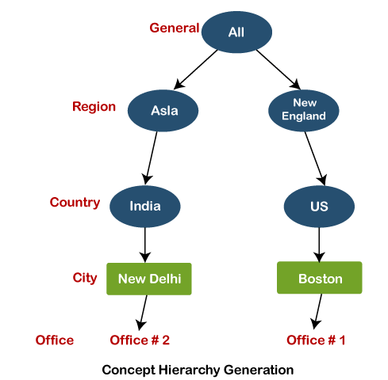
Mapping Approach of data discretization
Data discretization and concept hierarchy generation:
Top-down mapping
Top-down mapping often begins with basic information at the top and concludes with specialized information at the bottom.
Bottom-up mapping
Bottom-up mapping often begins at the bottom with specialized data and finishes at the top with more generalist data.
Notes:
This slide is good to go..

