Slide 1
Data Discretization
GROUP-8

Slide 2
Top Down Mapping
In the top-down mapping discretization starts with a single interval. In each step, one boundary is chosen (the number of intervals is incremented by one) so as to maximize the quality q(A) of the discretized attribute A. The process is repeated, until the quality q(A) of a discretized attribute stops increasing. The time complexity of the top-down approach is in the worst case also O(n2). However, since the number of intervals k is typically k ≪ n, the time complexity is usually in the range of O(kn).

Slide 3
Bottom Up Mapping
In the bottom-up mapping discretization starts with as many intervals as there are learning examples. Subsequently, two adjacent intervals, most similar with respect to class probability distributions, are joined. The process is repeated until the quality q(A) of the discretized attribute A stops increasing, or there are only two intervals left. The time complexity of the bottom-up approach is O(n2), n being the number of learning examples.

Slide 4
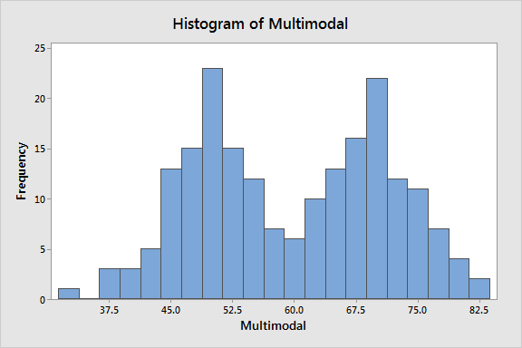
Histogram Analysis
A histogram is a graphical representation that divides a set of data points into ranges defined by the user. The histogram, which resembles a bar graph in appearance, condenses a data series into an easily understandable visual by grouping many data points into logical ranges or bins.

Slide 5
Cont.. for histogram analysis
Histogram analysis is an unsupervised discretization technique because it does not use class information.Various partitioning rules can be used to define histograms. In an equal-width histogram, the values are partitioned into equal sized partitions or ranges.With an equal-frequency histogram, the values are partitioned so that, ideally, each partition contains the same number of data tuples.

Slide 6
Cont.. for histogram analysis
To perform data discretization by histogram analysis, we will use the hist() function that computes a histogram of the given data values. The function provides a number of arguments.

