Slide 1
Data Discretization
Cluster Analysis

Slide 2
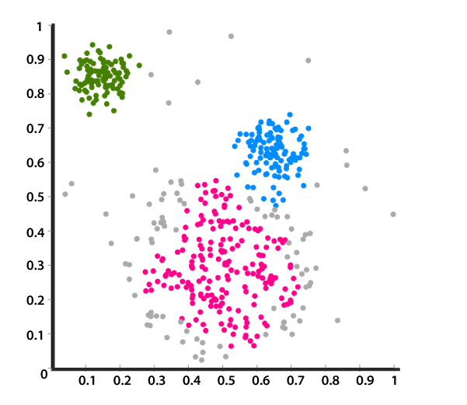
Cluster Analysis
Cluster analysis is a statistical method for processing data. It works by organizing items into groups, or clusters, on the basis of how closely associated they are.The objective of cluster analysis is to find similar groups of subjects, where “similarity” between each pair of subjects means some global measure over the whole set of characteristics.
Cluster analysis is an unsupervised learning algorithm, meaning that you don’t know how many clusters exist in the data before running the model. Unlike many other statistical methods, cluster analysis is typically used when there is no assumption made about the likely relationships within the data. It provides information about where associations and patterns in data exist, but not what those might be or what they mean.

Slide 3
Cont to… Cluster Analysis
Clustering procedures can be viewed as “pre-classificatory” in the sense that the researcher has not used prior judgment to partition the subjects (rows of the data matrix). However, it is assumed that some of the objectives are heterogeneous; that is, that “clusters” exist.
This presupposition of different groups is based on commonalities within the set of inputs into the algorithm, or clustering variables. This assumption is different from the one made in the case of discriminant analysis or automatic interaction detection, where the dependent variable is used to formally define groups of objects and the distinction is not made on the basis of profile resemblance in the data matrix itself.

Slide 4
Cont to… Cluster Analysis
Properties of Clustering
Clustering Scalability: There is a massive amount of data nowadays, and large databases need be dealt with. The clustering technique should be scalable if it is to handle large databases. If the data isn't scalable, we won't be able to achieve the right result, which will lead to incorrect outcomes.
High Dimensionality: The method should be able to handle both large and small data sets in a high-dimensional space.
Algorithm Usability with multiple data kinds: Different kinds of data can be used with algorithms of clustering. It should be capable of dealing with different types of data like discrete, categorical and interval-based data, binary data etc.

Slide 5
Cont to… Cluster Analysis
Dealing with unstructured data: These would be some databases that contain missing values, noisy or erroneous data. If the algorithms are sensitive to such data then it may lead to poor quality clusters. So it should be able to handle unstructured data give it some structure to the data by organizing it into groups of similar data objects. This makes the job of the data expert easier in order to process the data and discover new patterns.
Interpretability:The outcomes of clustering should be interpretable, comprehensible, and usable. The interpretability reflects how easily the data is understood.

Slide 6
Types of Clustering Algorithms
There are Various types of clustering algorithms present for example:
KNN
K-Means
Expectation-Maximization(EM) clustering
Density based Spatial Clustering of Application with Noise (DBSCAN)

