Slide 1
Cluster Analysis, Preprocessing and characteristics of Data

Slide 2
Cluster Analysis
Cluster analysis or Clustering is the task of grouping a set of objects in such a way that objects in the same group (called a cluster) are more similar to each other than to those in other groups (clusters).
Inter-cluster distances are maximized
Intra-cluster distances are minimized

Slide 3
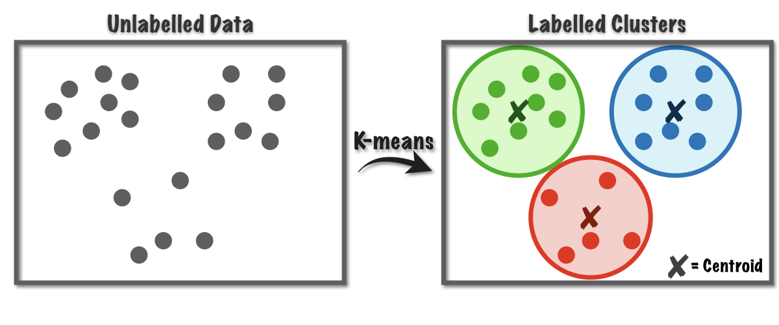
Centroid based clustering
K means algorithm is one of the centroid-based clustering algorithms. Here k is the number of clusters and is a hyperparameter to the algorithm. The core idea behind the algorithm is to find k centroids followed by finding k sets of points which are grouped based on the proximity to the centroid such that the squared distances of the points in the cluster to the centroid are minimized.

Slide 4
Pre-Processing
Normalization(Too many attributes to process)
Eliminate outliers
Types of Data(Binary to decimal conversion)
OUTLIER

Slide 5
Characteristics of Data
Type of proximity or density measure
How close the objects are to each other: distance measure
Sparseness
How dense the objects are in space
Attribute type
Can be numerical or categorical (short, medium, tall)
Type of Data
Some attribute values may be way larger than others, creating greater displacement when mapped in space. Others may be binary.

Slide 6
Characteristics of Data(Contd)
Dimensionality
The number of attributes we use directly relates to complexity
Noise and Outliers
Incorrect data, or objects which are extremely rare compared to all others
Type of Distribution (normal, uniform, etc.)

