Slide 1
Types of clustering

Slide 2
Types of clustering
Clustering is the task of grouping a set of objects in such a way that objects in the same group (called a cluster) are more similar (in some sense) to each other than to those in other groups (clusters).
There are two main types of clustering. They are:
Partitional Clustering
Hierarchical clustering

Slide 3
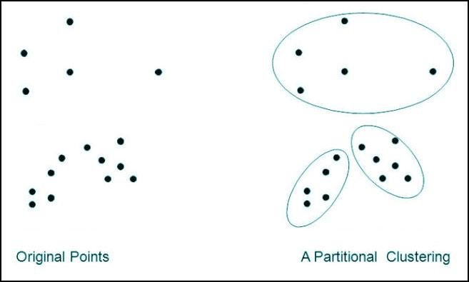
Partitional clustering
Partitional clustering (or partitioning clustering) are clustering methods used to classify observations, within a data set, into multiple groups based on their similarity.
We need to specify the specific number of clusters that need to be generated.

Slide 4
Hierarchical clustering
Hierarchical clustering, also known as hierarchical cluster analysis, is an algorithm that groups similar objects into groups called clusters.
It seeks to build hierarchy of clusters from the given data points.
There are two types of Hierarchical clustering.They are:
Divisive (top-down)
Agglomerative (bottom-up)

Slide 5
Hierarchical clustering-Divisive
Initially, all data is in the same cluster, and the largest cluster is split until every object is separate.

Slide 6
Hierarchical clustering-Agglomerative
The algorithm starts by treating each object as a singleton cluster. Next, pairs of clusters are successively merged until all clusters have been merged into one big cluster containing all objects.
The result is a tree-based representation of the objects, named dendrogram.

