Slide 1
Cluster Analysis Types of Clusters

Slide 2
Types Of clusters
Well Separated Cluster:
A cluster is a collection of items in which each object is closer or more similar to every other object in the cluster than to every other object.
Any two points in different groups are separated by a greater distance than any two points within the same group.
Clusters that are well-separated do not have to be circular and can have any form.
3 well-separated clusters

Slide 3
Center-Based Cluster:
A cluster is a set of objects in which each object is closer to the prototype that defines the cluster than to the prototype of any other cluster.
For data with continuous attributes, the prototype of a cluster is often a centroid, i.
When a centroid is not meaningful, such as when the data has categorical attributes, the prototype is often a medoid, i.
4 Center Based Clusters

Slide 4
Contiguous Clusters:
An important example of graph-based clusters is a contiguity-based cluster, where two objects are connected only if they are within a specified distance of each other.
This implies that each object in a contiguity-based cluster is closer to some other object in the cluster than to any point in a different cluster.
8 contiguous clusters

Slide 5
Density Based Cluster
A cluster is a dense region of objects that is surrounded by a region of low density.
When there are irregular or interconnected clusters, along with noise and outliers, this method is used.
6 density-based clusters

Slide 6
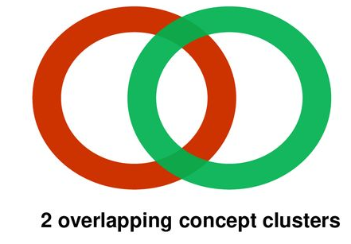
Conceptual Clusters:
Shared Property or Conceptual Clusters:
Finds clusters that share some common property or represent a particular concept.
The most general notion cluster in some ways includes all other types.

