Slide 1
Partitioning Clustering – K-Means

Slide 2
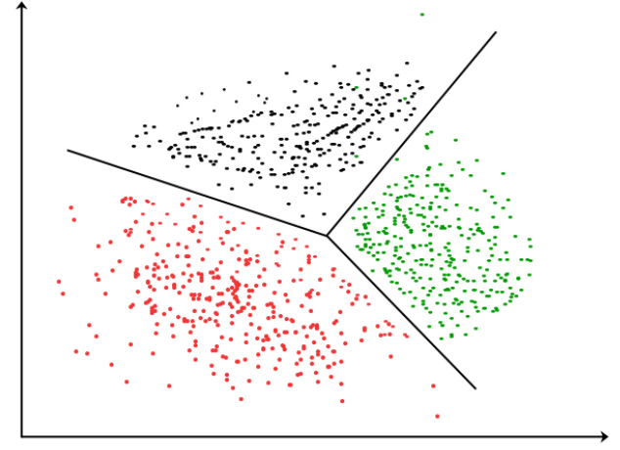
Cluster Analysis
Cluster analysis or Clustering is the task of grouping a set of objects in such a way that objects in the same group (called a cluster) are more similar to each other than to those in other groups (clusters).
Unsupervised learning technique

Slide 3
Applications of Clustering
Market and Customer segmentation
Search Results
Medical Imaging Analysis
Fraud Detection
Identification of Cancer Cells
Biological Data Analysis

Slide 4
Requirements of Clustering Algorithm
Scalability
Ability to deal with different kinds of attributes
High dimensionality
Ability to deal with noisy data
Interpretability

Slide 5
What is not Cluster Analysis
Results of a Query
Association Analysis
Supervised Classification
Simple Segmentation

Slide 6
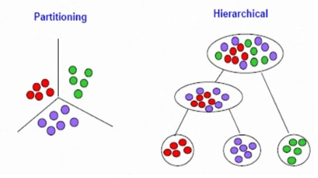
Types of Clustering
Partitioning Clustering
Hierarchical Clustering

