Slide 1
Hierarchical Clustering
Notes:
Cluster analysis groups data objects based on information found only in the
data that describes the objects and their relationships. The goal is that the
objects within a group be similar (or related) to one another and different from
(or unrelated to) the objects in other groups. The greater the similarity (or
homogeneity) within a group and the greater the difference between groups,
the better or more distinct the clustering.

Slide 2
Introduction
Hierarchical clustering is a set of nested clusters that are organized as a tree. Each node (cluster) in the tree (except for the leaf nodes) is the union of its children (subclusters), and the root of the tree is the cluster containing all the objects.
Notes:
Hierarchical versus Partitional The most commonly discussed distinction among different types of clusterings is whether the set of clusters is nestedor unnested, or in more traditional terminology, hierarchical or partitional. A partitional clustering is simply a division of the set of data objects into non-overlapping subsets (clusters) such that each data object is in exactly one subset. If we permit clusters to have subclusters, then we obtain a hierarchical clustering, which is a set of nested clusters that are organized as a tree. Each node (cluster) in the tree (except for the leaf nodes) is the union of its children (subclusters), and the root of the tree is the cluster containing all the objects. Often, but not always, the leaves of the tree are singleton clusters of individual data objects

Slide 3
Types
Agglomerative
Start with the points as individual clusters and, at each step, merge the closest pair of clusters. This requires defining a notion of cluster proximity.
Divisive
Start with one, all-inclusive cluster and, at each step, split a cluster until only singleton clusters of individual points remain. In this case, we need to decide which cluster to split at each step and how to do the splitting.
Notes:
Agglomerative hierarchical clustering techniques are by far the most common

Slide 4
Agglomerative
Algorithm: Basic agglomerative hierarchical clustering algorithm.
1: Compute the proximity matrix, if necessary.
2: repeat
3: Merge the closest two clusters.
4: Update the proximity matrix to reflect the proximity between the new cluster and the original clusters.
5: until Only one cluster remains.

Slide 5
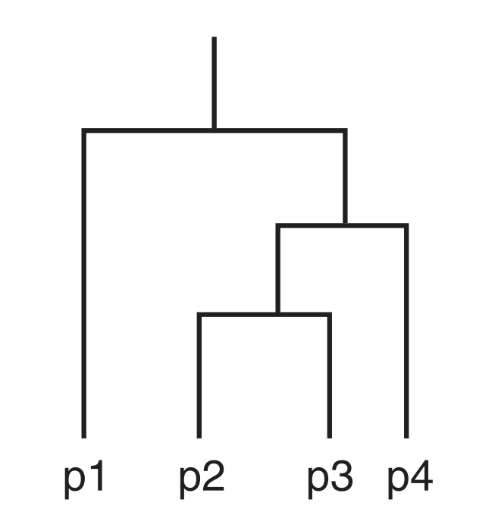
Dendrogram
Dendrogram is a tree-like diagram which displays both the clusters and-subcluster relationships and the order in which the clusters were merged or split.

Slide 6
Divisive
Algorithm: Divisive hierarchical clustering
given a dataset (d1, d2, d3, ....dN) of size N
at the top we have all data in one cluster
the cluster is split using a flat clustering method eg. K-Means etc
repeat
choose the best cluster among all the clusters to split
split that cluster by the flat clustering algorithm
until each data is in its own singleton cluster

