Slide 1
Correlation Similarity
The cosine similarity between centered versions of x and y, which is again restricted between -1 and 1, is referred to as correlation.
Correlation values go from -1, which is the strongest linear relationship with a negative slope to 1, which is the strongest linear relationship with a positive slope.
In both cases, if a straight line cannot go through all of the data, then we will get correlation values closer to 0 and the worst the fit the correlation value is 0.

Slide 2
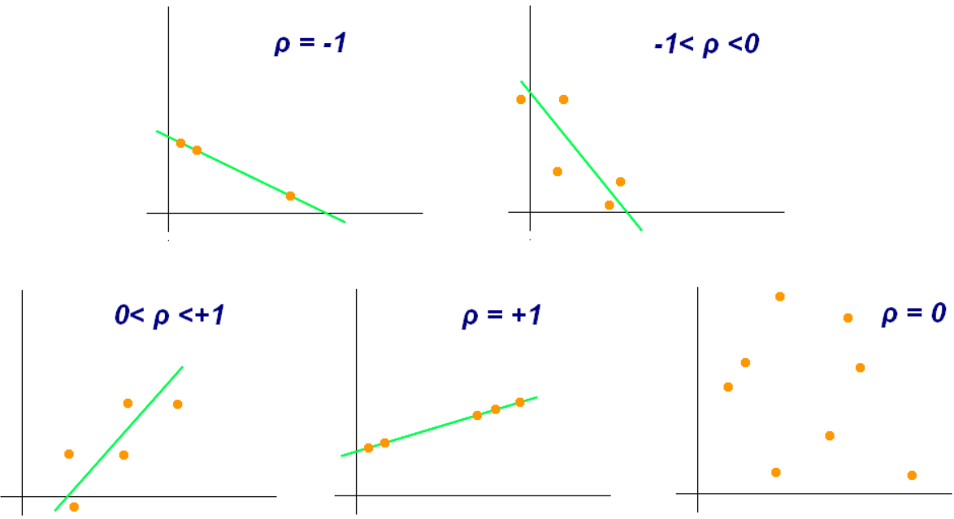
Correlation = 1 when a straight line with a positive slope can go through the center of every data point.
Correlation = -1 when a straight line with a negative slope can go through the center of every data point.
When correlation = 0, the value on the X-axis doesn’t tell anything about what to expect on Y-axis because there is no reason to choose one value over another.

Slide 3
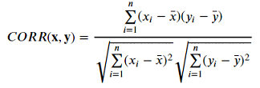
Correlation Similarity - Working
Correlation is the covariance of Gene X and Gene Y over square root of variance of Gene X times square root of variance of Gene Y.
Advantages: Correlation is a more concise (single value) summary of the relationship between two variables than regression. In result, many pairwise correlations can be viewed together at the same time in one table.
Disadvantages: Prediction and Optimization problem.

Slide 4
Correlation Similarity- Example
SUBJECT | AGE X | GLUCOSE LEVEL Y
1 | 43 | 99
2 | 21 | 65
3 | 25 | 79
4 | 42 | 75
5 | 57 | 87
6 | 59 | 81

Slide 5
Correlation = 2868/5413.27 = 0.529809
SUBJECT | AGE X | GLUCOSE LEVEL Y | XY | X^2 | Y^2
1 | 43 | 99 | 4257 | 1849 | 9801
2 | 21 | 65 | 1365 | 441 | 4225
3 | 25 | 79 | 1975 | 625 | 6241
4 | 42 | 75 | 3150 | 1764 | 5625
5 | 57 | 87 | 4959 | 3249 | 7569
6 | 59 | 81 | 4779 | 3481 | 6561
∑ | 247 | 486 | 20485 | 11409 | 40022

