Slide 1
Euclidean Distance

Slide 2
Euclidean Distance
Euclidean distance is typically a straight line between two vectors.
Euclidean distance is most commonly used to find the similarity measure in cluster analysis algorithms.
Euclidean distance prioritize objects with the lowest values to detect similarity amongst them.

Slide 3
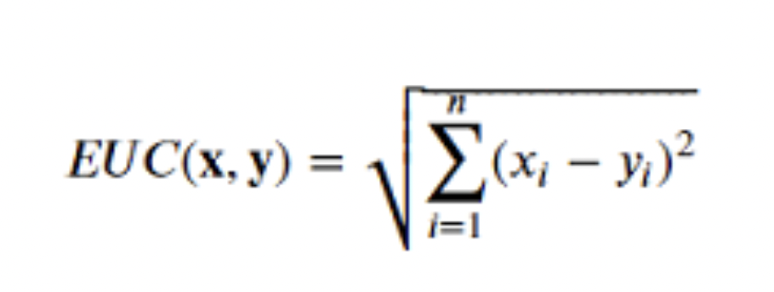
Euclidean distance formula
The formula for euclidean distance is given as:
Where:
X and Y are vectors
Xi and yi are ith attributes of x and y vector
N is number of attributes in vector

Slide 4
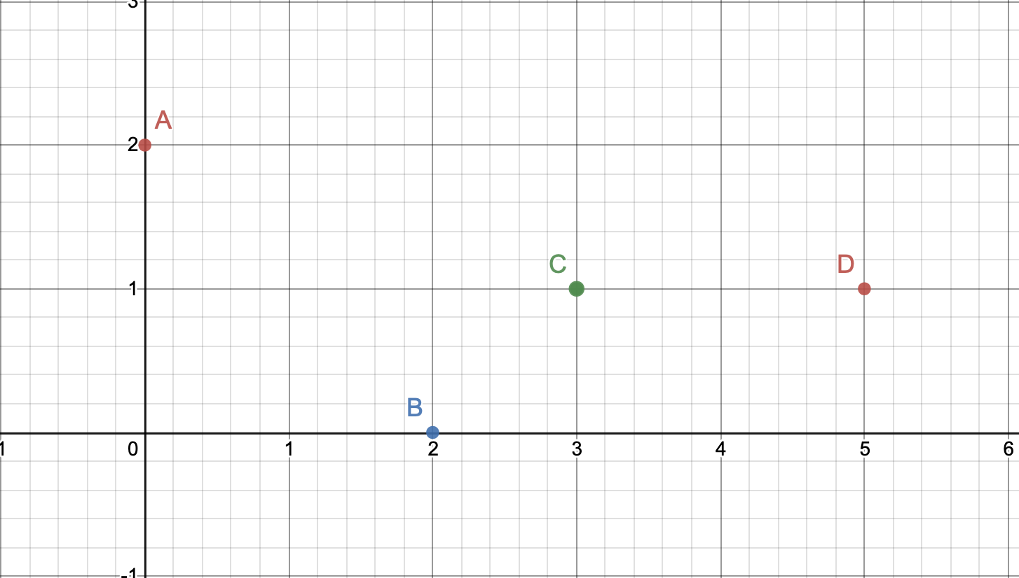
How do we measure similarity? With Example
If the value of the euclidean distance is high then the vectors are said to be dissimilar.
If the value of the euclidean distance is low then the vectors are said to be similar.
Example:

Slide 5
Example continuation
Vector | X | Y
A | 0 | 2
B | 2 | 0
C | 3 | 1
D | 5 | 1
.
 | A | B | C | D
A | 0 | 2.8 | 3.1 | 5
B | 2.8 | 0 | 1.4 | 3.1
C | 3.1 | 1.4 | 0 | 2
D | 5 | 3.1 | 2 | 0

Slide 6
Applications and drawbacks
Applications:
Most commonly used for
K-nearest Neighbour
K-means Clustering
HDBSCAN
Drawbacks:
Not scale Invariant
Dimensionality curse

Slide 7
Thank You

