Slide 1
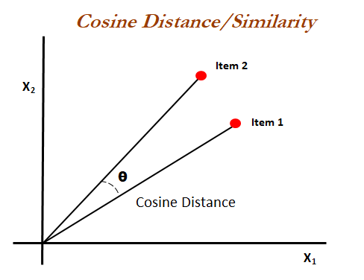
Cosine Similarity - Intro
The most basic approach to find the similarity between two documents is counts the number of similar words, known as Euclidean distance. This is flawed when the sizes of documents are far apart.
Cosine Similarity measure can overcome the euclidean distance flaw.
Cosine similarity is a similarity metric that is used to measure the similarity between documents irrespective of the size.
The Cosine similarity is the measure of angle between the documents projected as vectors over a multidimensional space.

Slide 2
Cosine Similarity - Working
The cosine similarity begins with finding the cosine of two non zero vectors. This can be derived by using the Euclidean dot product formula as given below
With the dot product of the vectors the Cosine similarity is given as
The output will range from -1 to 1 where ‘-1’ is non-similar ‘0’ is orthogonal(perpendicular) and ‘1’ is similar.

Slide 3
Cosine Similarity - Example
Doc 1 : Deep Learning can be hard
Doc 2: Deep Learning can be simple
Word | Doc 1 (word count) | Doc 2 (word count)
Deep | 1 | 1
Learning | 1 | 1
Can | 1 | 1
Be | 1 | 1
Hard | 1 | 0
Simple | 0 | 1

Slide 4
Cosine Similarity - Example (Contd.)
Doc 1: [1, 1, 1, 1, 1, 0], assume as ‘A’
Doc 2: [1, 1, 1, 1, 0, 1], assume as ‘B’
Finding the Dot product (A . B): 1.1 + 1.1 + 1.1 + 1.1 + 1.0 + 0.1 = 4
Magnitude of A : √1² + 1² + 1² + 1² +1² + 0² = 2.2360679
Magnitude of B : √1² + 1² + 1² + 1² +0² + 1² = 2.2360679
Similarity : (4) / ( 2.2360679 x 2.2360679 ) = 0.8
The given documents have 80% similarity.

Slide 5
Cosine Similarity - Applications
Cosine Similarity has a variety of applications in Data Science.
Plagiarism detectors
Recommendation systems
Information retrieval
Text matching
It can be also used as loss function while training neural networks.
Cosine Similarity is good because even if the documents are far apart by size they might inclined towards each other (angle between them is low) having high similarity.

Slide 6
Correlation Similarity
The cosine similarity between centered versions of x and y, which is again restricted between -1 and 1, is referred to as correlation.
Correlation values go from -1, which is the strongest linear relationship with a negative slope to 1, which is the strongest linear relationship with a positive slope.
In both cases, if a straight line cannot go through all of the data, then we will get correlation values closer to 0 and the worst the fit the correlation value is 0.

Slide 7
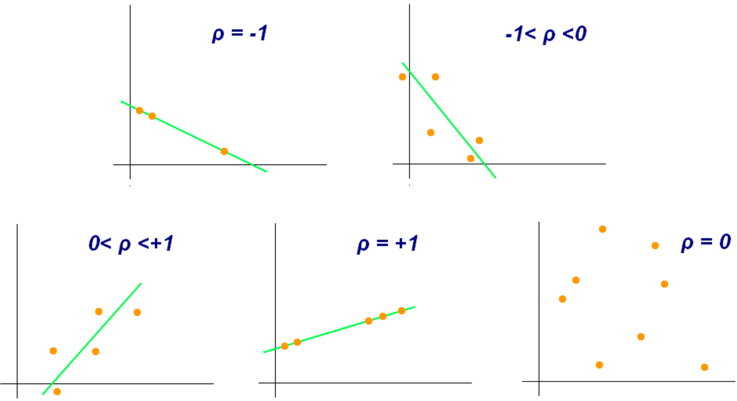
Correlation = 1 when a straight line with a positive slope can go through the center of every data point.
Correlation = -1 when a straight line with a negative slope can go through the center of every data point.
When correlation = 0, the value on the X-axis doesn’t tell anything about what to expect on Y-axis because there is no reason to choose one value over another.

Slide 8
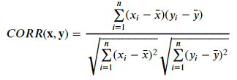
Correlation Similarity - Working
Correlation is the covariance of Gene X and Gene Y over square root of variance of Gene X times square root of variance of Gene Y.
Advantages: Correlation is a more concise (single value) summary of the relationship between two variables than regression. In result, many pairwise correlations can be viewed together at the same time in one table.
Disadvantages: Prediction and Optimization problem.

Slide 9
Correlation Similarity- Example
SUBJECT | AGE X | GLUCOSE LEVEL Y
1 | 43 | 99
2 | 21 | 65
3 | 25 | 79
4 | 42 | 75
5 | 57 | 87
6 | 59 | 81

Slide 10
Correlation = 2868/5413.27 = 0.529809
SUBJECT | AGE X | GLUCOSE LEVEL Y | XY | X^2 | Y^2
1 | 43 | 99 | 4257 | 1849 | 9801
2 | 21 | 65 | 1365 | 441 | 4225
3 | 25 | 79 | 1975 | 625 | 6241
4 | 42 | 75 | 3150 | 1764 | 5625
5 | 57 | 87 | 4959 | 3249 | 7569
6 | 59 | 81 | 4779 | 3481 | 6561
∑ | 247 | 486 | 20485 | 11409 | 40022

Slide 11
Euclidean Distance
Euclidean distance is typically a straight line between two vectors.
Euclidean distance is most commonly used to find the similarity measure in cluster analysis algorithms.
Euclidean distance prioritize objects with the lowest values to detect similarity amongst them.

Slide 12
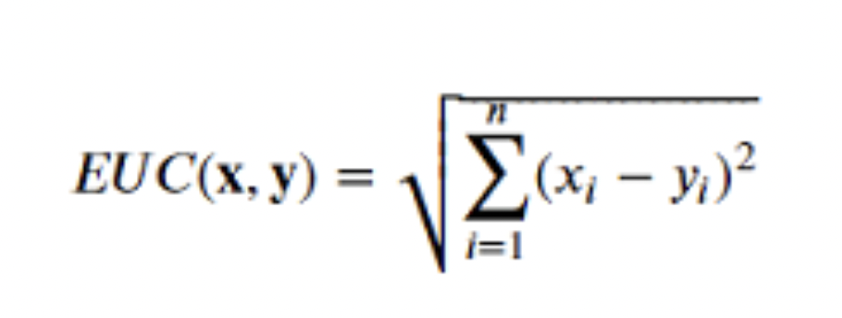
Euclidean distance formula
The formula for euclidean distance is given as:
Where:
X and Y are vectors
Xi and yi are ith attributes of x and y vector
N is number of attributes in vector

Slide 13
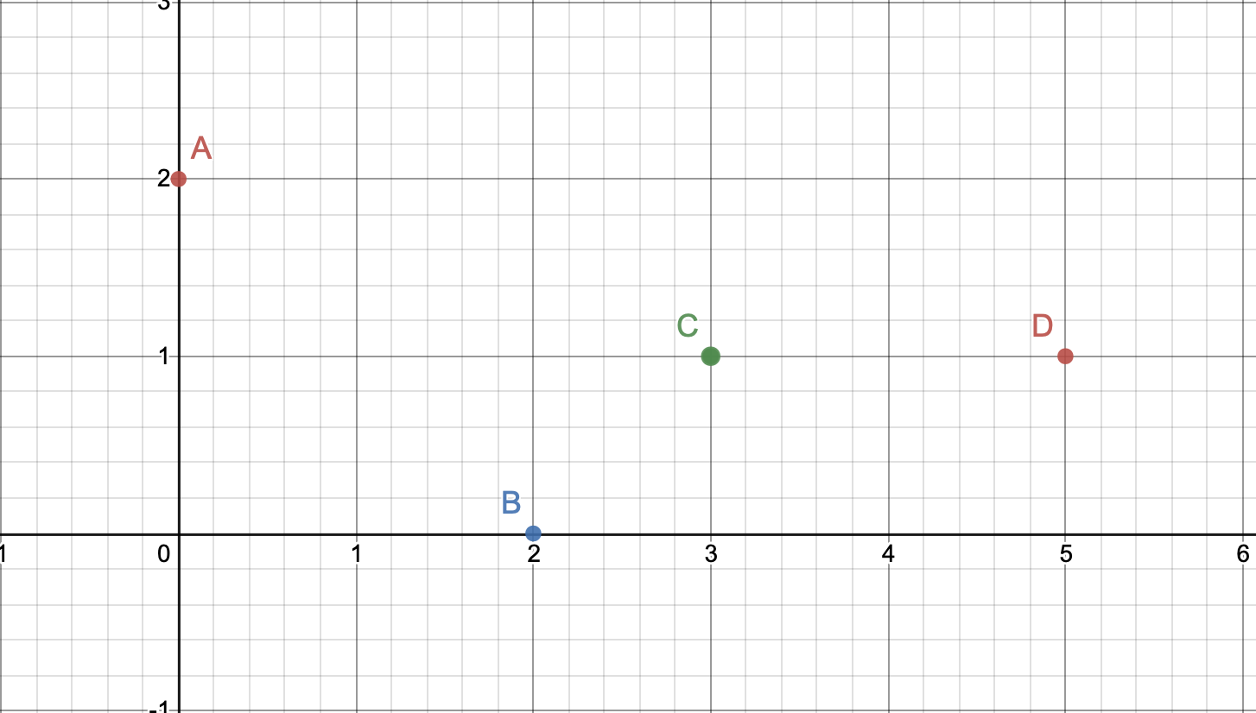
How do we measure similarity? With Example
If the value of the euclidean distance is high then the vectors are said to be dissimilar.
If the value of the euclidean distance is high then the vectors are said to be similar.
Example:

Slide 14
Example continuation
Vector | X | Y
A | 0 | 2
B | 2 | 0
C | 3 | 1
D | 5 | 1
.
 | A | B | C | D
A | 0 | 2.8 | 3.1 | 5
B | 2.8 | 0 | 1.4 | 3.1
C | 3.1 | 1.4 | 0 | 2
D | 5 | 3.1 | 2 | 0

Slide 15
Applications and drawbacks
Applications:
Most commonly used for
K-nearest Neighbour
K-means Clustering
HDBSCAN
Drawbacks:
Not scale Invariant
Dimensionality curse

Slide 16
Jaccard Similarity Index - Intro
A common proximity measurement used to compute the similarity between two sets of objects.
Jaccard Index value ranges from 0 to 1.
If two datasets share exactly the same members, their Jaccard similarity index will be close to 1.

Slide 17
Jaccard Similarity for Binary vectors
Jaccard similarity between two vectors ‘i’ and ‘j’ is :
where
a = the number of attributes equal to 1 in both i and j vectors
b = the number of attributes equal to 0 for i and equal to 1 for j
c = the number of attributes equal to 1 for i and equal to 0 for j

Slide 18
Jaccard Similarity for Binary vectors (Contd.)
For example, C1 and C2 → Customers,
Jaccard similarity between C1 and C2 is :
J (C1,C2) = a / (a+b+c) = 1 / (1+1+2) = 0.25
 | Item 1 | Item 2 | Item 3 | Item 4 | Item 5 | Item 6 | Item 7 | Item 8 | Item 9
C1 | 0 | 1 | 0 | 0 | 0 | 1 | 0 | 0 | 1
C2 | 0 | 0 | 1 | 0 | 0 | 0 | 0 | 0 | 1

Slide 19
Jaccard Similarity for two sets
Jaccard similarity between two sets A and B is calculated as follows :
Where |A∩B| = number of members shared between two sets
|A∪B| = total number of members in two sets
For example, A = {0,1,2,5,6,8,9} and B = {0,2,3,4,5,7,9}
|A∩B| = 4
|A∪B| = 10
Jaccard similarity = 4/ 10 =0.4

Slide 20
Applications of Jaccard Similarity
Most commonly used in Data science applications.
Example Use cases:
Text Mining
E-Commerce
Recommendation System

Slide 21
Similarity Measures using Vectors
Simulating different similarity measures of two example vectors.
Presented by:
Harish Puranam
801211382

Slide 22
Cosine Similarity
Let, the input vectors be; x = (0,1,0,1) and y = (1,0,1,0)
cosine_sim(A,B) = (0*1 + 1*0 + 0*1 + 1*0)/[(0*0+1*1+0*0+1*1)^{1/2}*(0*0+1*1+0*0+1*1^{1/2}]
= 0/[1+1]
=0

Slide 23
Correlation Similarity
Let, the input vectors be; x = (0,1,0,1) and y = (1,0,1,0)
X̄ = 1/4(0+1+0+1) = 1/2
Ȳ = 1/4(1+0+1+0) = ½
covariance = 1/(4-1) [(0-1/2)(1-1/2)+(1-1/2)(0-1/2)+(0-1/2)(1-1/2)+(1-1/2)(0-1/2)] =-⅓
Standard deviation of X = [(1/(4-1))[(0-1/2)²+(1-1/2)²+(0-1/2)²+(1-1/2)²]]^{1/2}=3^{1/2}/3 = 1/3^{1/2}
Standard deviation of Y = [(1/(4-1))[(1-1/2)²+(0-1/2)²+(1-1/2)²+(0-1/2)²]]1/2=1/3^{1/2}
Correlation_Sim(x,y) = covariance /[Standard deviation of X * Standard deviation of Y]
= (-1/3)/[( 1/3^{1/2})(1/3^{1/2})] = -1

Slide 24
Euclidean Similarity
Let, the input vectors be; x = (0,1,0,1) and y = (1,0,1,0)
Euclidean_Sim(x,y) = [(0-1)²+(1-0)²+(0-1)²+(1-0)²]^{1/2}
= 2

Slide 25
Jaccard Similarity
Let, the input vectors be; x = (0,1,0,1) and y = (1,0,1,0)
Jaccard_Sim(x,y) = 0/(2+2+0)
= 0

Slide 26
Applications of vector similarity measures in real-time
Document Similarity
Pose Matching
Recommendation systems

Slide 27
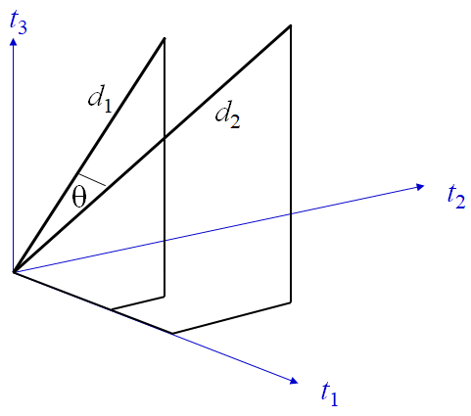
Document Similarity
Text similarity has to determine how ‘close’ two pieces of text
are both in surface closeness [lexical similarity] and
meaning [semantic similarity].
Quantification of the similarity between two documents can
be obtained by converting the words or phrases within the
document or sentence into a vectorised form of representation.
The similarity between two documents is a function of the angle
between their vectors in the term vector space.

Slide 28
Document Similarity
d = (w₁, w₂,w₃, ..., w_{n}) is a vector in an n-dimensional vector space
Length of d is given by (extension of Pythagoras theorem)
|d|² = w₁² + w₂² + w₃² + ... + w_{n}²
|d| = (w₁² + w₂² + w₃² + ... + w_{n}² )^{1/2}
If d₁ and d₂ are document vectors:
Inner product (or dot product) is given by
d₁.d₂ = w₁₁w₂₁ + w₁₂w₂₂ + w₁₃w₂₃ + ... + w_{1n}w_{2n}
Cosine angle between the docs d₁ and d₂ determines doc similarity
cos (q) =

Slide 29
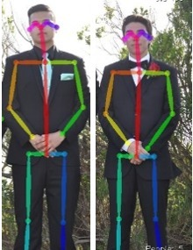
Pose Matching
Human pose estimation is the identification of a human’s pose
through joint and limb recognition on an image or in a video.
By using the cosine similarity in the Euclidean distance formula,
the distance from one vector to another can be computed without
being corrupted by the varying length of the vectors.
In several human pose estimation calculation models, there is a
factor known as the confidence score for each keypoint. The
confidence score represents the likeliness that the keypoint exists
in the calculated spot.

Slide 30
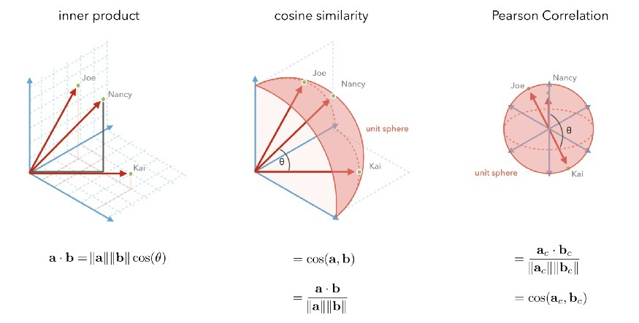
Recommendation Systems
The first three similarity metrics that we will
consider are all variations on the inner product
between user rating vectors.
The best way to choose a metric is to optimize
predictions offline with cross-validation, or
optimize them online with an A/B test.

Slide 31
COMPARISON AMONG DIFFERENT SIMILARITY MEASURES
Similarity is the state or fact of being similar or Similarity measures how much two objects are alike.
Similarity measure in a data mining context is a distance with dimensions representing features of the objects. If distance is small, two objects are very similar whereas if distance is large we will observe low degree of similarity.
There are lot of similarity distance measures out of which we have compared
1. Cosine similarity
2. Euclidean Distance
3. Jaccard Distance
4. Correlation

Slide 32
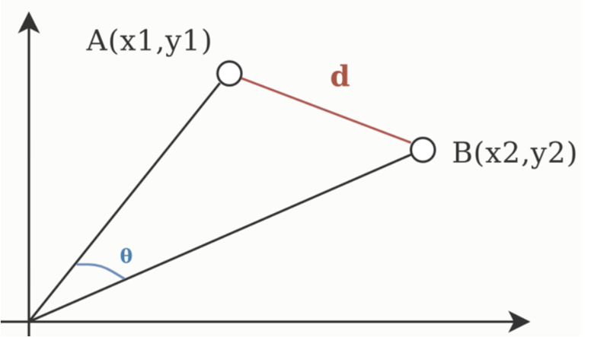
Cosine Similarity
The cosine similarity metric is used to determine how similar documents are regardless of their size.
It measures the cosine of the angle between two vectors projected in a multi-dimensional space mathematically.
Disadvantage:
The magnitude of vectors is not considered, merely their direction.
Use Case:
We use cosine similarity often when we have high-dimensional data and when the magnitude of the vectors is not of importance.
Formula:

Slide 33
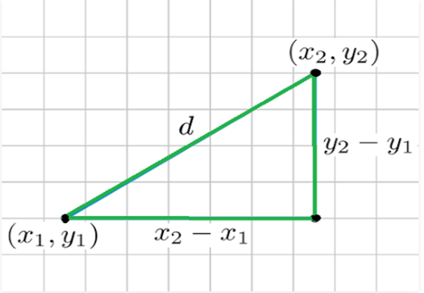
Euclidean Distance
It is a distance measure that best can be explained as the length of a segment connecting two points.
Mathematically it computes the root of squared differences between the coordinates between two objects.
Disadvantages:
It is not scale in-variant.
As the dimensionality increases of your data, the less useful Euclidean distance becomes.
Use Case:
Euclidean distance works great when you have low-dimensional data and the magnitude of the vectors is important to be measured.
Methods like kNN and HDBSCAN show great results out of the box if Euclidean distance is used on low-dimensional data.
Formula:

Slide 34
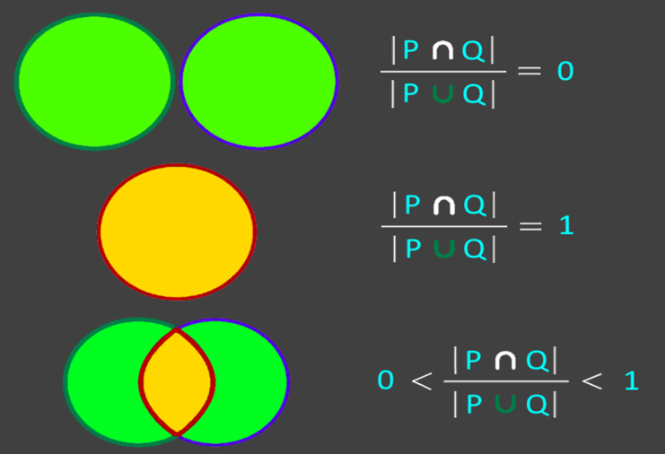
Jaccard Distance
A metric used to measure the similarity between two sets of data. One may argue that in order to measure similarity is to compute the size (cardinality, number of elements.) of the intersection between two given sets.
Disadvantage:
A major disadvantage of the Jaccard index is that it is highly influenced by the size of the data.
Use case:
The Jaccard index is often used in applications where binary or binarized data are used.
Formula:

Slide 35
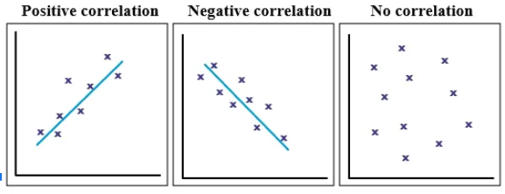
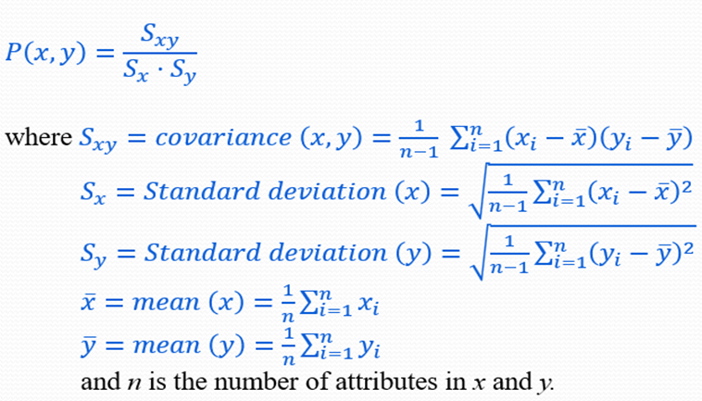
Correlation
The correlation between two data objects that have binary or continuous variables is a measure of the linear relationship between the attributes of the objects.
More precisely, Pearson’s correlation coefficient between two objects x and y.
There are three possible results of a correlational study: a positive correlation, a negative correlation, and no correlation.
Disadvantages:
Correlation is not and cannot be taken to imply causation.
Correlation does not allow us to go beyond the data that is given.
Use Case:
Prediction
Validity
Reliability
Theory Verification
Formula:

