Slide 1
Similarity Measures using Vectors

Slide 2
Applications of vector similarity measures in real-time
Document Similarity
Pose Matching
Recommendation systems

Slide 3
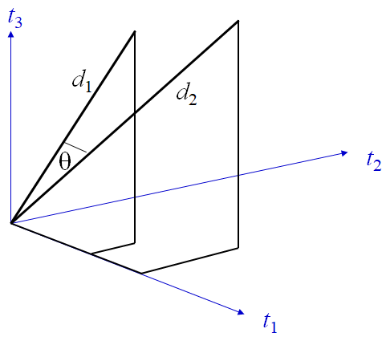
Document Similarity
Text similarity has to determine how ‘close’ two pieces of text
are both in surface closeness [lexical similarity] and
meaning [semantic similarity].
Quantification of the similarity between two documents can
be obtained by converting the words or phrases within the
document or sentence into a vectorised form of representation.
The similarity between two documents is a function of the angle
between their vectors in the term vector space.

Slide 4
Document Similarity
d = (w₁, w₂,w₃, ..., w_{n}) is a vector in an n-dimensional vector space
Length of d is given by (extension of Pythagoras theorem)
|d|² = w₁² + w₂² + w₃² + ... + w_{n}²
|d| = (w₁² + w₂² + w₃² + ... + w_{n}² )^{1/2}
If d₁ and d₂ are document vectors:
Inner product (or dot product) is given by
d₁.d₂ = w₁₁w₂₁ + w₁₂w₂₂ + w₁₃w₂₃ + ... + w_{1n}w_{2n}
Cosine angle between the docs d₁ and d₂ determines doc similarity
cos (q) =

Slide 5
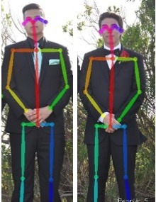
Pose Matching
Human pose estimation is the identification of a human’s pose
through joint and limb recognition on an image or in a video.
By using the cosine similarity in the Euclidean distance formula,
the distance from one vector to another can be computed without
being corrupted by the varying length of the vectors.
In several human pose estimation calculation models, there is a
factor known as the confidence score for each keypoint. The
confidence score represents the likeliness that the keypoint exists
in the calculated spot.

Slide 6
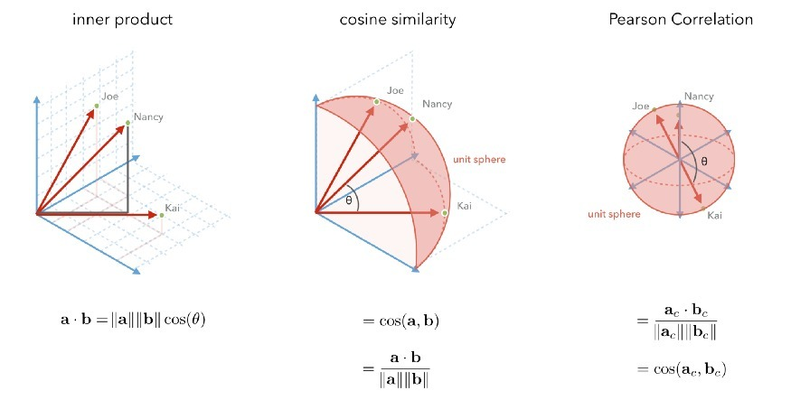
Recommendation Systems
The first three similarity metrics that we will consider are all variations on the inner product between user rating vectors.
The best way to choose a metric is to optimize predictions offline with cross-validation, or optimize them online with an A/B test.

