Slide 1
WEKA and ORANGE software -
run clustering, association rules discovery, and a decision tree
Group 5 Presentation

Slide 2
CLUSTERING USING ORANGE
Group 5 Presentation

Slide 3
DATA SET INTRODUCTION
Pima Indians Diabetes Database
Link to the Dataset : https://www.kaggle.com/datasets/uciml/pima-indians-diabetes-database
The dataset is originally from the National Institute of Diabetes and Digestive and Kidney Diseases. The objective of the dataset is to diagnostically predict whether or not a patient has diabetes, based on certain diagnostic measurements included in the dataset. Several constraints were placed on the selection of these instances from a larger database. In particular, all patients here are females at least 21 years old of Pima Indian heritage.

Slide 4
CLUSTERING
Clustering is an unsupervised machine learning method of identifying and grouping similar data points in larger datasets without concern for the specific outcome.
K-MEANS CLUSTERING
K-means clustering aims to partition data into k clusters in a way that data points in the same cluster are similar and data points in the different clusters are farther apart. Similarity of two points is determined by the distance between them. There are many methods to measure the distance.

Slide 5
K-MEANS CLUSTERING
To process the learning data, the K-means algorithm in data mining starts with a first group of randomly selected centroids, which are used as the beginning points for every cluster, and then performs iterative (repetitive) calculations to optimize the positions of the centroids
It halts creating and optimizing clusters when either:
The centroids have stabilized — there is no change in their values because the clustering has been successful.
The defined number of iterations has been achieved.

Slide 6
ORANGE SOFTWARE
Orange is an open-source data visualization, machine learning and data mining toolkit. It features a visual programming front-end for explorative rapid qualitative data analysis and interactive data visualization.

Slide 7
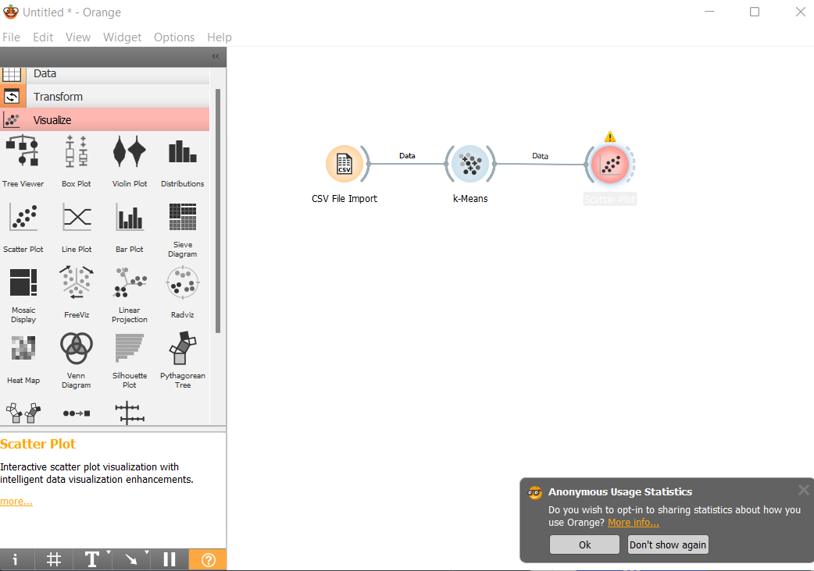
OUTPUT - VISUALIZATION

Slide 8
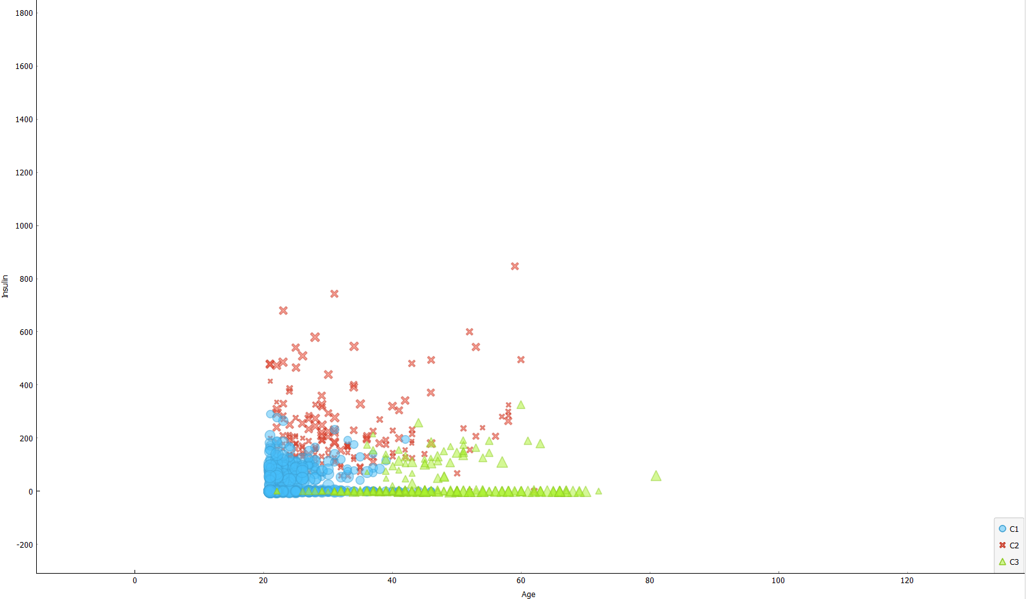
OUTPUT - CLUSTERING

Slide 9
THANK YOU

