Slide 1
Use WEKA to Build the Model

Slide 2
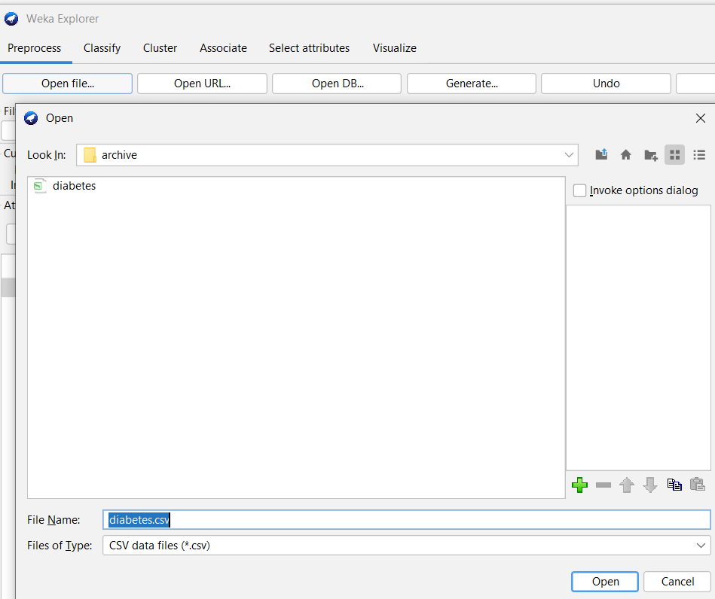
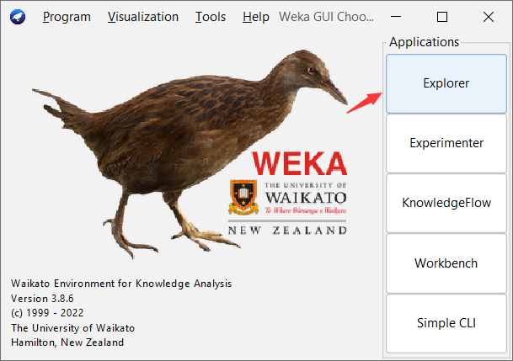
Load the data
Be careful with the type of the data file.

Slide 3
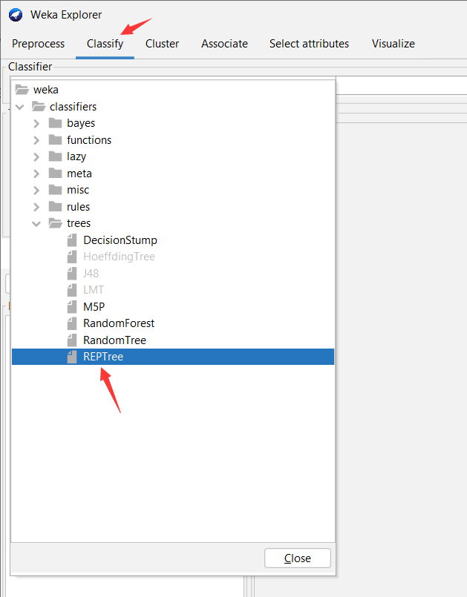
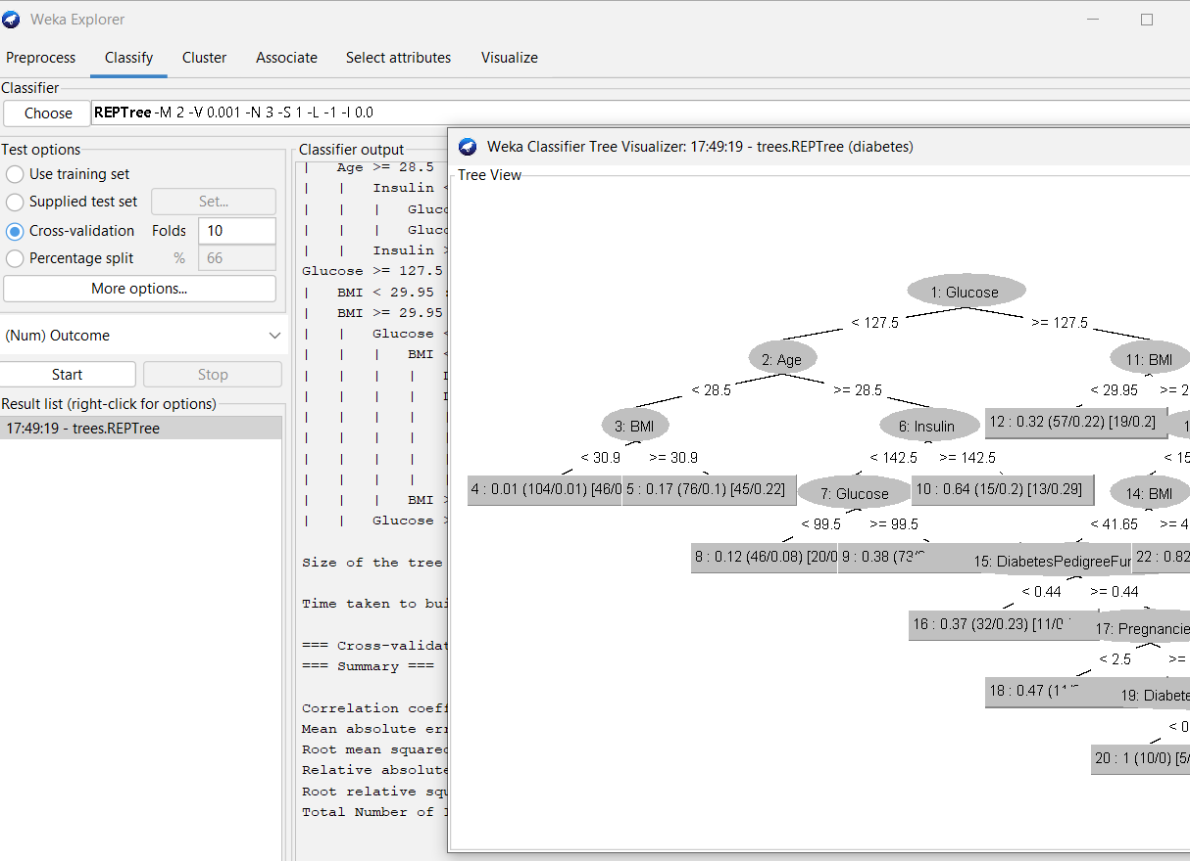
Build decision tree
You can choose any attributes.

Slide 4
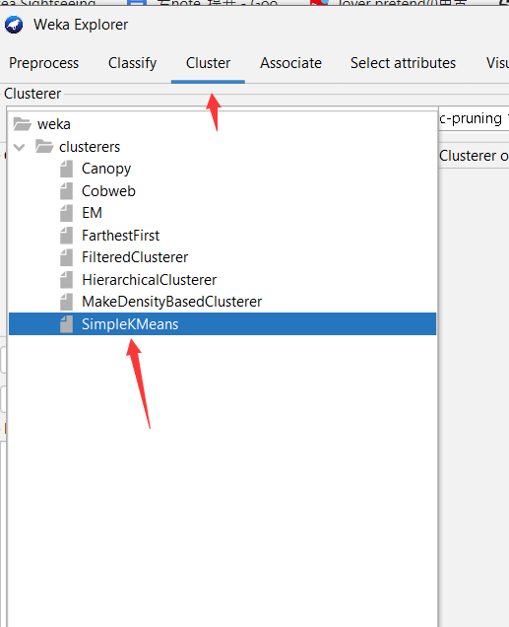
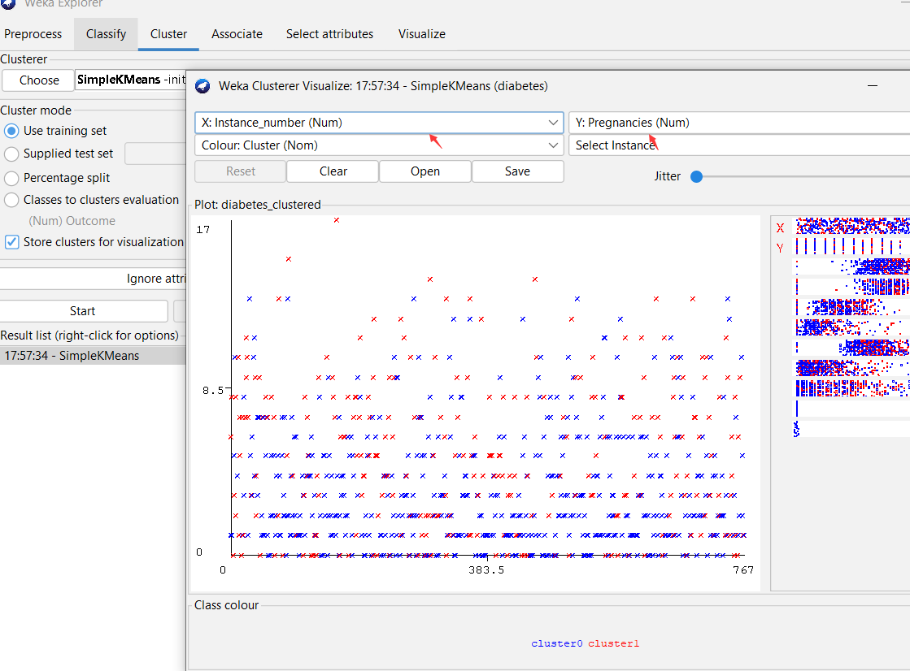
Build clustering
You can choose x and y attribute,

Slide 5
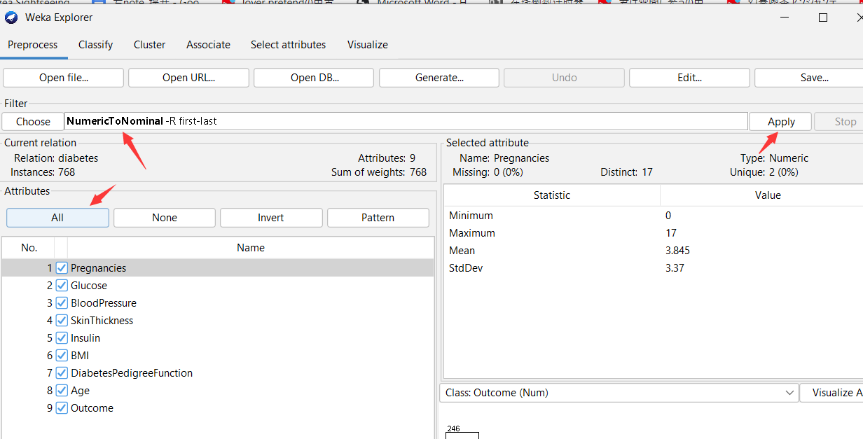
Build association rules
Convert the attributes to nominal FIRST!!!

Slide 6
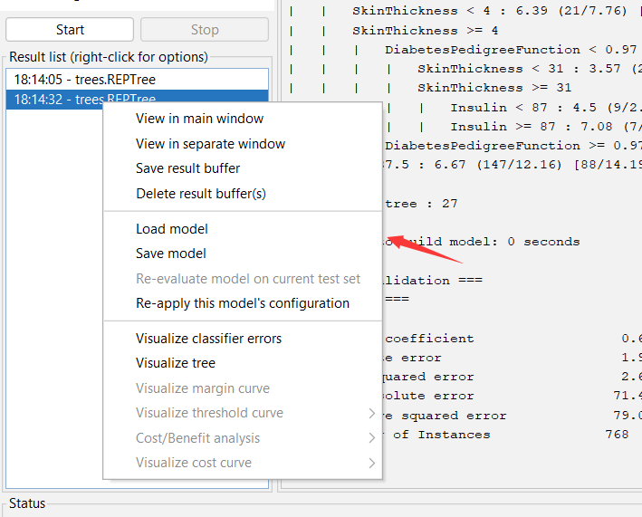
Save and Load

