Slide 1

DECISION TREES - WEKA

Slide 2
DECISION TREES:
Decision trees are also called classification or regression trees. They work by learning answers to a hierarchy of questions, if / if not that leads to a decision. The output is a tree like structure.
For example, if we want to predict a person will order food or not. The output tree is as follows:

Slide 3
Each node in the tree represents a question derived from the characteristics present in your data set.
The dataset is divided based on the questions until the maximum depth of the tree is reached. The last node represents to which class the value belongs.
The top node is the root node. The last node is the leaf node.
A node divided into sub nodes is called parent node and the sub nodes are called secondary nodes.

Slide 4
WHAT IS WEKA AND WHY?
Weka represents Waikato Environment for Knowledge Analysis. It has multiple built-in functions to implement a wide range of machine learning algorithms from linear regression to neural networks.
With weka data can be preprocessed, classified, grouped and also can be viewed. It supports different file formats like ARFF, CSV, C4.5 and JSON

Slide 5
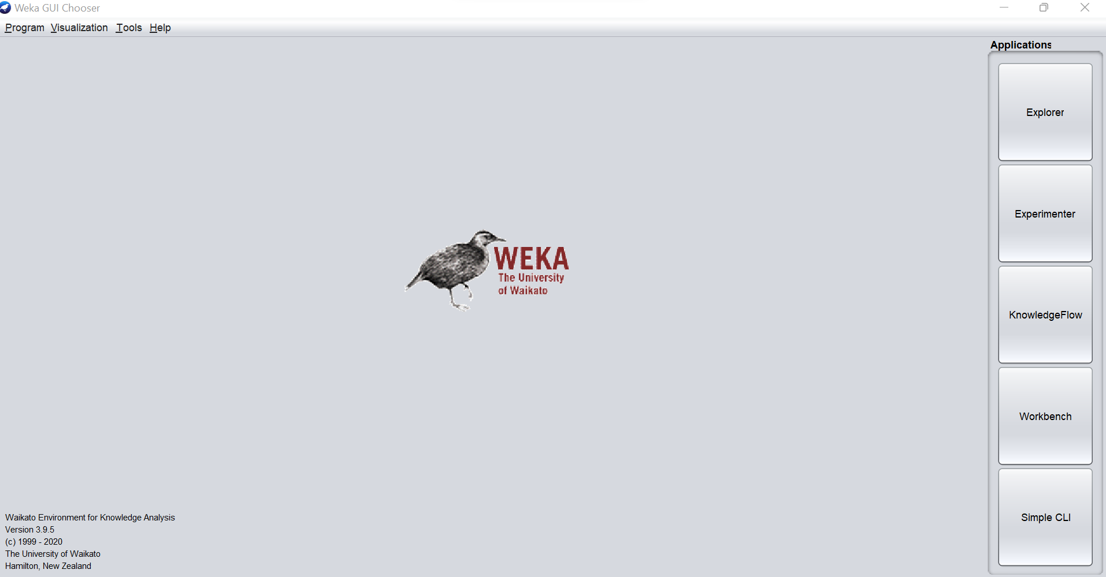
WEKA INTERFACE

Slide 6
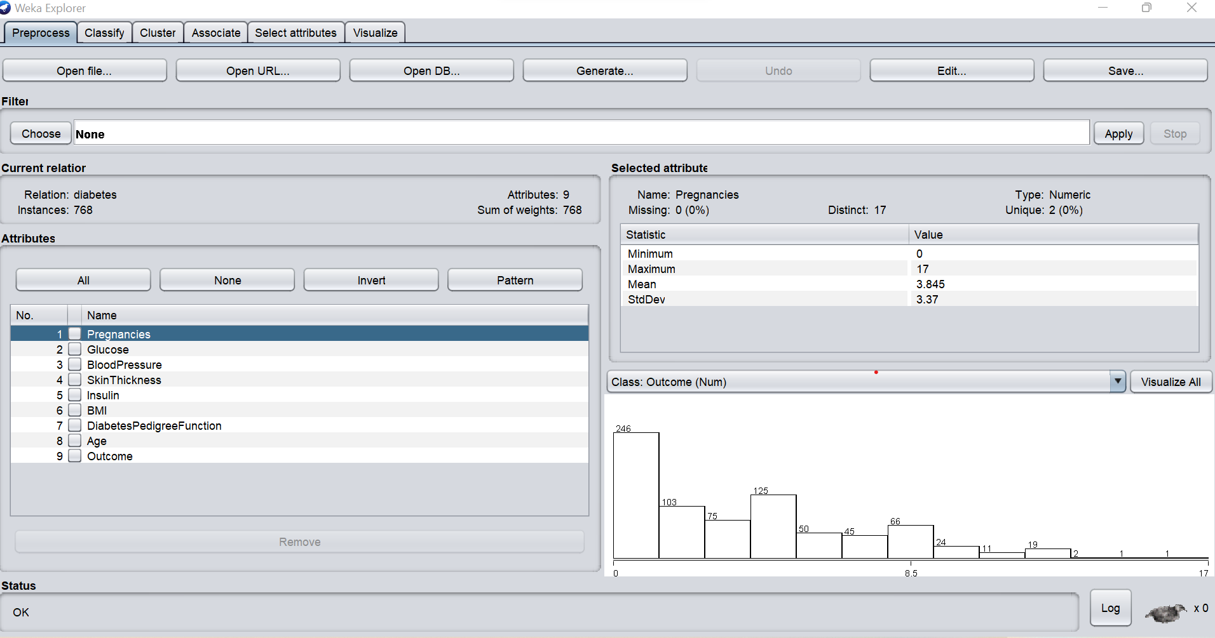

Slide 7
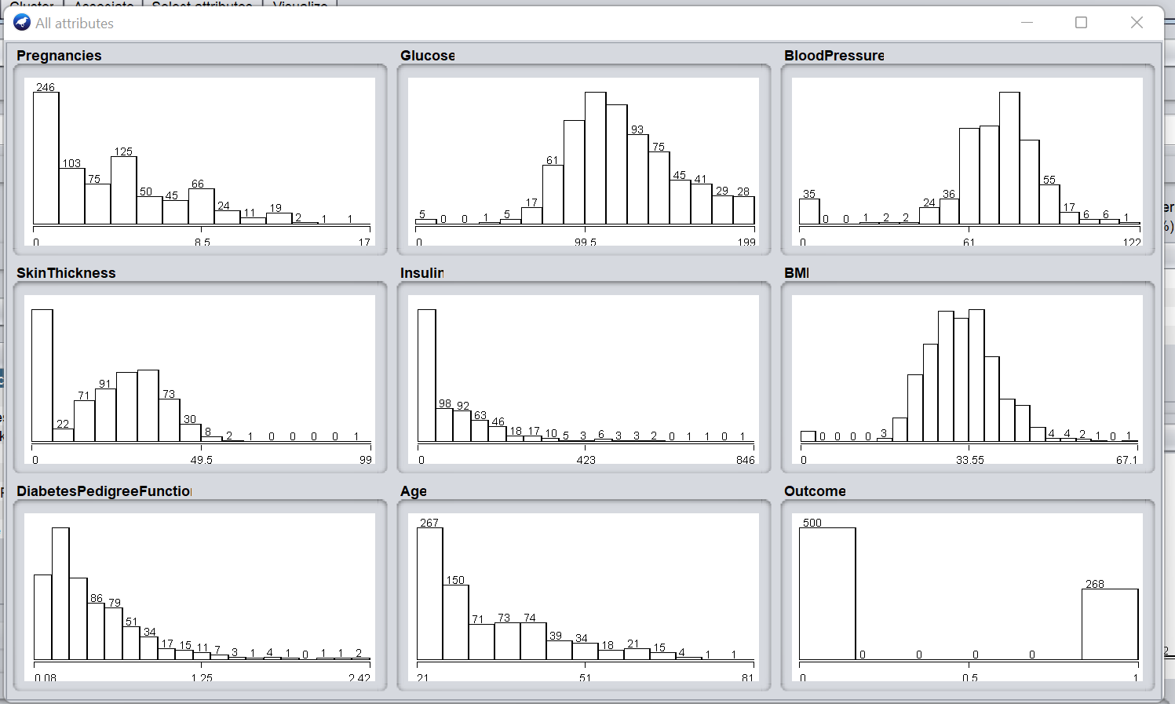

Slide 8
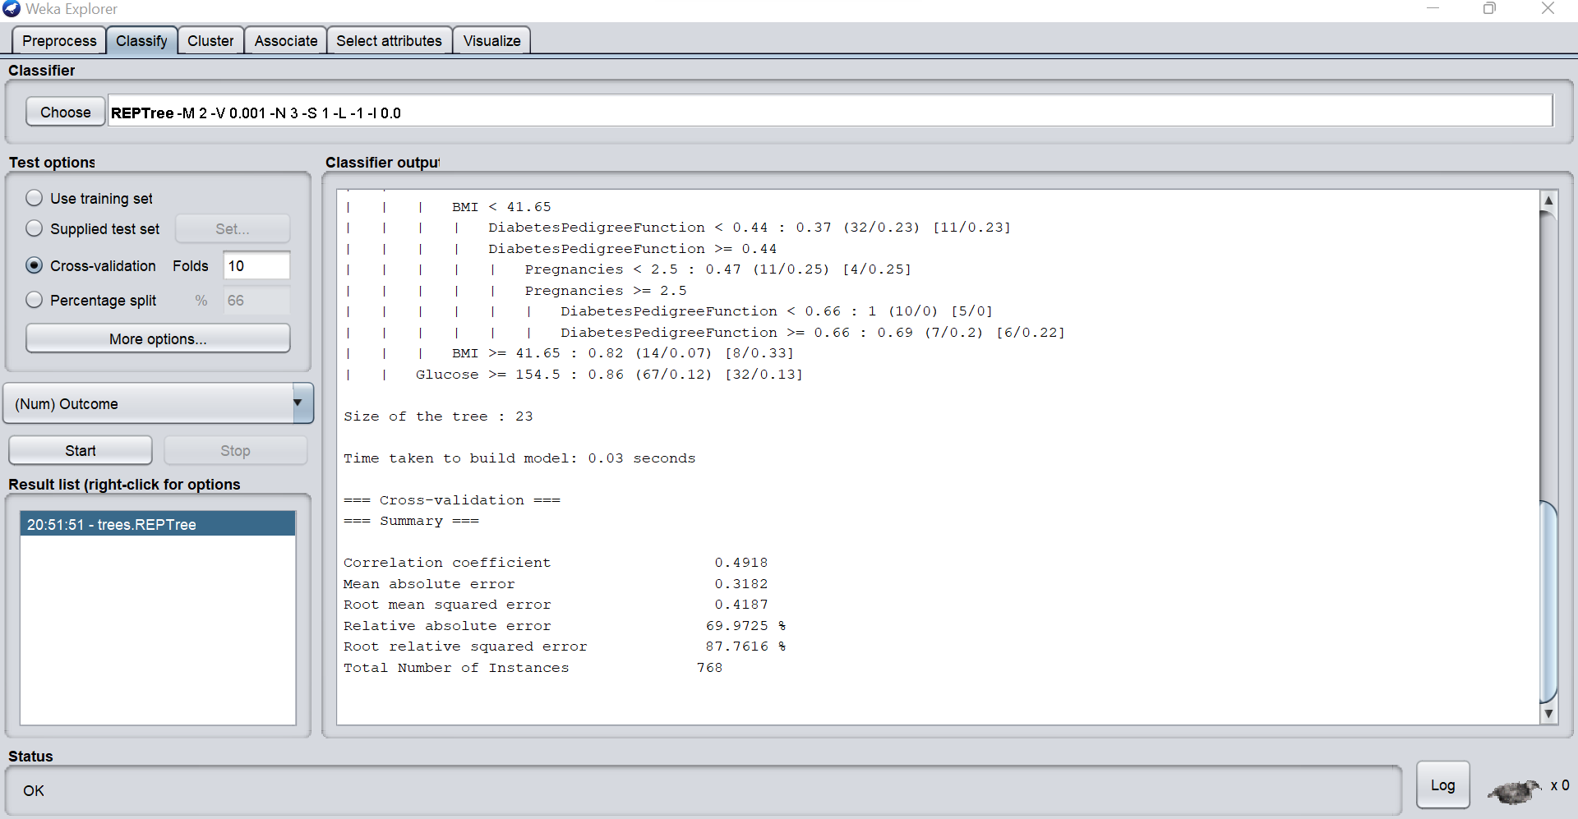

Slide 9
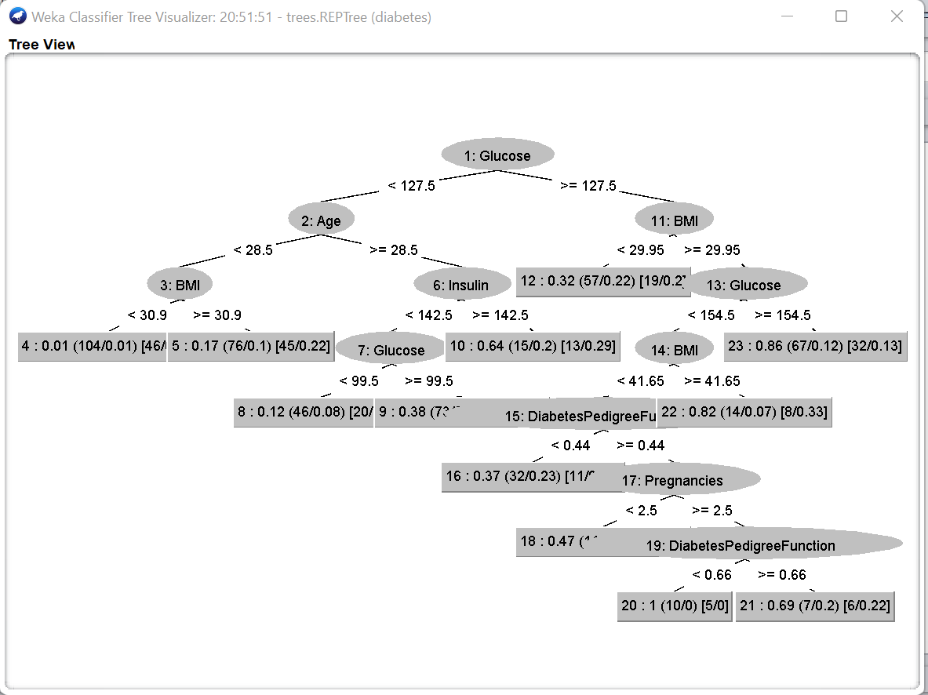
DECISION TREE VISUALIZATION IN WEKA

Slide 10

THANK YOU

