Slide 1
WEKA and ORANGE software -
run clustering, association rules discovery, and a decision tree
Group 5 Presentation

Slide 2
Dataset Introduction
Pima Indians Diabetes Database
Link to the Dataset : This data is from Kaggle Website
https://www.kaggle.com/datasets/uciml/pima-indians-diabetes-database
Context
This dataset is originally from the National Institute of Diabetes and Digestive and Kidney Diseases. The objective of the dataset is to diagnostically predict whether or not a patient has diabetes, based on certain diagnostic measurements included in the dataset. Several constraints were placed on the selection of these instances from a larger database. In particular, all patients here are females at least 21 years old of Pima Indian heritage.
Content
The datasets consists of several medical predictor variables and one target variable, Outcome. Predictor variables includes the number of pregnancies the patient has had, their BMI, insulin level, age, and so on.

Slide 3
Attributes of the Dataset
Pregnancies: Number of times pregnant
Glucose: Plasma glucose concentration a 2 hours in an oral glucose tolerance test
Blood Pressure: Diastolic blood pressure (mm Hg)
Skin Thickness: Triceps skin fold thickness (mm)
Insulin: 2-Hour serum insulin (mu U/ml)
BMI: Body mass index (weight in kg/(height in m)^2)
Diabetes Pedigree Function: Diabetes pedigree function
Age: Age (years)
Outcome: Class variable (0 or 1) 0 for healthy and 1 is for diabetic

Slide 4
Quicklook into the data

Slide 5
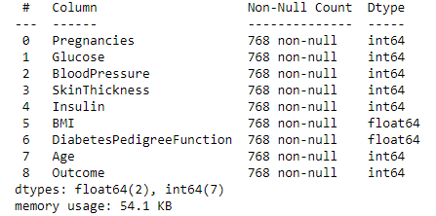
Info about the Dataset

Slide 6
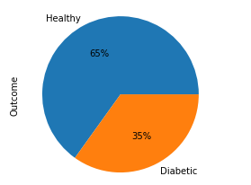
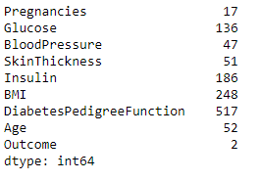
Analysis of the data
Distribution Of Outcome
Unique values

