Slide 1
WEKA and ORANGE software - run clustering, association rules discovery, and a decision tree
Group 5 Presentation

Slide 2
DECISION TREES - ORANGE

Slide 3
DECISION TREES:
Decision trees are also called classification or regression trees. They work by learning answers to a hierarchy of questions, if / if not that leads to a decision. The output is a tree like structure.
For example, if we want to predict a person will order food or not. The output tree is as follows:

Slide 4
Each node in the tree represents a question derived from the characteristics present in your data set.
The dataset is divided based on the questions until the maximum depth of the tree is reached. The last node represents to which class the value belongs.
The top node is the root node. The last node is the leaf node.
A node divided into sub nodes is called parent node and the sub nodes are called secondary nodes.

Slide 5
WHAT IS ORANGE
Orange is an open-source data visualization, machine learning and data mining toolkit. It features a visual programming front-end for explorative rapid qualitative data analysis and interactive data visualization.
The objective of Orange is to provide a platform for experiment-based selection, predictive modeling, and recommendation system. It primarily used in bioinformatics, genomic research, biomedicine, and teaching.

Slide 6
ORANGE INTERFACE

Slide 7
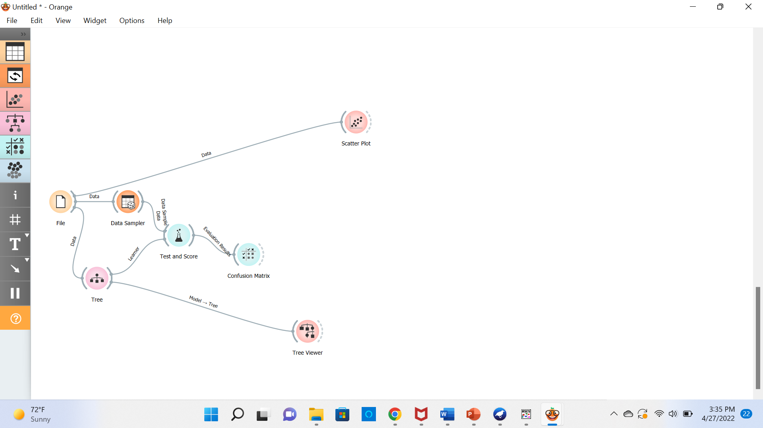

Slide 8
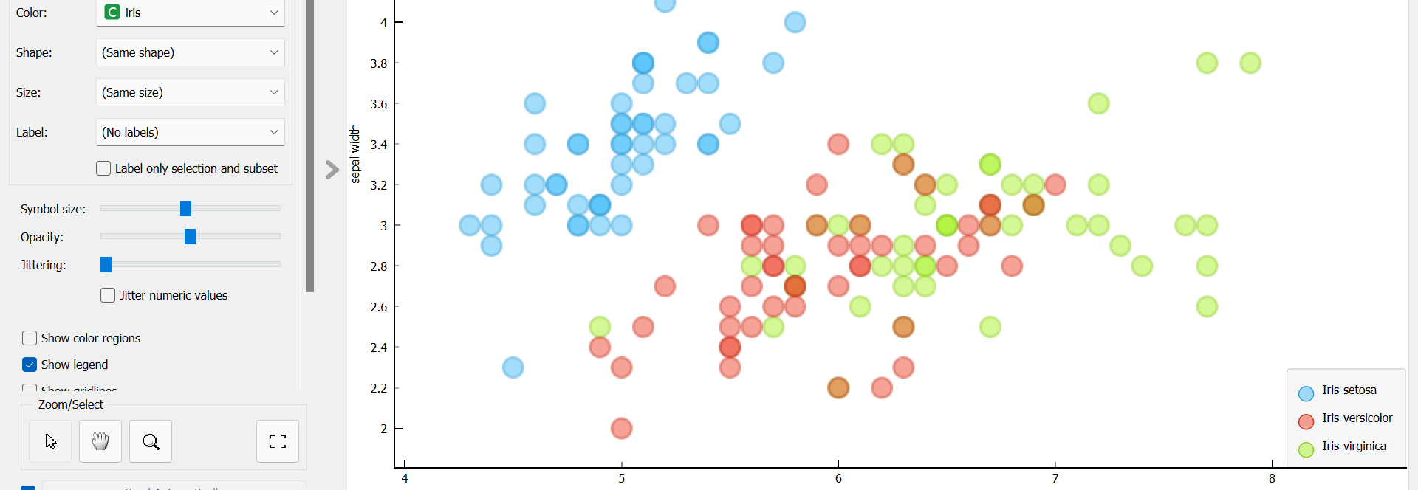
Scatter Plot for Iris Dataset
Scatter

Slide 9
DECISION TREE VISUALIZATION IN ORANGE

Slide 10
THANK YOU

