Slide 1

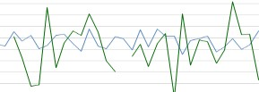

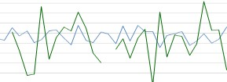
DATA MINING WITH HADOOP
AND HIVE
Introduction to Architecture
Dr. Wlodek Zadrozny, Dr. Srinivas Akella
Slide ‹#›

Slide 2
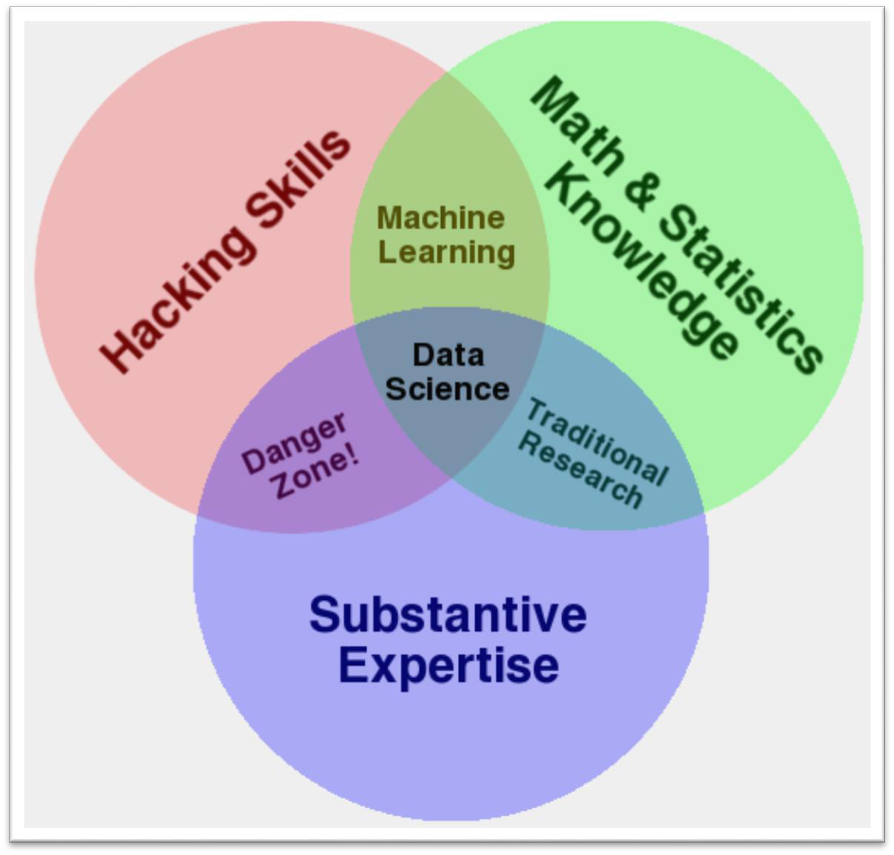


Data Science
Hadoop
& Hive
Source: http://www.dataists.com/2010/09/the- data-science-venn-diagram/
©2015-2025. Re
permission of
production or usage authors (Dr. Hansen
prohibited without or Dr. Zadrozny)
D
SBA6100 Big Da
ta Analyt
ics for Compe
titive Advant
age
Slide ‹#›
Slide ‹#›

Slide 3

MapReduce and Hadoop

Slide 4

MapReduce
MapReduce programming paradigm for clusters of
commodity PCs
Map computation across many inputs
Fault-tolerant
Scalable
Machine independent programming model
Permits programming at abstract level
Runtime system handles scheduling, load balancing

Slide 5
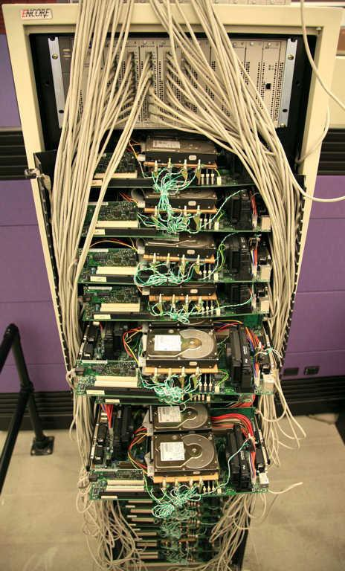
First Google server
~1999
Computer History Museum

Slide 6
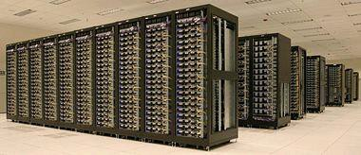
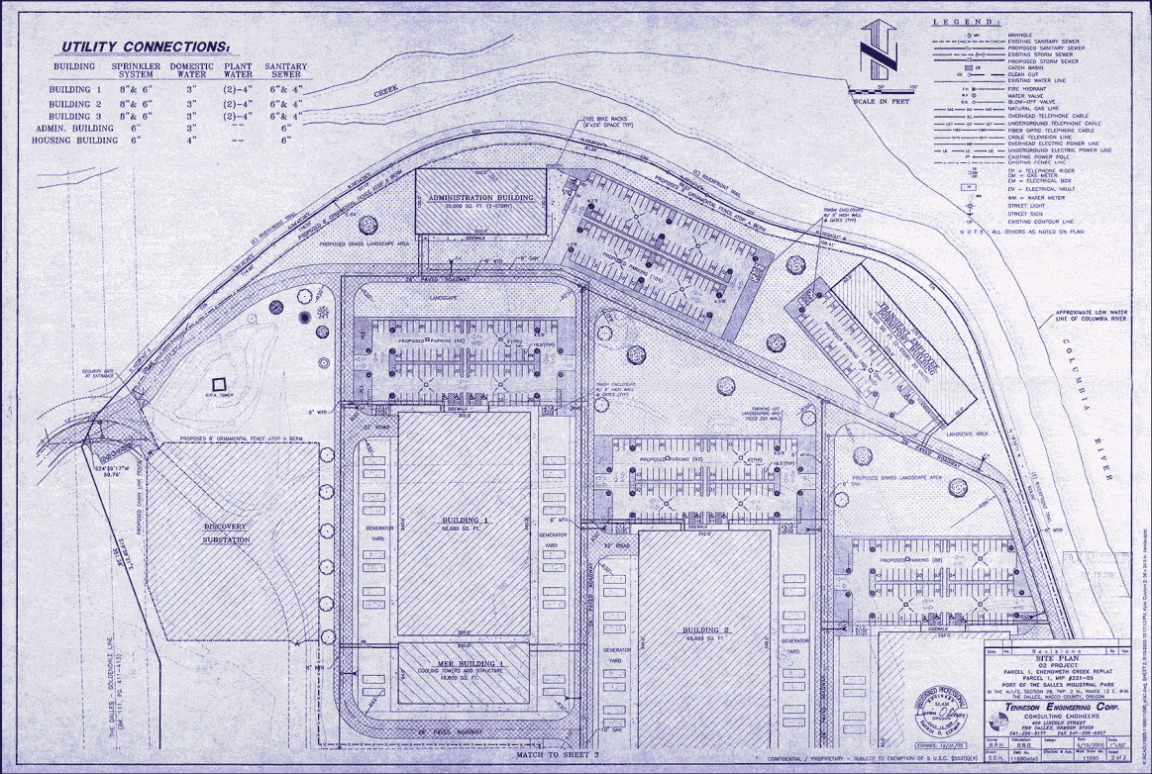
Data Centers
Yahoo data center
Google data center layout
Harpers, 3/2008

Slide 7
Motivation: Large Scale Data Processing
Many tasks: Process lots of data to produce other data
Want to use hundreds or thousands of CPUs
... but this needs to be easy
MapReduce provides:
  Automatic parallelization and distribution
  Fault-tolerance
  I/O scheduling
  Status and monitoring

Slide 8
Example Tasks
Finding all occurrences of a string on the web
Finding all pages that point to a given page
Data analysis of website access log files
Clustering web pages

Slide 9
Functional Programming
MapReduce: Based on Functional Programming paradigm that treats computation as
evaluation of math functions
Map
map result-type function sequence &rest more-sequences
The function must take as many arguments as there are sequences provided; at least one sequence must be provided. The result of map is a sequence such that element j is the result of applying function to element j of each of the argument sequences.
• Example: (map 'list #'- '(1 2 3 4)) => (-1 -2 -3 -4)
Reduce
reduce function sequence &key :from-end :start :end :initial-value
The reduce function combines all the elements of a sequence using a binary operation; for example, using + one can add up all the elements.
• Example: (reduce #'+ '(1 2 3 4)) => 10

Slide 10
MapReduce Programming Model
Input and Output: each a set of key/value pairs
Programmer specifies two functions:
map (in_key, in_value) -> list(out_key, intermediate_value)
  Processes input key/value pair
  Produces set of intermediate pairs
reduce (out_key, list(intermediate_value)) -> list(out_value)
  Combines all intermediate values for a particular key
  Produces a set of merged output values (usually just one)
Inspired by similar primitives in LISP and other languages

Slide 11
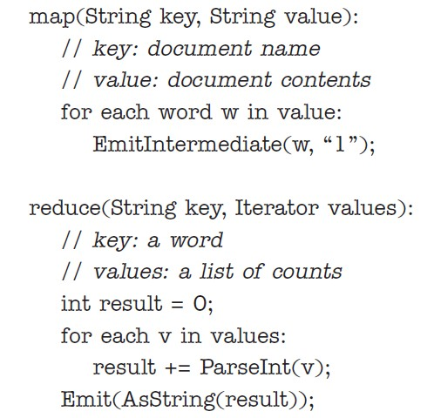
Example: Count word occurrences

Slide 12
MapReduce Operations
Conceptual:
– Map: (K1, V1) -> list(K2, V2)
  Reduce: (K2, list(V2)) -> list(K3, V3)
WordCount example:
  Map: (doc, contents) -> list(word_i, 1)
  Reduce:
(word_i, list(1,1,…)) -> list(word_i, count_i)

Slide 13
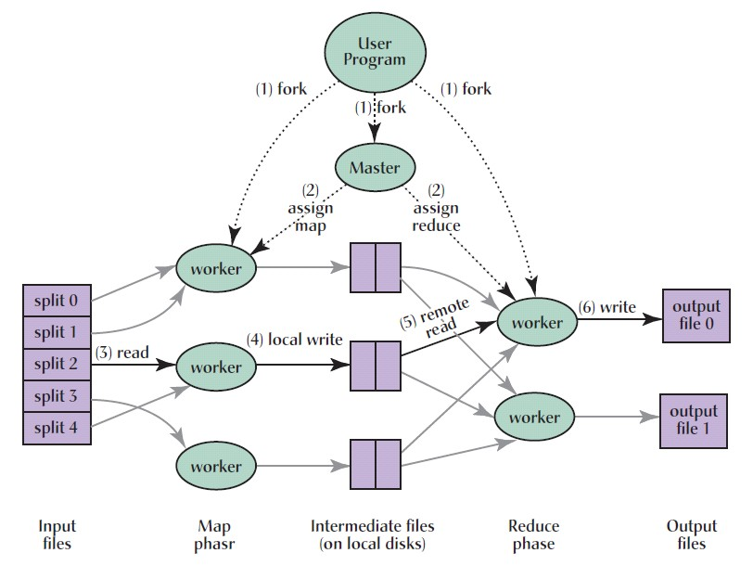
Execution Overview
Dean and Ghemawat, 2008

Slide 14
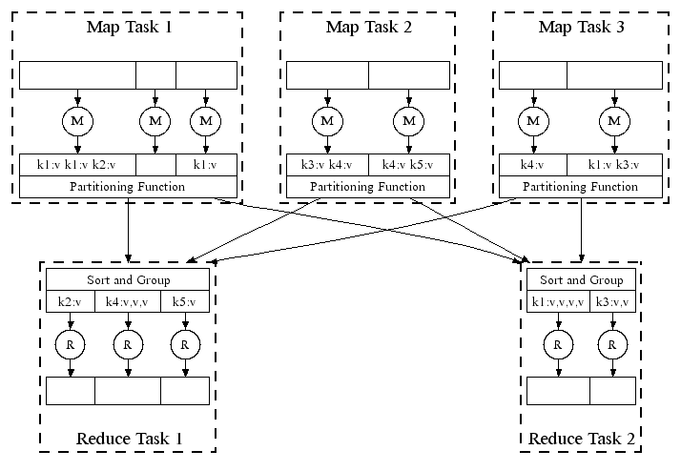
Parallel Execution
200,000 map/5000 reduce tasks w/ 2000 machines (Dean and Ghemawat, 2004)
Over 1m/day at FB last year

Slide 15
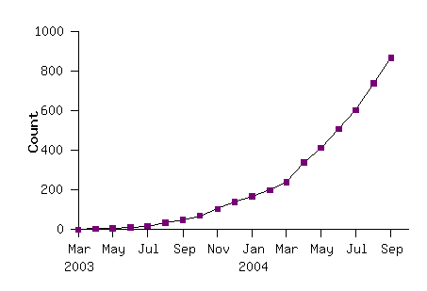
Model has Broad Applicability
MapReduce Programs In Google Source Tree
Example uses:
distributed grep | distributed sort | web link-graph reversal
term-vector per host document clustering | web access log stats machine learning | inverted index construction statistical machine translation

Slide 16
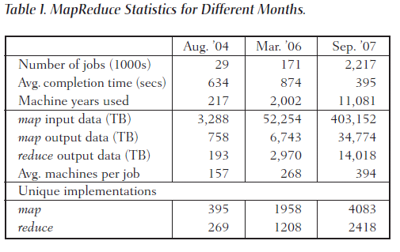
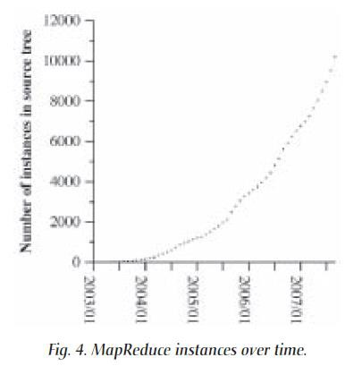
Usage at Google

Slide 17
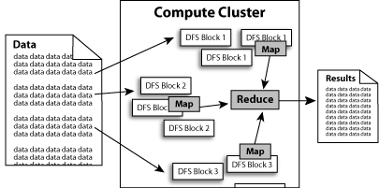
Hadoop
Open Source Apache project
Written in Java; runs on Linux, Windows, OS/X, Solaris
Hadoop includes:
  MapReduce: distributes applications
  HDFS: distributes data

Slide 18
Hadoop Design Goals
Storage of large data sets
Running jobs in parallel
Maximizing disk I/O
Batch processing

Slide 19
Job Distribution
Users submit mapreduce jobs to jobtracker
Jobtracker puts jobs in queue, executes on first-come, first-served basis
Jobtracker manages assignment of map and reduce tasks to
tasktrackers
Tasktrackers execute tasks upon instruction from jobtracker, and
handle data transfer between map and reduce phases

Slide 20
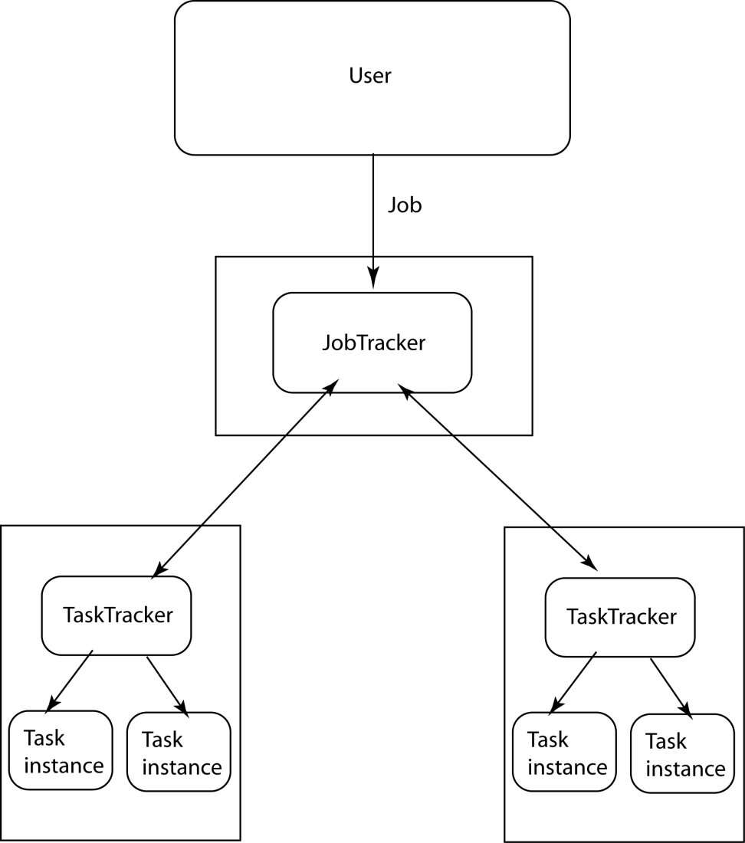
Hadoop MapReduce

Slide 21
Data Distribution
Data transfer handled implicitly by HDFS
Move computation to where data is: data locality
Map tasks are scheduled on same node that input data resides on
If lots of data is on the same node, nearby nodes will
map instead

Slide 22
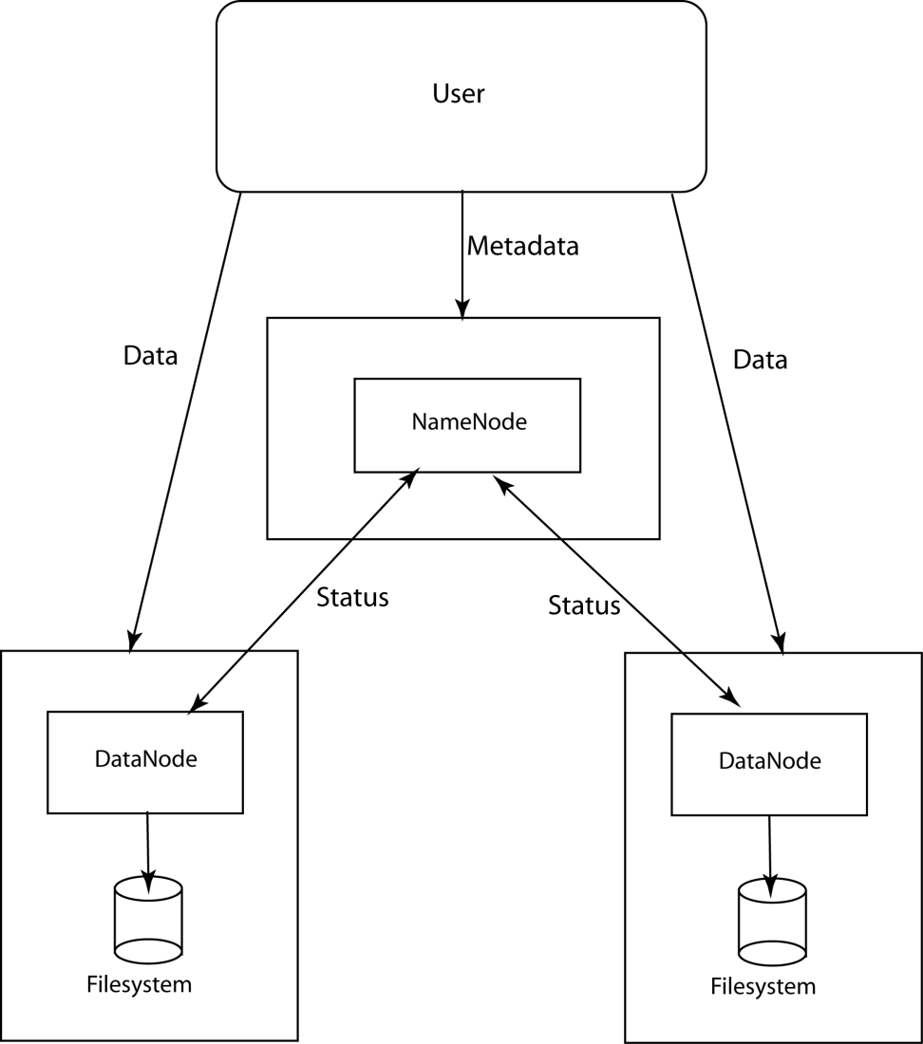
Hadoop DFS (HDFS)

Slide 23
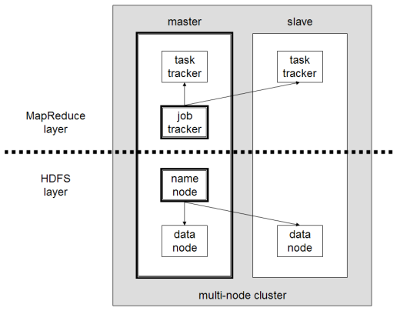
Map Reduce and HDFS
http://www.michael-noll.com/wiki/Running_Hadoop_On_Ubuntu_Linux_(Multi-Node_Cluster)

Slide 24
Data Access
CPU and transfer speed, RAM and disk size double every
18-24 months
Disk seek time is nearly constant (~5% per year)
Time to read entire disk is growing
Scalable computing should not be limited by disk seek
time
Throughput more important than latency

Slide 25
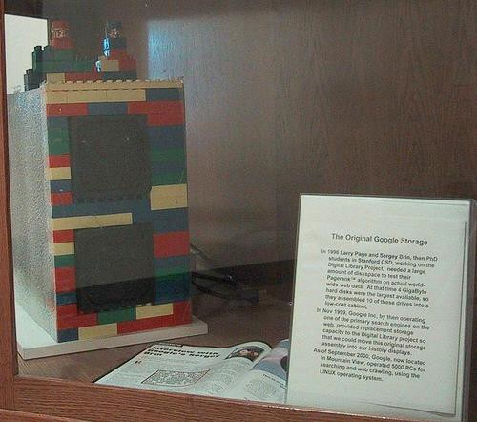
Original Google Storage
Source: Computer History Museum

Slide 26
HDFS
Inspired by Google File System (GFS)
Follows master/slave architecture
HDFS installation has one Namenode and one or more Datanodes (one per node in cluster)
Namenode: Manages filesystem namespace and regulates file access by clients. Makes filesystem namespace operations (open/close/rename of files and directories) available via RPC
Datanode: Responsible for serving read/write requests from filesystem clients. Also perform block creation/deletion/replication (upon instruction from Namenode)

Slide 27
HDFS Design Goals
Very large files:
  Files may be GB or TB in size
Streaming data access:
  Write once, read many times
  Throughput more important than latency
Commodity hardware
  Node failure may occur

Slide 28
HDFS
Files are broken into blocks of 64MB (but can be user
specified)
Default replication factor is 3x
Block placement algorithm is rack-aware
Dynamic control of replication factor

Slide 29
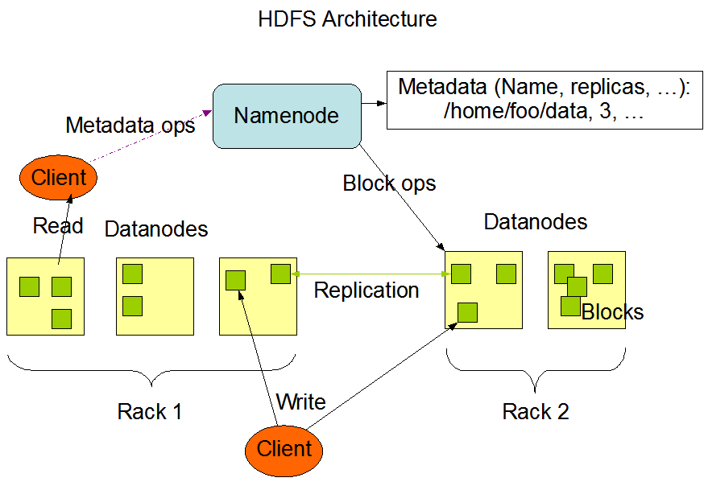
HDFS
Source: http://lucene.apache.org/hadoop/hdfs_design.html

Slide 30
Example HDFS Installation
Facebook, 2010 (Largest HDFS
installation at the time)
2000 machines, 22,400 cores
24 TB / machine, (21 PB total)
Writing 12TB/day
Reading 800TB/day
25K MapReduce jobs/day
65 Million HDFS files
30K simultaneous clients.
2014: Facebook generates 4 new petabyes of data and runs 600,000 queries and 1 million map-reduce jobs per day.
Hive is Facebook's data warehouse, with 300 petabytes of data in 800,000 tables More at:
https://research.facebook.com/blog/15226929279
72019/facebook-s-top-open-data-problems/
1B users per day
(http://fortune.com/2015/08/28/1-billion-facebook/)

Slide 31
Companies to first use MapReduce/Hadoop
Google
Yahoo
Microsoft
Amazon
Facebook
Twitter
Fox interactive media
AOL
Hulu
LinkedIn Disney NY Times Ebay Quantcast Veoh Joost Last.fm
Any company with enough data

Slide 32




Hadoop Vendors
Cloudera
Hortonworks
MapR
IBM BigInsights

Slide 33

Hive
Apache Hive is a data warehouse infrastructure built on top of Hadoop for
providing data summarization, query, and analysis.
Developed at Facebook to enable analysts to query Hadoop data
MapReduce for computation, HDFS for storage, RDBMS for metadata
Can use Hive to perform SQL style queries on Hadoop data
Most Hive queries generate MapReduce jobs
Can perform parallel queries over massive data sets

Slide 34

Apache Pig
Pig: High-level platform for creating MapRed
programs
Developed at Yahoo
Pig Latin: Procedural language for Pig
Ability to use user code at any point in pipeline makes it
good for pipeline development
uce

Slide 35
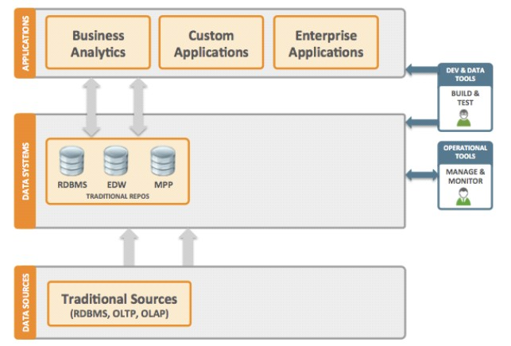
Traditional Data Enterprise Architecture
Hortonworks, 2013

Slide 36
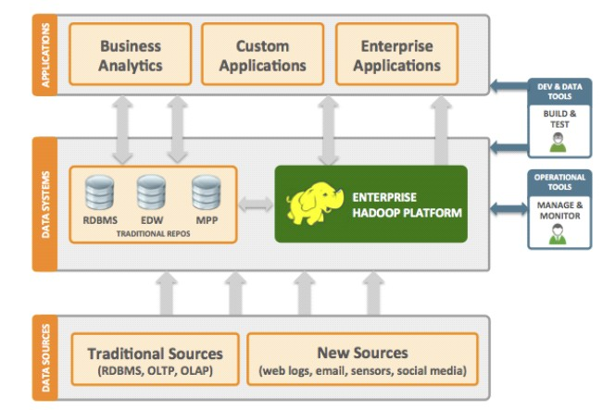
Emerging Big Data Architecture
Collect data
Clean and process using Hadoop
Push data to Data Warehouse, or use directly in Enterprise applications
Hortonworks, 2013

Slide 37
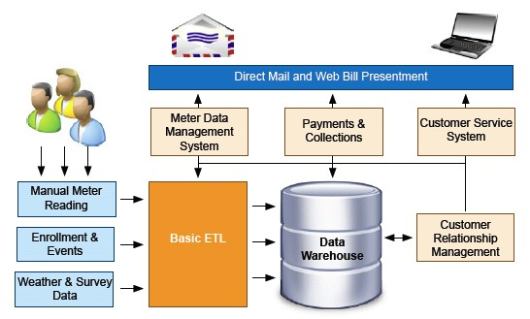
Data flow of meter done manually
Awadallah and Graham

Slide 38
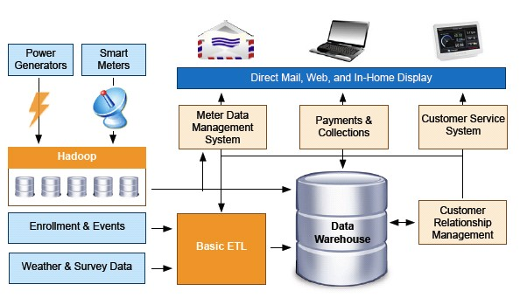
Automatic update of meter readings every 15 mins
Awadallah and Graham

Slide 39
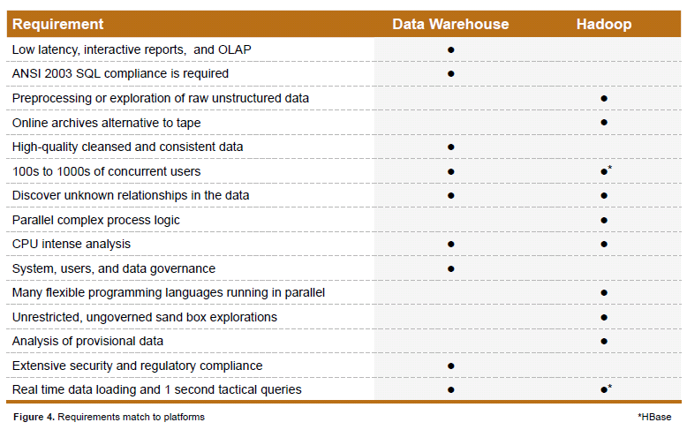
DW and Hadoop Use Cases
Awadallah and Graham

