Slide 1
MapReduce Types, Formats and Features

Slide 2
Map Reduce General Form
The map and reduce functions in Hadoop MapReduce have the following general form:
Here map input key K1 and value V1 are different from map output type K2 and V2
Reduce input is same as Map output but output of reduce is different as K3 and V3

Slide 3
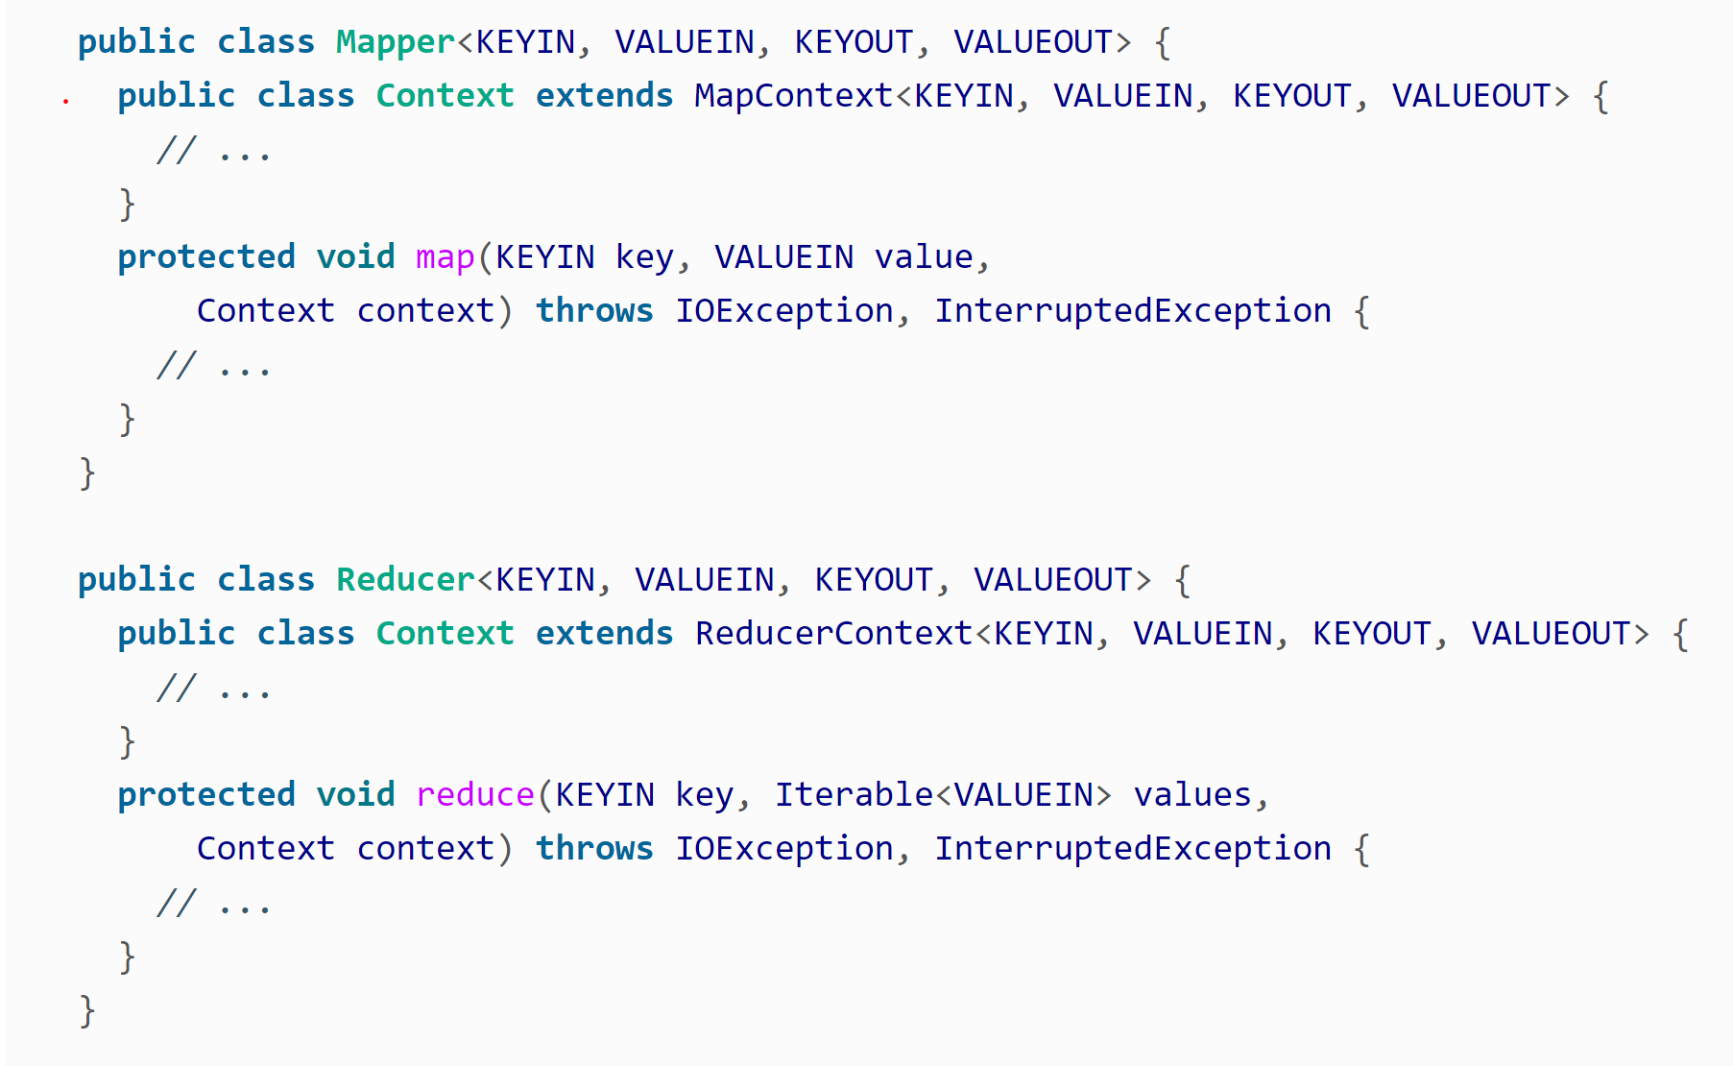
Generic Java Implementation of Mapper and Reducer Classes

Slide 4
Map Reduce Input- Basics and Background
Every input to Map Reduce Job is split into chunks called InputSplit
Each InputSplit consists of records – key value pairs to be processed by Map function
Input Split is implemented in Hadoop by java class InputSplit which has two methods: First one to return length of split and second to return location of split

Slide 5
Map Reduce Input Formats
Java Abstract InputFormat class responsible for creating input splits.
Application writers do not deal with splits instead create implemention of InputFormat class
InputFormat class returns to the job list of input splits .
The Job passes each split to createRecordReader method to get RecordReader class which is later used by mapper class.

Slide 6
Types of Input Format.
File input most common input format.Mainly 3 types of File Input Formats
FileInputFormat:The base class for all implementations of InputFormat that use a file as the source for data. Provides a place to define what files are included as input to a job and an implementation for generating splits for the input files.Input is often specified as a collection of paths
CombineFileInputFormat:Java class designed to work well with small files in Hadoop.Each split will contain many of the small files so that each mapper has more to process.Takes node and rack locality into account when deciding what blocks to place into the same split
WholeFileInputFormat:Defines a format where the keys are not used and the values are the file contents.Takes a FileSplit and converts it into a single record.

Slide 7
Types of Input Formats
Text Input
TextInputFormat: Default Input Format.Each record is a line of input.Key is byte offset from beginning of the file and value is content of the line.
KeyValueTextInputFormat:Appropriate class to handle when each line of file is key value pair.
NLineInputFormat: Appropriate class to handle fixed number of lines in input text file.
Binary Input
SequenceFileInputFormat:Suited to handle Hadoop’s sequential file format consisting of binary key value pair.
SequenceFileAsTextInputFormat: Appropriate class to convert Sequence file key and value to text objects to make it suitable for streaming.
SequenceFileAsBinaryInputFormat:Retrieves the sequence file’s keys and values as binary objects
FixedLengthInputFormat:Used for reading fixed-width binary records from a file where the records are not separated by delimiters
Multiple Input:Used to handle multiple input of different formats.
Database Input: Input format for reading data from a relational database

Slide 8
Output Type Formats
TextOutputFormat:Default output format.Writes records as lines of text (keys and values are turned into strings).
Binary Output
SequenceFileOutputFormat:Writes sequence files as output
SequenceFileAsBinaryOutputFormat:Writes keys and values in binary format into a sequence file container.
MapFileOutputFormat:Writes map files as output.
Multiple Output:Allows programmer to write data to files whose names are derived from output keys and values to create more than one file
LazyOutput: Wrapper output format that ensures the output file is created only when the first record is emitted for a given partition
Database Output:Writes to relational database and Hbase.

Slide 9
Counters
Counters are useful to gather statistical information about the job, to diagnose problem incase there is one.
Built in counters
Task Counters: It gathers information about the task and finally results are aggregated for all tasks in a job.
Job Counters: Maintained by application master,measure job level statistics such total number of map and reduce tasks etc.
User Defined Java Counters
Dynamic Counters:Application writer created counters by using Java enum or staring interface.
Retrieving Counters: Give job level statistics while job in running unlike other counters which are available only at the end.Builtin Java APIs available to implement these counters.

Slide 10
Sorting
The ability of sort data at the heart of Map Reduce capability.
Sorting in Map Reduce comes in following flavors
Partial Sort:This is the default sort where map reduce sort the data by keys.Each Output file is sorted but does not combine each out to produce globally sorted file
Total Sort:Produces global sorted output file. It does this by using a partitioner that respects the total order of the output and the partition sizes must be fairly even.
Secondary Sort: sorts the records by key in map phase instead of reduce phase.

Slide 11
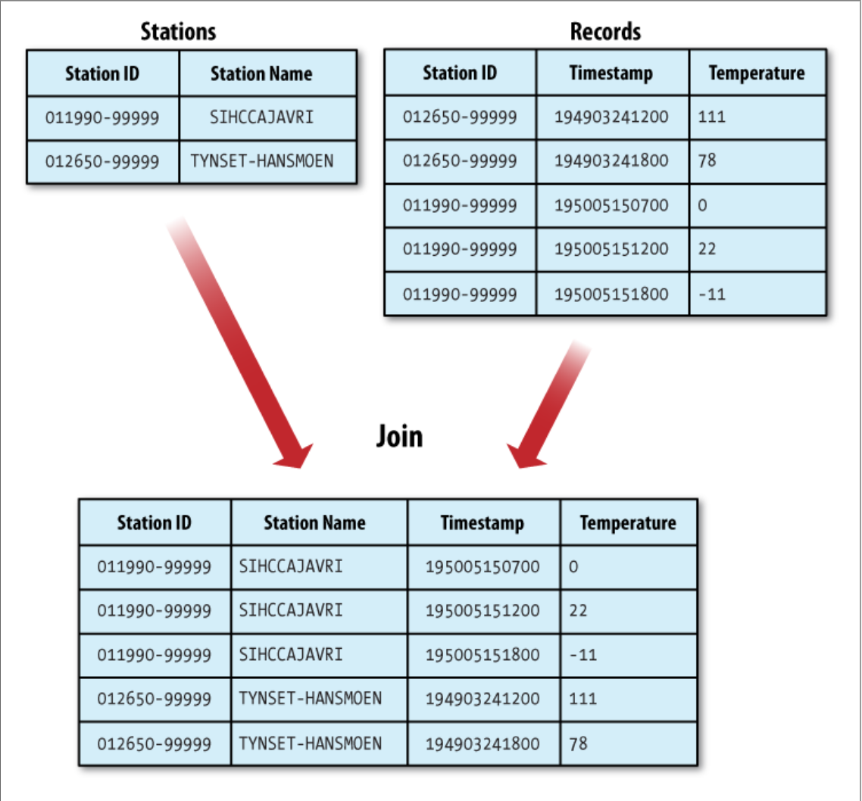
Joins
MapReduce can be used to perform joins between large datasets.

Slide 12
Joins
Map-side join
Reduce-side join
If the join is performed by the mapper it is called a map-side join.
A map-side join between large inputs works by performing the join before the data reaches the map function. For this to work, though, the inputs to each map must be partitioned and sorted in a particular way.
Each input dataset must be divided into the same number of partitions, and it must be sorted by the same key (the join key) in each source. All the records for a particular key must reside in the same partition.
If the join is performed by the reducer it is called a reduce-side join.
A reduce-side join is more general than a map-side join, in that the input datasets don’t have to be structured in any particular way, but it is less efficient because both datasets have to go through the MapReduce shuffle.
The basic idea is that the mapper tags each record with its source and uses the join key as the map output key, so that the records with the same key are brought together in the reducer

Slide 13
Side Data Distribution
Side Data can be defined as extra read-only data needed by a job to process the main dataset.
To make side data available to all the map or reduce tasks a big challenge.
One way to make data available is to use Job Configuration setter method to set key-value pairs .
Hadoop’s distributed cache is another way to distribute the datasets.
Provides a service for copying files and archives to the task nodes in time for the tasks to use them when they run.
Two types of objects can be placed into cache: Files and Archives

