Slide 1
Map/Reduce
Data processing with Hadoop

Slide 2
Agenda
Map/Reduce General Form
Java Implementation of Map Reduce
Input Format and its types
Output Format
Counters
Side Data Distribution
Map Reduce Library classes
Shuffle and Sort
Joins

Slide 3
Map/Reduce General Form
The generic form of the map and reduce functions are as follows
map(key1, val1) returns list(key2, val2)
reduce(key2, List(val2)) returns list(k3, val3)
Values are pulled by the mapper and sent to the reducer (if used)
The Reducer takes all the values (in the form of a key, value list) and Aggregates the values
Another layer can be added as well to the Map/Reduce stack - combiners.
Combiners are an optimization step and act like reducers.

Slide 4
Java implementation of Map/Reduce
Java uses generics in its implementation which allows for various types of keys and values to be passed to the mapper function.
When Hadoop receives a job request, it determines if the job can run on the local JVM (Java Virtual Machine), if not it reserves other JVM instances on other nodes to run processes in parallel.
Using streams, the JVM can pull data from sources outside of a java environment.
The size of the job is determined by the number of mappers required to process the data, this can be configured and is defaulted to 10

Slide 5
MapReduce Input Formats
Input split is the input chunk which is processed by a single map.
A single split is processed by each map.
Each split is divided into records, and the map processes each record—a key-value pair—in turn.
Input splits are represented by the Java class InputSplit, which has two methods: first returns length of the split while other returns location of the split.

Slide 6
Types of Input Format
File Input Format : The most commonly used Input Format is File Input Format. They are of mainly 3 types :
FileInputFormat - It’s the base class for all implementations of InputFormat that use files as their data source. It provides two things: a place to define which files are included as the input to a job, and an implementation for generating splits for the input files.
CombineFileInputFormat - This packs many files into each split so that each mapper has more to process. Hadoop handles small number of large files better than a large number of small files.
WholeFileInputFormat - This a format where the keys are not used and the values are the file contents. It uses a FileSplit and hence converting it into a single record.
2. Multiple Input - It handles multiple input of different formats.
3 . Database Input - Input format for reading data from a relational database.

Slide 7
4. Text Input
TextInputFormat - It’s the default Input Format. Every line of input has a record. Key is byte offset from beginning of the file and value is content of the line.
KeyValueTextInputFormat - This class handles when each line of file is key value pair.
NLineInputFormat - This is the class to handle fixed number of lines in input text file.
5. Binary Input
SequenceFileInputFormat - It’s used to handle Hadoop’s sequential file format which consists of binary key value pair.
SequenceFileAsTextInputFormat - This class converts Sequence file key and value to text objects to make it suitable for streaming.
SequenceFileAsBinaryInputFormat - The class here fetches the sequence file’s keys and values as binary objects.
FixedLengthInputFormat - It’s used for reading fixed-width binary records from a file where the records are not separated by delimiters.

Slide 8
Output Formats
Determines the implementation of RecordWriter for writing output files
Types:
TextOutputFormat - default format,, writes key value pairs in individual lines
SequenceFileOutputFormat - writes serialized output can be deserialized with SequenceFileInputFormat
SequenceFileAsBinaryOutputFormat - writes to sequence file in binary format
MapFileOutputFormat
MultipleOutputs - writes to multiple files whose names are derived from keys
LazyOutputFormat - creates output file only when a record is emitted
DBOutputFormat - prepares batch SQL & writes to HBase and other relational databases

Slide 9
Counters
Keeps track of event occurrence
In-built counters:
Task counters: keeps track information about task (MAP_INPUT_RECORDS, REDUCE_INPUT_RECORDS)
Filesystem counters: Number of bytes read/written (BYTES_READ, BYTES_WRITE)
Job counters: Number of tasks launched (TOTAL_LAUNCHED_MAPS, TOTAL_LAUNCHED_REDUCES)
Custom counters:
Defined by Java Enums
public enum DIAGNOSIS_COUNTER { PULMONARY_DISEASE, BRONCHITIS_ASTHMA };
if(<some condition>) { context.getCounter(DIAGNOSIS_COUNTER.PULMONARY_DISEASE).increment(1); }

Slide 10
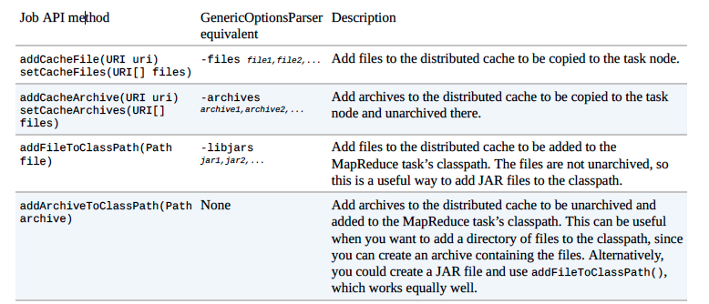
Side Data Distribution
Side Data - the extra read-only data needed by a job to process the main dataset.
There are two ways to make side data available:
Using getConfiguration() method to set-key-value pairs. Then serialize using Hadoop’s Stringifier class.
Great for passing small amounts of data
Larger data (>2-3KB) can cause memory issues
Distributed Cache
Hadoop copies specified files and archives to the distributed file system
Files are copied to the local disk - the cache
The node manager maintains a reference count of tasks using each localized file.
After files have been run, they are eligible for deletion and are deleted when the cache exceeds 10GB.
Distributed cache API
Uses the Job class

Slide 11
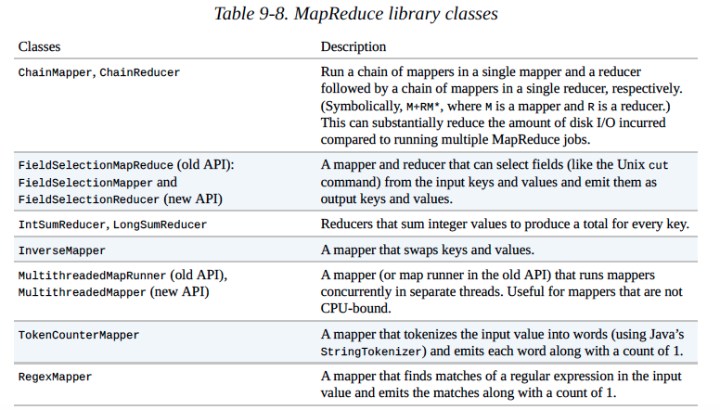
MapReduce Library classes

Slide 12
Shuffle and Sort
The process by which the system performs the sort—and transfers the map outputs to the reducers as inputs—is known as the shuffle.
•Map side and Reduce side
–Map side
•buffering writes in memory
•spill the contents to disk
•merge to one output file: partitioned and sorted
–Reduce side
•copy phase: reducer copies outputs when each completes
•sort phase(merge phase): merges the map outputs
•reduce phase: the output is written to HDFS

Slide 13
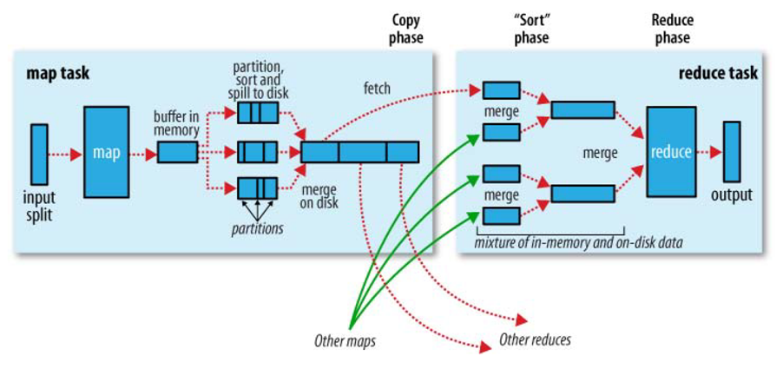
Shuffle and Sort
Hadoop: The Definitive Guide, Tom White, p163

Slide 14
Joins
To combine large datasets, joins are used in MapReduce
Two different large data can be joined in map reduce programming also. Joins in Map phase refers as Map side join, while join at reduce side called as reduce side join.
Lets go in detail, Why we would require to join the data in map reduce. If one Dataset A has master data and B has sort of transactional data(A & B are just for reference). we need to join them on a coexisting common key for a result. It is important to realize that we can share data with side data sharing techniques(passing key value pair in job configuration /distribution caching) if master data set is small. we will use map-reduce join only when we have both dataset is too big to use data sharing techniques.

Slide 15
Map side join and reduce side join
For Map side Join
Map-side join is a feature of MapReduce where the join is performed by the mapper. Joining at map side performs the join before data reached to map.
Data should be partitioned and sorted in particular way.
Each input data should be divided in same number of partition.
Must be sorted with same key.
All the records for a particular key must reside in the same partition.
For Reduce side join
Reduce side join also called as Repartitioned join or Repartitioned sort merge join and also it is mostly used join type. This type of join would be performed at reduce side. i.e it will have to go through sort and shuffle phase which would incur network overhead. to make it simple we are going to add the steps needs to be performed for reduce side join. Reduce side join uses few terms like data source, tag and group key
Data Source is referring to data source files, probably taken from RDBMS
Tag would be used to tag every record with it’s source name, so that it’s source can be identified at any given point of time be it is in map/reduce phase.
Group key is referring column to be used as join key between two data sources.

