Slide 1
MAPREDUCE TYPES, FORMATS AND FEATURES

Slide 2
MAPREDUCE GENERAL FORM
The general form of map and reduce functions in Hadoop MapReduce is:
The map input key K1 and value V1 are different from the map output key K2 and value V2.
The reduce input is same as the map output.
The reduce output is different as key K3 and value V3.
Data Flow:

Slide 3
BASIC HADOOP API
Mapper
void map(K1 key, V1 value, OutputCollector<K2, V2> output, Reporter reporter)
void configure(JobConf job)
void close() throws IOException
Reducer/Combiner
void reduce(K2 key, Iterator<V2> values, OutputCollector<K3,V3> output, Reporter reporter)
void configure(JobConf job)
void close() throws IOException
Partitioner
void getPartition(K2 key, V2 value, int numPartitions)

Slide 4
JAVA IMPLEMENTATION OF MAPREDUCE
Java allows various types of keys and values to be passed to the mapper function because it uses generics in its implementation.
When Hadoop receives a job request, it determines if the job can run on the local JVM (Java Virtual Machine). If it is not possible, other JVM instances are reserved on other nodes to avail parallel processing.
The JVM can pull data from sources outside the java environment using streams.
The size of the job by default is 10 and it can be configured.
The size of the job is determined by the number of mappers required to process the data.

Slide 5
MAPREDUCE INPUT FORMATS
The Java Abstract InputFormat class is responsible for creating input splits.
Application writers create implementation of InputFormat class. They do not deal with splits.
Input split is the input chunk which is processed by a single map and a single split is processed by each map.
Each split is divided into records which is processed by the map which is in the form of a key-value pair.
Input splits are represented by the Java class InputSplit. It has two methods:
-The first method returns length of the split
-The second method returns the location of the split.
There are two types of input formats:
File Input Formats
Text Input Formats

Slide 6
FILE INPUT FORMATS
FileInputFormat:
It is the base class for all implementations of InputFormat which use files as their data source. It provides a place to define the input files required for a job, and an implementation for generating splits for the input files.
CombineFileInputFormat:
In this input format, many files are packed into each split so that each mapper has more to process. Hadoop works better with a small number of large files than a large number of small files.
WholeFileInputFormat:
In this input format, keys are not used and values are the file contents. It takes a FileSplit and converts it into a single record.

Slide 7
TEXT INPUT FORMATS
TextInputFormat: It is the default InputFormat in which each record is a line of input. The key is the byte offset. The value is the content of the line and is packaged as a Text object.
KeyValueTextInputFormat: The keys in TextInputFormat are not normally useful as they are just offsets within a file. Each line in a file can be a key-value pair, separated by a delimiter such as a tab character.
NLineInputFormat: For mappers to receive a fixed number of lines of input, thenNLineInputFormat should be used.
XML: StreamXmlRecordReader (which is in the org.apache.hadoop.streaming.mapreduce package) is used for Hadoop.

Slide 8
OTHER INPUT FORMATS
Binary Input:
SequenceFileInputFormat:
This input format is designed to handle Hadoop’s sequential file format which consists of binary key value pair.
SequenceFileAsTextInputFormat:
This input format converts Sequence file key and value to text objects and makes it suitable for streaming.
SequenceFileAsBinaryInputFormat:
This input format retrieves the sequence file’s keys and values as binary objects.
FixedLengthInputFormat:
This input format is used for reading fixed-width binary records from a file where the records are not separated by delimiters.
Multiple Input:
This input format is used to handle multiple inputs of different formats.
Database Input:
This Input format is used to read data from a relational database.

Slide 9
OUTPUT FORMATS
TextOutputFormat: It is the default output format. It writes records as lines of text.
Binary Output:
SequenceFileOutputFormat: This output format writes sequence files as the output.
SequenceFileAsBinaryOutputFormat: This output format writes keys and values in binary format into a sequence file container.
MapFileOutputFormat: This output format writes map files as the output.
Multiple Output: This output format allows the programmer to write data to files. The file names are derived from the output key-value pairs to create more than one file.
LazyOutput: It is a wrapper output format which ensures tha the output file is created only when the first record is emitted in a given partition.
Database Output: This output format writes to relational database and Hbase.

Slide 10
FEATURES
Counters:
Counters are handy when you want to diagnose a problem in case there is one, or to gather statistical information about the task.
Types of Counters:
Built in counters:
Task Counters: It gathers information about the task and then results are aggregated for all the tasks in a job.
Job Counters: It is maintained by an application master, it measures job level statistics such as total number of map and reduce tasks.
User Defined counters:
Dynamic counters are app. writer which is created by counters using Java enum or by interface.
Retrieving counters give the job level statistics even when the job is still running instead of waiting till the end for the job to finish. Built-in Java APIs.
User-defined streaming functions:
They can increment counters by sending a specially formatted line to the standard error stream.
The line must have the following format: reporter:counter:group,counter,amount.

Slide 11
SORTING
The ability to sort data is one of the main features of MapReduce capabilities.
MapReduce can be sorted in the following ways:
Partial Sort:
This is the default sort where MapReduce sorts the data by keys. Individual output files are sorted but no globally sorted file is combined and produced.
Total Sort:
Produces globally sorted output files. It does this by using a partitioner that respects the total order of the output and the partition sizes must be fairly even.
Secondary Sort:
Sorts the records by key in the map phase instead of the reduce phase.

Slide 12
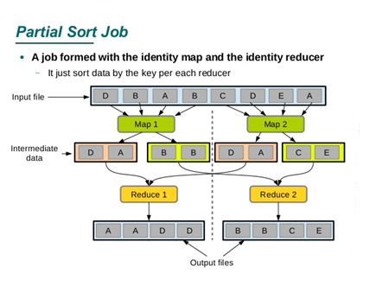
SORTING

Slide 13
JOINS
Joins can be used in MapReduce to combine large datasets together.
Implementation depends upon how large the dataset is and on how they are partitioned.
When processing large data sets the need for joining data by a common key can be very useful, if not essential.
By joining data you can further gain insights.

Slide 14
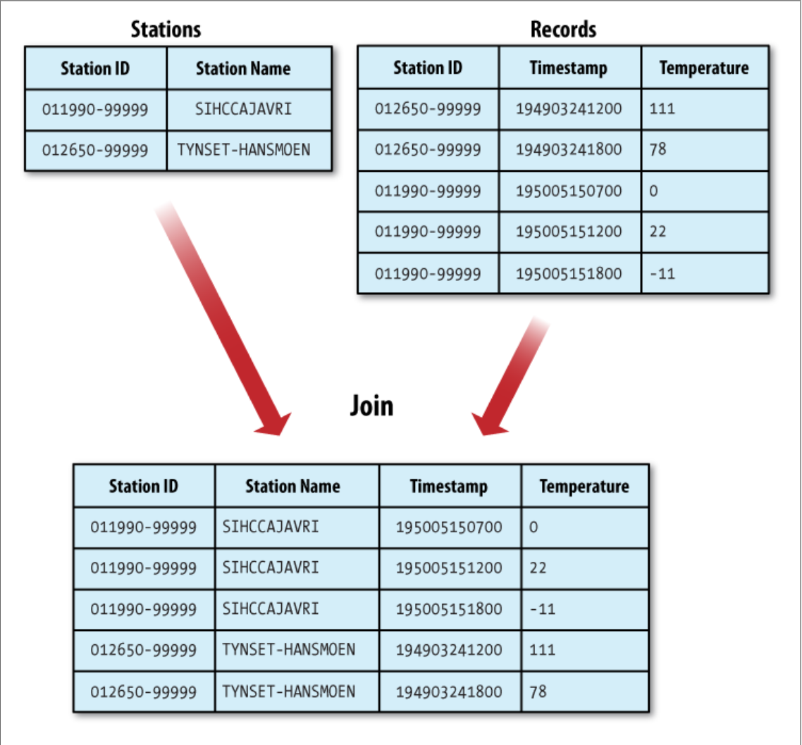
JOINS
Map Reduce can be used to join large datasets.

Slide 15
JOINS
Map Side Join
When the join function is performed by the mapper it is called map side join.
A map-side join between large inputs works by performing the join before the data reaches the map function. For this to work, though the inputs to each map must be partitioned and sorted in a particular way.
Each input dataset must be divided into the same number of partitions, and it must be sorted by the same key (the join key) in each source. All the records for a particular key must reside in the same partition.
To take advantage of map-side joins our data must meet one of following criteria:
The datasets to be joined are already sorted by the same key and have the same number of partitions.
Of the two datasets to be joined, one is small enough to fit into memory.

Slide 16
JOINS
Reduce Side Join
If the join is performed by the reducer it is called a reduce-side join.
A reduce-side join is more general than a map-side join, as the input datasets don’t have to be structured in any particular way, but it is less efficient because both datasets have to go through the MapReduce shuffle.
The basic idea is that the mapper tags each record with its source and uses the join key as the map output key, so that the records with the same key are brought together in the reducer.
How does this work?
Multiple Inputs: The input sources for the datasets generally have different formats, so it is very convenient to use the MultipleInputs class to separate logic for parsing and tagging.
Secondary Sort: Reducer checks the records from both sources that have the same key, but they are not guaranteed to be in any particular order.

Slide 17
SIDE DATA DISTRIBUTION
Side Data can be defined as extra read-only data needed by a job to process the main dataset.
To make side data available to all the map or reduce tasks is a big challenge.
Ways to make data available:
One way is to use Job Configuration setter method to set key-value pairs .
Another way is using Hadoop’s distributed cache to distribute the datasets.
This provides a service for copying files and archives to the task nodes in time for the tasks to use them when they run.
Two types of objects can be placed into cache:
Files
Archives

Slide 18
MapReduce LIBRARY CLASSES
Mappers/ Reducers for commonly used functions:

Slide 19
CONCLUSION
A simple way to scale an application is provided by MapReduce.
Important applications include Social networking and Search engines, PageRank, Statistics and Genomics.
This scales out to more machines, rather than scaling up.
It can effortlessly scale from a single machine to thousands of machines.
This is fault tolerant & has a high performance.
If your use case can fit into its paradigm, then scaling is handled by the framework.

Slide 20
THANK YOU

