Slide 1
GROUP PROJECT 1- TOPIC : MapReduce Types , Formats and Features
ITCS 6190 - CLOUD COMPUTING FOR DATA ANALYSIS FALL 2020

Slide 2
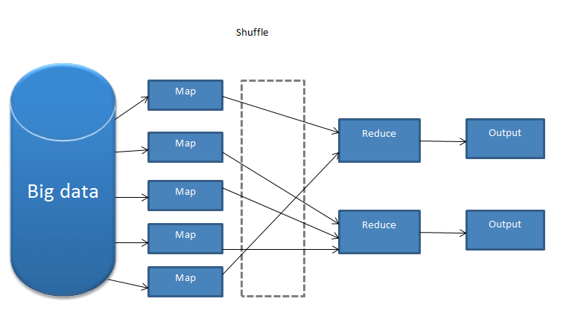
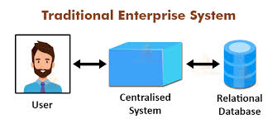
Introduction to MapReduce
Large Datasets cannot be processed using traditional computing techniques.
Dividing tasks into smaller parts.

Slide 3
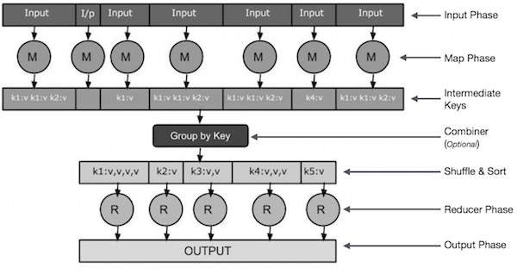
Phases of MapReduce :
Input Phase
Map Phase
Intermediate Keys
Combiner
Shuffle and Sort
Reducer
Output Phase

Slide 4
Features of MapReduce
Counters:They are a useful channel for gathering statistics about the job like quality control. Apart from that they help in diagnosing problems in mapreduce jobs. For example, you get information about the spilled records and memory usage which gives you an indicator about the performance of your MapReduce job.
Types of counters: Built-in (bytes read, bytes written, etc) and User defined (amount of skewness, etc).
Sorting:Ability to sort data is at the heart of MapReduce. (Partial sort, Total sort, Secondary sort)
Joins:MapReduce can perform joins between large datasets, mapper tags each record with its source and uses the join key as map output key, so that the records with same key are brought
together in the reducer.

Slide 5
Features of MapReduce
Using the Job Configuration:We can set arbitrary key-value pairs in the job configuration using various setter methods on Configuration.
Distributed Cache:Rather than serializing side data in job configuration, it is preferable to distribute datasets using Hadoop's distributed cache mechanism.
Side Data Distribution:It can be defined as extra read only data needed by job to process the main dataset.Challenge is to make side data available to all the map or reduce tasks in convenient and efficient fashion.
MapReduce Library Classes:Hadoop comes with library of mappers
and reducers for commonly used functions.

Slide 6
Functions Of MapReduce
Mapper:
Map Reduce filters and parcels/distributes out work to various nodes within the cluster or map and this functionality of Map Reduce is referred as Mapper
The Input to mapper function is a block of data, which is read and processed to produce the key-value pairs as intermediate outputs

Slide 7
Reducer:
Map Reduce collects, organizes and reduces the results from each node into a cohesive/collective answer to the query, this functionality if Map Reduce is referred as Reducer.
The output of the mapper function(key-value pairs) is input to the Reducer.
The Reducer receives the key-value pairs from multiple mapper functions and aggregates those intermediate data tuples into a smaller set of tuples or key-value pairs which is the final output.

Slide 8
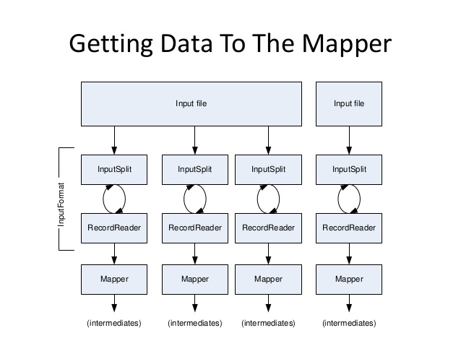
Input Formats
https://www.slideshare.net/MukeshGkp/hadoop-16823174

Slide 9
Types of Input Formats
Text Input
Plain text input format.
Key-value text input format
N Line input format
XML input format
Binary Input
Sequential binary to textual input format
Sequential binary input format
Fixed length binary input format
Database Input
Multiple Input

Slide 10
Output Format
The Output Format checks the Output-Specification of the job.
RecordWriter: RecordWriter writes the output key-value pairs from the Reducer phase to output files.
The way these output key-value pairs are written in output files is determined by the Output Format.
The output files are written to the HDFS (Hadoop Distributed File System) or local disk.
Notes:
Speaker : Aditi Nair Balachandran

Slide 11
Types of Output Formats
Notes:
Speaker : Aditi Nair Balachandran

Slide 12
Counters
Counters in MapReduce are used to gather statistical insights about the job, and to diagnose problem when it arises.
There are two kinds of Counters:
Built-in Counters:
Task Counters: This gathers information about the task and then the results are aggregated for all the tasks in a job
Job Counters: This is maintained by application master, and this is used to measure the job level statistics such as total number of map and reduce tasks performed etc.
User Defined Counters:
Dynamic Counters: These are created by the application developer using Java enums
Retrieving Counters: This provides job level statistics while the job is still executing unlike other counters which aggregate them at the end of the job.

Slide 13
Sorting
The ability to sort data is at the heart of the MapReduce framework.
In MapReduce Framework the keys generated by the mapper are automatically sorted.
For each of the sorted key a Reducer in Mapreduce creates a new task if the key is different from the previous key.
There are different kinds of Sorting :
Partial Sort: This is the default where MapReduce framework will sort the data by keys. In this each output file is sorted, but, it is not combined to form a global output file.
Total Sort: In this a global output file is generated by using a partitioner that respects the total order of the output and the partition sizes are fairly even.
Secondary Sort: If we want to sort the reducer values, then we can use the secondary sorting technique.

Slide 14
Joins in MapReduce
What is Join in Mapreduce?
MAPREDUCE JOIN operation is used to combine two large datasets. However, this process involves writing lots of code to perform the actual join operation. Joining two datasets begins by comparing the size of each dataset. If one dataset is smaller as compared to the other dataset then smaller dataset is distributed to every data node in the cluster.
Once it is distributed, either Mapper or Reducer uses the smaller dataset to perform a lookup for matching records from the large dataset and then combine those records to form output records.

Slide 15
Types of Joins in Map Reduce
Depending upon the place where the actual join is performed, this join is classified into
1. Map-side join -
When the join is performed by the mapper, it is called as map-side join.
In this type, the join is performed before data is actually consumed by the map function.
It is mandatory that the input to each map is in the form of a partition and is in sorted order.
Also, there must be an equal number of partitions and it must be sorted by the join key.
2. Reduce-side join -
When the join is performed by the reducer, it is called as reduce-side join.
There is no necessity in this join to have a dataset in a structured form (or partitioned).

Slide 16
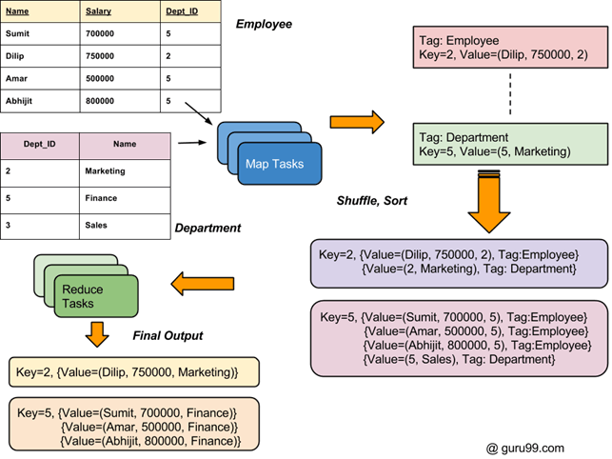
Overall process flow of Joins in Map-Reduce

Slide 17
Map-side Join: Parallel Scans
•If datasets are sorted by join key, join can be accomplished by a scan over both datasets
•How can we accomplish this in parallel?
–Partition and sort both datasets in the same manner
•In MapReduce:
–Map over one dataset, read from other corresponding partition
–No reducers necessary (unless to repartition or resort)
•Consistently partitioned datasets: realistic to expect?

Slide 18
Reduce Side joins
Reduce side join also called as Repartitioned join or Repartitioned sort merge join and also it is mostly used join type.
This type of join would be performed at reduce side. i.e it will have to go through sort and shuffle phase which would incur network overhead. to make it simple we are going to add the steps needs to be performed for reduce side join.
Reduce side join uses few terms like data source, tag and group key lets be familiar with it.
Data Source is referring to data source files, probably taken from RDBMS
Tag would be used to tag every record with it’s source name, so that it’s source can be identified at any given point of time be it is in map/reduce phase. why it is required will cover it later.
Group key is referring column to be used as join key between two data sources.

Slide 19
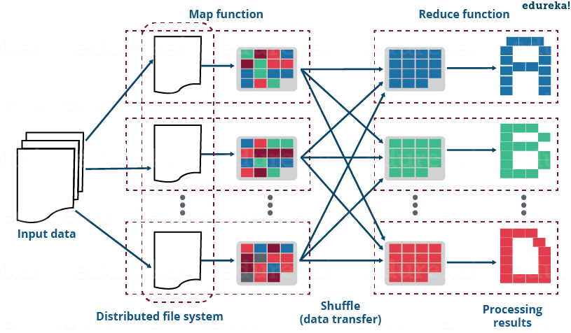
Implementation for Map side and Reduce Joins

Slide 20
Difference between Map side and Reduce Side Joins
A map side join, as explained earlier, happens on the map side whereas a reduce side join happens on the reduce side.
A map side join happens in the memory whereas a reduce side join happens off the memory.
Map side joins are effective when one data set is big while the other is small, whereas reduce side joins work effectively for big size data sets.
Map side joins are expensive, whereas reduce side joins are cheap.

Slide 21
Conclusion
MapReduce is the processing layer of Hadoop
It is designed for processing large volumes of data in parallel by dividing the work into a set of independent tasks.
Topics discussed:
Introduction
Features of MapReduce
Functions of MapReduce
Input Formats
Output Formats
Sorting and Counters
Joins and Types

Slide 22
THANK YOU

