Slide 1
INTRODUCTION TO
PIG, HIVE, HBASE and ZOOKEEPER

Slide 2
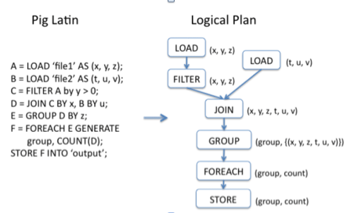
WHAT IS PIG?
Framework for analyzing large un-structured and semi-structured data on top of hadoop
Pig engine: runtime environment where the program executed.
Pig Latin: is simple but powerful data flow language similar to scripting language.
SQL
Provide common data operations( loud, filters, joins, group, store)

Slide 3
PIG CHARACTERISTIC
A platform analyzing large data sets that runs on top hadoop
Provides a high-level language for expressing data analysis
Uses both Hadoop Distributed File System (HDFS) red and write files and MapReducer ( execute jobs )

Slide 4
EXECUTION TYPES
Local Mode:
Pig runs in a single JVM and accesses the local filesystem. This mode is suitable only for small datasets and when trying out Pig.
MapReduce Mode:
Pig translates queries into MapReduce jobs and runs them on a Hadoop cluster. It is what you use when you want to run Pig on large datasets.

Slide 5
RUNNING PIG PROGRAMS
There are three ways of executing Pig programs
Script -> Pig can run a script file that contains Pig commands
Grunt -> Interactive shell for running Pig commands
Embedded -> users can run Pig programs from Java using the PigServer class

Slide 6
PIG LATIN DATA FLOW
A LOAD statement to read data from the system
A series of “transformation” statement to process the data
A DUMP statement to view results or STORE statement to save the result
LOAD
TRANSFORM
DUMP OR STORE

Slide 7
WHAT IS HIVE?
Hive: A data warehousing system to store structured data on Hadoop file system
Developed by Facebook
Provides an essay query by executing Hadoop MapReduce plans
Provides SQL type language for querying called HiveQL or HQL
The Hive shell is the primary way that we will interact with Hive

Slide 8
HIVE DATA MODEL
Tables: all the data is stored in a directory in HDFS
Primitives: numeric, boolean, string and timestamps
Complex: Arrays, maps and structs
Partitions: divides a table into parts
Queries that are restricted to a particular date or set of dates can run much more efficiently because they only need to scan the files in the partitions that the query pertains to
Buckets: data in each partitions is divided into buckets
Enable more efficient queries
Makes sampling more efficient

Slide 9
MAJOR COMPONENTS OF HIVE
UI: Users submits queries and other operations to the system
Driver: Session handles, executes and fetches APIs modeled on JDBC/ODBC interfaces
Metastore: Stores all the structure information of the various tables and partitions in the warehouse
Compiler: Converts the HiveQL into a plan for execution
Execution Engine: Manages dependencies between these different stages of the plan and executes these stages on the appropriate system components

Slide 10
HIVE VS PIG
PIG
HIVE
Procedural Data Flow Language
For Programming
Mainly used by Researchers & Programmers
Operates on the client side of a cluster
Better dev environments, debuggers expected
Does not have a thrift server
Declarative SQL Language
For creating reports
Mainly used by Data/Business Analysts
Operates on the server side of a cluster
Better integration with technologies expected
Thrift Server
Notes:
Similarities:
Both High Level Languages which work on top of the map reduce framework
Can coexist since both use the underlying HDFS and map reduce

Slide 11
PROS
CONS
Easy way to process large scale data
Converting variety of format within Hive is simple
Supports SQL based queries
Multiple users can simultaneously query the data using HiveQL
Allows to write custom MapReduce framework processes to perform more detailed data analysis
Not designed for Online transaction processing (OLTP)
Hive supports overwriting or apprehending data, but not updates and deletes
Subqueries are not supported
No easy way to append data

Slide 12
HBase
HBase is a distributed column-oriented database built on top of the HDFS. It is an open-source project and horizontally scalable.
HBase is a data model that is similar to Google’s big table that designed to provide quick random access to huge amounts of structured data.
HBase is a part of Hadoop ecosystem that provides real-time read/write access to data in the Hadoop File System.
HBase stores its data in HDFS.

Slide 13
HBase vs. HDFS
HDFS is a suitable for storing large files.
HDFS does not support fast individual record lookups.
It provides high latency batch processing;
It provides only sequential access of data.
HBase is a database built on top of the HDFS.
HBase provides fast lookups for larger tables.
It provides low latency access to single rows from billions of records (Random access).
HBase internally uses Hash tables and provides random access, and it stores the data in indexed HDFS files for faster lookups

Slide 14
Storage Mechanism in HBase
HBase is a column-oriented database and the tables in it are sorted by row. The table schema defines only column families, which are the key value pairs. A table have multiple column families and each column family can have any number of columns. Subsequent column values are stored contiguously on the disk. Each cell value of the table has a timestamp. In short, in an HBase:
Table is a collection of rows.
Row is a collection of column families.
Column family is a collection of columns.
Column is a collection of key value pairs.

Slide 15
Hbase is Not
Not an SQL Database.
Not relational.
No joins.
No fancy query language and no sophisticated query engine.
Features of HBase
HBase is linearly scalable.
It has automatic failure support.
It provides consistent read and writes.
It integrates with Hadoop, both as a source and a destination.
It has easy java API for client.
It provides data replication across clusters.
When Should I Use HBase?
make sure you have enough data. If you have hundreds of millions or billions of rows, then HBase is a good candidate.

Slide 16
What is Zookeeper?
ZooKeeper is an open source Apache™ project that provides a centralized infrastructure and services that enable synchronization across a cluster. ZooKeeper maintains common objects needed in large cluster environments. Examples of these objects include configuration information, hierarchical naming space, and so on. Applications can leverage these services to coordinate distributed processing across large clusters.
Created by Yahoo! Research
Started as sub-project of Hadoop

Slide 17
What is Zookeeper meant for?
Naming service − Identifying the nodes in a cluster by name. It is similar to DNS, but for nodes
Configuration management − Latest and up-to-date configuration information of the system for a joining node
Cluster management − Joining / leaving of a node in a cluster and node status at real time
Leader election − Electing a node as leader for coordination purpose
Locking and synchronization service − Locking the data while modifying it. This mechanism helps you in automatic fail recovery while connecting other distributed applications like Apache HBase
Highly reliable data registry − Availability of data even when one or a few nodes are down

Slide 18
How Zookeeper Works
Zookeeper gives you a set of tools to build distributed applications that can safely handle partial failures
Zookeeper is simple
Zookeeper is expressive
Zookeeper facilitates loosely coupled interactions
Zookeeper is a library
Zookeeper requires Java to run
Maintains configuration information
Zookeeper has a hierarchical name space
Znodes

Slide 19
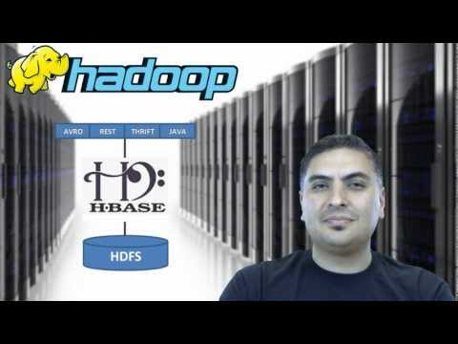
VIDEO

