Slide 1
Introduction to
PIG, HIVE, HBASE & ZOOKEEPER

Slide 2
What is PIG?
Apache Pig is a platform for analyzing large data sets that consists of a high-level language for expressing data analysis programs, coupled with infrastructure for evaluating these programs.
The salient property of Pig programs is that their structure is amenable to substantial parallelization, which in turns enables them to handle very large data sets.
Apache Pig creates a simpler procedural language abstraction over MapReduce to expose a more SQL-like interface for Hadoop applications.
We can write simple Pig commands instead of entire MapReduce applications.

Slide 3
PIG Characteristics
PIG Latin - A high-level language developed by Pig where programmers can develop their own functions for reading, writing and processing data.
Apache Pig uses a multi-query approach thereby reducing the LoC and development time.
Execution Types -
Local Mode (JVM)
MapReduce Mode (Hadoop Cluster)
Running Pig programs -
Script
Grunt
Embedded

Slide 4
PIG LATIN Dataflow
LOAD
TRANSFORM
DUMP
DEPLOY

Slide 5
What is HIVE ?
Data warehousing package built on top of Hadoop
Used for data analysis
Targeted towards users comfortable with SQL
Similar to SQL the query language is HiveQL
No need learn Java and Hadoop APIs
Developed by Facebook and made open source
For managing and querying structured data

Slide 6
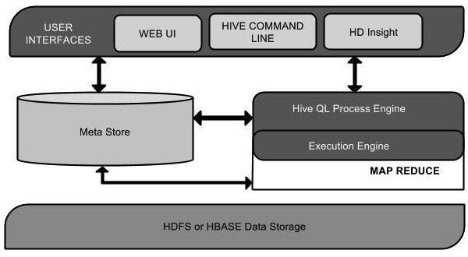
Hive Architecture
•UI: Users submits queries and other operations to the system
•Metastore: Stores all the structure information of the various tables and partitions in the warehouse
•Execution Engine: Manages dependencies between these different stages of the plan and executes these stages on the appropriate system

Slide 7
Hive Data Model
Tables: Data is stored as a directory in HDFS
Partitions: Divides a table into parts based on a key(column). It is a way of dividing a table into related parts based on the values of partitioned columns such as date, city, and department. Using partition, it is easy to query a portion of the data.
Buckets: Bucketing decomposes data into more manageable or equal parts. With partitioning, there is a possibility that you can create multiple small partitions based on column values. If you go for bucketing, you are restricting number of buckets to store the data. This number is defined during table creation scripts.

Slide 8
Hive vs Relational Database
By using Hive, we can perform some peculiar functionality that is not achieved in Relational Databases.
Relational databases are of "Schema on READ and Schema on Write" Hive is "Schema on READ only".
No support for Update or Delete in HIVE
No support for inserting single rows.
Supports Partitioning and Bucketing.

Slide 9
PIG Vs HIVE
PIG:
Procedural Data FLow Language.
Mainly used when there are more joins and filters.
Operates on the client side of a cluster.
Mainly used by researchers for programming.
Can handle both structured and unstructured data.
Cannot operate on thrift server.
Pig uses Pig Latin for programming
No need to create tables.
HIVE:
Declarative SQL Language.
Used when limited number of joins are present.
Operates on the server side of a cluster.
Mainly used by data analysts for creating reports.
Supports only structured data.
Can operate on thrift server.
It uses HQL which goes beyond the SQL.
Should manually create tables.

Slide 10
HIVE Pros and Cons:
Pros:
Hive works extremely well with large data sets. Analysis over them is made easy.
User-defined functions gives flexibility to users to define operations that are used frequently as functions.
String functions that are available in Hive has been extensively used for analysis.
Partition to increase query efficiency.
Cons:
Joins (especially left join and right join) are very complex, space consuming and time consuming. Improvement in this area would be of great help!
Debugging can be messy with ambiguous return codes and large jobs can fail without much explanation as to why.
Slow because it uses mapreduce.

Slide 11
PIG Pros and Cons:
Pros:
It has many advanced features built-in such as joins, secondary sort, many optimizations, predicate push-down, etc.
Provides a decent abstraction for Map-Reduce jobs, allowing for a faster result than creating your own MR jobs
Can handle large and unstructured datasets.
Cons:
Writing your own User Defined Functions (UDFS) is a nice feature but can be painful to implement in practice
May not fit every need and a SQL-like abstraction may not be easy
The commands are not executed unless either you dump or store an intermediate or final result. This increases the iteration between debug and resolving the issue.

Slide 12
HBase is… HBase is not ...
A distributed column oriented database built on top HDFS.
A data model that is similar to Google’s Big Table that designed to provide quick random access to huge amounts of data.
Not an SQL Database
Not Relational
No Joins
No fancy query language and no sophisticated query engine.

Slide 13
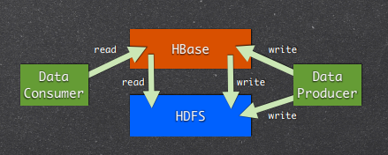
HBase Features
Linear Scalability: Capable of storing hundreds of terabytes of data.
Automatic and configurable sharding of tables.
Automatic failover support.
Strictly consistent read and writes.

Slide 14
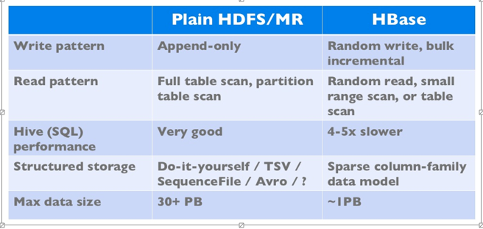
HBase vs HDFS
Both are distributed systems that scale to hundreds or thousands of nodes.

Slide 15
HBase vs HDFS (Continued...)
•HBase is a database built on top of the HDFS.
•HBase provides fast lookups for larger tables.
•It provides low latency access to single rows from billions of records (Random access).
•HBase internally uses Hash tables and provides random access, and it stores the data in indexed HDFS files for faster lookups
•HDFS is a suitable for storing large files.
•HDFS does not support fast individual record lookups.
•It provides high latency batch processing;
•It provides only sequential access of
data.

Slide 16
Zookeeper
Apache ZooKeeper is a software project of the Apache Software Foundation.
It is essentially a distributed hierarchical key-value store, which is used to provide a distributed configuration service, synchronization service, and naming registry for large distributed systems.
Examples include configuration information, hierarchical naming space, and so on. Applications can leverage these to coordinate distributed processing across large clusters.
ZooKeeper was developed by Yahoo research and was a sub-project of Hadoop but is now a top-level Apache project in its own right.

Slide 17
ZooKeeper Service
Zookeeper “Ensambles”
Zookeeper provides high Availability and consistency
Server know each other
Client connects to only one server at a time.

Slide 18
Zookeeper Features and Uses
Features:
Reliable System: This system is very reliable as it keeps working even if a node fails.
Simple Architecture: The architecture of ZooKeeper is quite simple as there is a shared hierarchical namespace which helps coordinating the processes.
Fast Processing: Zookeeper is especially fast in "read-dominant" workloads (i.e. workloads in which reads are much more common than writes).
Scalable: The performance of ZooKeeper can be improved by adding nodes.
Uses:
HBase uses it for coordination between servers, bootstrapping etc.
Hadoop and MapReduce for high availability of resource manager.
Flume - Used for configuration.

Slide 19
VIDEO LINKS:
HIVE- https://youtu.be/uY7Rr7ru9E4
PIG- https://youtu.be/rxnXHlaSohM
HBase- https://youtu.be/kN01ELCAsn8
ZooKeeper- https://youtu.be/Kgf9EjTNucM

Slide 20
Thank You…….
Any Questions????

