Slide 1
Cloud Computing for Data Analysis Pig|Hive|Hbase|Zookeeper

Slide 2
Question:
Pig was developed by?

Slide 3
Pig
Framework for analyzing large unstructured and semi-structured data on top of hadoop.
There are two important components of PIG:
Pig Latin: It is a high level language(designed for ease of programming)
It is also extensible, users can create their own functions.
Pig Engine: Runtime environment where programs are executed.
It can also execute its Hadoop jobs in MapReduce, Apache Tez and Apache Spark

Slide 4
Pig features:
Pig Latin is procedural and fits very naturally in the pipeline paradigm while SQL is instead declarative.
Pig Latin script describes a directed acyclic graph (DAG) rather than a pipeline.
We can use Pig for ETL(Extraction Transformation Load) tasks naturally as it can handle unstructured data.

Slide 5
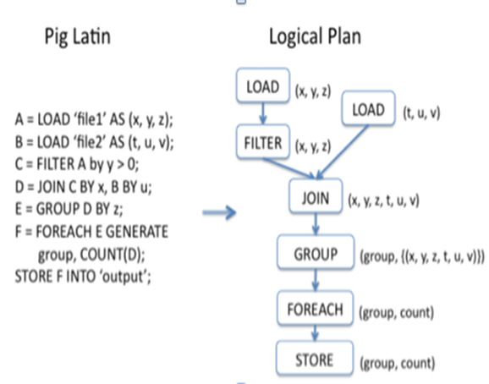
Pig Statement Basics
Load & Store Operators
LOAD operator (load data from the file system)
STORE operator (saves results into file system)
Both these operators use several built-in functions for handling different data types
1.BinStorage() 2.PigStorage() 3.TextLoader() 4.JsonLoader()
Diagnostic Operators
DUMP operator (writes results to the console)
Describe Operators
DESCRIBE operator is used to view the schema of a relation.
EXPLAIN operator is used to display the logical, physical, and MapReduce execution plans of a relation.
ILLUSTRATE operator gives you the step-by-step execution of a sequence of statements.

Slide 6
Advantages and Disadvantages
Advantages
Disadvantages
Less development time
Easy to learn
Procedural language
Dataflow
Easy to control execution
UDFs
Lazy evaluation
Usage of Hadoop features
Effective for unstructured
Base Pipeline
Errors of Pig
Not mature
Support
Minor one
Implicit data schema
Delay in execution

Slide 7
Hive
A data warehousing system to store structured data on Hadoop file system.
Developed by Facebook
Provides an essay query by executing Hadoop MapReduce plans
Provides SQL type language for querying called HiveQL or HQL
The Hive shell is the primary way that we will interact with Hive

Slide 8
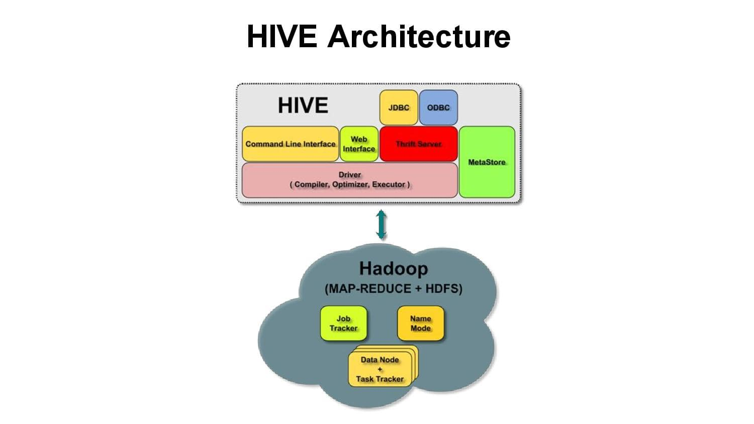
Hive
•UI: Users submits queries and other operations
•Driver: Session handles, executes and fetches APIs modeled on JDBC/ODBC interfaces
•Metastore: Stores all the structure information of the various tables and partitions in the warehouse
•Compiler: Converts the HiveQL into a plan for execution
•Execution Engine: Manages dependencies between these different stages of the plan and executes these stages on the appropriate system components

Slide 9
Question
Give some applications of Hive.

Slide 10
Question
Give some applications of Hive.
Text Mining
Document Indexing
Predictive Modeling

Slide 11
Pig vs Hive
Procedural Data Flow Language
For Programming
Mainly used by Researchers
& Programmers
Operates on the client side of a cluster
Better dev environments, debuggers
expected
Does not have a thrift server
Declarative SQL Language
For creating reports
Mainly used by Data/Business Analysts
Operates on the server side of a cluster
Better integration with technologies expected
Thrift Server

Slide 12
Question:-
Is Hive operate on client side of the server?
True/false?

Slide 13
Zookeeper
ZooKeeper is an open source Apache™ project that provides a centralized infrastructure and services that enable synchronization across a cluster. ZooKeeper maintains common objects needed in large cluster environments.Examples of these objects include configuration information, hierarchical naming space, and so on. Applications can leverage these services to coordinate distributed processing across large clusters.
Created by Yahoo! Research as part of Hadoop sub-project.

Slide 14
Features:
Reliable System: This system is very reliable as it keeps working even if a node fails.
Simple Architecture: The architecture of ZooKeeper is quite simple as there is a shared hierarchical namespace which helps coordinating the processes.
Fast Processing: Zookeeper is especially fast in "read-dominant" workloads (i.e. workloads in which reads are much more common than writes).
Scalable: The performance of ZooKeeper can be improved by adding nodes

Slide 15
Question
What is the model of a ZooKeeper cluster?

Slide 16
HBase
HBase is a distributed column-oriented data store built on top of HDFS
HBase is an Apache open source project whose goal is to provide storage for the Hadoop Distributed Computing
HBase runs on top of HDFS and is well-suited for faster read and write operations on large datasets with high throughput and low input/output latency.
Unlike relational and traditional databases, HBase does not support SQL scripting; instead the equivalent is written in Java, employing similarity with a MapReduce application.

Slide 17
HBase Architecture
HBase has three major components: the client library, a master server, and region servers. Region servers can be added or removed as per requirement.
•Region
•A subset of a table’s rows, like horizontal range partitioning
•Automatically done
•RegionServer (many slaves)
•Manages data regions
•Serves data for reads and writes (using a log)
•Master
•Responsible for coordinating the slaves
•Assigns regions, detects failures
•Admin functions

Slide 18
Question
Give the name of the key components of HBase

Slide 19
Hbase Data Model
HBase is based on Google’s Bigtable model
Key-Value pairs

Slide 20
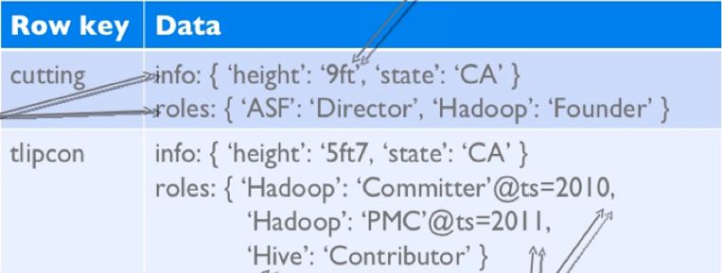
Hbase Data Model
HBase schema consists of several Tables
Each table consists of a set of Column Families
Columns are not part of the schema
HBase has Dynamic Columns
Because column names are encoded inside the cells
Different cells can have different columns
“Roles” column family has different columns in different cells

Slide 21
Hbase Data Model(Contd..)
The version number can be user-supplied
Even does not have to be inserted in increasing order
Version number are unique within each key
Table can be very sparse
Many cells are empty
Keys are indexed as the primary key

Slide 22
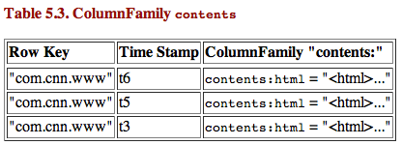
HBase Physical Model
Each column family is stored in a separate file (called HTables)
Key & Version numbers are replicated with each column family
Empty cells are not stored

Slide 23
Question
What is one major difference between Hbase Data Model and Hbase Physical Model?

Slide 24
Question:
Does HBase needs HDFS?

Slide 25
HBase vs HDFS
HDFS
HBase
HDFS is java based file system.
HDFS is stored as flat files.
HDFS is a suitable for storing large files.
HDFS does not support fast individual record lookups.
It provides only sequential access of data.
HBase is a Java based NoSQL database
HBase stores key/value pairs in columnar fashion.
HBase is a database built on top of the HDFS.
HBase provides fast lookups for larger tables.
HBase internally uses Hash tables and provides random access, and it stores the data in indexed HDFS files for faster lookups

Slide 26
HBase vs HDFS(Cont’d)
HDFS
HBase
HDFS Follows write-once read-many ideology.
Not good for updates.
It provides high latency batch processing.
HDFS has fixed architecture which does not allow changes. It does not support dynamic storage
HBase is convenient for multiple read-write of data
HBase support for updates.
It provides low latency access to single rows from billions of records (Random access).
HBase allows run-time changes and can be used for standalone applications

Slide 27
THANK YOU

