Slide 1
Introduction to Pig, Hive, HBase and Zookeeper

Slide 2
What is Apache Pig?
Janhvi Chitnis
Apache Pig is a platform for analyzing large data sets by representing them as Data Flow.
Pig was initially developed by Yahoo! for its data scientists who were using Hadoop.
To write data analysis programs, Pig provides a high-level language known as Pig Latin.
Pig Latin is SQL-like language and it is easy to learn Apache Pig when you are familiar with SQL.
All these scripts are written in Pig Latin and then internally converted to Map and Reduce tasks.

Slide 3
Architecture of
Apache Pig
Janhvi Chitnis
Parser
Optimizer
Compiler
Execution Engine

Slide 4
What are the advantages of using Pig?
Janhvi Chitnis
Pig consists of collection of Rich set of operators in order to perform operations such as join, filer, sort and many more.
By using the existing operators, users can easily develop their own functions to read, process, and write data.
Pig analyzes all type of Data and store the results in HDFS
Pig Latin language is extremely easy to learn, people who struggle to write java programs for Map Reduce tasks in Hadoop would find Pig, a very friendly language to work with.

Slide 5
HBase
Supriya Chinthakuntla
HBase is a data model that is similar to Google’s big table designed to provide quick random access to huge amounts of structured data.
HBase is a distributed column-oriented database built on top of the Hadoop file system.
It is a part of the Hadoop ecosystem that provides random real-time read/write access to data in the Hadoop File System.
HBase sits on top of the Hadoop File System and provides read and write access.
HBase is a column-oriented database and the tables in it are sorted by row.
Table is a collection of rows.
Row is a collection of column families.
Column family is a collection of columns.
Column is a collection of key value pairs.

Slide 6
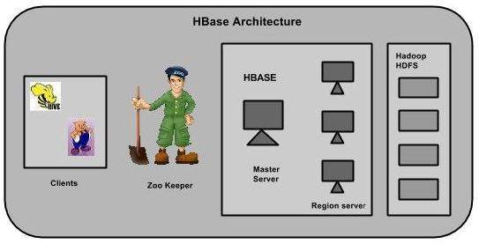
HBase Architecture
Supriya Chinthakuntla
HBase has three major components: the client library, a master server, and region servers. Region servers can be added or removed as per requirement.

Slide 7
Why HBase is faster?
Supriya Chinthakuntla
HBase is a NoSQL random access database for Hadoop. It runs on top of HDFS and provides real time data access to distributed data via its key/value store
By storing data in rows of column families, HBase achieves a four dimensional data model that makes lookups exceptionally fast.
For example, you can quickly retrieve a specific column by specifying the table, row, and column family. This makes finding "needles" in data "haystacks" a reality with HBase.

Slide 8
HBase vs RDBMS
Mounika Chebrolu
HBase | RDBMS
No SQL database | Requires SQL
Column oriented database | Row oriented database
Schema is flexible and less restrictive | Schema is more restrictive
Dynamic in nature | Static in nature
Supports scale out | Supports scale up
Suitable for both structured and unstructured data | Suitable for structured data

Slide 9
HBase Pros and Cons
Mounika Chebrolu
Pros | Cons
Handles very large volumes of data | Single point of failure
Fault tolerant | No transaction support
Automatic fail over Support | No built-in authentication or permissions
Fast processing | Joins are not handled in database
Distributed and Scalable
License free

Slide 10
Mounika Chebrolu
Question:
Which of the following does HBase support ?
Scale Up
Scale Out
Answer:
HBase supports Scale out. This means when we need additional computing power and more disk, we need to add new servers to the cluster rather than upgrading the existing one.

Slide 11
What is Hive?
Rajesh Chakka
Hive is data warehousing tool for managing and querying structured data on top of Hadoop.
Initially it was developed by Facebook to make the best use of Hadoop, and was later taken over and developed as an open source by Apache Foundation.
Hive is a tool used to develop SQL type scripts to perform MapReduce operations.
It stores schema in a database and processed data into HDFS.
It is an Online analytical processing tool.
It uses a SQL type language called HiveQL or HQL.
It is scalable and extensible.

Slide 12
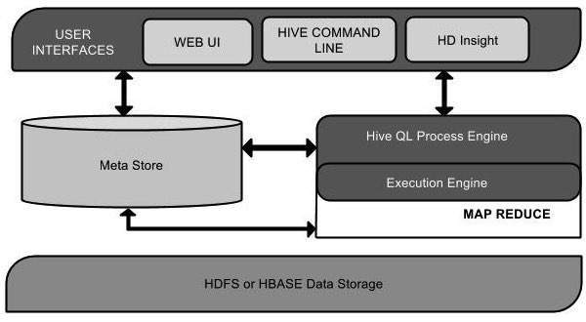
Architecture of Hive.
Rajesh Chakka

Slide 13
Question
Rajesh Chakka
What do Hive queries look like?
HiveQL is pretty much similar SQL.
HiveQL has 9 data types and while SQL has only 5.
HiveQL supports all select commands, sub queries and Joins similar to SQL.

Slide 14
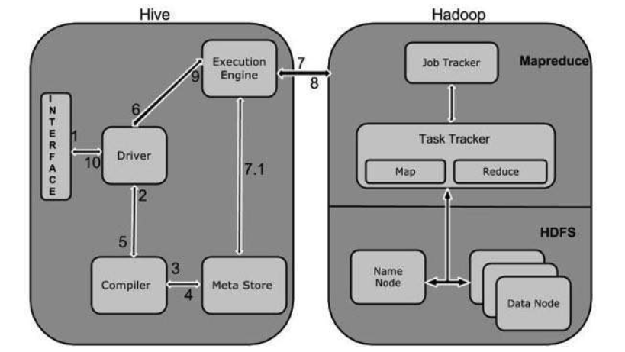
Working of Hive:
Sneha Chilumula
1 Execute Query
2 Get Plan
3 Get Metadata
4 Send Metadata
5 Send Plan
6 Execute Plan
7 Execute Job
8 Fetch Result
9 Send Results
10 Send Results

Slide 15
Apache Hive vs Apache HBase
Sneha Chilumula
Characteristics | Hive | HBase
Database type | It is not a database | It supports NoSQL database
Processing Type | It supports Batch processing i.e OLAP | It supports Real-time processing. i.e OLTP
Data Schema | It supports to have schema model | It is free from schema model
Hadoop Integration | Runs on the top of Hadoop | Runs on the top of HDFS (Hadoop distributed file system)
SQL Support | Provides SQL-like querying capabilities with HiveQL. | Does not use SQL.

Slide 16
Question:
Sneha Chilumula
When can Hive not be used?
Answer:
It's not designed for Online transaction processing (OLTP)
It can not be used for real time updates or queries
It cannot be used for scenarios where low latency data retrieval is expected, because there is a latency in converting the HIVE scripts into Map Reduce scripts by hive.

Slide 17
ZooKeeper
The ZooKeeper framework was originally built at “Yahoo!” for accessing their applications in an easy and robust manner.
ZooKeeper is a distributed coordination service to manage large set of hosts.
Coordinating and managing a service in a distributed environment is a complicated process.
ZooKeeper solves this issue with its simple architecture and API.
ZooKeeper allows developers to focus on core application logic without worrying about the distributed nature of the application.
Later, Apache ZooKeeper became a standard for organized service used by Hadoop, HBase, and other distributed frameworks.
Apache HBase uses ZooKeeper to track the status of distributed data

Slide 18
Architecture of Zookeeper

Slide 19
Features
Simple Architecture
Reliable System
Scalable
Fast processing

Slide 20
Question
What is a Zookeeper ensemble?
Answer - Basically, an array of nodes (or servers, if you like) that form our Distributed Computer Ecosystem is what we call Ensemble. Especially, we use multiple zookeeper servers to create an ensemble, when we want to have high availability in zookeeper server.

Slide 21
References
https://www.tutorialspoint.com/hbase/index.htm
https://www.tutorialspoint.com/hbase/hbase_architecture.htm
https://www.tutorialspoint.com/apache_pig/apache_pig_overview.htm
https://www.tutorialspoint.com/hive/hive_introduction.htm
https://www.tutorialspoint.com/zookeeper/zookeeper_overview.htm

