Slide 1
Spark

Slide 2
Contents
Overview
Layers and packages in Spark
Download and Installation
Spark Application Overview
Simple Spark Application
Introduction to Spark
How a Spark Application Runs on a cluster?
Spark Abstraction
Scala introduction
Getting started in scala
Example programs with Scala and Python
Prediction with Regressions utilizing MLlib

Slide 3
Introduction to Spark
Spark is a general-purpose distributed data processing engine that is suitable for use in a wide range of circumstances. on top of the spark core data processing engine, there are libraries for sql, machine learning, graph computation, and stream processing, which can be used together in an application.
Programming languages supported by spark include: java, python, scala, and r. application developers and data scientists incorporate spark into their applications to rapidly query, analyze, and transform data at scale.
Tasks most frequently associated with spark include etl and sql batch jobs across large data sets, processing of streaming data from sensors, iot, or financial systems, and machine learning tasks.

Slide 4
Overview
Spark is general purpose engine for large-scale data processing.
Spark SQL for querying structured data via SQL and Hive Query Language (HQL)
Runs on Hadoop
Uses APIs to help execute workloads
It has been claimed to be 100 times faster than Hadoop’s MapReduce
It Supports Java, Python, R, and Scala programming languages
asks most frequently associated with Spark include ETL and SQL batch jobs across large data sets, processing of streaming data from sensors, IoT, or financial systems, and machine learning tasks

Slide 5
Layers and packages in Spark
Spark SQL allows for querying structured data via SQL and Hive Query Language (HQL).
It has its own Graph Computation Engine, called GraphX that allows users to make computations using graphs.
Spark Streaming mainly enables you to create analytical and interactive applications for live streaming data. You can do the streaming of the data and then, Spark can run its operations from the streamed data itself.
MLLib is a machine learning library that is built on top of Spark, and has the provision to support many machine learning algorithms.
But the point difference is that it runs almost 100 times faster than MapReduce.

Slide 6
Download and Installation
Download at http://spark.apache.org/downloads.html
Prior to downloading, ensure that Java JDK and Scala is installed on your machine.
Spark requires Java to run and Scala is used to implement Spark.
Select package type as “Pre-built for Hadoop 2.7 and later” and download the compressed TAR file. Unpack the tar file after downloading.
Spark’s shell provides a simple way to learn the API, as well as a powerful tool to analyze data interactively.
It is available in either Scala (which runs on the Java VM and is thus a good way to use existing Java libraries) or Python.
Open the spark shell by typing “./bin/spark-shell” for Scala version and “./bin/pyspark ” for Python Version

Slide 7
Download and Installation
Configure the environment according to your needs/preferences using options such as the SparkConf or the Spark Shell tools. You should also be able to configure the settings using the Installation Wizard for the Spark application.
Initialize a new SparkContext using your preferred language (i.e. Python, Java, Scala, R). SparkContext sets up services and connects to an execution environment for Spark applications.

Slide 8
Spark Application Overview
Each Spark application is a self-contained computation that runs user-supplied code to compute a result like MapReduce applications But, Spark has many advantages over MapReduce.
In MapReduce, the highest-level unit of computation is a job while In Spark, the highest-level unit of computation is an application.
A Spark application can be used for a single batch job, an interactive session with multiple jobs, or a long-lived server continually satisfying requests.
Multiple tasks can run within the same executor. Both combine to enable extremely fast task startup time as well as in-memory data storage, resulting in orders of magnitude faster performance over MapReduce.
Spark application execution involves runtime concepts such as driver, executor, task , job and stage

Slide 9
Simple Spark Application
Spark application can be developed in 3 of the supported following languages.
1)Java 2) Python 3) Scala
Spark provides primarily two abstractions in its applications:
RDD (Resilient Distributed Dataset) --- (Dataset in newest version)
Two types of Shared Variables in parallel Operations
Broadcast variables: Can be stored in the cache of each system
Accumulators : Can help with aggregation functions such as addition
○Accumulators

Slide 10
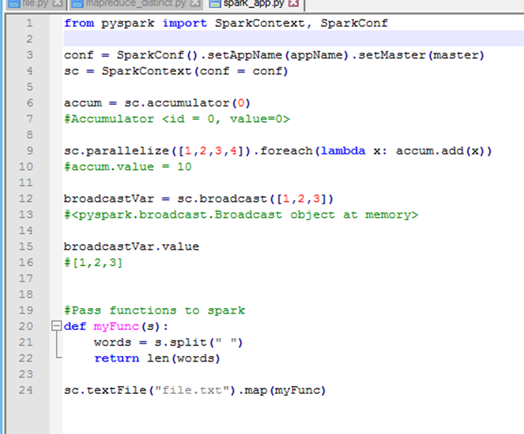
Simple Spark Applications Continued
Accumulator: Stores variable that can have additive and cumulative functions performed onto it. Safer than using “Global” declaration
Parallelize: Stores iterable data such as a list onto a distributed dataset to be sent to clusters on network
Broadcast: Sends variable to other memory devices in cluster. Efficient algorithm pre-built that helps reduce communication costs. Should only be used if the same data is needed in all nodes
Foreach (Reducer): Runs function on each element in dataset, output is best to be an accumulator object for safe updates

Slide 11
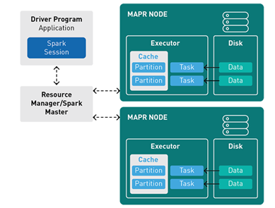
How a Spark Application Runs on a cluster?
A Spark application runs as independent processes, coordinated by the SparkSession object in the driver program.
The resource or cluster manager assigns tasks to workers, one task per partition.
A task applies its unit of work to the dataset in its partition and outputs a new partition dataset. Because iterative algorithms apply operations repeatedly to data, they benefit from caching datasets across iterations.
Results are sent back to the driver application or can be saved to disk.

Slide 12
Spark Abstraction
Resilient Distributed Database (RDD)
It is the fundamental abstraction in Apache Spark. It is the basic data structure. RDD in Apache Spark is an immutable collection of objects which computes on the different node of the cluster.
Resilient- i.e. fault-tolerant ,so able to recompute missing or damaged partitions due to node failures.
Distributed- since Data resides on multiple nodes.
Dataset -represents records of the data you work with. The user can load the data set externally which can be either JSON file, CSV file, text file or database via JDBC with no specific data structure.

Slide 13
contd..
Data Frame
We can term DataFrame as Dataset organized into columns. DataFrames are similar to the table in a relational database or data frame in R /Python.
Spark Streaming
It is a Spark’s core extension, which allows Real-time stream processing from several sources. To offer a unified, continuous DataFrame abstraction that can be used for interactive and batch queries these two sources work together. It offers scalable, high-throughput and fault-tolerant processing.
GraphX
It is one more example of specialized data abstraction. It enables developers to analyze social networks. Also, other graphs alongside Excel-like two-dimensional data.

Slide 14
What is scala?
Scala is a general purpose language that can be used to develop solutions for any software problem.
Scala combines object-oriented and functional programming in one concise, high-level language.
Completely compatible with java consequently runs on JVM
Scala offers a toolset to write scalable concurrent applications in a simple way with more confidence in their correctness.
Scala is an excellent base of parallel, distributed, and concurrent computing, which is widely thought to be a very big challenge in software development but by the unique combination of features has won this challenge.

Slide 15
Why Scala??
Using Scala apps are less costlier to maintain and easier to evolve Scala because Scala is a functional and object-oriented programming language that makes light bend reactive and helps developers write code that's more concise than other options.
Scala is used outside of its killer-app domain as well, of course, and certainly for a while there was a hype about the language that meant that even if the problem at hand could easily be solved in Java, Scala would still be the preference, as the language was seen as a future replacement for Java.
It reduces the amount of code developers to write the code.

Slide 16
Getting Started in Scala:
•scala
–Runs compiled scala code
–Or without arguments, as an interpreter!
•scalac - compiles
• fsc - compiles faster! (uses a background server to minimize startup time)
•Go to scala-lang.org for downloads/documentation
•Read Scala: A Scalable Language
(see http://www.artima.com/scalazine/articles/scalable-language.html )

Slide 17
Example programs with Scala and Python
WordCount:In this example we use few transformations to build a dataset of (String, int) pairs called counts and save it to a file.
Python:
text_file = sc.textFile("hdfs://...") # Read data from file
counts = text_file.flatMap(lambda line: line.split(" ")) \
.map(lambda word: (word, 1))\
.reduceByKey(lambda a, b: a + b)
counts.saveAsTextFile("hdfs://...") #Save output into the file
Scala:
val textFile = sc.textFile("hdfs://...")
val counts = textFile.flatMap(line => line.split(" "))
.map(word => (word, 1))
.reduceByKey(_ + _)
counts.saveAsTextFile("hdfs://...")

Slide 18
Prediction with Regressions utilizing MLlib
Python:
#Read data into dataframe
df = sqlContext.createDataFrame(data, ["label","features"])
lr = LogisticRegression(maxIter=10)
#Fit the model to the data
model = lr.fit(df)
# Predicting the results using the model
model.transform(df).show()
Scala:
// Read data into dataframe
val df = sqlContext.createDataFrame(data).toDF("label", "features")
val lr = new LogisticRegression().setMaxIter(10)
val model = lr.fit(df)
val weights = model.weights
// Predicting the results using the model
model.transform(df).show()

Slide 19
THANKYOU

