Slide 1
Spark Presentation

Slide 2
Overview
Its a fast general-purpose engine for large-scale data processing.
Speed
Ease of use
Generality
Runs everywhere

Slide 3
Overview
Spark SQL for querying structured data via SQL and Hive Query Language (HQL)
Spark Streaming mainly enables you to create analytical and interactive applications for live streaming data. You can do the streaming of the data and then, Spark can run its operations from the streamed data itself.
MLLib is a machine learning library that is built on top of Spark and has the provision to support many machine learning algorithms. But the point difference is that it runs almost 100 times faster than MapReduce.
Spark has its own Graph Computation Engine, called GraphX.
Spark Core Engine allows writing raw Spark programs and Scala programs and launch them; it also allows writing Java programs before launching them. All these are being executed by Spark Core Engine.

Slide 4
Layers and packages in Spark
Spark SQL - allows queries to be made on structured data using both SQL and HQL (Hive Query Language).
MLlib - a library designed to support the execution/creation of multiple machine learning algorithms.
Estimated to run 100 times faster than Hadoop’s MapReduce.
Spark Streaming - allows for the creation of interactive applications designed to run data analysis operations on live streamed data.
GraphX - an engine that allows the user to make computations using graphs.

Slide 5
Downloading and Getting started
Download at http://spark.apache.org/downloads.html
Select package type as “Pre-built for Hadoop 2.7 and later” and download the compressed TAR file. Unpack the tar file after downloading
Spark’s shell provides a simple way to learn the API, as well as a powerful tool to analyze data interactively.
It is available in either Scala (which runs on the Java VM and is thus a good way to use existing Java libraries) or Python.
Spark shell can be opened by typing “./bin/spark-shell” for Scala version and “./bin/pyspark ” for Python Version
Spark’s primary abstraction is a distributed collection of items called a Dataset. Datasets can be created from Hadoop InputFormats (such as HDFS files) or by transforming other Datasets.(Until Spark 2.0 it used to be RDD’s)

Slide 6
Spark Application
Like MapReduce applications, each Spark application is a self-contained computation that runs user-supplied code to compute a result.
In Spark, the highest-level unit of computation is an application.
A Spark application can be used for a single batch job, an interactive session with multiple jobs, or a long-lived server continually satisfying requests.
A Spark job can consist of more than just a single map and reduce. A Spark application can have processes running on its behalf even when it's not running a job.
Multiple tasks can run within the same executor
Therefore, this enables extremely fast task startup time as well as in-memory data storage, resulting in orders of magnitude faster performance

Slide 7
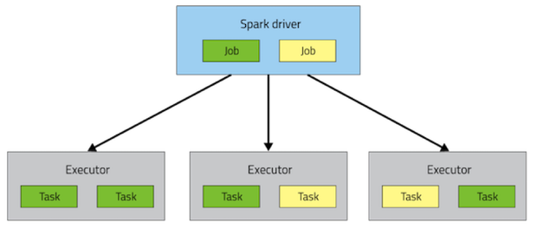
Simple Spark Applications
Spark’s highest unit is an application
Every application is self-contained that runs code for a result
Each application can be used once or constantly on a server filling jobs
Applications can have processes running in the background
Multiple tasks can run in one executor.
Spark application uses concepts like driver, executor, task, job, and stage.

Slide 8
PySpark
PySpark in an interactive shell for Spark in Python.
The bin/pyspark script launches a Python interpreter that is configured to run PySpark applications
The PySpark supports Python 2.6 and above.
The Python shell can be used explore data interactively and is a simple way to learn the API:

Slide 9
PySpark
PySpark in an interactive shell for Spark in Python.
The bin/pyspark script launches a Python interpreter that is configured to run PySpark applications
The PySpark supports Python 2.6 and above.
The Python shell can be used explore data interactively and is a simple way to learn the API:

Slide 10
PySpark
By default, the bin/pyspark shell creates SparkContext that runs applications.
In PySpark, RDDs(Resilient Distributed Dataset) support the same methods as their Scala counterparts but take Python functions and return Python collection types.
Spark revolves around the concept of a resilient distributed dataset (RDD), which is a fault-tolerant collection of elements that can be operated on in parallel. There are two ways to create RDDs:

Slide 11
Introduction to Scala
A scalable programming language Influenced by Haskell and Java
Can use any Java code in Scala, making it almost as fast as Java but with much shorter code
Allows fewer errors – no Null Pointer errors
More flexible - Every Scala function is a value, every value is an object
Scala Interpreter is an interactive shell for writing expressions
$ scala starts interpreter
scala> 3 + 5 expression to be evaluated by interpreter
Unnamed0: Int = 8 result of evaluation
scala> :quit quits interpreter

Slide 12
Why Scala?
Scala smoothly integrates object oriented and functional programming
Runs on the JVM
Scala is compatible with java. Java libraries and frameworks can be used without glue code or additional declarations.
Many design patterns are already natively supported
It allows decomposition of objects by pattern matching.
Patterns and expressions are generalized to support the natural treatment of XML documents

Slide 13
Video Link:

Slide 14
Code Demonstration

Slide 15
Questions? ☺

