Slide 1
Boolean Retrieval
Term Vocabulary and Posting Lists
Web Search Basics

Slide 2
Information Retrieval
Information Retrieval: is finding material of an unstructured nature that satisfies an information need from within large collections.
Used to reduce information overload (aka Infoxication, infobesity, data smog, and info glut.)
Used to retrieve information from a large collection of data. Think library system.
Most visible use is Web Searches.
Documents are typically transformed into a usable representation before I.R.
Documents represented as words or phrases
Documents and queries represented as vectors, matrices, or tuples
etc.

Slide 3
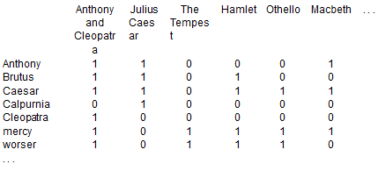
Incident matrix
An example of how documents can be represented:
Can be used for a Boolean Retrieval
Simply a boolean stating on whether a word has been used in a document.
The statement “Brutus AND Ceasar AND NOT Calpurnia” becomes
110100 AND 110111 AND 101111 = 100100
Therefore “Anthony and Cleopatra” and “Hamlet” is returned

Slide 4
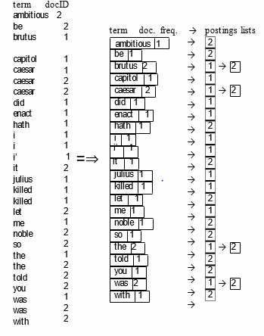
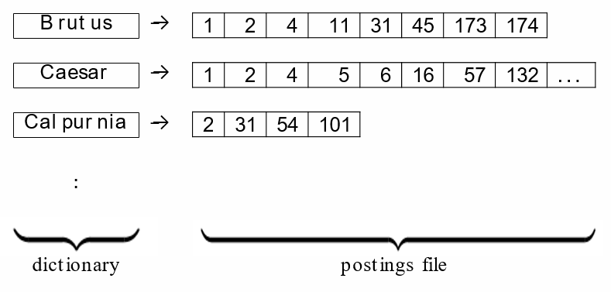
Inverted Index
Too large to work with.
An inverted Index is created to help search efficiency.
Documents where each term occurs and places in posting list.

Slide 5
Boolean Retrieval Model
Arguably the simplest model to base an I.R. system on. It is the first and very commonly adopted.
Boolean Retrieval queries are boolean expressions and the search engine returns returns all documents that satisfy that boolean expression
Boolean queries are queries that use AND, OR, or NOT.
Consider the query: BRUTUS AND CALPURNIA
The steps will be:
Locate BRUTUS in the dictionary
Retrieve its posting list from the postings file
Locate CALPURNIA in the dictionary
Retrieve its posting list from the Postings file
Intersect the two posting lists.

Slide 6
Term Vocabulary
Tokenization
Stop words
Normalization
Stemming
Lemmatization

Slide 7
Tokenization
Tokens: Sequence of characters in a document
Ex:
Input: “Friends, Romans, Countrymen”
Output:
Friends
Romans
Countrymen
Issues:
Spacing Issues: San Francisco – one token or two?
Language issues: in French : L'ensemble – one token or two?
In Chinese and Japanese: No spaces in between words.

Slide 8
Stop Words
Stop words - Dropping common terms which would appear to be have little value in helping selecting documents
a, an, and, are, as, at, be, by, for, from, has, he, in, is, it, its, of, on, that, the, to, was, were, will, with
Stop List: the members of which are then discarded during indexing

Slide 9
Normalization
“normalize” words in indexed text as well as query words into the same form
Ex:
match U.S.A with USA (deleting periods)
anti‐discriminatory to antidiscriminatory (deleting hyphens)
Accents - résumé vs. resume.
Date forms - 7月30日vs. 7/30
Case folding – Reduce all letters to lower case since every user will search using lower case letters instead of correct capitalization
Ex: Searching for UNC Charlotte – unc charlotte

Slide 10
Stemming and Lemmatization
Stemming – Reduce terms to their “roots” before indexing
“Stemming” suggest crude affix chopping
Language dependent
e.g.: automate(s), automatic, automation all reduced to automat.
Porter’s Algorithm is the most used algorithm for stemming
Lemmatization - Reduce inflectional/variant forms to base form
Ex:
am, are, is → be
car, cars, car's, cars’ → car

Slide 11
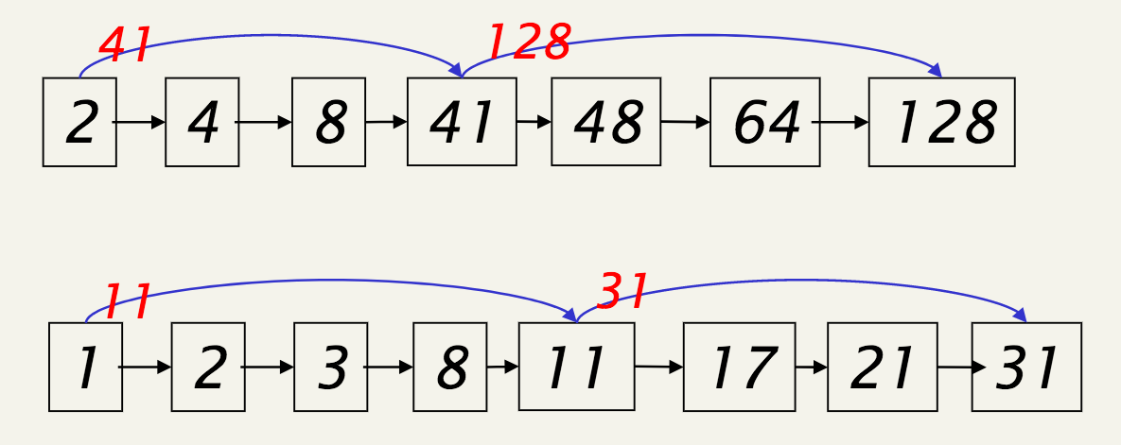
Posting Lists
If the list lengths are m and n, the merge takes O(m+n)operations.
Can we do it better? Yes
Postings with Skip Pointers
To skip postings that will not figure in the search results
This makes intersecting postings lists more efficient
Some postings contains several million entries, so efficiency can be an issue even if basic intersection is linear

Slide 12
Web Search Basics
Anchor text is the clickable text in a hyperlink. Anchor text is relevant to the page the user is linking to, rather than generic text.
The keywords in anchor text are one of the many signals search engines use to determine the topic of a web page.
The words contained in the anchor text help determine the ranking that the page will receive by search engines such as Google or Yahoo and Bing.

Slide 13
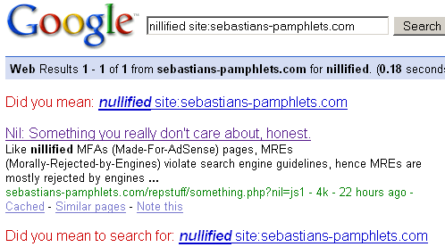
Example of anchor text:
The blue hyperlinked texts are the anchor text:

Slide 14
How web search would be without search engine?
The World Wide Web contains more than ten million websites with thousands more being added daily from all over the world, and search engines are tasked with presenting the most relevant pages based on the search criteria entered.
Without search engine, content is hard to find: relevant information retrieval becomes hard.
Without search engine, there is no incentive to create content.
Somebody needs to pay for the web.
Search engines are a key enabler for interest aggregation: a small number of geographically dispersed people with similar interests can find each other.

Slide 15
IR in web vs IR in general
The web is a chaotic und uncoordinated collection. → lots of duplicates – need to detect duplicates.
No control / restrictions on who can author content → lots of spam – need to detect spam.

Slide 16
PageRank
Why it is needed?
•To rank the pages that retrieved and making sure the information retrieved is more relevant.
•How to rank efficiently/ spam proof?
•Google come with an algorithm called PageRank.
•Every page is ranked based upon number of links available to the page and Page rank of the page in which the link is available.
•for ex: Say we have a web page X that has n links including one link to Y, the contribution of this pageX to page rank of Y is PR(X)/n.
•PR(A) = (1-d) + d (PR(T1)/C(T1) + ... + PR(Tn)/C(Tn))

Slide 17
PageRank (Cont..)

