Slide 1
PageRank
GROUP 4

Slide 2
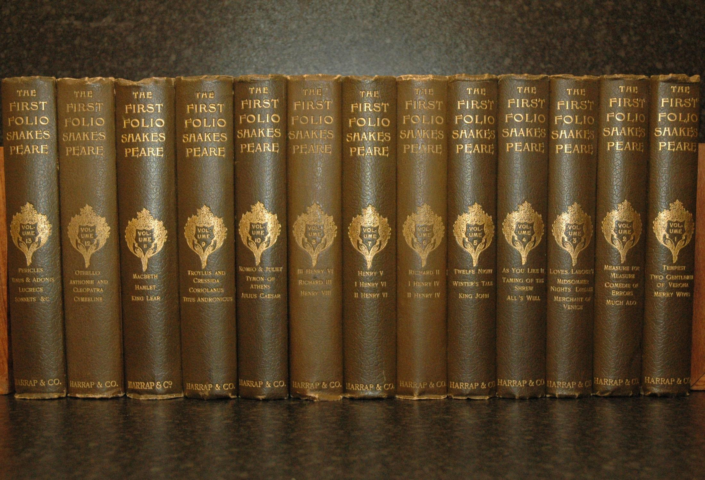
Boolean Retrieval - Information Retrieval (IR)
Information Retrieval: Finding material of an unstructured nature(text) that satisfies an information need from within large collections`(Computer).
Use: Web Search, Domain-specific search, Personal Information Retrieval. e.g.: reference librarians, google search etc.
Problem example:
Query : Brutus and Caesar, but NOT Calpurnia in Shakespeare’s collection

Slide 3
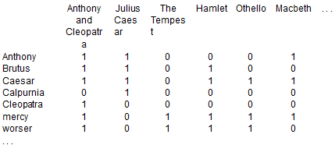
Boolean Retrieval -- Boolean Retrieval Model
Solution 1: Linear Scan from beginning through all text by grep command in unix.
Solution 2: Index
The statement “Brutus AND Ceasar AND NOT Calpurnia” becomes
110100 AND 110111 AND 101111 = 100100
Therefore “Anthony and Cleopatra” and “Hamlet” is returned
Boolean Retrieval Model: Process a query by using Boolean Index with operators AND, OR and NOT.

Slide 4
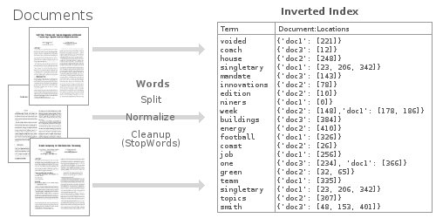
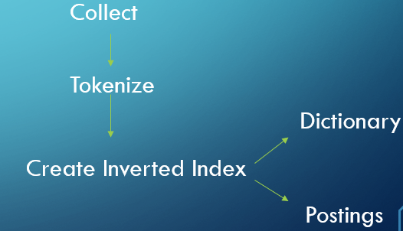
Boolean Retrieval -- Inverted Index
Ad-hoc Retrieval: Standard IR task. From collection, retrieves relevant documents based on arbitrary IN.
Problem: create an incidence matrix in a much larger size? Too large to store.
Inverted Index: an index data structure storing a mapping from content

Slide 5
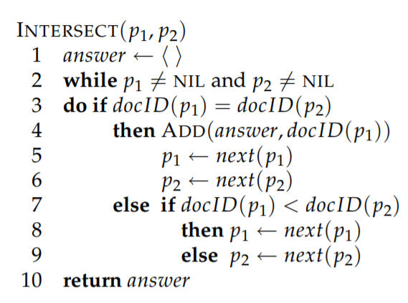
Processing Boolean queries
Process a query using an inverted index and the basic Boolean retrieve model.`
Brutus AND Calpurnia
Locate Brutus in the Dictionary
Retrieve its postings
Locate Calpurnia in the Dictionary
Retrieve its postings
Intersect the two postings lists

Slide 6
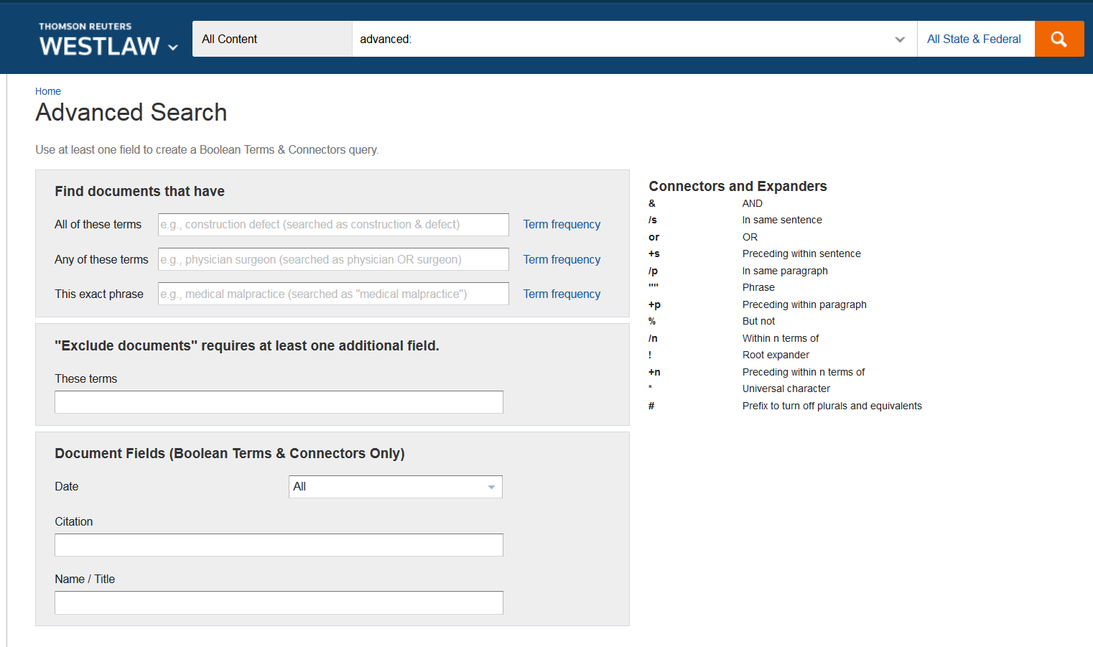
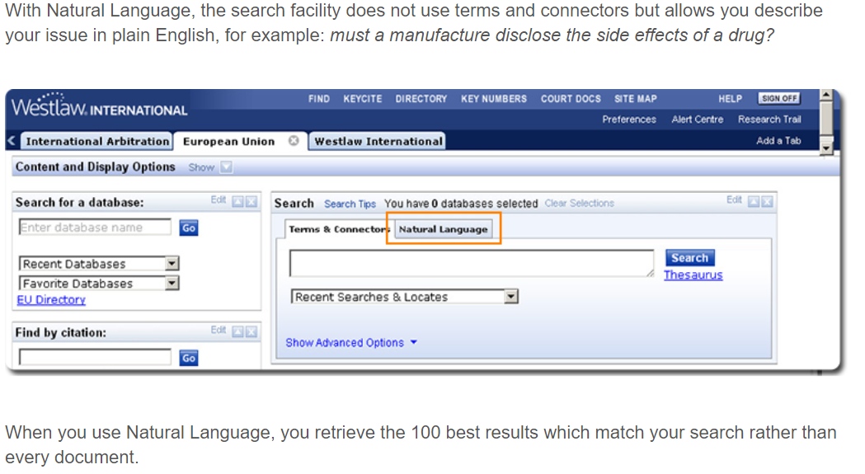
External Boolean Retrieval vs Ranked Retrieval
Extended Boolean retrieval
additional operators such as term proximity operators (Besides AND OR NOT)
Ranked retrieval (using free text queries)
just typing one or more words rather than using a precise language with operators for building up query expressions, and the system decides which documents best satisfy the query.
In 2005, Boolean search (called “Terms and Connectors” by Westlaw) was still the default, and used
by a large percentage of users, although ranked free text querying (called “Natural
Language” by Westlaw) was added in 1992.

Slide 7
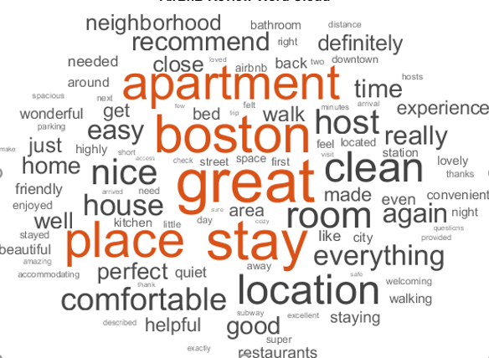
Term Vocabulary - Tokenization
A token is an instance of a sequence of characters
Input: “Friends, Romans and Countrymen”
Output: Tokens
Friends
Romans
Countrymen

Slide 8
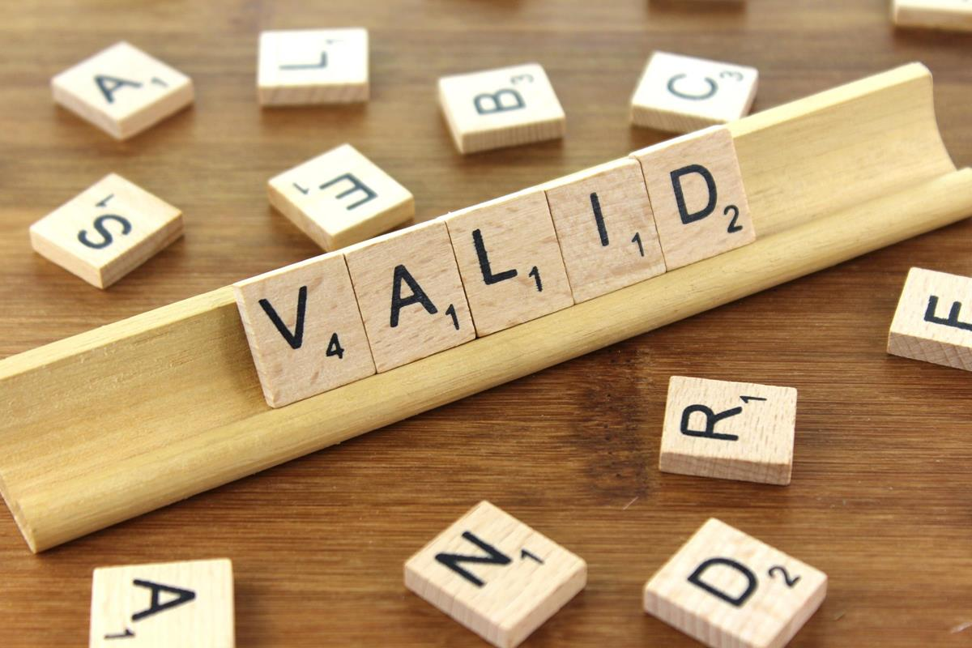
What are valid tokens to emit??
Finland’s capital →
Finland AND s? Finlands? Finland’s?
Hewlett-Packard → Hewlett and Packard as two tokens?
San Francisco: one token or two?
3/20/91 Mar. 12, 1991 20/3/91
French
L'ensemble → one token or two?
(800) 234-2333

Slide 9
Stop Words
Stop words - Dropping common terms which would appear to be have little value in helping selecting documents
a, an, and, are, as, at, be, by, for, from, has, he, in, is, it, its, of, on, that, the, to, was, were, will, with
Stop List: the members of which are then discarded during indexing
You need them for:
Phrase queries: “King of Denmark”
Various song titles, etc.: “Let it be”, “To be or not to be”
“Relational” queries: “flights to London”
Notes:
Nevertheless: “Google ignores common words and characters such as where, the, how, and other digits and letters which slow down your search without improving the results.” (Though you can explicitly ask for them to remain.)

Slide 10
Normalization to Terms
We may need to “normalize” words in indexed text as well as query words into the same form
Removing periods
U.S.A. and USA
Accents
Tel’ e gram - > Telegram
Deleting hyphens –
Good-hearted ->Good Hearted
Date Forms-
7月30日 vs. 7/30
Tokenization and normalization may depend on the language and so is intertwined with language detection
Is this
German “mit”?
Morgen will ich in MIT …

Slide 11
Case Folding
Reduce all letters to lower case
Exception: upper case in mid-sentence?
E.g.,
General Motors
Fed vs. fed
SAIL vs. sail
Often best to lower case everything, since users will use lowercase regardless of ‘correct’ capitalization…

Slide 12
Lemmatization & Stemming
Lemmatization -Reduce inflectional/variant forms to base form
E.g.,
am, are, is → be
car, cars, car's, cars' → car
Lemmatization implies doing “proper” reduction to dictionary headword form
Reduce terms to their “roots” before indexing
Stemming- “Stemming” suggests crude affix chopping
Language dependent
e.g.,
automate(s), automatic, automation all reduced to automat.

Slide 13
Posting Lists
A postings list present in every inverted index is comprised of individual postings, each of which consists of a document id and a payload. For simple boolean retrieval, payload is not needed in the posting other than the document id
Term Frequency (tf )- the most common payload indicates the number of times the term occurs in the document.
Other complex payloads could be
positions of every occurrence of the term in the document
properties of the term
results of linguistic processing
These complex payloads are useful in enriching the representation of document content

Slide 14
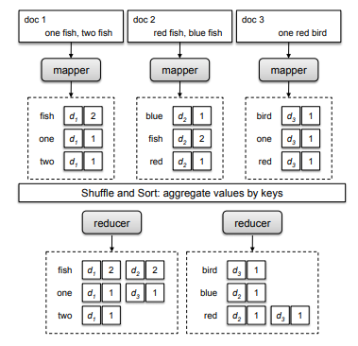
Posting Lists Baseline Implementation
Every document is identified by a unique integer ranging from 1 to n, where n is the total number of documents
Each document is then analyzed and broken out into its components
For Web pages HTML tags, JavaScript code, tokenizing, case folding, stemming and stop words are stripped out
Once the document has been analyzed, term frequencies are computed by iterating over all the terms and keeping track of counts

Slide 15
Posting Lists Baseline Implementation
The mapper then emits an intermediate key-value pair with the term as the key and the posting as the value
In the shuffle and sort phase, The reducer begins by initializing an empty list and then appends all postings associated with the same key (term) to the list
The postings are then sorted by document id, and the entire postings list is emitted as a value, with the term as the key

Slide 16
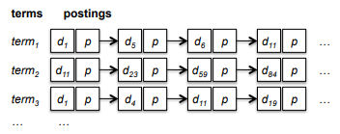
Posting Lists Baseline Implementation
Simple illustration of an inverted index. Each term is associated with a list of postings.
Each posting is comprised of a document id and a payload, denoted by p in this case. An inverted index provides quick access to documents ids that contain a term.

Slide 17
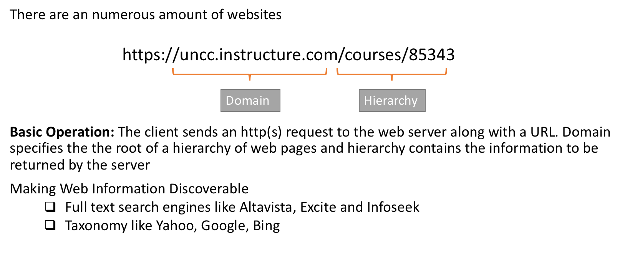
Web Search Basics

Slide 18
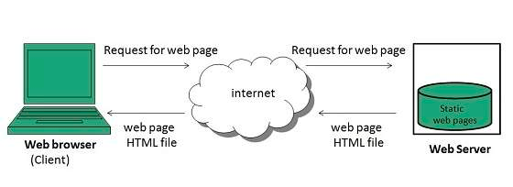
Types of web pages
The webpages are broadly divided into static and dynamic web pages.
Static web pages contain a fixed number of pages and the webpage’s format is fixed before it delivers information to the client.
Dynamic web pages content changes dynamically while it is running on the client’s browser.

Slide 19
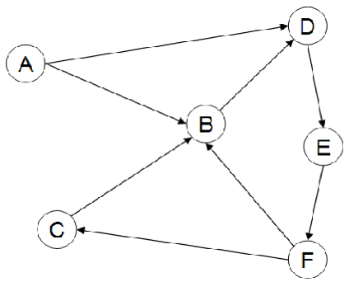
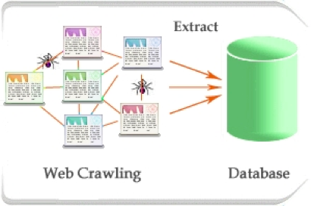
Web Search
Web Graph: A list of interconnecting HTML
pages are stitched together with hyperlinks.
Each page is a node and each hyperlink
is a directed edge.
Web Crawling: The act of programmatically scanning a webpage for predefined information, such as web pages and the link structure that connects them.

Slide 20
Page Rank
An algorithm used by many search engines to rank importance and relevance
Important to understand to get your page closer to the top of search engine.
Average PageRank within a website: 1
Total page rank within website increases with number of pages.
Other pages link to yours: Increase average PageRank
Including external link(s) on your page decreases average PageRank.

Slide 21
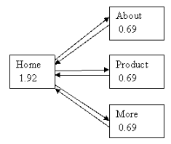
Page Rank
Fully Meshed Network
Hierarchal network

Slide 22
Page Rank
Content Creators Favored
2 ways of increasing your PR greatly:
Many smaller webpages with links to your page
One or more webpages with a link to your page.
Influence of Site Map

Slide 23
References
http://www.cs.princeton.edu/~chazelle/courses/BIB/pagerank.htm
http://www.westlawinternational.com/updates/update-september-2013/

Slide 24
Thank you!!

