Slide 1
Boolean Retrieval, Term Vocabulary and Posting Lists, Web Search Basics

Slide 2
Contents
Information Retrieval
Boolean Retrieval
Incidence Matrix
Inverted Index
Determining the Vocabulary of Terms
Stop Words, Stemming And Lemmatization
Index size and estimation
Near duplicates and Shingling
Posting Lists
Web search Basics

Slide 3
Information Retrieval
Information retrieval - finding material of an unstructured nature that satisfies an information need from within large collections.
Used to retrieve data from a large collection of data
Used to retrieve data from the semi structured data which contains java in the title and threading in the body
Can be distinguished on the scale on which they operate like the web search, Personal information retrieval, domain specific search

Slide 4
Boolean Retrieval
Boolean Retrieval Model - Simplest model to base an information retrieval model.
Consists of terms like AND, OR, NOT
The result is the documents that satisfy the boolean expression
One of the precise retrieval tools
Example - Brutus AND Calpurnia
Brutus is searched in dictionary & the Calpurnia and from the result we search the intersection that contains both Brutus and Calpurnia

Slide 5
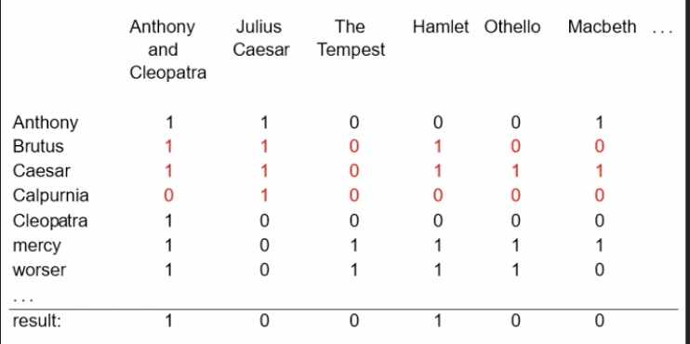
Incidence Matrix
Grep - Linear scan from beginning through all the text. However it is Slow, Line oriented, less flexible.
Incidence Matrix - Represent the matrix via a boolean stating on if a word is present or not
Statement : “Brutus AND Ceaser AND NOT Calpurnia” becomes
110100 AND 110111 AND 101111 = 100100

Slide 6
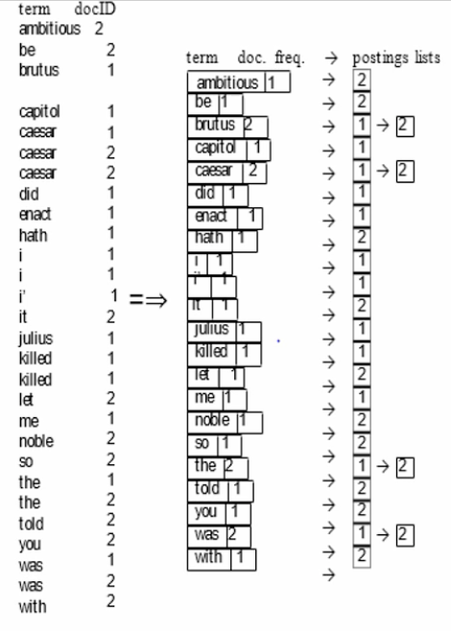
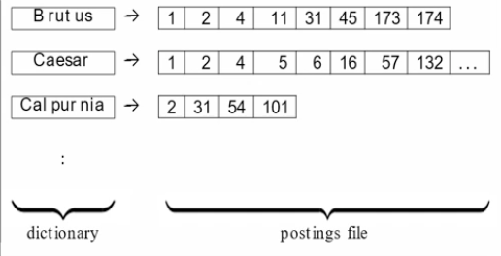
Inverted Index
Suitable for large collections
Collect Documents
Tokenize and pre-process
Generate and sort postings
Create posting Lists
Determine Document Frequency
Inverted Index (Dictionary + Postings files)

Slide 7
Determining the vocabulary of Terms
Given a character sequence and defined document unit, tokenization is the task of chopping it up into pieces called tokens.
Token Normalisation - process of canonicalizing token so that matches occur despite superficial differences in character sequences of the tokens.

Slide 8
Stop words, Stemming and Lemmatization
Stop words - Common words that appear to be of little value in helping select documents matching a user need.
They are excluded from vocabulary entirely.
The goal of stemming and Lemmatization is to reduce the inflectional forms and derivationally related forms of a word to a common base form.

Slide 9
Index Size and Estimation
The size of the index of a web search engine can be used to determine the quality of web search engines.
Given two search engines, what are the relative sizes of their indexes?Even this question turns out to be imprecise, because:
1.In response to queries a search engine can return web pages whose contents it has not(fully or even partially) indexed.
2.Search engines generally organise their indexes in various tiers and partitions, not all of which are examined on every search.
Assumption: There is a finite size for the web from which each search engine chooses a subset, and second, that each engine chooses and independent,uniformly chosen subset.
Based on these assumptions, we can invoke a classical estimation technique known as the capture-recapture method.

Slide 10
Near-duplicates and Shingling
The web contains multiple copies of the same content. It is estimated that 40% of the pages on the web are duplicates of other pages.
Search engines try to avoid indexing multiple copies of the same content, to keep down storage and processing overheads.
A solution to resolve this problem is a technique known as Shingling.
What is Shingling?
In natural language processing a w-shingling is a set of unique shingles(therefore n-grams) each of which is composed of contiguous subsequences of tokens within a document, which can then be used to ascertain the similarity between documents.

Slide 11
Posting Lists
Each item in the list which record that a term appeared in a document is called a posting.
The list is called posting list and all posting lists taken together are called posting lists.
Faster pointing list interaction via skip pointers-
Walk through two posting simultaneously in time linear in total of posting entries is bit time consuming.
Hence to improve the efficiency we use fast pointing via skip pointers.
How it works:
Take the list and augument it with skip pointers at indexing time.
Skip pointers point ot a random node in the list far ahead by skipping same node in between

Slide 12
Positional posting and Phrase queries-
Complex and technical terms with multi word compounds or phrases.
E.g “Stanford University”
To be able to support such queries, it is no longer sufficient for postings lists to be simply lists of documents that contain individual terms.
A search engine should not only support phrase queries, but implement them efficiently.
Biword indexes - Index every consecutive pair of terms in the text as phrase.
Positional indexes - In the posting, store for each term the position which token of it appear

Slide 13
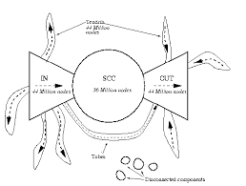
Web search Basics
Anchor text is clickable text in a hyperlink. Anchor text is relevant to the page the user is linking to, rather than generic text.
The keywords in the anchor text are one of the many signals search engines use to determine the topic of a web page.

Slide 14
THANK YOU !!

