Slide 1
Boolean Retrieval, Term Vocabulary and Posting Lists, Web Search Basics

Slide 2
Information Retrieval
●Information retrieval is the activity of obtaining information system resources that are relevant to an information need from a collection of those resources.
●Searches can be based on full-text or other content-based indexing.
●Information retrieval can provide organizations with immediate value
●Used to retrieve data from the semi structured data which contains java in the title and threading in the body
●Used to retrieve data from a large collection of data

Slide 3
Boolean Retrieval
●The (standard) Boolean model of information retrieval (BIR) is a classical information retrieval (IR) model.
●Pure Boolean Operators: AND, OR, NOT
●Most systems support simple regular expressions as search terms to match spelling variants
●Boolean model is most common exact-match model
– queries are logic expressions with document features as operands
– In pure Boolean model, retrieved documents are not ranked

Slide 4
Does Google use the Boolean Model?
On Google, the default interpretation of a query [w₁ w₂. . . w_{n}] is w₁ AND w₂ AND . . . AND w_{n}
Simple Boolean Retrieval returns matching documents in no particular order.
Google(and most well designed Boolean engines) rank the result set -they rank the good hits according to estimator of relevance higher than bad hits.

Slide 5
Exact vs. Best match
Exact-match
query specifies precise retrieval criteria
every document either matches or fails to match query
result is a set of documents
Best-match
Query describes good or “best” matching document
Every document matches query to some degree
Result is ranked list of documents

Slide 6
Exact vs. Best match
Advantages of exact match
Can be very efficiently implemented
Predictable, easy to explain
Structured queries for pinpointing precise documents
Work well when you know exactly what the collection contains and what you’re looking for
Disadvantages of exact match
Query formulation difficult for most users
Difficulty increases with collection size
Indexing vocabulary same as query vocabulary
Acceptable precision generally means unacceptable recall
Ranking models consistently shown to be better
Hard to compare best- and exact-match in principled way (why?)

Slide 7
Exact vs. Best match
Advantages of best match
Significantly more effective than exact match
Uncertainty is a better model than certainty
Easier to use (supports full text queries)
Similar efficiency (based on inverted file implementations)
Disadvantages of best match
More difficult to convey an appropriate cognitive model (“control”)
Full text does not mean natural language understanding (no “magic”)
Efficiency is always less than exact match (cannot reject documents early)

Slide 8
Question
Where are these matches widely used?

Slide 9
Web Search Basics
● In-links - These are the hyperlinks that goes into a page.
● out-links - These are the hyperlinks that goes out of a page.
● Distribution of links - It is not randomly distributed however, it follows power law.
i is proportional to 1/iα;
i = web pages with in-links
α = 2.1
● Web graph connecting web pages has bowtie shape.

Slide 10
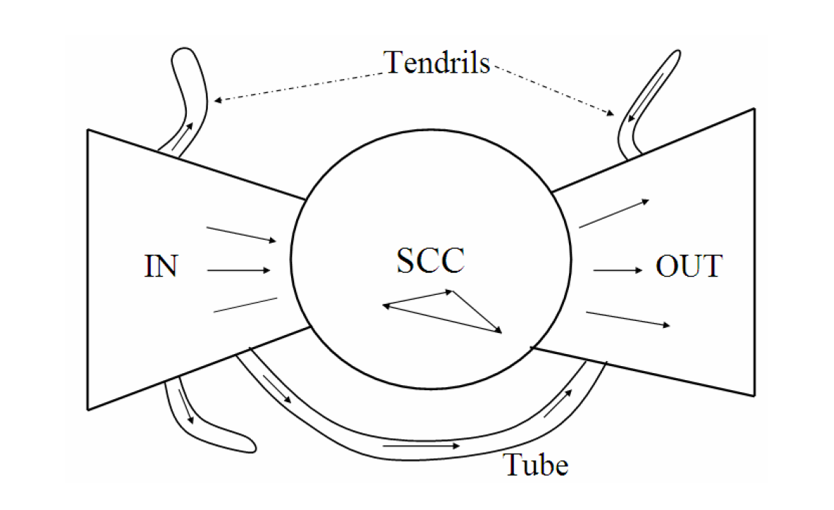
Web Graph
Three major categories : -
● IN - web surfer pass from IN -> SCC
● OUT - web surfer pass from OUT -> OUT
● SCC - web surfer can pass from SCC to OUT, SCC.
● Tube - directly from IN -> OUT
● Tendrils - leads nowhere from IN and from nowhere to OUT.

Slide 11
● Question : What are different categories of user search queries ?

Slide 12
The search user experience
Three major categories : -
● Information queries - seek general information on a broad topic.
users with informational queries typically try to assimilate information from multiple web pages
● Navigational queries - seek website of single entity.
- “Lufthansa airlines” first search result should be home page of lufthansa
● Transactional queries - seek result to perform transaction on web.
Like purchasing a product, downloading a file or making a reservation.

Slide 13
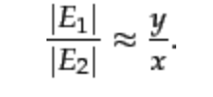
Index Size and Estimation
The quality of an web search engine can be identified by the size of its indexes.
Given two search engines, what are the relative sizes of their indexes?Even this question turns out to be imprecise, because:
In response to queries a search engine can return web pages whose contents it has not(fully or even partially) indexed.
Search engines generally organise their indexes in various tiers and partitions, not all of which are examined on every search.
So , we run a experiment where we take 2 search engines E1 and E2 and see for a topic how many pages of E1 are indexed by E2 and similarly of E2 by E1.
If x are fraction of pages indexed by E1 and y are fraction of pages indexed by E2
Therefore estimation if index size can be given by :
.

Slide 14
Near duplicates and Shingling
Web consist of a lot of duplicate data having multiple copies of the same content.
An estimation says that 40% of the pages on web are duplicate.
To avoid these search engines try to refrain from indexing these similar copies of same content so that the storage and processing overheads are kept minimum.
In Order to solve this problem a technique is used which is known as Shingling.
Shingling
A solution to resolve this problem is a technique known as Shingling.
In natural language processing a w-shingling is a set of unique shingles(therefore n-grams) each of which is composed of contiguous subsequences of tokens within a document, which can then be used to ascertain the similarity between documents.
Hence these shingles act as fingerprints to the document/pages and help us identify near duplicates which can be rejected from indexing.

Slide 15
Are there any Sampling techniques to generate web pages so that we can check the indexing of different browsers?

Slide 16
Term Vocabulary & Posting List
Issues while parsing a document:
What format is it in?
pdf/word/excel/html?
What language is it in?
What character set is in use?
Documents being indexed can include docs from many different languages
A single index may have to contain terms of several languages.
Sometimes a document or its components can contain multiple languages/formats
French email with a German pdf attachment.
What is a unit document?
A file?
An email? (Perhaps one of many in an mbox.)
An email with 5 attachments?
A group of files (PPT or LaTeX as HTML pages)

Slide 17
Tokens and Terms
Steps to normalize the document terms:
Following the above steps, we collect list of document terms and add them to a list called postings

Slide 18
Question
Q. How many postings comparisons would be made if the postings lists are intersected without the use of skip pointers?

Slide 19
Posting lists
Each item in the list - which records that a term appeared in a document (and, later, often, the positions in the document) - is conventionally called a posting.
The list is then called a postings list (or ), and all the postings lists taken together are referred to as the postings.
Postings merges faster when Skip Pointers / Skip Lists are used.
For example if we want to walk through two lists, It is time consuming and the merge takes O(m+n) operations.
This can be improved by using the Skip Pointers provided that the index shouldn’t change too fast.
Skips only works with AND queries and not OR queries.

Slide 20
Take a list and augment it with skip pointers at indexing time.
For postings of length L use Square root of L evenly spaced Skip Pointers.
This ignores the distribution of query terms.
This is easy only if the index is static. I.e L should not be changing frequently because of updates.
This definitely used to help; with modern hardware it may not (Bahle et al. 2002) unless you’re memory-based – The I/O cost of loading a bigger postings list can outweigh the gains from quicker in memory merging!
Tradeoff:
More skips -> shorter skip spans => more likely to skip. But lots of comparisons to skip pointers.
Fewer skips -> few pointer comparison, but then long skip spans => few successful skips.

Slide 21
Phrase Queries:
Want to be able to answer queries such as ‘University of North Carolina’ as a single phase.
Biword Indexes:
Index every consecutive pair of terms in the text as a phrase.
For example friends, romans, countrymen -
Friends romans
Romans countrymen
Longer Phrase Queries:
Longer phrases are processed as Boolean biword queries.
dalhousie university halifax canada can be broken into the following Boolean query on biwords:
dalhousie university AND university halifax AND halifax canada
Questions:
What’s the main disadvantage of Phrase Queries and the solution for it?

Slide 22
Stemming and lemmatization:
Stemming and lemmatization are two language modelling techniques used to improve the document retrieval precision performance.
Stemming is a procedure to reduce all words with the same stem to a common form.
Lemmatization removes inflectional endings and return the base form of a word.
In information retrieval systems,lemmatization produced better precision compared to stemming.
Findings suggest that language modeling techniques improve document retrieval,with lemmatization technique producing best result.
Stemming and lemmatization are also used in tagging systems,indexing,SEOs,Web search results and mainly information retrieval for example searching fish on Google will also result in fishes,fishing as fish in the stem of both words.

Slide 23
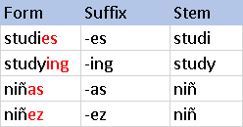
Differences between stemming and lemmatization:
Stemming algorithms work by cutting off the end or the beginning of the word taking into account a list of common prefix and suffixes that can be found in an inflected word.For ex:
Lemmatization on the other hand takes into consideration the morphological analysis of the words.For ex:

Slide 24
Question:
Which on is best for information retrival lemmatization or stemming?

Slide 25
Thank You..,

