Slide 1
Data Mining: Data

Slide 2
DATA
Data: collection of objects and attributes
Objects Collection of attributes
Attribute Property or characteristic of an object. Examples: eye color of a person, temperature. Types of attributes:
Discrete: Finite or countably infinite set of values
Examples: Zip Codes , counts
Continuous: Has real numbers as attribute values
Examples: Temperature, height, weight

Slide 3
Attributes Levels
Nominal Distinctness of objects. Distinguish one object from another.
Examples: Zip codes, ID numbers
Ordinal Distinctness with order. Provide enough information to order objects.
Examples: hardness of materials {good,better,best},grades
Interval Difference between values are meaningful.
Examples: Temperature in Celsius or Fahrenheit
Ratio Both difference and ratios are meaningful
Examples: Count, age, mass, length

Slide 4
Types of data sets
Record data
Data Matrix
Document Data
Transaction Data
Graph
World Wide Web
Molecular Structures
Ordered
Spatial Data
Temporal Data
Sequential Data
Genetic Sequential Data

Slide 5
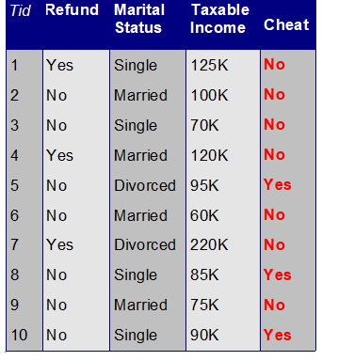
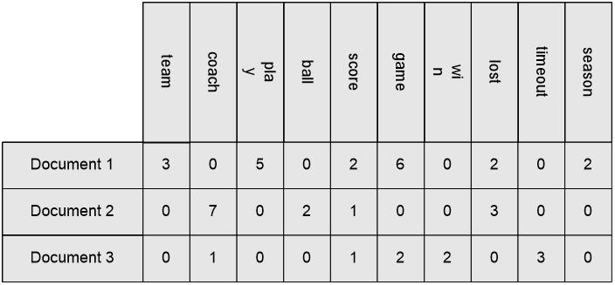
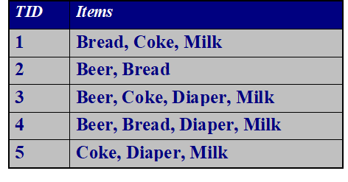
Record Data
Data that consists of a collection of records, each of which consists of a fixed set of attributes.
(c) Document - term matrix.
Record data
(b) Data Matrix
(d) Transaction data

Slide 6
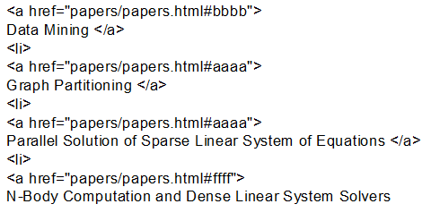
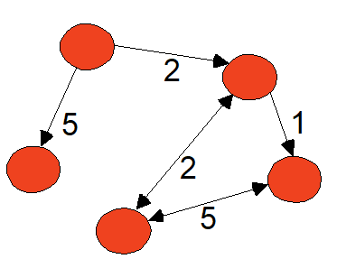
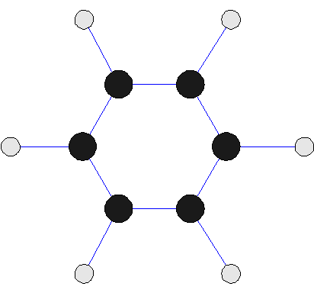
Graph Data
Examples : Generic graph and HTML Links
Generic graph
(c) Benzene molecule
(b) HTML Links

Slide 7
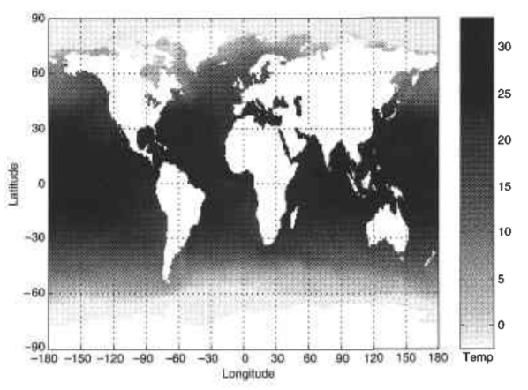
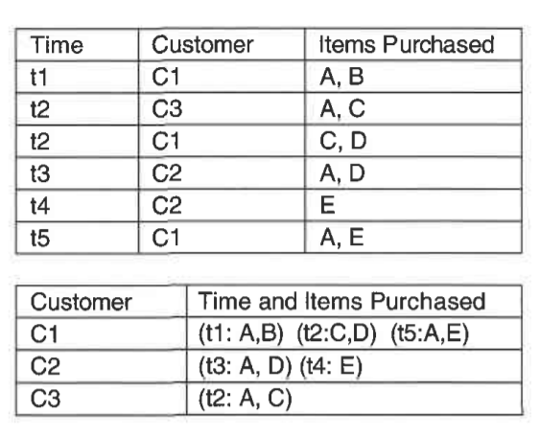
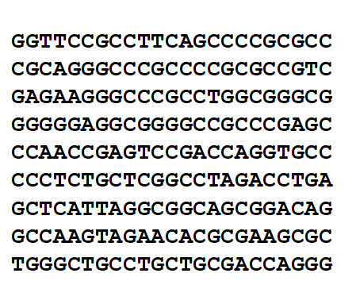
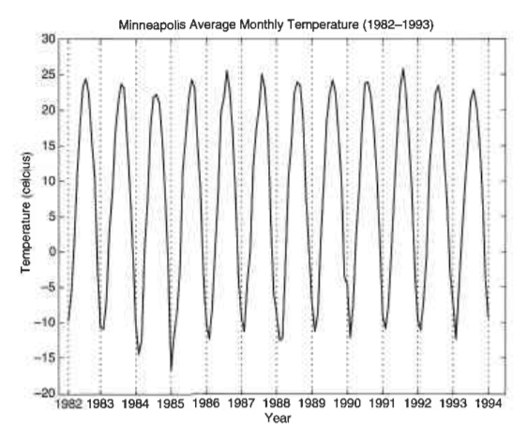
Ordered Data
(a) Spatial data
(c) Sequential data
(d) Genomic sequence data
(b) Temporal data

Slide 8
Data Quality
What is Data Quality?
Why is Data Quality Important?
What kinds of data quality problems exist and what causes them?
Examples of data quality problems:
Noise and Outliers
Missing Values
Duplicate Data

Slide 9
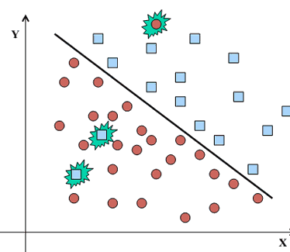
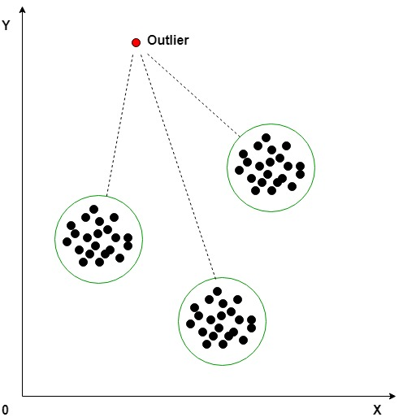
Noise and Outliers
Noise is the distortion of the data. ie. the data is present but not correct
Examples:
Irrelevant/weak features
Noisy records
Outliers are data objects which are considerably different than other data objects in the data set
Outliers -may be valuable patterns:
Fraud Detection
Customized Marketing

Slide 10
Missing Values and Duplicate Data
Missing values occur when no data value is stored for the variable in an observation
Reasons for missing values:
Information is not collected
Attributes not applicable
Handling missing values :
Eliminate or Replace with attribute Mean/Median/Mode
Predict by building model
Use Algorithms Which Support Missing Values-KNN
Data set may include data objects that are duplicates, or almost duplicates of one another
Example: Same person with multiple email addresses
Issues:
Produces skewed or incorrect insights when they go undetected
Takes a toll on the computation and storage

Slide 11
Data Preprocessing-Aggregation
Data aggregation is the process where raw data is gathered and expressed in a summary form for statistical analysis.
Combining two or more attributes (or objects) into a single attribute(or objects)
Purpose of Aggregation servers as follows:
Data reduction: Reducing the volume but producing the same or similar analytical results.
Change of Scale: Cities aggregated into regions, states, countries, etc
More “stable” data-Aggregated data tends to have less variability

Slide 12
Types of Sampling
Simple Random Sampling:
There is an equal probability of selecting any particular item
Sampling without replacement
As each item is selected, it is removed from the population
Sampling with replacement
Objects are not removed from the population as they are selected for the sample. The same object can be picked up more than once
Stratified sampling
Split the data into several partitions; then draw random samples from each partition

Slide 13
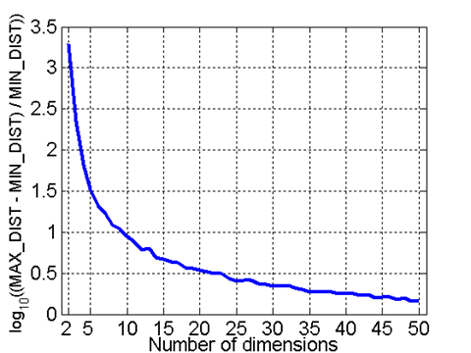
Curse of Dimensionality
When Dimensionality increases, data becomes increasingly sparse in the space that it occupies.
To avoid this, we have Dimensionality Reduction techniques like PCA and ISOMAP
Goal is to find a projection that finds the largest amount of variation in data and project it onto a new subspace with fewer dimensions.
It helps in reducing the amount of time and memory required by data mining algorithms and allows data to be easily visualized.
It helps in overcoming the overfit issues by reducing number of features.
- Randomly generate 500 points
- Compute distance between max and min distance between any pair of points

Slide 14
Feature Subset Selection
Redundant features: duplicate much or all of the information contained in one or more other attributes.
Irrelevant features: contain no information that is useful for the data mining task.
Feature Selection Techniques:
Brute-force approach: Trying all possible feature subsets.
Embedded approach: Feature selection occurs naturally as part of the data mining algorithm.
Filter approach: Features are selection is done before running the data mining algorithm .

Slide 15
Data Preprocessing-Aggregation
Feature Creation
Feature creation - process of constructing new features from existing data
- also known as feature engineering
Create new attributes that can capture the important information in a data set much more efficiently than the original attributes
Methodologies:
Feature extraction - creation of new set of features from original raw data, highly domain specific
Mapping data to new space - different view of data reveals important & interesting features
Feature construction - combination of features

Slide 16
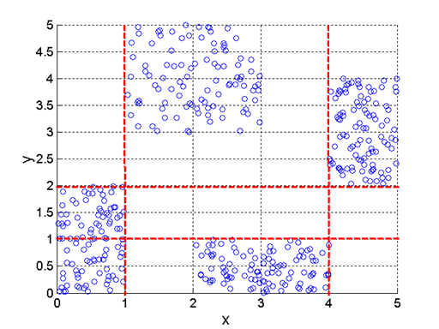
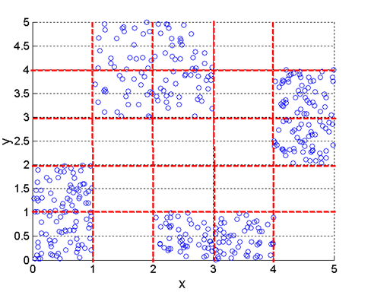
Data Preprocessing-Aggregation
Discretization and Binarization
Transforming a continuous attribute into a categorical attribute is known as Discretization.
Transforming both continuous and discrete attributes into one or more binary attribute is known as Binarization.
Discretization Using Class labels : Entropy based approach
(a) Three intervals
(b) Five intervals

Slide 17
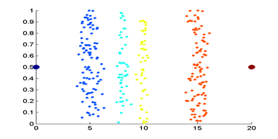
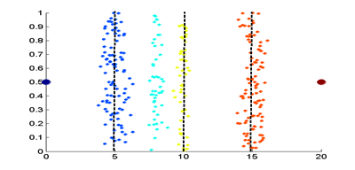
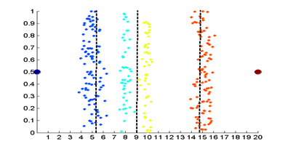
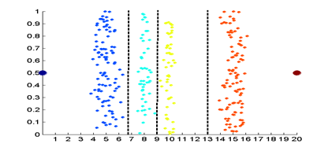
Data Preprocessing-Aggregation
Discretization without using Class Labels
(a) Original Data
(b) Equal width discretization
(c) Equal frequency discretization
(d) K-means discretization

Slide 18
Attribute Transformation
lA function that maps the entire set of values of a given attribute to a new set of replacement values such that each old value can be identified with one of the new values
Euclidean Distance:
Where n is the number of dimensions (attributes) and p_{k} and q_{k} are, respectively, the k^{th} attributes (components) or data objects p and q.

Slide 19
Jaccard Coefficient and Cosine Similarity
Jaccard Coefficient is a measurement of asymmetric information on binary and non-binary variables.
Formula: J = Number of members shared between both sets/total number of members in both set.
Cosine Similarity: Cosine similarity is a metric used to measure how similar are the documents are irrespective of their size.
lIf d₁ and d₂ are two document vectors, then
cos( d₁, d₂ ) = (d₁ · d₂) / ||d₁|| ||d₂|| ,
where · indicates vector dot product and || d || is the length of vector d.

Slide 20
Thank you!

