Slide 1
Vector Space Classification
Yu Lan
ITCS 6190/8190 Fall 2018 project
Notes:
Hello! It’s Yu Lan here. This is the first one in a series of videos on vector space classification. In this video, I will introduce some basic knowledge about vector space classification.

Slide 2
Introduction

Slide 3
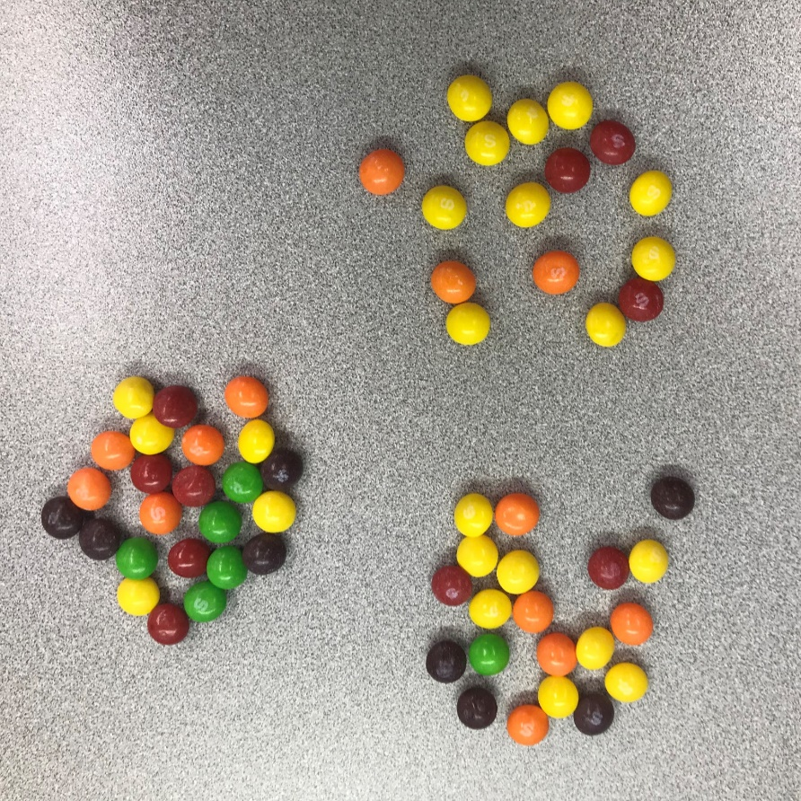
Vector Space Model
each document is a vector
one component for each term
terms are axes
high dimensionality: 100,000s of dimensions
the representation of a set of documents as vectors in a common vector space
UK
KENYA
CHINA

Slide 4
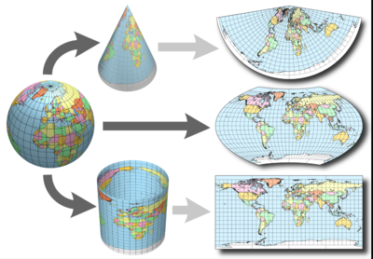
Document representations and measures of relatedness in vector spaces
Source: https://www.earthdatascience.org/courses/earth-analytics/spatial-data-r/geographic-vs-projected-coordinate-reference-systems-UTM/

Slide 5
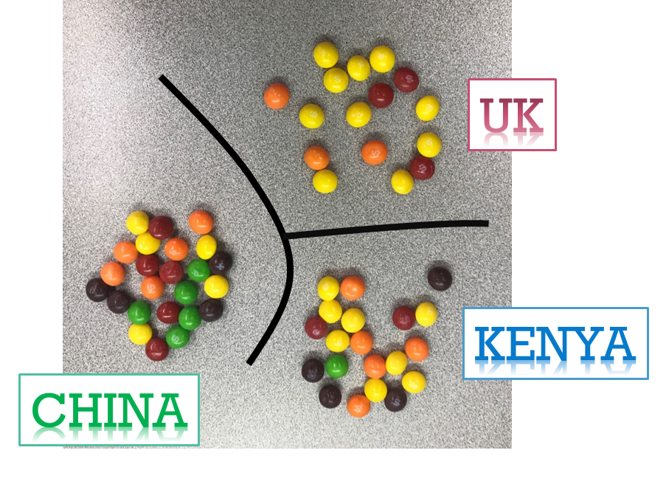
Contiguity hypothesis
documents in the same class form a contiguous region
regions of different classes do not overlap

Slide 6
Rocchio classification

Slide 7
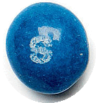
Decision Boundaries
good boundaries: high classification accuracy on data unseen during training.
Notes:
First, we need know what is decision boundaries. As our previous skittles example shows three classes, China, UK and Kenya, in a two-dimensional (2D) space. Documents are shown as skittles. The boundaries in this example, which we call decision boundaries, are chosen to the three classes. To classify a new document, represented as a blue skittle in the picture, we determine the region it occurs in and assign it the class of that region – UK in this case.
Our task in vector space classification is to devise algorithms that compute good boundaries.
So what is good means? where “good” means high classification accuracy on data unseen during training.

Slide 8
Rocchio classification
uses centroids to define the boundaries
$$\vec{u}\left(c\right)= \frac{1}{\left|D_{c}\right|}\sum_{d∈D_{c}}{\vec{v}(d)}$$

Slide 9
UK
$\left|a_{1}\right|$=$\left|a_{2}\right|$
$\left|b_{1}\right|$=$\left|b_{2}\right|$
$$a_{1}$$
$$c_{1}$$
$\left|c_{1}\right|$=$\left|c_{2}\right|$
$$b_{1}$$
b
c
a
$$b_{2}$$
$$a_{2}$$
$$c_{2}$$
CHINA
KENYA
Notes:
The boundary between UK AND KENYA is the grey line. a b c are points in the boundary line.
From the centroid of uk to point a, the distance is a one
While from the centroid of kenya to point a, the distance is a two. The absolute value of a1 and a2 is the same.
The distance of both centroids to point b and c are as same as what happens to point a. which means the absolute value of b1 and b2 is the equal and the absolute value of c1 and c2 is the also equal.
This set of points (like a b c) is always a line.

Slide 10
Rocchio algorithm
TrainRocchio(C, D)
for each $c_{j}∈C$
do $D_{j}←\left\{d:\left\langle d, c_{j}\right\rangle ∈D\right\}$
$\vec{u_{j}}←\frac{1}{D_{j}}\sum_{d∈D_{j}}{\vec{v}(d)}$
Return {$\vec{u_{1}}$, …, $\vec{u_{J}}$}
ApplyRocchio({$\vec{u_{1}}$, …, $\vec{u_{j}}$}, $d)$
Return arg $\min_{j}\left|\vec{u_{j}}−\vec{v}(d)\right|$

Slide 11
Win!!
UK
CHINA
KENYA
Notes:
Finally, we are going to use the racchio algorithm to assign the blue one to the perfect group.
First, we have centroids for each group, and we need to compare the distance from the blue skittle to each centroid.
It is obviously that the pink line is the shortest one among these three lines.
Therefore, this blue one belongs to the topic of UK.

Slide 12
k nearest neighbor

Slide 13
k nearest neighbor (knn)
1NN
we assign each document to the class of its closest neighbor.
kNN
we assign each document to the majority class of its k closest neighbors where k is a parameter.
Based on the contiguity hypothesis, we expect a test document d to have the same label as the training documents located in the local region surrounding d.
Notes:
K nearest neighbor is also called KNN. Unlike Rocchio, kNN classification determines the decision boundary locally.
When k is equal to 1, we call it 1NN. For 1NN we assign each document to the class of its closest neighbor.
For kNN, we assign each document to the majority class of its k closest neighbors where k is a parameter.
The rationale of kNN classification is that, based on the contiguity hypothesis which we talked in the first video, we expect a test document d to have the same label as the training documents located in the local region surrounding d.

Slide 14
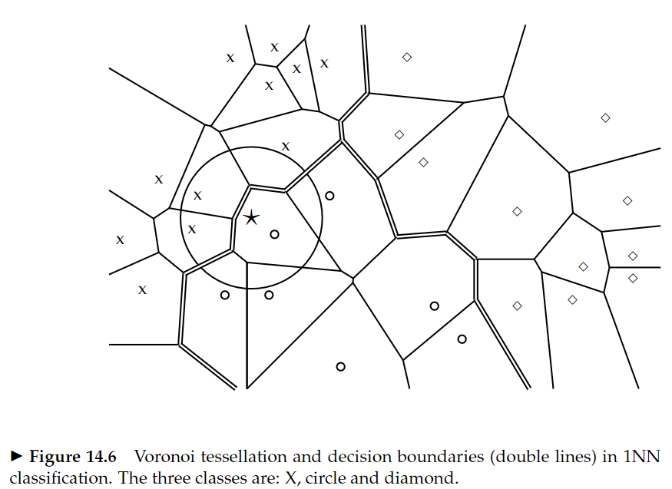
Notes:
Decision boundaries in 1NN are concatenated segments of the Voronoi tessellation as shown. The Voronoi tessellation of a set of objects decomposes space into Voronoi cells, where each object’s cell consists of all points that are closer to the object than to other objects. In our case, the objects are documents. 1NN is not very robust. The classification decision of each test document relies on the class of a single training document, which may be incorrectly labeled.
kNN for k > 1 is more robust. It assigns documents to the majority class of their k closest neighbors, with ties broken randomly.

Slide 15
kNN algorithm
Train-kNN(C, D)
$D^{′ }⃪ Preprocess\left(D\right)$
k $⃪$ Select-k(C, $D^{′ }$)
Return $D^{′ }, k$
Apply-kNN(C, $D^{′ }, k, d)$
$S_{k}←ComputeNearestNeighbors(\text{C}\text{, }D^{′ }, k, d)$
for each $c_{j}∈C$
Do $p_{j}←\left|S_{k}\bigcap{c_{j}}\right|/k$
Return arg $\max_{j}p_{j}$

Slide 16
k = 1
KENYA
UK
k = 3
3
d1<d2<d3<d4<d5
2
UK
1
k = 5
5
4
KENYA
CHINA
KENYA
Notes:
Let’s use the skittles example to see how K nearest neighbor classification method works.
Don’t forget each skittle represents one document, and there are three topics or groups which are china uk and Kenya. The blue skittle represents the test case.
For the blue one, there are five nearest documents, and the distance from the blue one to these five documents are ordered as the nearest to the farthest which means that d1 is shortest and d5 is the longest.
When we select the value of k as 1, which is 1 nearest neighbor, the blue skittle belongs to the topic of Kenya because the document 1 is the nearest document.
When we set the values of k as 3, the three nearest documents to the blue skittle are document 1 2 3. Because there are document 2 and 3 belong to the topic UK, and only one document belongs to the topic KENYA. Therefore, the probability that the test document belongs to UK group is higher. The blue skittle will be assigned to group UK.
When k is 5, the blue skittle will be classified into the group Kenya due to high probability that three out of five documents belong to this group.
When we select the value of k, odd number is better than even number.

Slide 17
Linear versus nonlinear classifiers

Slide 18
Linear classifiers
decides class membership by comparing a linear combination of the features to a threshold.
Naïve Bayes
Rocchio
Notes:
To simplify the discussion, we will only consider two-class classifiers in this video and define a linear classifier as a two-class classifier that decides class membership by comparing a linear combination of the features to a threshold.
We will talk about two learning methods here. The First one is Naive Bayes which is covered in our class. The Second one is Rocchio which are introduced in the second video of this series. They are instances of linear classifiers, the perhaps most important group of text classifiers, and We will contrast them with nonlinear classifiers.

Slide 19
$w_{1}x_{1}+w_{2}x_{2}$ = b
$w_{1}x_{1}+w_{2}x_{2}$ > b
$w_{1}x_{1}+w_{2}x_{2}$ ≤ b
${\overset{⃑}{w}}^{T}\overset{⃑}{x}$ = b
$$ApplyLinearClassifier\left(\overset{⃑}{w}, b,\overset{⃑}{x}\right)$$
score$⃪$ $\sum_{i=1}^{M}{w_{i}x_{i}}$
If score > b
then return 1
else return 0
Notes:
In two dimensions, a linear classifier is a line. These five lines represents five examples.These lines have the functional form w1x1 + w2x2 = b.
Here, (x1 ,x2) T is the two-dimensional vector representation of the document and (w1,w2) T is the parameter vector together with b that defines the decision boundary.
The classification rule of a linear classifier is to assign a document to some class c if the left part is bigger than b
if the left part is less then or equal to b then the document is assigned to the complement of that class. By doing this, the boundary is made.
We can generalize this 2D linear classifier to higher dimensions by defining a hyperplane as we did here: using this equation, we can apply same concepts in higher dimensional space.
Let’ look at the linear classification algorithm in M dimensions. Linear classification at first seems trivial given the simplicity of this algorithm.
However, the difficulty is in training the linear classifier, that is, in determining the parameters w and b based on the training set.
In general, some learning methods compute much better parameters than others where our criterion for evaluating the quality of a learning
method is the effectiveness of the learned linear classifier on new data.

Slide 20
Noise Document
Linear Separability
Notes:
It is quite common to have some noise documents in text classification. A nosie document when included in the training set does not fit well into the overall distribution of the classes. It misleads the learning method and increases classification error. Noise documents are one reason why training a linear classifier is hard. If we pay too much attention to noise documents when choosing the decision hyperplane of the classifier, then it will be inaccurate on new data.
More fundamentally, it is usually difficult to determine which documents are noise documents and therefore potentially misleading. If there exists a hyperplane that perfectly separates the two classes, then we call the two classes linearly separable. In fact, if linear separability holds, then there is an infinite number of linear separators, where the number of possible separating hyperplanes is infinite. Here comes another challenge in training a linear classifier. If we are dealing with a linearly separable problem, then we need a criterion for selecting among all decision hyperplanes that perfectly separate the training data. In general, some of these hyperplanes will do well on new data, some will not.

Slide 21
Nonlinear classifiers
KNN
Notes:
The decision boundaries of kNN are locally linear segments, but in general have a complex shape that is not equivalent to a line in 2D or a hyperplane in higher dimensions.there is no good linear separator between the distributions circle and triangle because of the circular “enclave” in the upper right part of the graph. Linear classifiers misclassify the enclave, whereas a nonlinear classifier like kNN will be highly accurate for this type of problem if the training set is large enough.
If a problem is nonlinear and its class boundaries cannot be approximated well with linear hyperplanes, then nonlinear classifiers are often more accurate than linear classifiers. If a problem is linear, it is best to use a simpler linear classifier.

Slide 22
Classification with more than two classes

Slide 23
Any-of, multilabel, or multivalue classification
UK
Classification for classes that are not mutually exclusive.
CHINA
KENYA
Notes:
Classification for classes that are not mutually exclusive is called any-of, multilabel, or multivalue classification.
In this case, a document can belong to several classes simultaneously, or to a single class, or to none of the classes.
A decision on one class leaves all options open for the others. It is sometimes said that the classes are independent of each other, but this is misleading since the classes are rarely statistically independent.
Let’s look at our favorite skittle example.
Solving an any-of classification task with linear classifiers is straightforward:
1. Build a classifier for each class, where the training set consists of the set of documents in the class (positive labels) and its complement (negative labels).
2. Given the test document, apply each classifier separately. The decision of one classifier has no influence on the decisions of the other classifiers.

Slide 24
One-of, multinomial, polytomous, multiclass, or single-label classification
UK
The classes are mutually exclusive.
CHINA
KENYA
Notes:
The second type of classification with more than two classes is one-of classification. Here, the classes are mutually exclusive.
Each document must belong to exactly one of the classes. One-of classification is also called multinomial, polytomous, multiclass, or single-label classification. True one-of problems are less common in text classification than any-of problems.

Slide 25
Build a classifier for each class, where the training set consists of the set of documents in the class (positive labels) and its complement (negative labels).
Given the test document, apply each classifier separately.
Assign the document to the class with
• the maximum score,
• the maximum confidence value,
• or the maximum probability.
?
Notes:
However, J hyperplanes do not divide the set into J distinct regions. Thus, we must use a combination method when using two class linear classifiers for one-of classification.
The simplest method is to rank classes and then select the top-ranked class. Geometrically, the ranking can be with respect to the distances from the J linear separators.
Documents close to a class’s separator are more likely to be misclassified, so the greater the distance from the separator, the more plausible it is that a positive classification decision is correct. Alternatively, we can use a direct measure of confidence to rank classes, e.g., probability of class membership.
We can state this algorithm for one-of classification with linear classifiers as follows:
1. Build a classifier for each class, where the training set consists of the set of documents in the class (positive labels) and its complement (negative labels).
2. Given the test document, apply each classifier separately.
3. Assign the document to the class with
• the maximum score,
• the maximum confidence value,
• or the maximum probability.

Slide 26
confusion matrix
UK
It shows for each pair of classes <c1 ,c2>, how many documents from c1 were incorrectly assigned to c2.
ASSGIGNED CLASS TRUE CLASS | UK | CHINA | KENYA
UK | 20 | 5 | 2
CHINA | 0 | 25 | 3
KENYA | 1 | 0 | 28
CHINA
KENYA
Notes:
An important tool for analyzing the performance of a classifier for more than 2 classes is the confusion matrix. The confusion matrix shows for each pair of
Classes (c1 ,c2), how many documents from c1 were incorrectly assigned to c2. let’s look at this table. For the topic of UK, there are in total 20 documents and 5 documents from it were incorrectly assigned to the topic of china. To address this error, one could attempt to introduce features that distinguish UK documents from China documents.

Slide 27
ITCS 6190/8190 Fall 2018 project
Source: Chapter 14 from “Introduction to Information Retrieval”, by Christopher D. Manning, Prabhakar Raghavan, and Hinrich Schutze, Cambridge University Press, 2008, ISBN: 9780521865715
Presenter: Yu Lan, Department of Geography and Earth Sciences, University of North Carolina at Charlotte, Charlotte, NC 28223, USA

